Slide 1
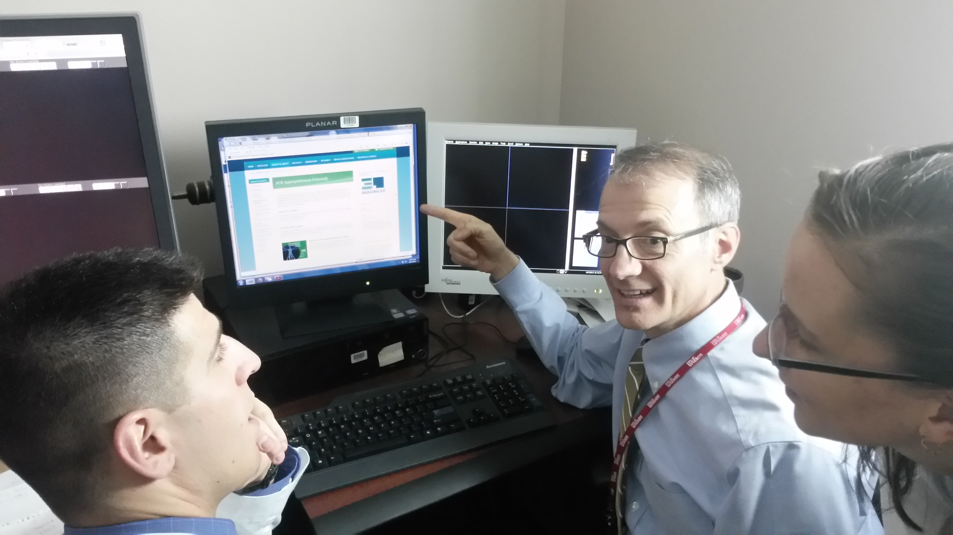
Using the ACR Appropriateness Criteria
Jeffrey Hogg, M.D.
West Virginia University Department of Radiology
A tutorial in the use of the ACR Appropriateness Criteria®

Slide 2

How does one choose???
What imaging study is the best choice to answer my clinical question.
CT scan
Chest radiograph
CT pulmonary angiogram
CT arthrogram
?
MRI scan
Nuclear medicine bone scan
V/Q scan
DEXA scan
Brain CT or MRI?
myelogram
PET scan
Ultrasound
With IV contrast?
What exam should I order?
Notes:
But, beyond these very basic guidelines, how do you decide? Guesses aren’t good enough. Best practice for those in your care demands a patient specific, tailored approach.

Slide 3
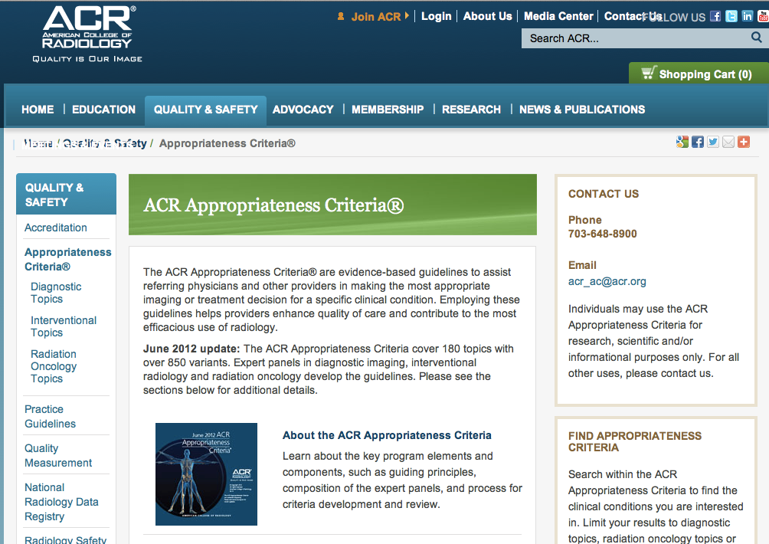
American College of Radiology Appropriateness Criteria
Topics to be covered in this presentation.
What is it?
Why is it helpful?
How to use it
Notes:
Let‘s talk about the ACR Appropriateness Criteria.

Slide 4
ACR Appropriateness Criteria®
A “National standard” of quality
By panels of experts
Multiple medical specialties
Notes:
The ACR appropriateness criteria is a widely accepted national quality standard developed by experts from multiple disciplines, including orthopedics, neurology, neurosurgery, radiology, and rheumatology, among others.

Slide 5
Why is it helpful?
Helps providers choose the most appropriate imaging studies
Evidence-based guidelines
  180 topics
  >850 variants
Notes:
The Appropriateness Criteria provide continuously updated, evidence based guidelines to doctors so they can make the most appropriate imaging and treatment decisions in specifically defined clinical settings. 180 topics with 850 specific variants are currently included. Chances are, your patient fits into one of these.

Slide 6
How do we use it?
www.acr.org/ac
or
search for “ACR Appropriateness Criteria”
Notes:
So how do we use it? Free of cost, with no passwords or logins, or hassle. You just need internet access, and you can type the web address, or just Google it.

Slide 7
Notes:
So, If you google ACR appropriateness criteria, this is the website. Background information about the history and mission is found here.

Slide 8
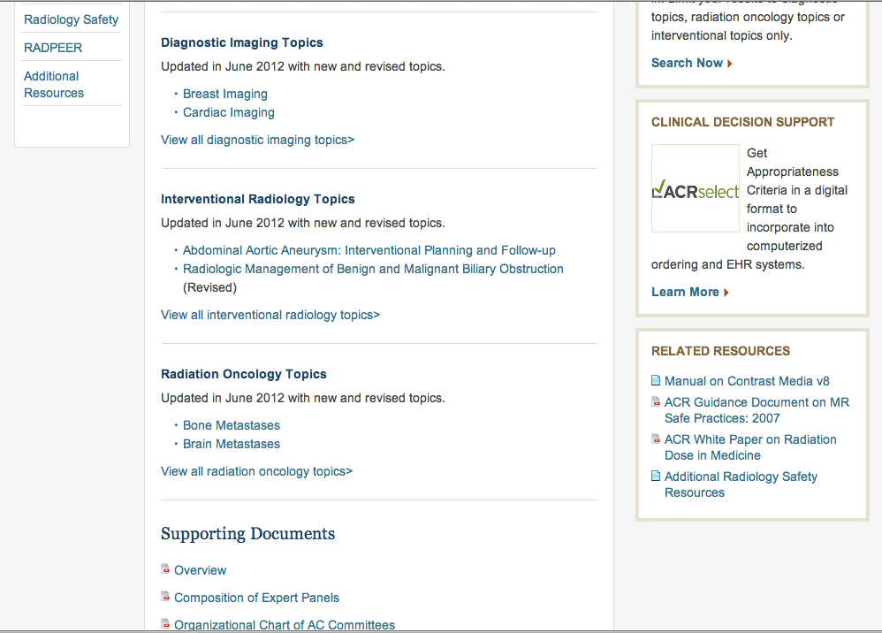
Notes:
If you scroll down on that page, you can find more about the composition of the expert panels and overall structure. Appropriateness criteria are also provided for therapeutic interventional procedures and radiation therapy. For today’s focus on the spine, we want to look at the diagnostic imaging topics. We can click on that …

Slide 9
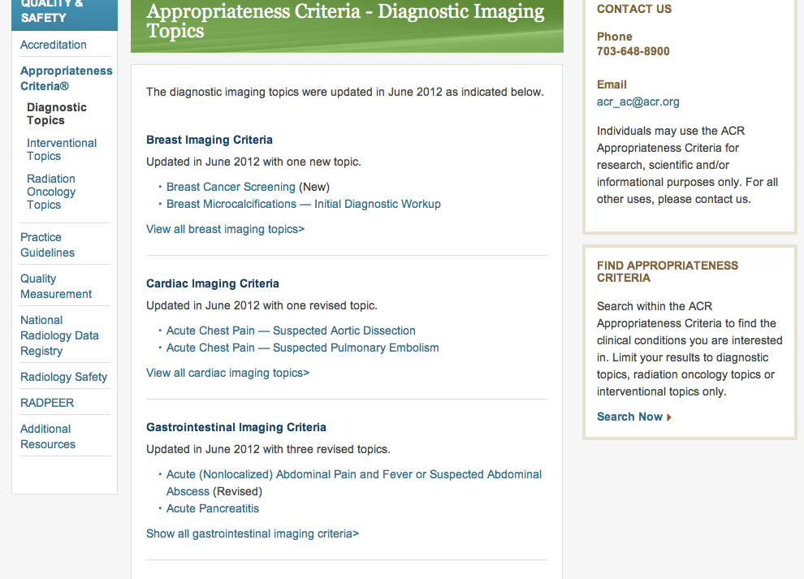
Notes:
…and arrive at Diagnostic Imaging Topics, which are listed alphabetically from breast, cardiac, and GI…

Slide 10
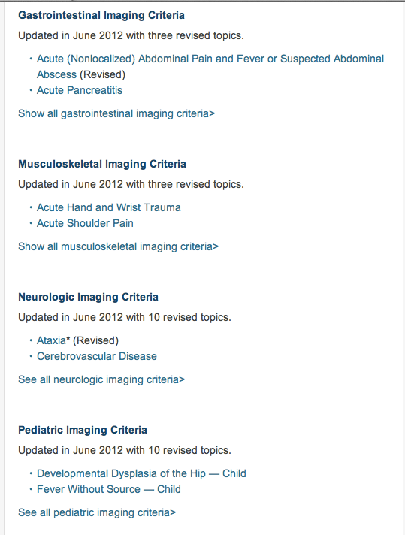
Notes:
…to musculoskeletal, neurological and so on through vascular. For the spine, we will stay with musculoskeletal and neurologic imaging criteria.

Slide 11
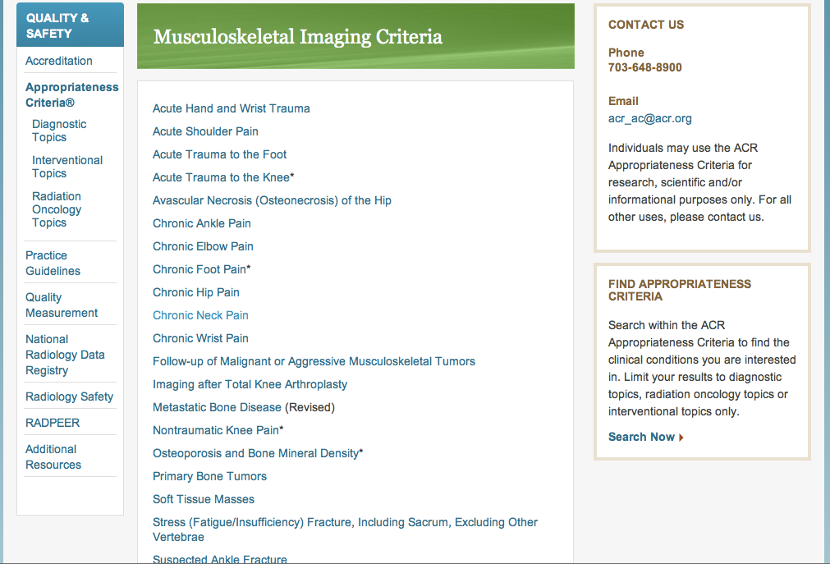
Notes:
Let’s look first in Musculoskeletal,
…where we find chronic neck pain as one of the topics.

Slide 12
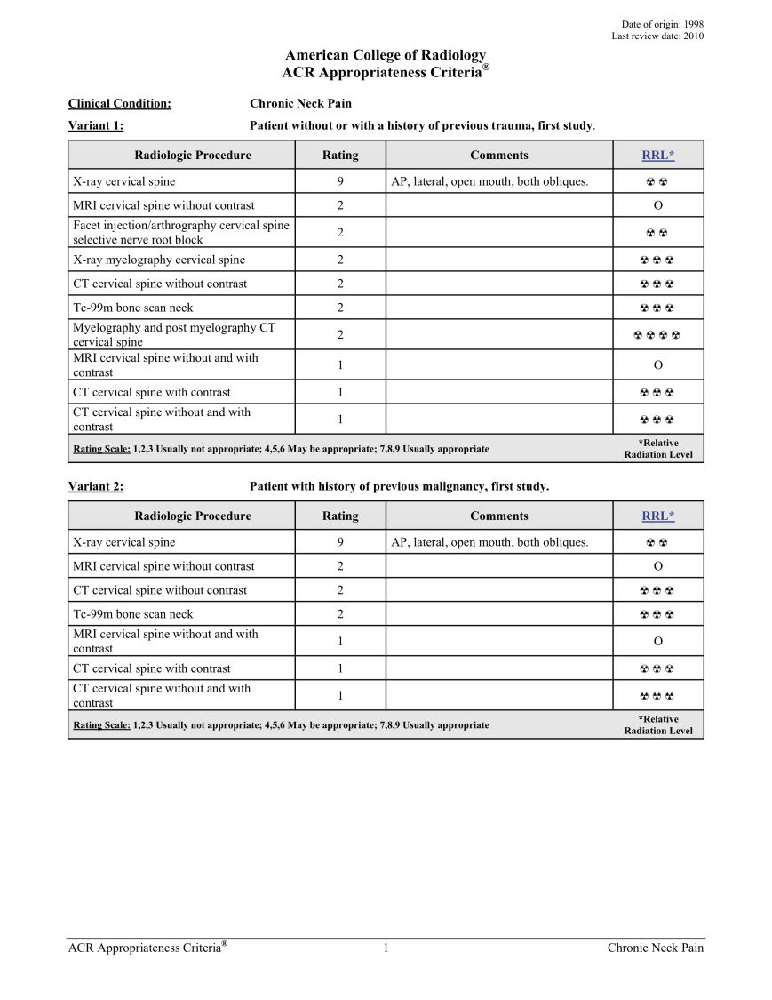
Notes:
When we click on any one of the 180 topics, we get to tables like this. All topics are laid out the same way.
In the upper right corner is the date of last revision, This one from 2010 is due to be reviewed and revised again, as these are updated every 2-3 years. I cannot on my own keep up with every detail of every diagnostic imaging topic. I am glad to have a resource to help with decision support. When a clinician calls me to ask what to do for a particular scenario, this is where I work out the best answer.
Here we find the title of the clinical topic, in this case chronic neck pain.
Below the topic, we find the more specific variant within the topic. This is how you tailor the imaging to your patient’s specific situation.
Every topic chart is laid out the same way with four columns. This first column lists all the imaging studies you might consider for the patients condition, chronic neck pain in this example. The most appropriate choice is always listed at the top.
The second column is the appropriateness Rating. This is a number between 1 and 9 that describes the appropriateness of the imaging examination according to a scale that is uniform throughout all topics, and that scale is…
…here at the bottom of each variant table. Examinations with ratings of 9, 8, or 7 are usually appropriate, while those with ratings of 1,2,or 3 are usually not appropriate. Those with ratings of 4,5, or 6 may be appropriate under certain circumstances …
…and when examinations have ratings in this intermediate 4-6 range, there will be some guidance offered in this third column entitled comments.
In the fourth column, relative radiation exposure levels are listed. Patients want to minimize radiation exposure. The Criteria can help you avoid using unnecessary radiation exposure. It can also help when your patients are reluctant to have an appropriate X-ray or CT based exam. With the ACR Appropriateness Criteria, you can confidently prescribe the very best, most up to date, evidence based imaging workup. You can better address your patient’s questions and concerns. The criteria give you strong support for your decisions. (Some clinicians show them to their patients, so they know why a particular exam has been chosen.)

Slide 13
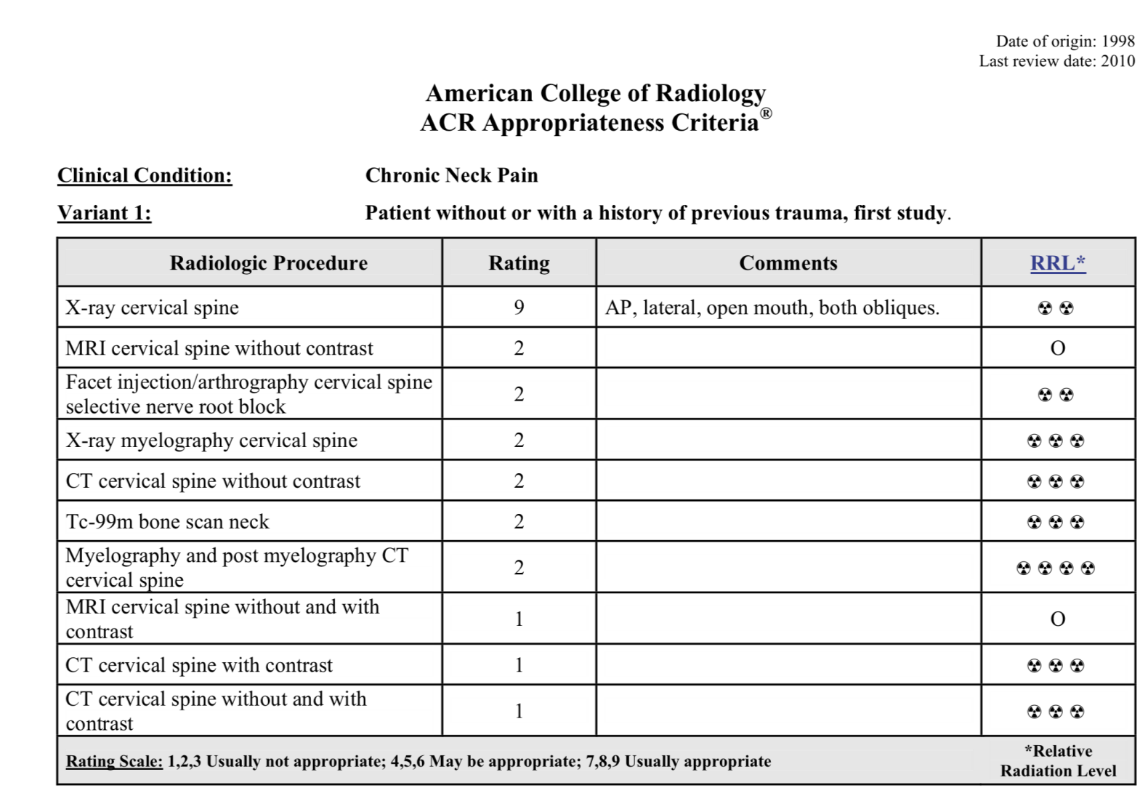
Notes:
So, in variant one, the patient without or with a history of trauma complains of chronic neck pain and you consider imaging
The table indicates plain x-ray exam is highly appropriate with a score of 9. And, nothing else is appropriate.
Comments in the 3rd column list what views yield optimal effectiveness.

Slide 14
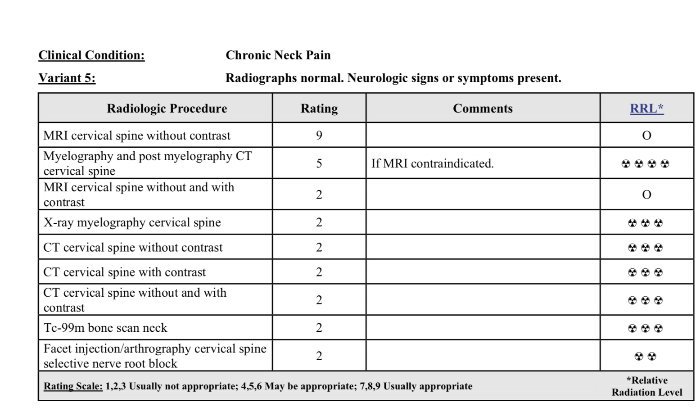
Notes:
In variant 5, the x-rays were normal, but in this variant, the patient has neurologic signs like weakness, numbness, etc.

Slide 15
Notes:
Variant 5 has MRI of cervical spine as the most appropriate next imaging

Slide 16
Notes:
If the patient has a pacemaker and cannot have MRI, then myelogram CT is the next most appropriate imaging, with a score of 5 and the comments guide you to the most appropriate imaging for this situation.

Slide 17
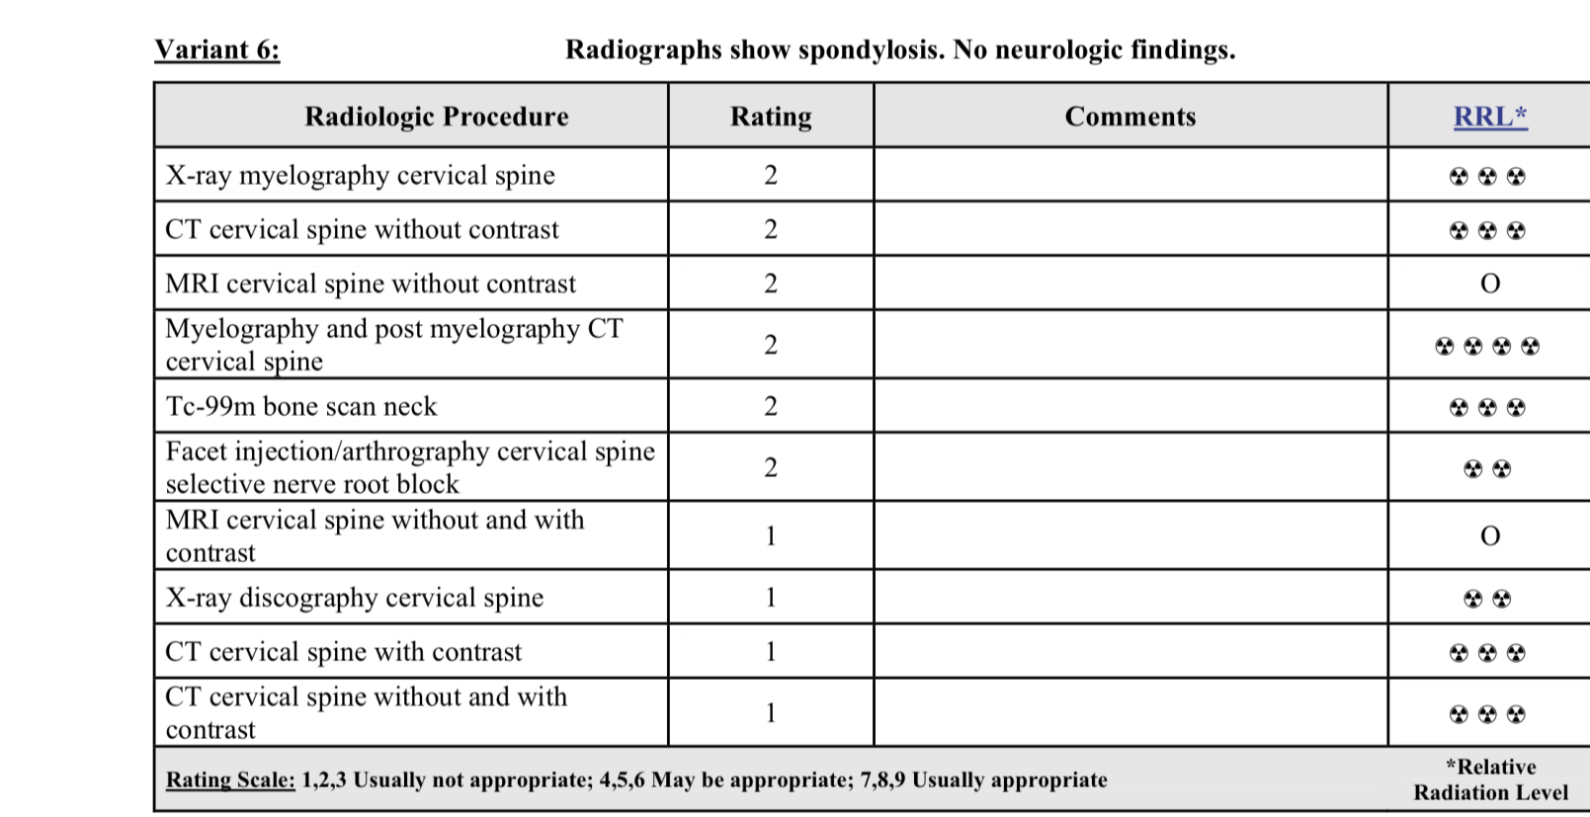
Notes:
In variant 6, the x-rays have degenerative changes but the patient has no neurologic signs.

Slide 18
Notes:
So, NO imaging is most appropriate . This saves the patient time and expense, and the outcome is not altered.

Slide 19
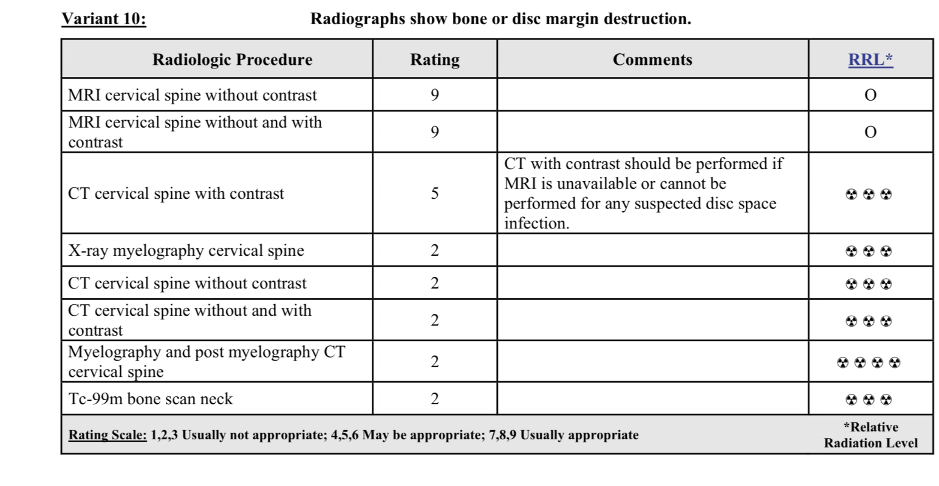
Notes:
In variant 10, the x-rays show disk and endplate destruction,

Slide 20
Notes:
so MRI cervical spine to characterize the probable infection is the most appropriate exam. There is a common thread running through these criteria that integrates the imaging with specific clinical findings. If you can identify your patient’s particular situation confidently, then you can easily find the best imaging approach for them. This is the value of evidence based clinical decision support resources like the ACR Appropriateness Criteria.

Slide 21
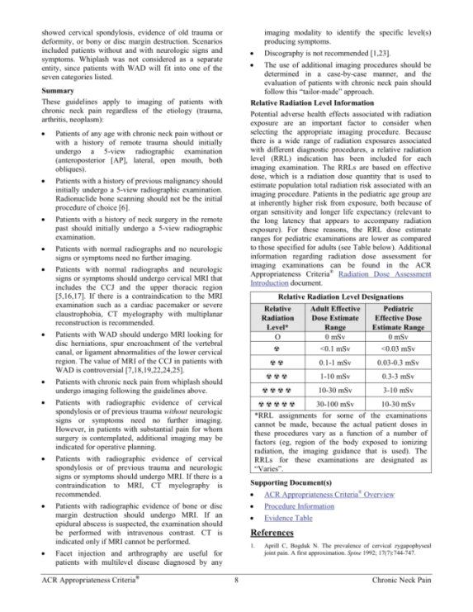
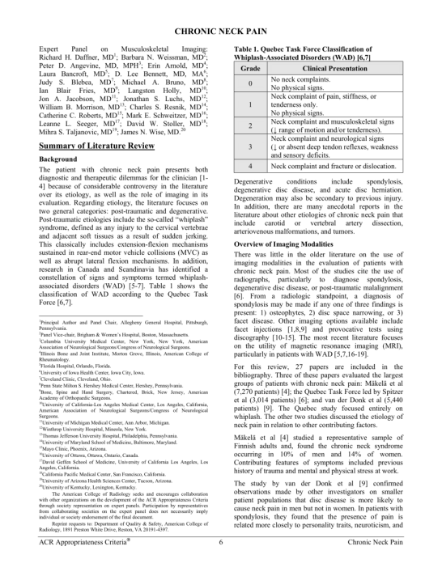
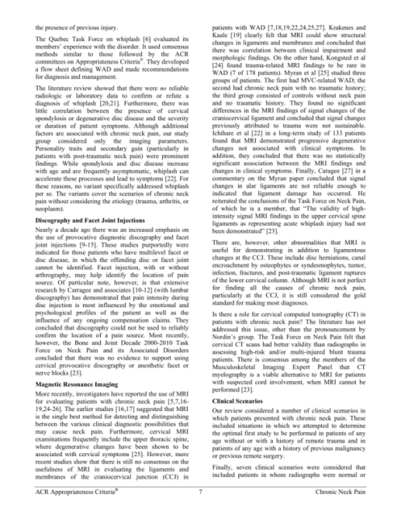
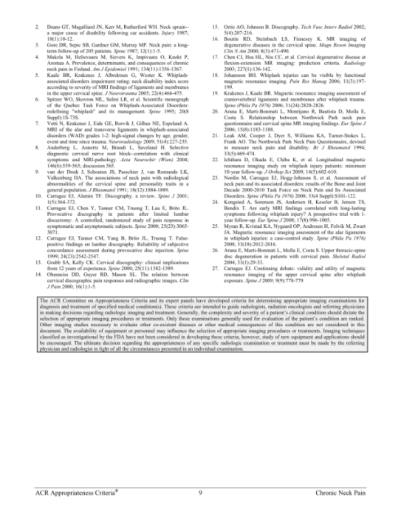
Literature Review
Notes:
After the tables for each topic is a concise literature review that describes the topic and the imaging approach…

Slide 22
ACR Appropriateness Criteria®
Clinical Decision Support
  Evidence based
  Multidisciplinary
  Up to date
  Free resource
www.acr.org/ac
Notes:
In ending, the ACR Appropriateness Criteria gives us a national standard of quality that provides free, multidisciplinary, updated, evidence based decision support so you can offer best practice care in your use of imaging. I hope you will consider using it. I want to thank the conference organizers for inviting me to speak, and to thank the American College of Radiology for permission to show their website images.

