Slide 1


Slide 2

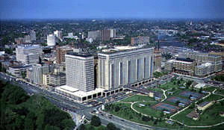
2013 A³CR² Annual Chief Resident Survey
Anup Shetty, MD
Mallinckrodt Institute of Radiology

Slide 3



St. Louis
AKA The Lou, Mound City, Gateway to the West

Slide 4
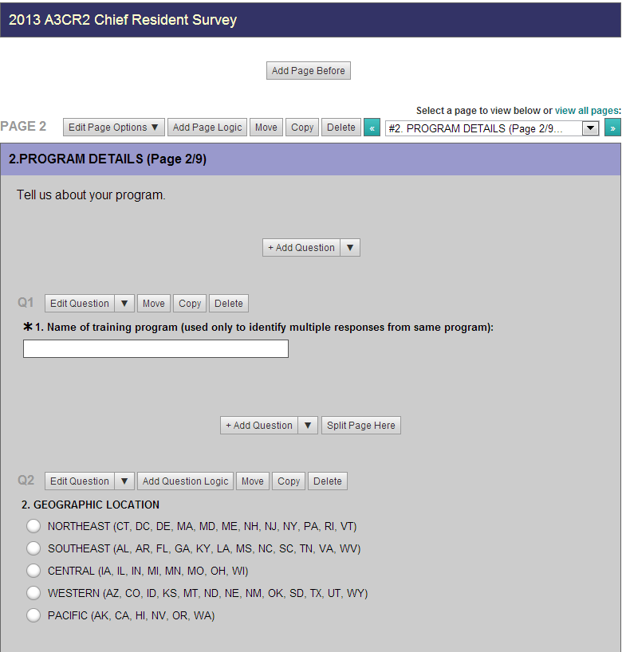
Survey Format
Confidential online survey (surveymonkey.com)
Multiple choice questions (single and multiple answer), free text for additional comments

Slide 5
Survey Purpose
Share facts and information about the structure of training programs
Use information about resident benefits to address shortfalls at individual programs
Share opinions of fellow chief residents about important issues facing radiology training
Share ideas for how to deal with these important issues

Slide 6
Survey Topics
Recurring
  Basic Program Information and Resident Benefits
  Chief Resident Responsibilities
  Call and Outside Hospital Studies
  New Board Exam Format and its Impact On:
    Curriculum, Call System, Fellowships
  Ultrasound and MR interpretations on call
  Healthcare Reform and its Economic Impact on Residency Programs, Fellowships, and the Job Market
  Practice Quality Improvement
New in 2013
  Overreads
  Sick Resident Coverage
  Senior Selectives/Mini-Fellowships
  Core Exam Board Review Format
  Feedback/Safety Training

Slide 7
Limitations
Opinions and estimations
Sampling bias (only chief residents included)
Duplicate responses from programs with multiple chief residents
  We attempted to exclude them from the relevant data sets

Slide 8
Program details

Slide 9
Participation
Number of Responses 2008-2013
Year | Individual Responses | Unique Programs
2013 | 134 | 99
2012 | 185 | 135
2011 | 259 | 148
2010 | 228 | 140
2009 | 143 | 112
2008 | 100 | ---
* Out of approximately 187 programs in the US
Results will be available to A³CR² members by e-mail on request
Results will also be available to A³CR² members in the newsletter and on the website
THANK YOU FOR PARTICIPATING!

Slide 10
Program Size
Changes in Size
Increase in program size over 10 years
  Total # residents increased 29% from 2003 to 2013
  # women residents increased 47% from 2003 to 2013

Slide 11
Hospital Coverage
More residency programs are increasing # hospitals they cover for training

Slide 12
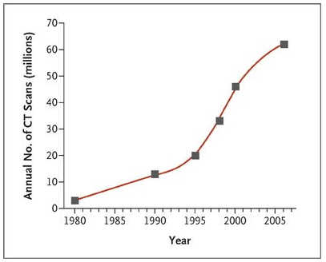
Volume
Annual # CT scans (millions) per year*
* Brenner DJ, Hall EJ. Computed tomography--an increasing source of radiation exposure. N Engl J Med. 2007 Nov 29;357(22):2277-84

Slide 13
Medical Student Recruitment
Others
  Integrate medical students into research projects
  Ultrasound workshops

Slide 14
RESIDENT benefits

Slide 15
Resident Benefits
Average Amount = $1800 ($400-$7500)
% Residents that attend AIRP = 96%
Other Benefits: meals, parking, computer fund, happy hours, flexible funds

Slide 16
Vacation and Salary
Resident Salaries have increased 8.2% for PGY-2 and 6.9% for PGY-5, roughly in line with core US inflation of about 7% from 2009 to 2013

Slide 17
Family Leave
For Significant Others of Pregnant Residents
For Pregnant Residents
% Programs offering Family Leave
% Programs offering Family Leave
% Programs with Family Leave taken from All, Some, or None of Vacation/Sick Days
% Programs with Family Leave taken from All, Some, or None of Vacation/Sick Days

Slide 18
CHIEF resident

Slide 19
Chief Resident Selection
Other
All Seniors are Chiefs
All faculty and/or residents vote
Education committee chooses

Slide 20
Chief Resident Responsibilities
Others
  Emergency coverage
  QA/town hall meetings
  Physics curriculum

Slide 21
Chief Resident Benefits
Average Salary Bonus
$2248, previously $1932

Slide 22
Call, weekends, and attending coverage

Slide 23
Call and Weekend Coverage
Short Prelim depending on modality (US, neuro)
ER cases finalized with attending, inpatient cases prelimed
Site dependent

Slide 24
Ultrasound Coverage
Specific Situations
Ob-Gyn Service performs Pelvic US Vascular Surgery Service performs DVT US Resident performs certain studies (RUQ, Scrotal, Renal) | In-house Sonographer depending on time, hospital, and day of the week

Slide 25
MRI Coverage
*No significant change from 2012
Specific Situations
Residents provide Prelim Reports Telerad service reads MR exams Read only by request (i.e. if clinician calls) Complex cases read by attending only Depends on study (i.e. Cardiac read only by fellows)
Specific Situations
Emergent MR Examinations only “STAT” Examinations only ER or Inpatient MR Exams only

Slide 26
Weekend Coverage

Slide 27
Readout Format
Specific Situations
Face-to-face readout for Neuro Studies only Face-to-face readout for junior residents only Face-to-face readout only if there is a question on the study

Slide 28
Overread Procedure
Specific Situations
Not applicable to programs with overnight in-house attendings

Slide 29
After Hour Attending Coverage
3% programs plan to implement extended in-house attending coverage (5-10pm) within the next year
7% programs plan to implement overnight in-house attending coverage within the next year
29% programs do not plan to implement extended in-house attending coverage
Frequently section-dependent
ER-specific coverage 24 hrs

Slide 30
Sick Resident Coverage
Specific Situations
More frequently pulled for procedural services (IR, US) Service dependent
Specific Situations
Resident scheduled for next shift covers Staff may cover if no other alternative

Slide 31
EXAM OF THE (VERY NEAR) FUTURE

Slide 32
ABR Core Exam
Advantages Expressed
Incorporates physics into clinical knowledge Synthesizes knowledge earlier in training Fairness of testing
Disadvantages Expressed
Loss of focused period of consolidating knowledge, not just for exam but for future career 15 month wait period post-graduation to be board-certified No testing of interpersonal skills Studying for MCE, less real-world application of knowledge

Slide 33
Changing Board Examination

Slide 34
Changing Board Examination
Other Plans
Continue fulfilling Mamms and Nucs requirements Remediation in sections of poor performance “Mini-fellowships” are optional

Slide 35
Changing Board Examination

Slide 36
Changing Board Examination
Average Weeks Out of Call Pool / Off Service (If Given)
Call Pool 10.2 weeks (2-52) | Off Service 5.7 weeks (1-12)

Slide 37
Changing Board Examination
Plans for board reviews for the new board exam structure

Slide 38
Changing Board Examination
Other Schemes
Funding for external physics review course Physics problem-based learning in lieu of traditional lectures

Slide 39
Selectives/”Mini-Fellowships”
Weeks Allotted in 4th Year
24.4 weeks average (8-52 weeks)

Slide 40
Selectives
Notes
Space limitations on high demand mini-fellowships (e.g. Breast, MSK) Research track mini-fellowship a possibility

Slide 41
FellowShips

Slide 42
Fellowships

Slide 43
Fellowships

Slide 44
Fellowships
7% of Residents Planning on Doing Two Fellowships
ED
Onc Imaging
Private practice

Slide 45
Healthcare Economics and the Job Market

Slide 46
Healthcare Economics and the Job Market

Slide 47
Healthcare Economics and the Job Market

Slide 48
Healthcare Economics and the Job Market
How the Current Economic Environment and Current Job Market Influences Career Plans
What are you willing to compromise to obtain a job?

Slide 49
Healthcare Economics and the Job Market
What effects do you think healthcare reform will have on radiology?
Does your program offer some training in healthcare economics and radiology business?
92% (prev 86%) feel practices will try to increase their volume to maintain a similar salary despite the lower reimbursement rates
70% (prev 65%) feel it will discourage top-tier medical students from choosing radiology
  0% feel it will encourage top-tier medical students to choose radiology
40% (prev 36%) feel that practices are going to be looking for radiologists trained in more than one fellowship

Slide 50
Healthcare Economics and the Job Market
Poor economic climate has lead to budget issues at some programs, esp. programs that have more trainees than its training “cap,” paying for a certain # trainees out of pocket.
∴ such programs may need to downsize # trainees
61% programs with # trainees = training “cap”
12% programs with # trainees > training “cap”
13% programs planning on increasing # trainees
7% programs planning on decreasing # trainees
34% programs not planning on changing # trainees
2% programs planning on increasing # fellows
12% programs planning on decreasing # fellows
23% programs not planning on changing # fellows

Slide 51
MISCELLANEOUS

Slide 52
Quality Improvement
How well does your training program prepare you for ABR’s PQI requirements?*
ABR requires radiologists to document participation in 3 successful PQI projects every 10 years to maintain board certification
*No significant change from 2012

Slide 53
Resident Feedback and Requirements
Simulation Lab

Slide 54
Resident Feedback and Requirements
Procedure Competency Notes
About 50 % of programs have minimum procedure requirements, apart from I-131 mandated by NRC In IR, competency may need to be demonstrated prior to performing procedure independently Competency requirements can be by individual procedure such as knee MRI, LP or PICC

Slide 55
discussion

Slide 56
Discussion
Total # residents increased 29% from 2003 to 2013, with greater proportional increase of female residents (47%)
Resident salaries have increased at roughly the same pace as U.S. inflation since 2009
E-Anatomy (3% -> 16%) and RadPrimer (16% -> 56%) have increasingly been provided as resources to residents
About 96% of residents attend AIRP, with an average stipend of $1800
Slightly more programs offering full-day Saturday/Sunday services

Slide 57
Discussion
Fewer programs consistently read-out post-call residents face to face (49% -> 35%), with more programs not having post-call readout (21% -> 28%)
Only ~50% of programs document overreads
24 hour attending coverage has doubled from 2009 (12%) to 2013 (24%)
Chiefs are concerned about the Core Exam format not testing the skills that will be valuable in practice
82% of programs plan to offer 4th year mini-fellowships; average of 24 weeks allotted

Slide 58
Discussion
Programs giving 3rd years study time plan to offer 10 weeks of time off call and 5.5 weeks off of service
73% of residents are worried or very worried about their job prospects now, compared with only 47% in 2011, and are willing to make more compromises to secure a job
70% feel health care reform efforts will discourage top-tier medical students from a career in radiology

Slide 59
Future Directions
How successful were our board preparations for the core exam
How senior selectives were received
ACGME residency milestones
Informatics

Slide 60
Thanks!
Chief Resident Participants
Laurie May at RSNA
Gautham Reddy and the A³CR² Leadership
Jennifer Gould and Ron Evens
Steve Sauk, Elizabeth Sheybani, Colin Thompson, David Slat and Taylor Stone
To Request Data from this Survey: shettya@mir.wustl.edu

