Slide 1
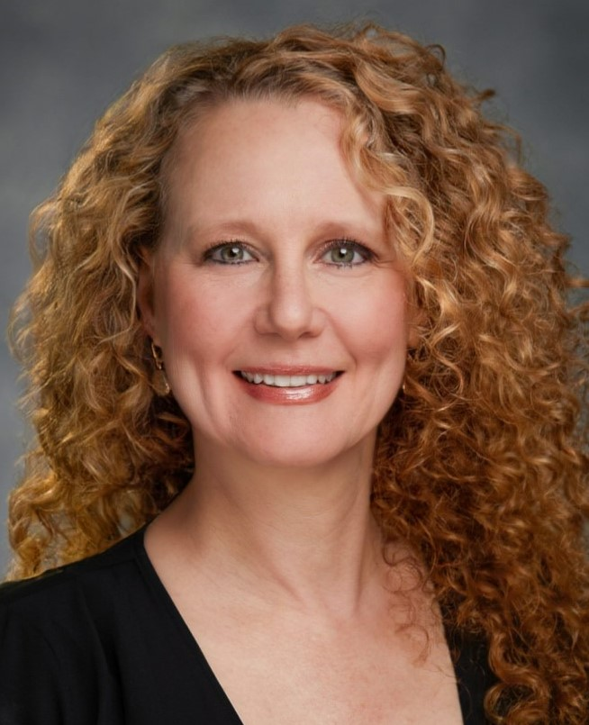
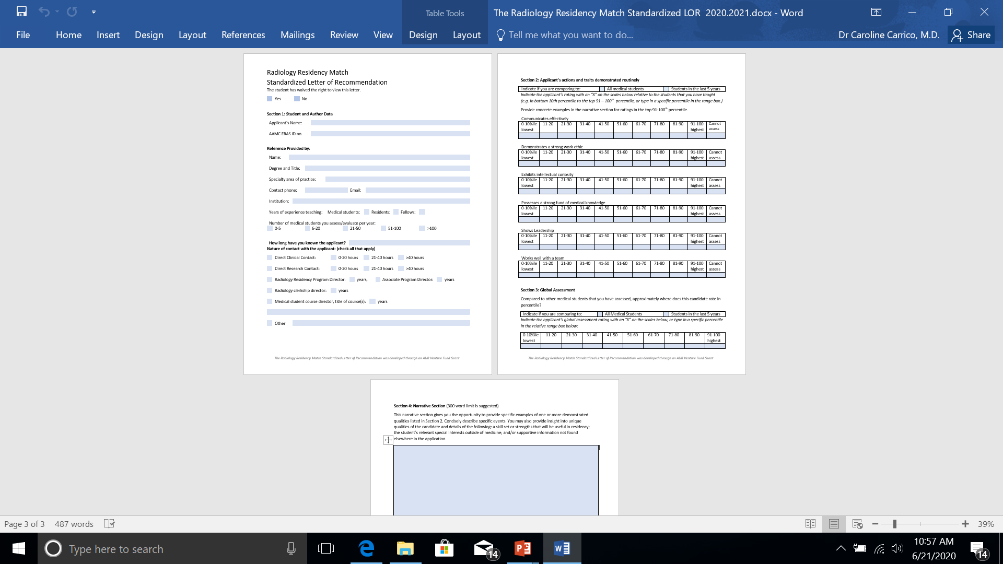

Standardized Letter of Recommendation for use in the Radiology Residency Match
Caroline Carrico, MD, FAUR
Associate Professor of Radiology
Duke University School of Medicine

Slide 2
Letters of Recommendation (LOR) in The Residency Match
Narrative
Standardized

Slide 3
Narrative Letter Elements
Your (Writer’s) background, rank and experience
Length and context of your relationship with the student
Applicant’s qualification for radiology residency
Specific concrete examples of applicant’s personal traits, performance and skills
Insight into unique features of candidate
Compare applicant to current peers and predecessors
Global recommendation with reference range
Messner and Shimahara The Laryngoscope 118: Aug 2008
Notes:
Do not exaggerate or be vague

Slide 4
The Narrative Letter: Negatives
Excessive praise and flattery
Hard to interpret
  Hierarchy of praise phrasing
  Code words or phrases
Low inter-reader reliability
Redundant information
  Restates ERAS data
Gender bias
Reader fatigue
Do not predict clinical performance
Messner and Shimahara
Laryngoscope 118 2008
Perkins et al, Laryngoscope 2013 p.123-133

Slide 5
Benefits of Standardized LOR
Faster to interpret (p<0.0001)
  Mean SLOR 68 seconds
  Mean NLOR 128 seconds
Higher inter-rater reliability for determining applicant’s personality, work ethic and reliability (p<0.001)
Less exaggeration of positive traits (p<0.0001)
Status of author and relationship with student
  SLOR 4.4 pieces NLOR 2.3 pieces
Less time to write and to interpret
  <5 minutes to write
Higher inter-rater reliability
  Applicant’s qualifications for otolaryngology
  Global assessment
  Summary statement
  Overall letter ranking
Perkins et al Laryngoscope 2013 123-133

Slide 6
EM Program Directors Perspective
150/159 Council of Emergency Medicine Residency Directors (CORD) 94.3% of program directors participated
99.3% Support SLOR as an evaluative tool
92.7% SLOR #1 Element in the decision to interview an applicant
SLOR had been in use 12 years

Slide 7
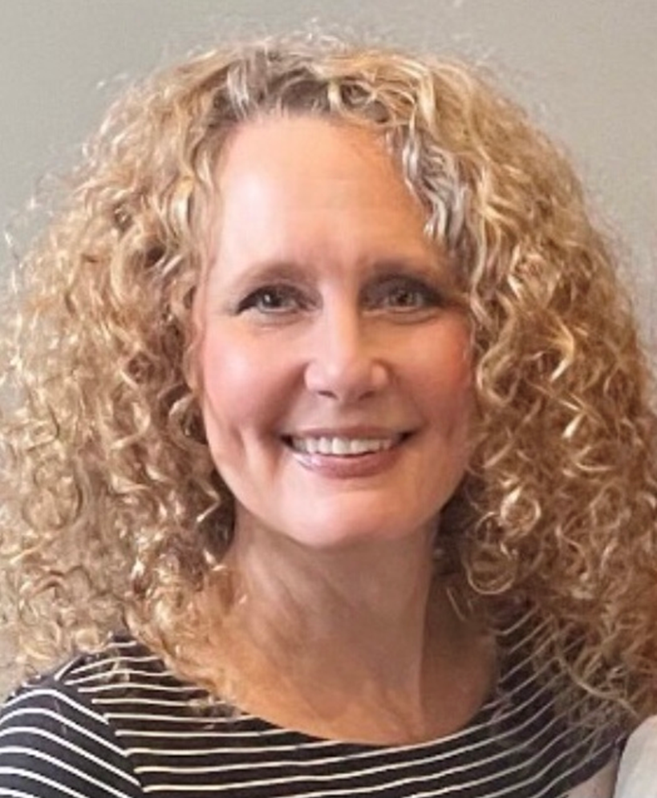
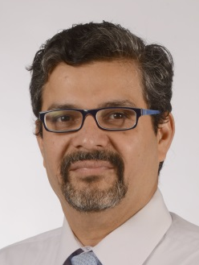
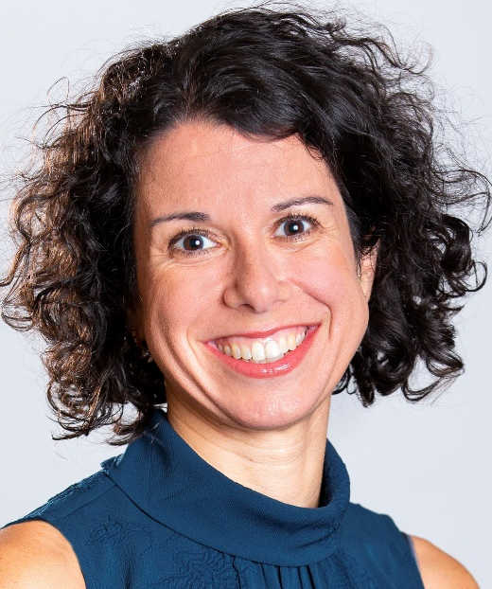
Developing the Radiology Residency Match Standardized Letter of Recommendation
AUR Venture Fund Grant
Caroline Carrico, MD
  Duke University
Kedar Jambhekar, MD
  University of Arkansas
Ana Lourenco, MD
  Brown University
Expected impact:
  Provide a means for more informative, meaningful and efficient communication between letter writers and readers.

Slide 8
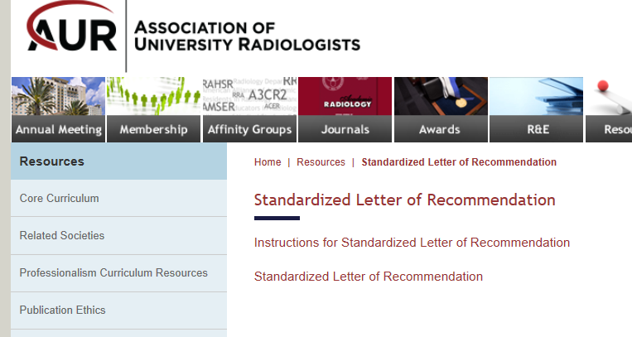
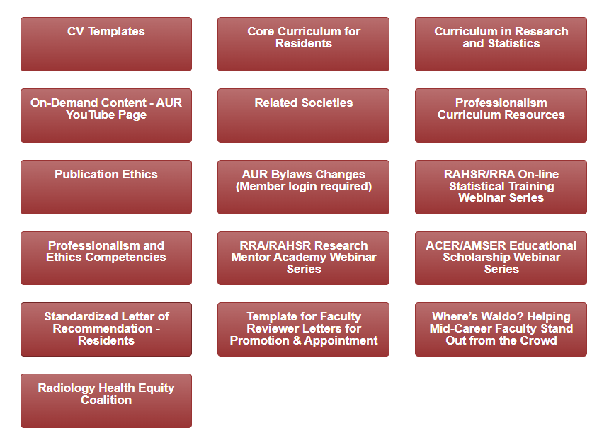
Aur.org resources tab aur.org/en/resources
GOOGLE
Radiology SLOR

Slide 9
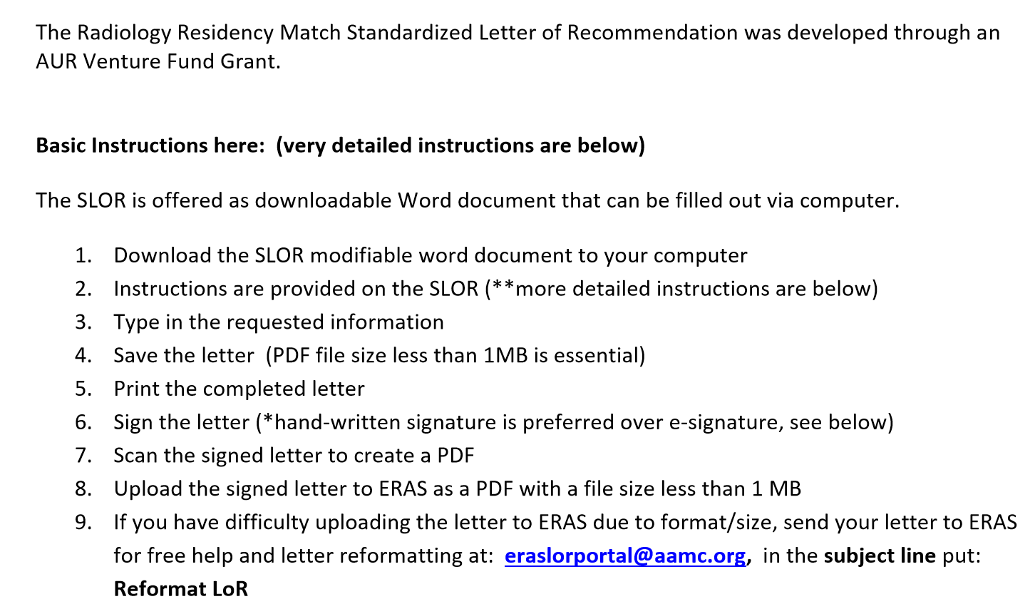

Slide 10
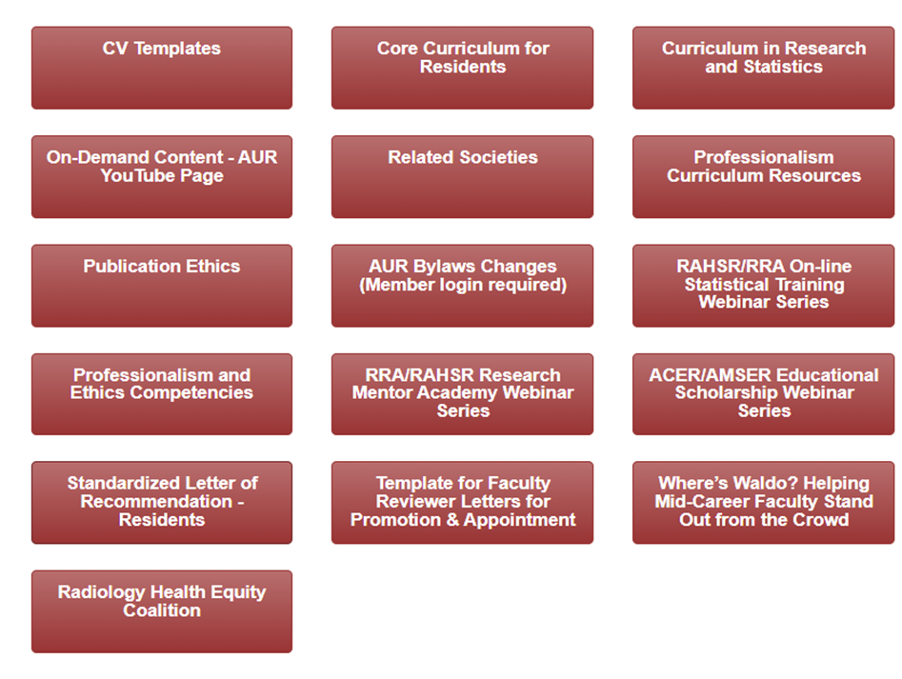
Aur.org resources tab aur.org/en/resources

Slide 11
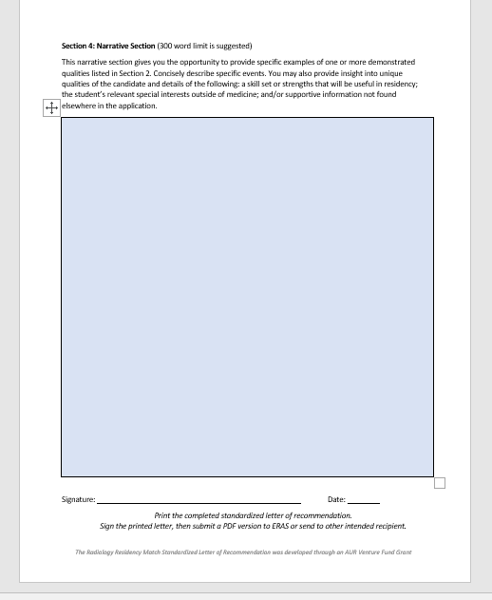
Radiology SLOR

Slide 12
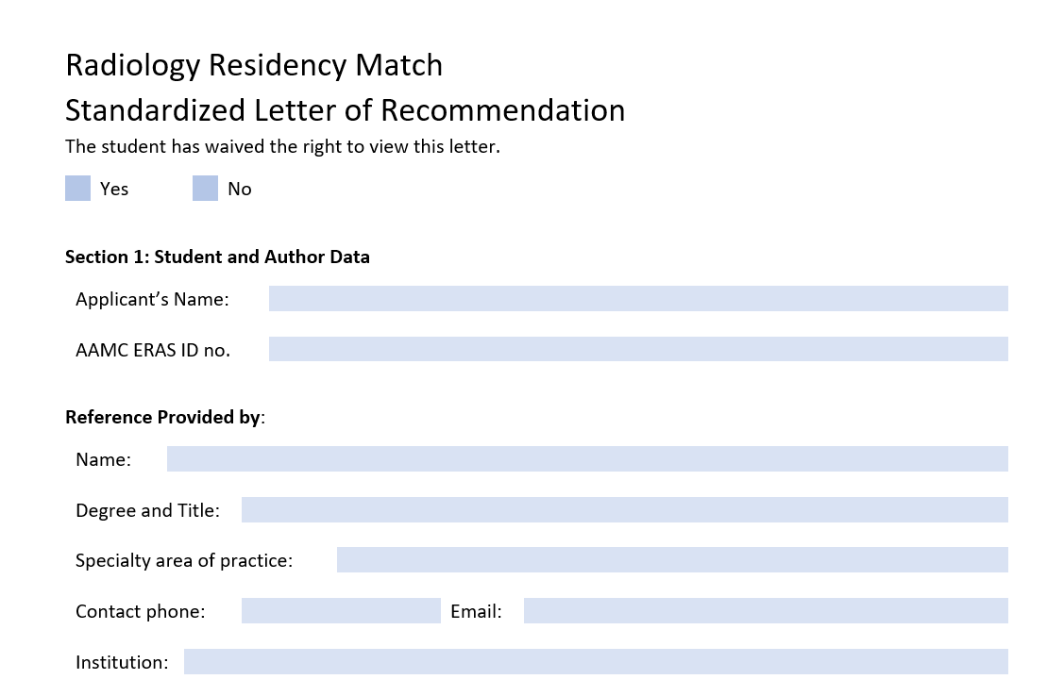
x
Caroline Carrico
MD, Associate Professor of Radiology and Pediatrics
Pediatric Radiology
919-684-7514
caroline.carrico@duke.edu
Duke University School of Medicine

Slide 13
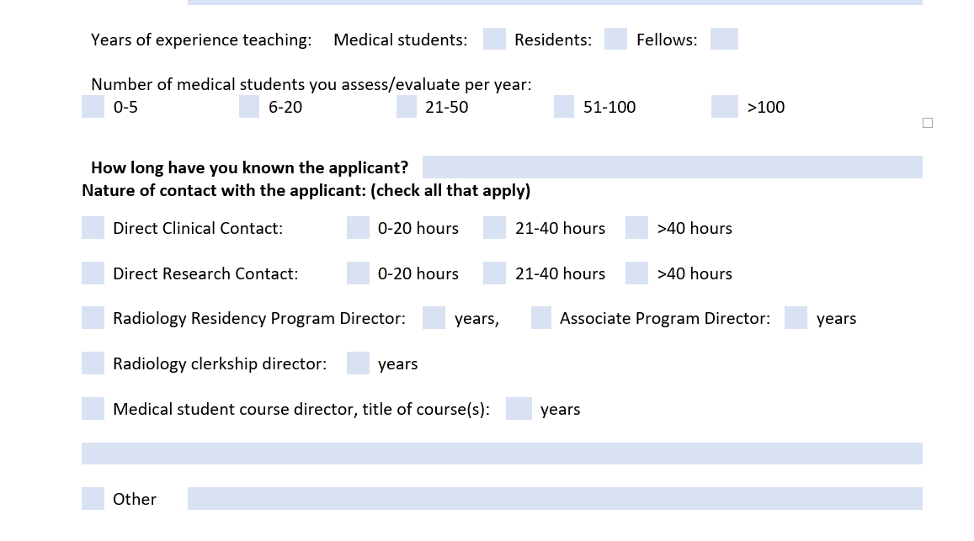
17 18 18
x
13
14
Basic Radiology Clerkship, Core Radiology Clerkship, Pediatric Radiology Elective
Radiology Interest Group Faculty Advisor 13 years

Slide 14
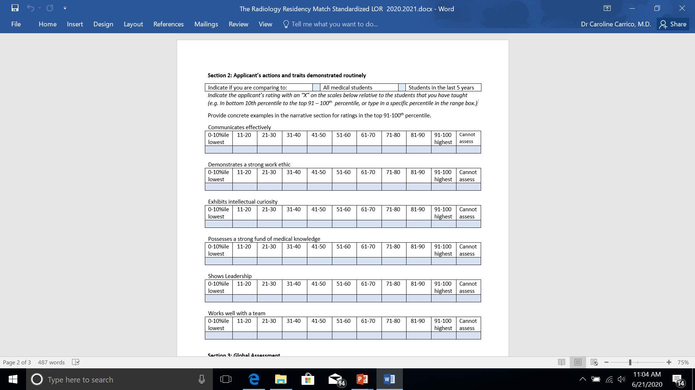
Applicant’s actions and traits demonstrated routinely
Communicates effectively
Demonstrates a strong work ethic
Exhibits intellectual curiosity
Possess a strong fund of medical knowledge
Shows leadership
Works well with a team

Slide 15
x
x
89
100

Slide 16
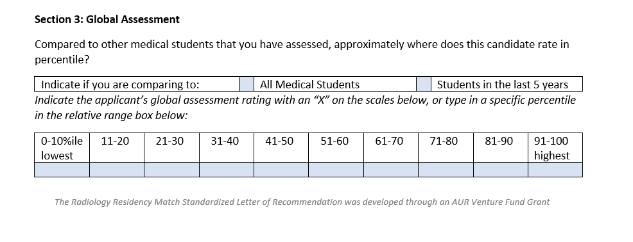
Global Assessment
x
X
100

Slide 17
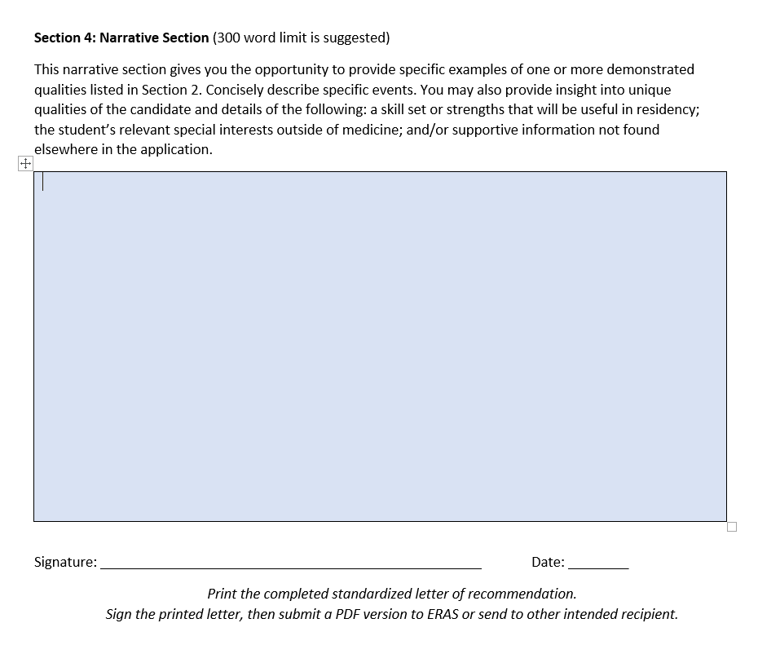
Provide examples and concisely describe specific events
Insight into unique qualities of the candidate
A skill set or strengths that will be useful in residency
Relevant special interest outside of medicine
Supportive information not found elsewhere in the application
300 word limit is suggested but not required, the text box is expandable.

Slide 18
Signature
The Electronic Residency Application Service (ERAS) prefers a physically hand-written signature.
E-signatures that are in the form of an image of your formal signature that is layered onto the word document may be able to be uploaded successfully
Per an ERAS advisor, in the past, some program users have received error messages when trying to access documents with electronic signatures attached. It is not clear how often an e-signature causes an error message for the letter recipient.

Slide 19
Free ERAS support
The uploaded letter must be a PDF with file size less than 1 MB
eraslorportal@aamc.org subject line: Reformat LoR

Slide 20
Perceived Benefits of the Radiology SLOR
Easier to read 54%
Easier to interpret 49%
Save time 43%
Easier to write 42%
Facilitates rating
candidates 38%
Greater inter-rater reliability 36%
More transparent 30%
More concrete examples of the candidate’s strengths 24%
More concrete examples of the candidate’s weaknesses 18%
More objective 17%
Allow less praise inflation 17%
Allows less grade inflation 11%
Limits gender bias 10%

Slide 21
Perceived Drawbacks to the Radiology SLOR
Less personal format 66%
Concerns about how it is perceived by PD 38%
SLOR is new & untested in radiology 21%
Did not know the candidates well enough to give specific examples of the traits 19%
Did not know ERAS would help reformat 17%
Did not know how to find the letter 14%

Slide 22
Interacting with Medical Students
Tasking, observing, and assessing the top six desired traits
Giving constructive feedback is important
Excellent articles regarding teaching, assessing and giving feedback:
Jack Ende, M.D., JAMA 1983 vol 250 no 6 , 777-781
Kost and Chen, Acad Med. 2015; 90:20–24

Slide 23

Formative Assessment
Teach student
Elicit evidence regarding student status
Assess student performance
Teacher adjusts instruction
Student adjusts learning process or practice

Slide 24
Preparing in Advance to Write a Letter
Task and Assess the Student
Communicates effectively
Demonstrates a strong work ethic
Exhibits intellectual curiosity
Possess a strong fund of medical knowledge
Shows leadership
Works well with a team
Student Name
Communicates effectively
Called results often, on speaker, clear and well documented
Leadership
Helped junior students and visiting NP, PA students orient to the reading room and procedure room routines
Curiosity
Researched and presented the PMH and PSH with prior imaging of the procedure patients every day, and always researched patient’s disease
Notes:
CC: What do you all think about asking a student at the beginning of the month if they will be looking for a LOR by the end of the month, then helping them direct their time and energy to one or two faculty that will be there most or are best at involving medical students. Many that want letters rotate in summer when a lot of people are on vacation.

Slide 25
Thank You caroline.carrico@duke.edu
Please email me any questions or constructive criticisms in advance of the meeting and or after the meeting.
In the subject line please put:
AUR 2023 SLOR

