Slide 1

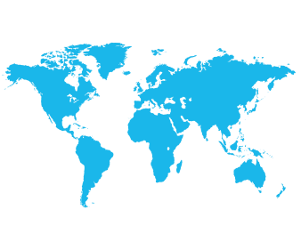
Committee on International Radiology Education
CIRE
Kristen DeStigter, MD
RSNA CIRE Chair
- FOUNDED 1986 -

Slide 2
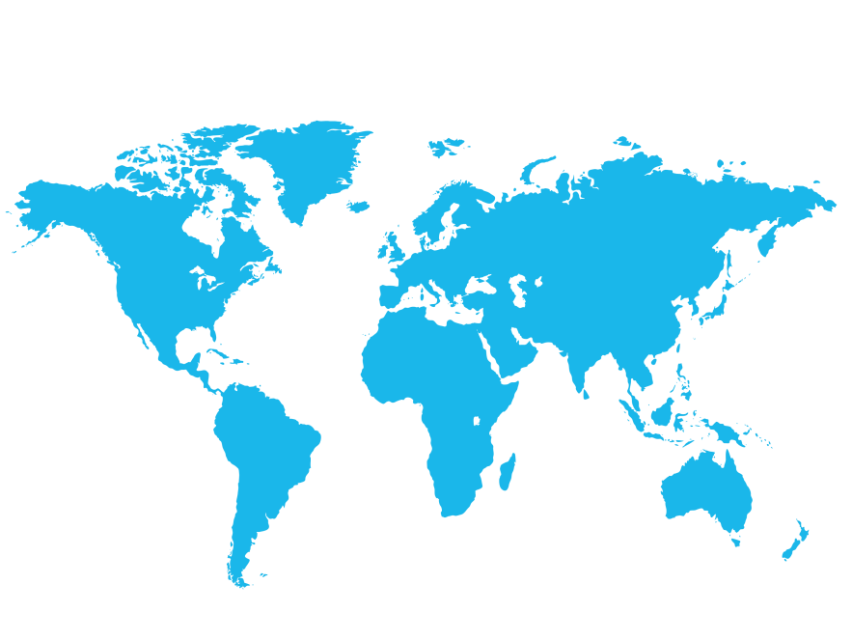
RSNA Membership: 54,314
~15,722 Members (29%) Outside North America
North America
38,592
Europe
6,822
Asia
3,948
Africa
890
South America
3,235
Australia
827

Slide 3
International Membership
1994–2015

Slide 4
Resident & Fellow Membership
Receive all the benefits of full membership:
Registration to the RSNA Annual Meeting
Online access to RSNA Journals: Radiology and RadioGraphics
Online education courses
Access unlimited online document storage through myRSNA®
FREE Membership
for Current Residents & Fellows
Notes:
RSNA offers free membership to radiology residents and fellows. This includes all of the same benefits available to paying members:
Free registration to the Scientific Assembly and Annual Meeting held in Chicago
Free online subscriptions to two of the top journals: RadioGraphics and Radiology
Free online education courses

Slide 5
Discounted Dues Membership
Membership dues of only $50 for eligible applicants from the following nations
Receive online access to RSNA Journals, Radiology and RadioGraphics
Afghanistan | Guatemala | Pakistan
Albania | Guinea | Papua New Guinea
Algeria | Guinea-Bissau | Paraguay
Belize | Iran | Senegal
Bolivia | Jamaica | Solomon Islands
Congo, Republic of | Maldives | Timor-Leste
Cote d'Ivoire | Mali | Togo
Cuba | Marshall Islands | Tonga
Dominican Republic | Moldova | Tuvalu
Ecuador | Mongolia | Uganda
El Salvador | Mozambique | Uzbekistan
Eritrea | Myanmar | Vanuatu
Ethiopia | Namibia | Vietnam
Ghana | Nigeria | Zimbabwe
*For a complete list, visit www.rsna.org/Discounted_Dues_Eligible_Countries.aspx

Slide 6
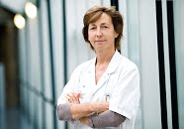
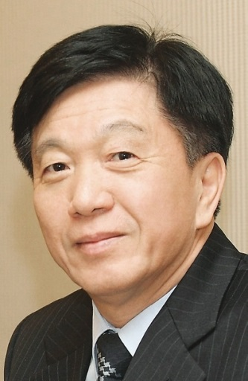
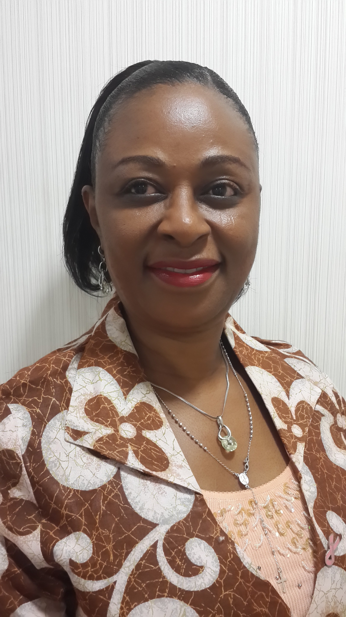
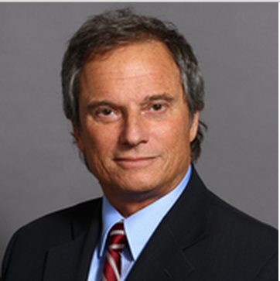
Regional Committees
Europe
Dr. Valerie Vilgrain
Asia/Oceania
Dr. Byung Ihn Choi
Middle East/Africa
Dr. Omolola Atalabi
Latin America
Dr. Ricardo Garcia-Monaco
Notes:
The Society introduced four regional committees over the past three years that are responsible for representing their respective region and its interaction with RSNA.
The CIRE and regional committees work together to bring awareness of RSNA’s outreach programs to residents, radiologists and societies in the region.

Slide 7






CIRE Programs
International Visiting Professor
Derek Harwood-
Nash International Fellowship
Intro to Research for International
Young Academics
Education Materials and Journal Awards
TRAVEL WORDLWIDE
TRAVEL
TO USA
TRAVEL
TO CHICAGO
MATERIALS FROM RSNA
- SINCE -
1986
- SINCE -
1998
- SINCE -
2000
- SINCE -
2000
108
VISITS
36
SCHOLARS
234
PARTICIPANTS
175
INSTITUTIONS
46 COUNTRIES
24 COUNTRIES
55 COUNTRIES
62 COUNTRIES

Slide 8

International Visiting Professor Program
Established 1986
108 visits to 46 countries
Beginning in 2016, increases to five visits annually.
Offers webinar opportunities when in-person visits cannot be accommodated
Two or three-member teams of visiting professors spend up to two weeks in selected country
Match needs of host country with RSNA speakers
Usually at time of local national radiology meeting
RSNA donates educational materials
Application deadline for national radiology societies: December 31

Slide 9
Recent and Upcoming Visits
2007 Algeria, Honduras, Uganda, Mexico
2008 China, Nigeria, Vietnam, Mexico
2009 Argentina, Estonia, Bolivia, South Africa, Mexico
2010 Philippines, Thailand, Brazil, Mexico
2011 Lithuania, Malaysia, Myanmar, Mexico
2012 El Salvador, Nepal, Vietnam, Mexico
2013 Kenya, Russia, Mexico
2014 Argentina, Brazil, Tunisia, South Africa, Mexico (webinar: Thailand)
2015 Chile, Nicaragua, Mexico
2016 Philippines, Ghana, Mongolia, Mexico (webinars: Lebanon, Algeria)

Slide 10
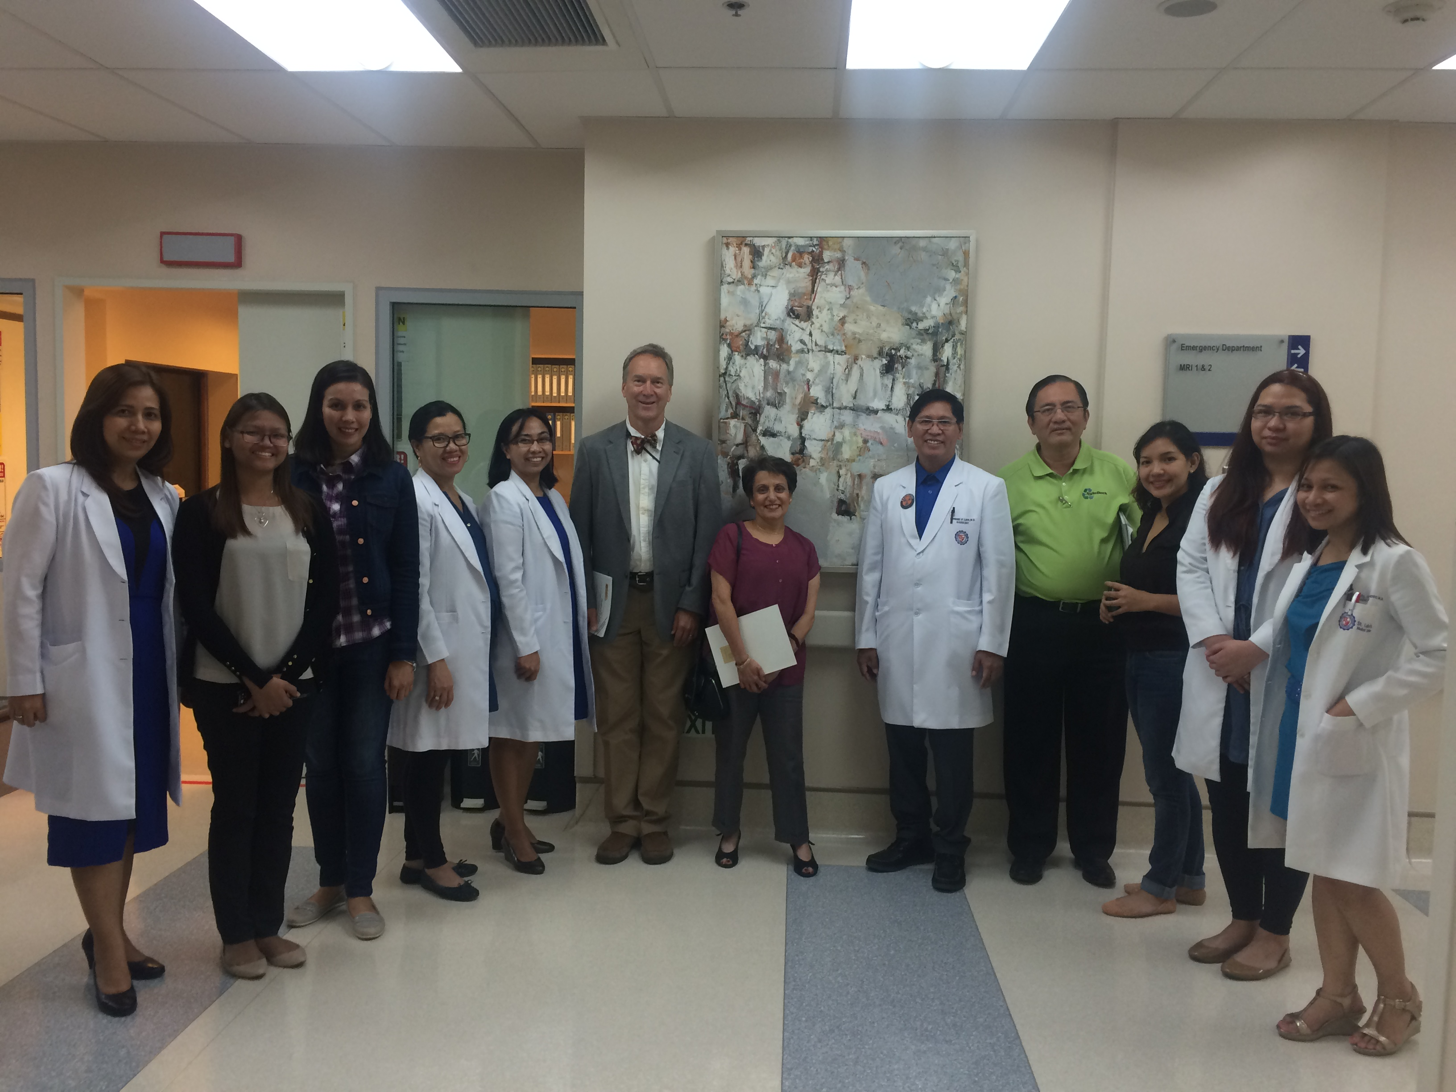
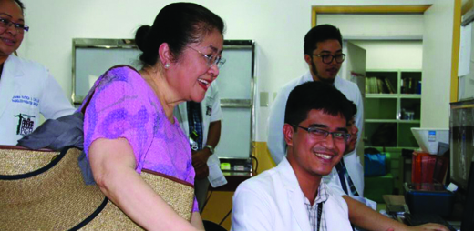
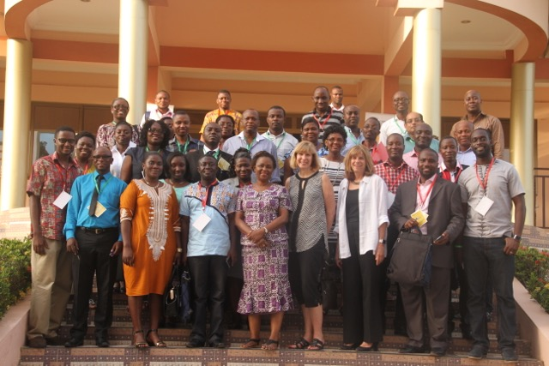
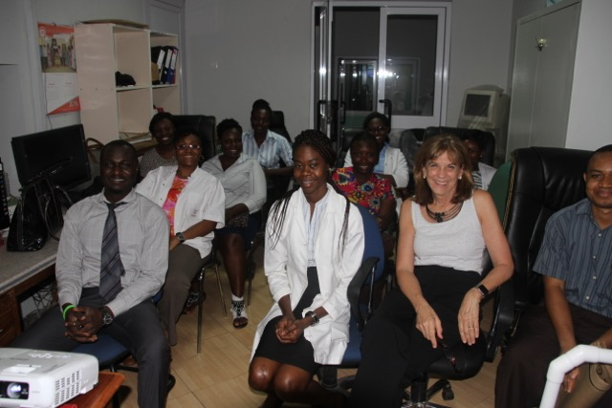
2016 Visits
Philippine College of Radiology
Ghana Association of Radiologists

Slide 11
Derek Harwood-Nash
International Fellowship Program
Established 1998
Three participants per year are selected to spend 6–12 weeks at a North American institution
RSNA pays travel, modest accommodations and a per diem allowance
Eligible applicants must hold a faculty position in a radiology department and be 3–10 years beyond training
36 fellows from 24 countries
Application deadline: July 1

Slide 12


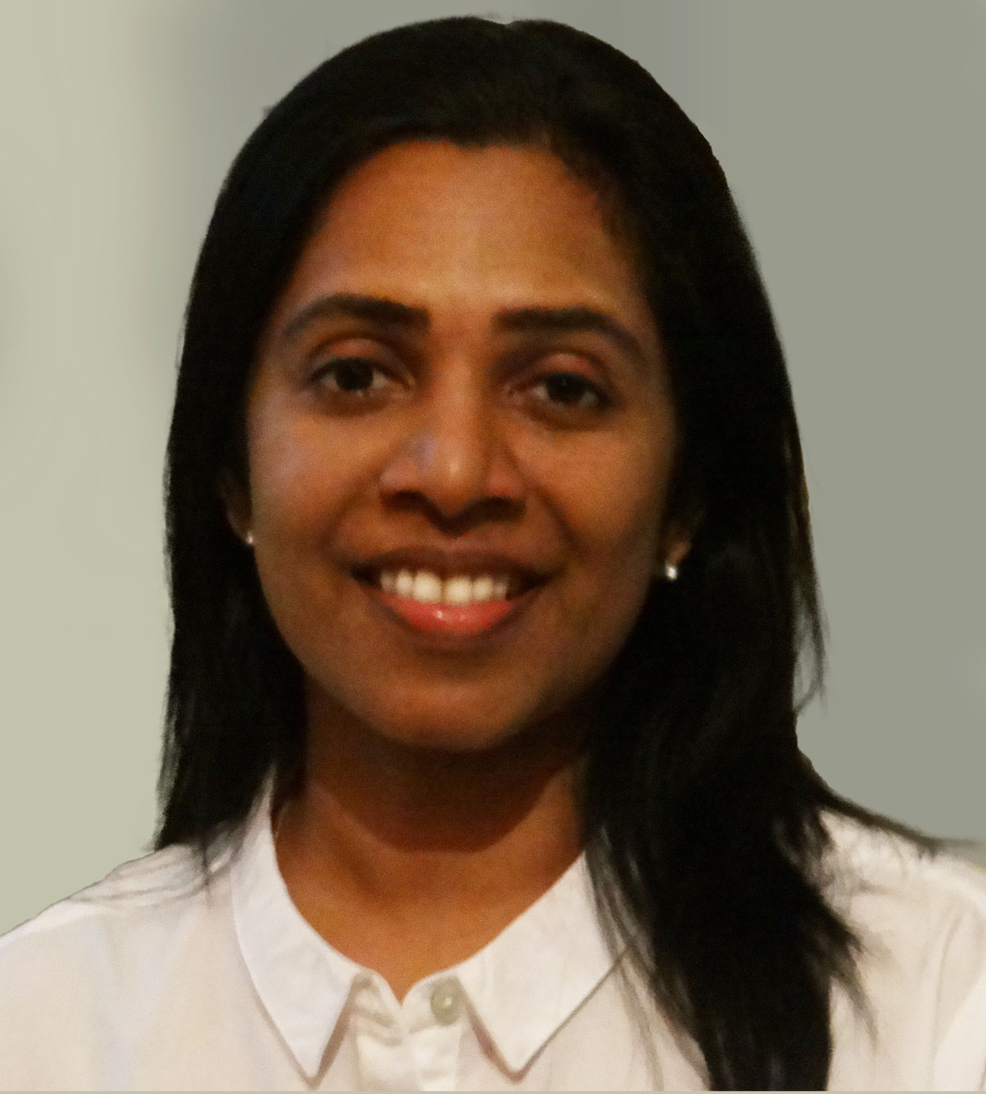
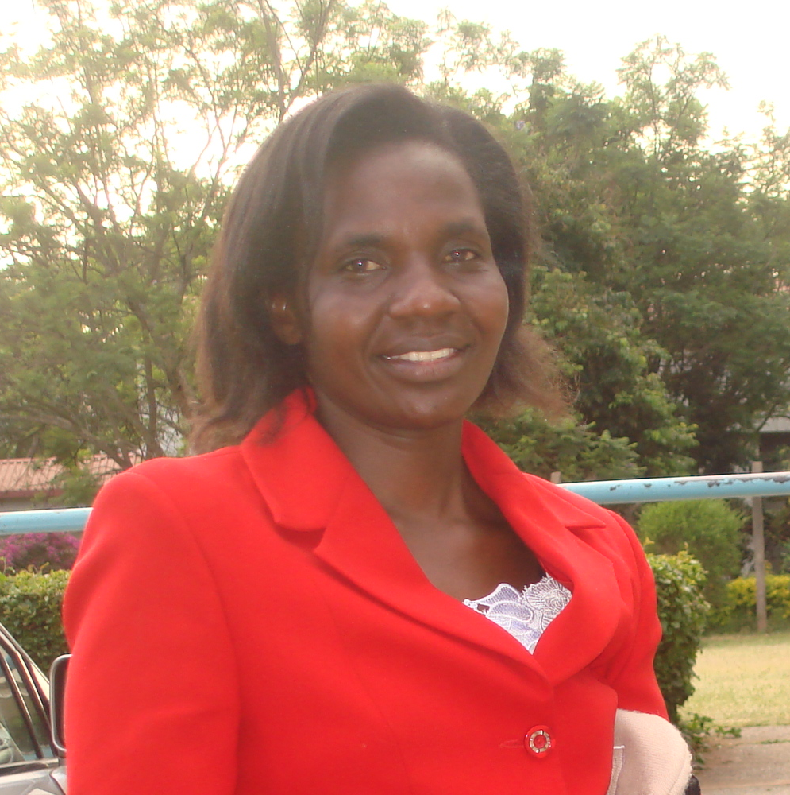

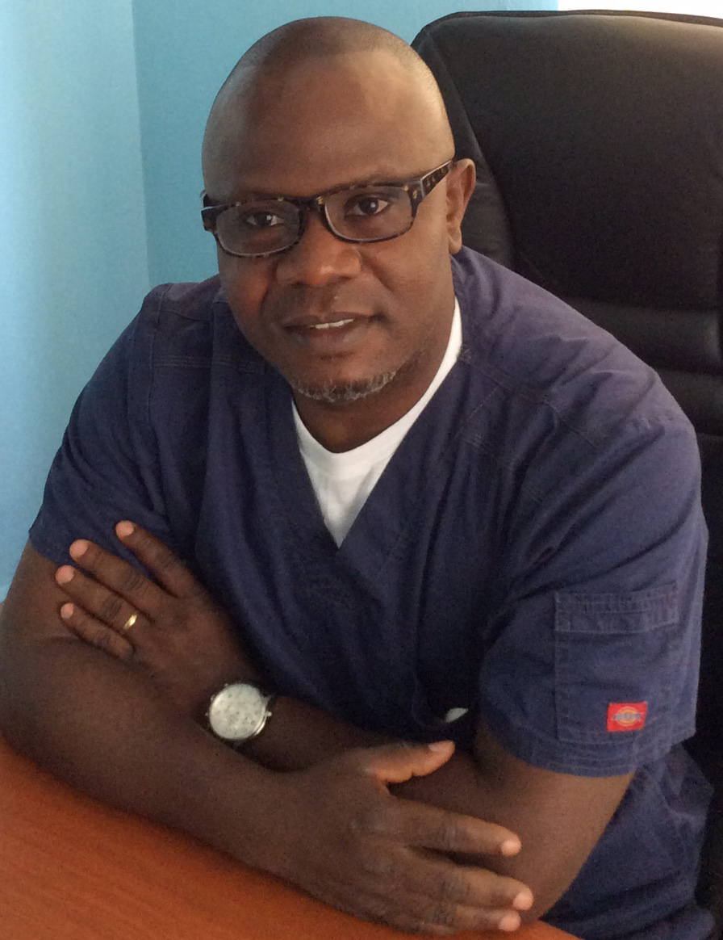

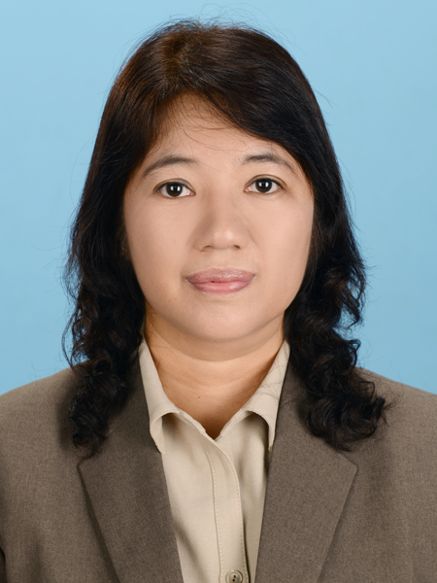
Recent and Upcoming Program Participants
2014
2015
2016
Sri Lanka
Uganda
India
Aruna Pallewatte, MBBS, MD, FRCR
Neuroradiology
Mount Sinai School of Medicine
Jimmy Okello, MBCHB, MMED
Breast Imaging
John Hopkins Hospital
Sniya V. Sudhakar, MD, MBBS
Pediatric Neuroradiology
University of Toronto
Kenya
India
Nigeria
Callen Onyambu, MBChB
MSK
University of Maryland Medical Center
Aruna R. Patil, MD, DNB, FRCR
Abdominal Imaging & MSK
University of Wisconsin School of Medicine
Abraham Inikori, MD
Body Imaging
University of Virginia
Malaysia
Nepal
Myanmar
Radhika Sridharan, MBBS, FRCR, RAD
MSK/Breast
Univ of Texas MD Anderson Cancer Center
Kamal Subedi, MBBS, MD
MSK & MRI
Case Western Reserve University &
Univ Hospitals
Wai Wai Htun, MBBS, MMedSc
CT & MRI
Lahey Hospital & Medical Center

Slide 13
Introduction to Research for
International Young Academics Program
Established 2000
Encourages young academics (residents or fellows up to 2 years beyond training) to pursue careers in academic radiology
17 participants per year
Work with 5 day North American Resident Research program
234 attendees representing 55 countries
Shared hotel accommodation, stipend awarded
Application deadline: April 15

Slide 14
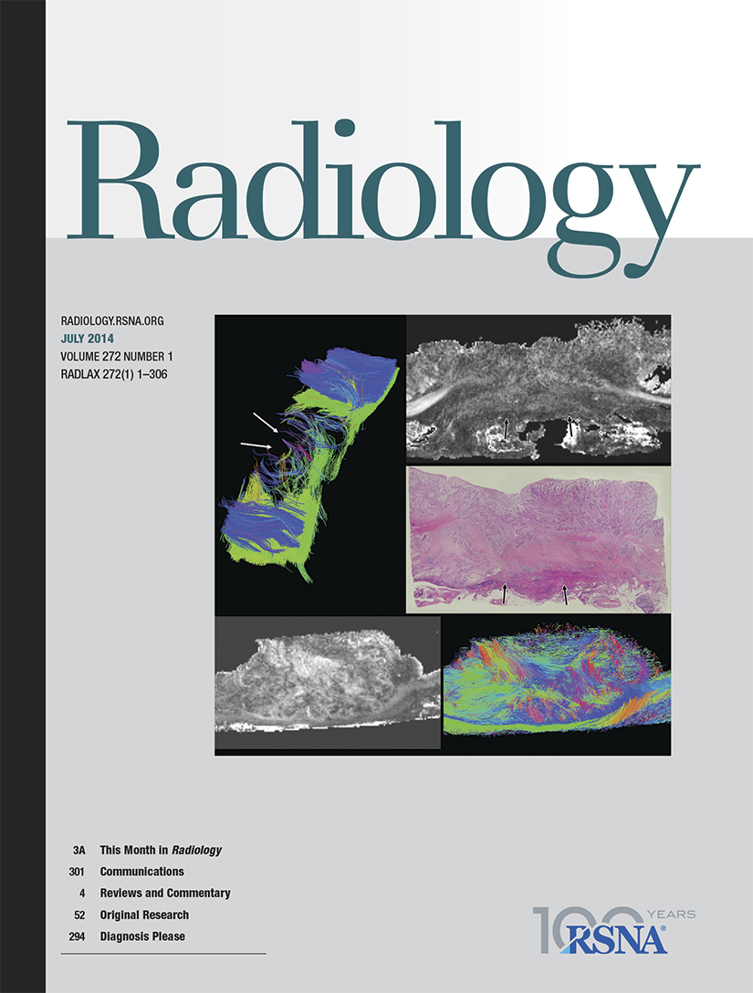
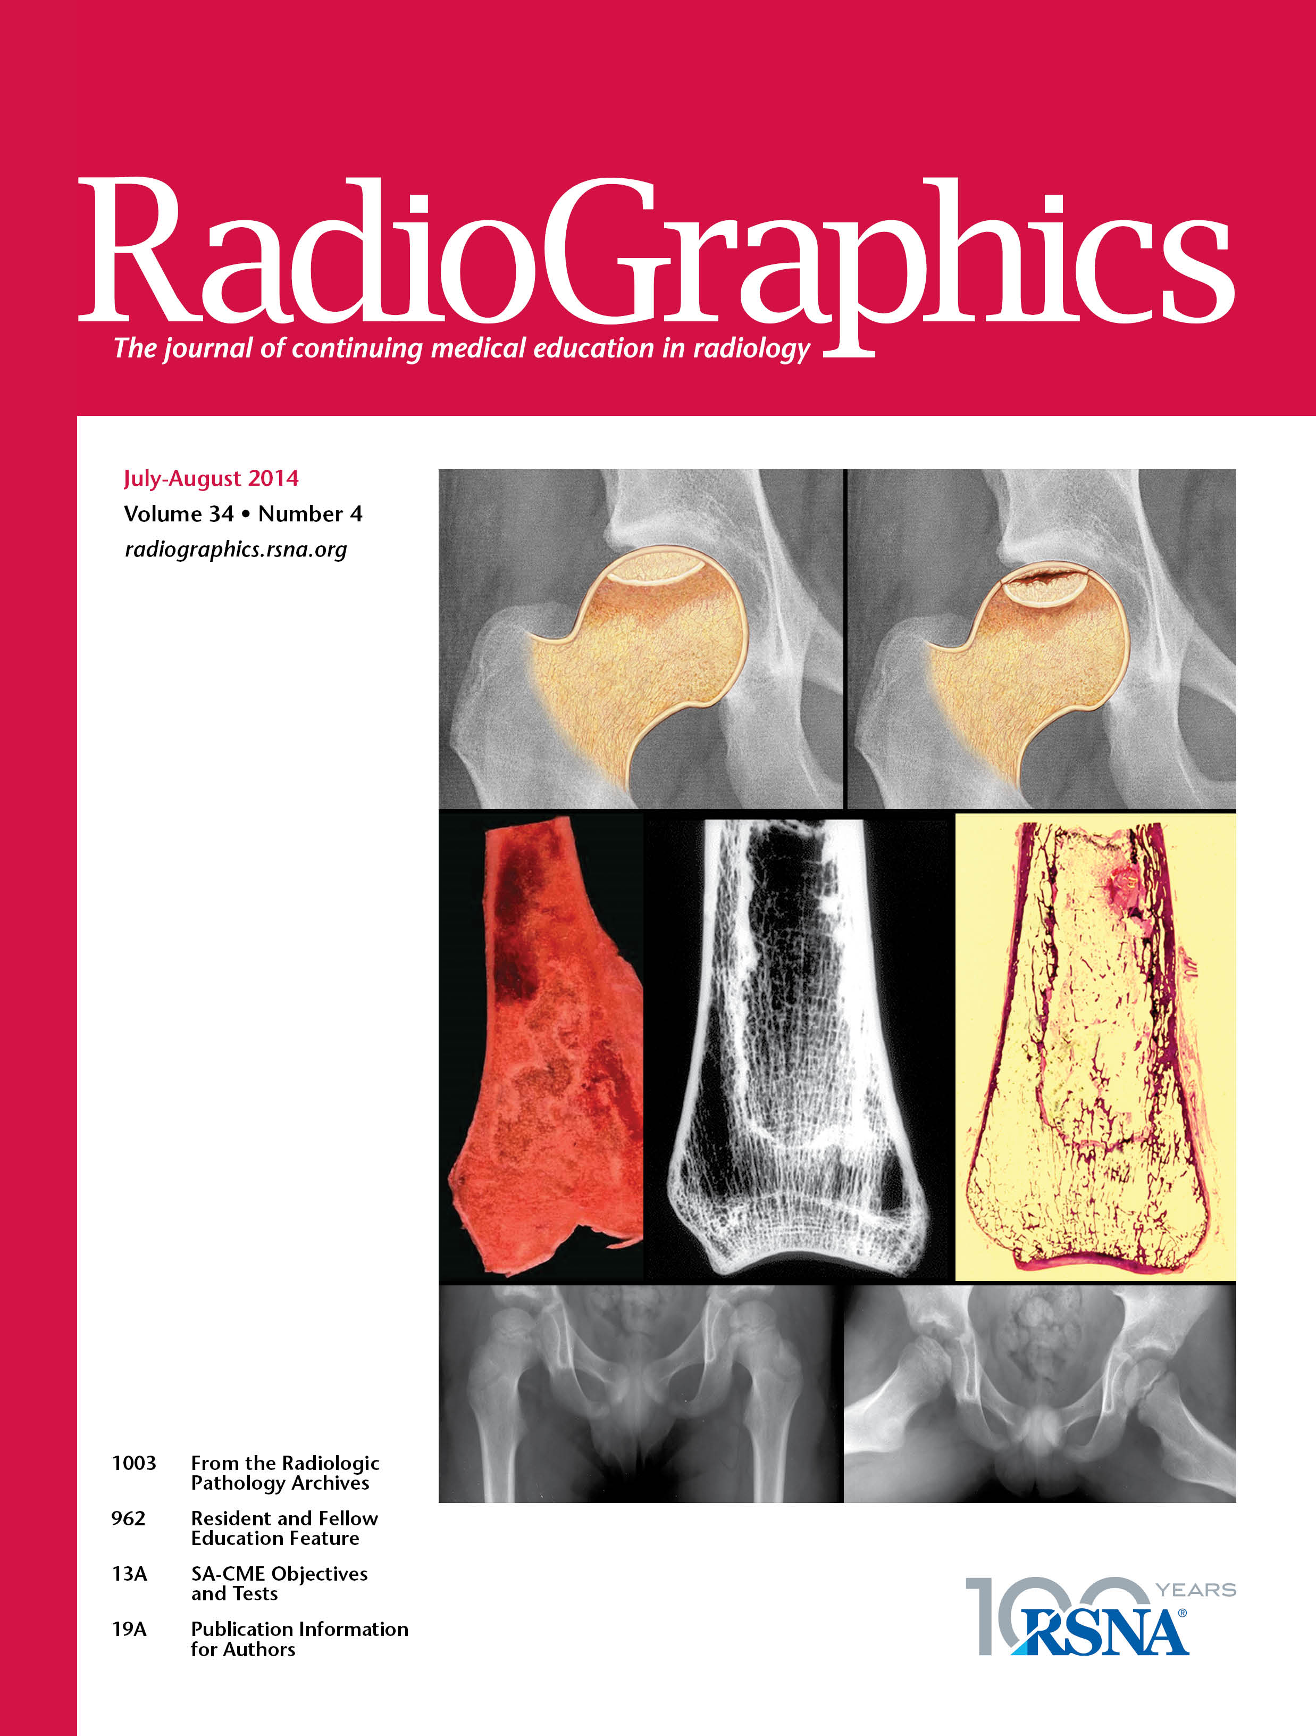

Education Materials
and Journal Award Program
Established 2000
Radiology teaching institutions, hospitals and medical libraries in under-resourced nations may apply to receive gratis subscriptions to RadioGraphics and Radiology
Radiology teaching institutions are also eligible to receive materials from the RSNA Education Center Store that support their teaching programs
Provided education to 175 institutions from 62 countries

Slide 15

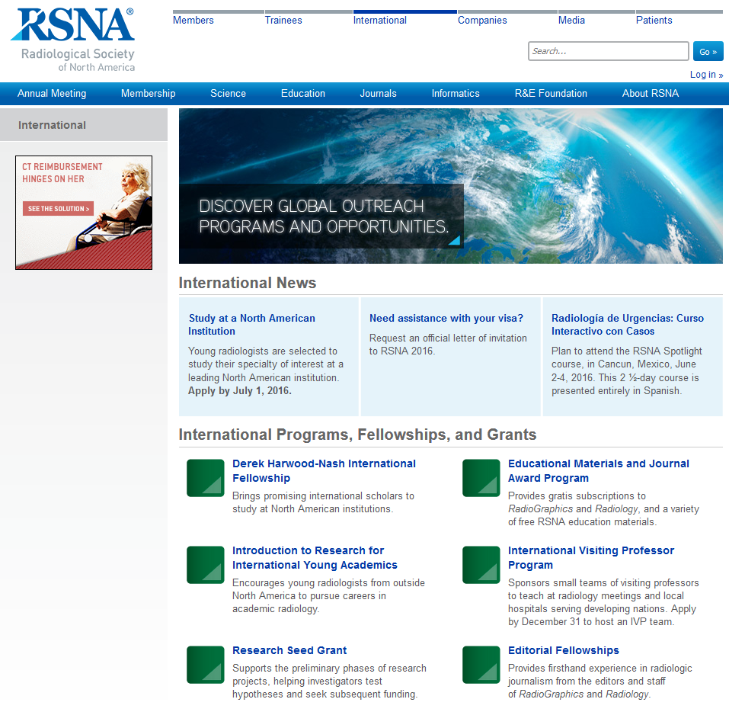
RSNA.org/International

Slide 16
CIRE Programs

Slide 17
Derek Harwood-Nash Fellows
Countries of Origin, 1998–2016

Slide 18
International Visiting Professor Visits
1986–2016

Slide 19
Resident Researchers
Countries of Origin, 2000–2015

Slide 20
Materials and Awards Recipients
2000–2016

Slide 21
All CIRE Programs

Slide 22
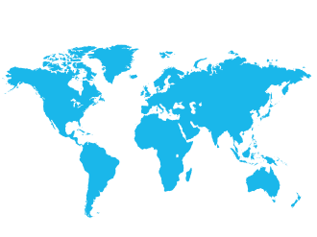
THANK
YOU
for being a part of our global community

