Slide 1
IR/DR Update
Kimi L. Kondo, DO, FSIR
Associate Professor
Division of Interventional Radiology
Department of Radiology
University of Colorado Anschutz Medical Campus
Kimi.Kondo@ucdenver.edu
April 2, 2016

Slide 2
Current IR Training Requirements
6 year pathway
Internship (1 yr); Diagnostic Radiology Residency (4 yrs); Interventional Radiology Fellowship (1 yr)
ABR
Diagnostic Radiology Primary Certificate
Vascular and Interventional Radiology (VIR) Subspecialty Certificate

Slide 3
VIR Subspecialty Certificate
ABR Diagnostic Radiology diplomates only
Completion ACGME-accredited fellowship
500 cases from fellowship
200 cases from 12 months practice
Oral examination
10 year renewable certificate (CAQ)

Slide 4
IR/DR Dual Certificate Residency
Approved by the American Board of Medical Specialties (ABMS) in 2012
IR/DR Certificate is one of 4 primary certificates offered by the ABR
Clinical internship
Residency
PGY 2-4 (R1-3) standard DR imaging training
IR residents must past ABR Core Exam
PGY 5-6 (R4-5) IR training
**Oral IR board examination
Notes:
Other certificates offered by ABR: Diagnostic Radiology; Radiation Oncology; Medical Physics

Slide 5
Program Formats
Integrated
5 years in length (total 6 years of post graduate training)
Residents are matched from medical school
Entire educational experience is provided during the residency
Independent
2 years in length (total 7 years of post graduate training)
This training format is available to graduates of a diagnostic radiology residency.
Launch date July 1, 2020

Slide 6
ESIR
Early Specialization in IR
Allows for completion of DR and IR in 6 years
Curriculum includes MINIMUM of 11 IR or IR-related rotations and ICU rotation during DR residency
MINIMUM of 500 procedures during DR residency
Total 6 years post graduate training

Slide 7
Integrated Programs
Medical School Match
4 Week Rotations
PGY | DR | IR* | ICU
1 | Internship (Surgery, Medicine, Transitional)
2 | 12 | 1
3 | 12 | 1
4 | 12 | 1
5 | 0-4 | 8-12 | 1
6 |  | 13
Totals | 36-40 | 28-32 | 1
Radiology 3:2
*IR or IR-related rotations
Training in Interventional Radiology: ACGME Update April 2014, Dr. Jeanne LaBerge, 39th Annual SIR Meeting, San Diego CA, March 2014.
Notes:
5 years of training after a clinical internship year
3 DR, 2 IR under a IR Program Director
Match out of medical school or transfer in from DR residency (PGY 3-6) at the home institution
During PGY 3-5, could transfer out of IR and into DR residency
Qualifying residents may enter the PGY6 year if have adequate training experience including at least 12 IR or IR-related rotations and documentation of at least 500 procedures covering the broad domain of IR
During PGY 5 and 6, training in IR content can be achieved in the IR section or on IR-related rotations outside of the IR section proper. Examples include rotations in vascular surgery, medical oncology clinic or interventional procedural rotations housed within diagnostic radiology sections. However, residents must accrue a minimum number of designated IR procedures. Consequently, rotations outside of IR proper must be carefully tailored to meet the overall goals and requirements of the residency.

Slide 8
Independent Programs
4 Week Rotations
PGY | DR | IR* | ICU
1 | Internship (Surgery, Medicine, Transitional)
4 Year Diagnostic Radiology Residency
“5” = 6 | 0-4 | 8-12 | 1
“6” = 7 |  | 13
Totals |  | 28-32 | 1
DR Graduates
Qualified
ESIR Transfer
*IR or IR-related rotations
Notes:
Independent format would allow continuation of programs that are not currently tied to a DR residency program (eg Miami Vascular). Residents transfer into the program from outside institutions but can also be from within the program. This might also allow blend of programs and residents at a single institution esp. during the transition period.
Residents complete 2 years of training after completing a 4-year DR residency
Candidates may enter the second year of the program provided they have adequate training experience including minimum of 11 IR or IR-related rotations and ICU rotation and documentation of at least 500 procedures during DR residency
During PGY 5 and 6, training in IR content can be achieved in the IR section or on IR-related rotations outside of the IR section proper. Examples include rotations in vascular surgery, medical oncology clinic or interventional procedural rotations housed within diagnostic radiology sections. However, residents must accrue a minimum number of designated IR procedures. Consequently, rotations outside of IR proper must be carefully tailored to meet the overall goals and requirements of the residency.

Slide 9
Residency transfers
Within a single institution, it will be possible to transfer between the IR and DR residencies at the beginning of the PGY2, PGY3, or PGY4 year provided qualifications for transfer are met.

Slide 10
Integrated Programs
As of March 2016: 63 applications received
20 institutions have received ACGME accreditation
Beth Israel Deaconess, Boston
Brigham & Women’s Hospital, Boston
Georgetown University, Washington
Icahn SOM at Mount Sinai, NY
Maine Medical Center, Portland
Massachusetts General Hospital, Boston
Medical College of Wisconsin, Milwaukee
Medical University of South Carolina, Charleston
Rush University, Chicago
Stanford Hospital, Calif.
UCLA, Los Angeles
University of Arkansas, Little Rock
University of California (San Diego)
University of Illinois, Chicago
University of Kansas, Lawrence
University of Michigan, Ann Arbor
University of Minnesota, Minneapolis
University of Pennsylvania, Philadelphia
Vanderbilt University, Nashville, Tenn.
Washington University, St. Louis

Slide 11
ESIR As of March 2016: 30 applications received 10 Institutions have received ACGME accreditation
Florida Hospital Medical Center, Orlando
Loyola University, Maywood, Ill.
University of Louisville School of Medicine, Ky.
William Beaumont Hospital, Royal Oak, Mich.
Mount Auburn Hospital, Cambridge, Mass.
Albert Einstein Healthcare Network, Philadelphia
Drexel University College of Medicine/Hahnemann University Hospital, Philadelphia
University of Pennsylvania, Philadelphia
Pennsylvania Hospital of the University of Pennsylvania Health System, Philadelphia
Medical University of South Carolina, Charleston

Slide 12
Current 3rd Year Medical Students (Class of 2017)
Option 1 (6 years)
1 yr Internship + 5 yrs Integrated IR residency
Option 2 (6 years)
1 yr Internship
Match into ACGME DR residency program developing an Integrated IR residency (transfer after ACGME accreditation)
Option 3a ESIR track (6 years)
1 yr internship + 4 yrs DR residency + 1 yr advanced Independent IR residency
Option 3b (7 years)
1 yr internship + 4 yrs DR residency DR residency + 2 yrs Independent IR residency

Slide 13
Current 4th Year Medical Students (Class of 2016) and Interns (PGY 1)
Option 1 (6 years)
Matched into DR residency that is developing an Integrated IR residency
If accredited by ACGME before R4 year (PGY5), you may be able to transfer internally into the program at your home institution
Option 2 (6 or 7 years)
Program not developing Integrated IR residency or home institution application not accredited before R4 year (PGY5) or not able to transfer into institution’s Integrated IR residency, apply to Independent IR during R3 year (6 yrs with ESIR)
Same as Option 3b (7 years without ESIR) = DR + Independent IR residency

Slide 14
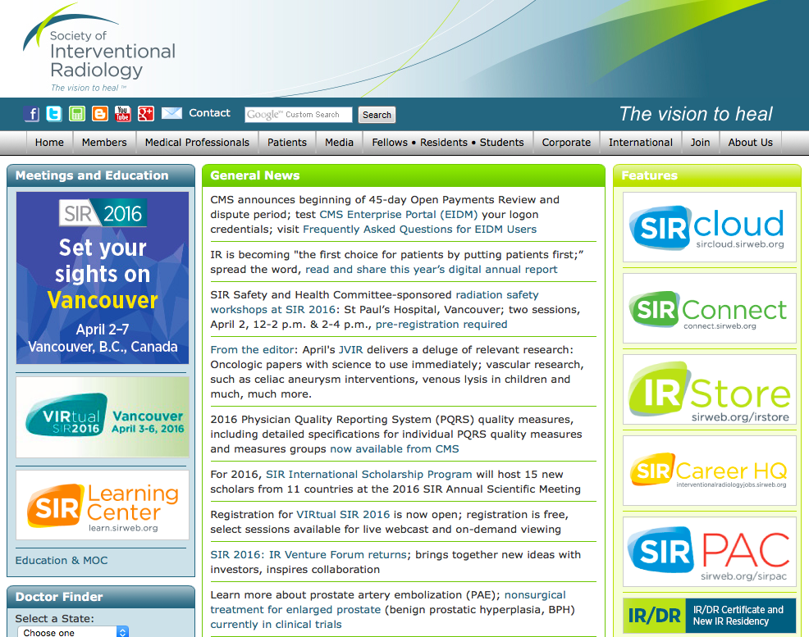
www.sirweb.org

Slide 15
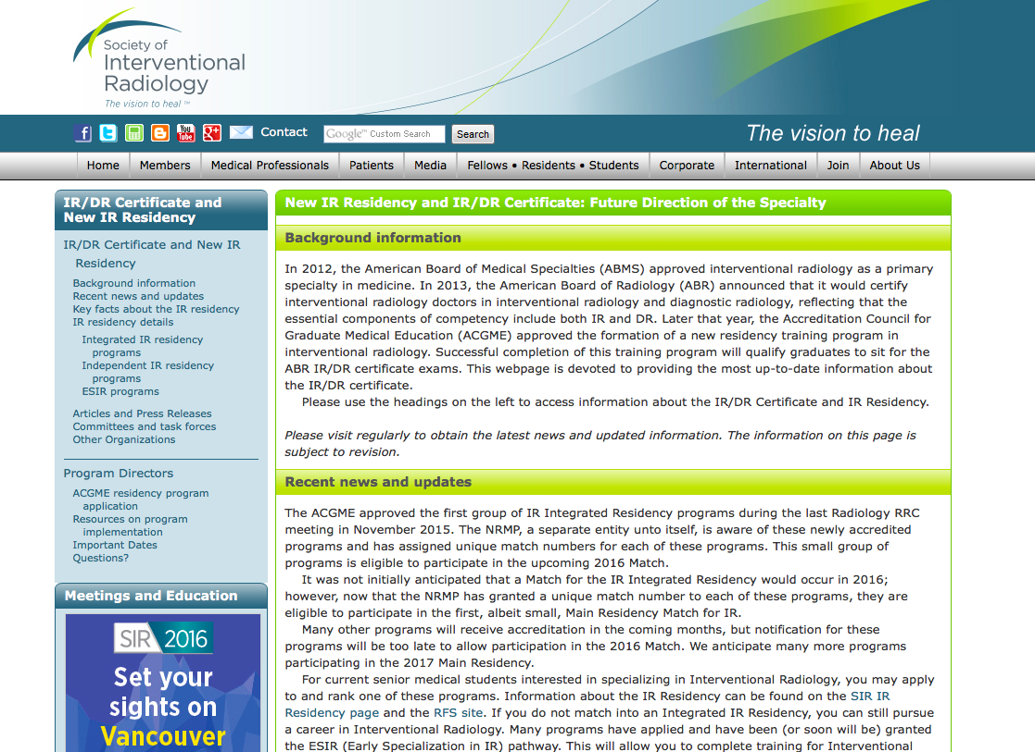

Slide 16
Other Resources
American Board of Radiology (ABR):
www.theABR.org
Accreditation Council for Graduate Medical Education (ACGME): www.acgme.org
Program requirements

Slide 17
QUESTIONS?

