Slide 1




How to Approach Abdominal Radiographs in Adults – A Primer
Authors:
Dhakshina Ganeshan, MD
MD Anderson Cancer Center Houston TX
Ashish P. Wasnik, MD
Michigan Medicine
University of Michigan, Ann Arbor, MI

Slide 2
Introduction
Although advanced imaging techniques such as CT and ultrasound have a higher diagnostic accuracy, abdominal radiographs are often the initial imaging study performed in the emergency room for non-traumatic acute abdominal pain
Objectives of this module is to
  Review the indications and contraindications of abdominal radiographs
  Discuss the technique of acquiring abdominal radiographs
  Describe how to systematically interpret abdominal radiographs
  Illustrate common and uncommon pathologies that cane be diagnosed on abdominal radiographs

Slide 3
Indications & Contraindications
Common indications for abdominal radiographs in adults include:
  Evaluation and follow-up of abdominal distension, bowel obstruction, or nonobstructive ileus
  Follow-up of the postoperative patient, including suspected retained foreign bodies
  Evaluation and follow-up of urinary tract calculi
  Evaluation of ingested or other introduced foreign bodies
  Evaluation of the placement of medical devices
  Evaluation of pneumoperitoneum, toxic megacolon etc.
ACR-SPR practice parameter for the performance of abdominal radiography. 2016; https://www.acr.org/-/media/ACR/Files/Practice-Parameters/RadAbd.pdf;
ACR Appropriateness Criteria. https://www.acr.org/Clinical-Resources/ACR-Appropriateness-Criteria

Slide 4
Indications & Contraindications
ACR reports abdominal radiographs “may be appropriate” for initial evaluation of “non-localized acute abdominal pain” but not for suspected appendicitis, diverticulitis or right upper quadrant pain of suspected biliary origin
Abdominal radiographs may also be appropriate for initial evaluation of palpable abdominal mass when bowel obstruction or constipation is suspected as the source of the palpable abnormality
  However, CT, ultrasound or MR would be more appropriate in all the above indications
Pregnancy is a relative contraindication for abdominal radiographs (consider alternative tests such as ultrasound or MR, if appropriate)
ACR-SPR practice parameter for the performance of abdominal radiography. 2016; https://www.acr.org/-/media/ACR/Files/Practice-Parameters/RadAbd.pdf;
ACR Appropriateness Criteria. https://www.acr.org/Clinical-Resources/ACR-Appropriateness-Criteria

Slide 5
Technique
No prior patient preparation required
low kVp around 60 to 75 kVp is typically used, although this can vary according to patient size and other parameters
Use of grid and gonadal shielding is desirable for adult abdominal radiographs
Typical radiation dose for abdominal radiographs is around 0.1–1.0 mSv, compared to 10–15 mSv for CT of the abdomen and pelvis
Depending upon the indication for abdominal radiography, either single or multiple views of the abdomen may be obtained
  supine anteroposterior, upright, decubitus, or cross-table lateral projections)
ACR-SPR practice parameter for the performance of abdominal radiography. 2016; https://www.acr.org/-/media/ACR/Files/Practice-Parameters/RadAbd.pdf;

Slide 6
Technique
Supine AP radiograph should cover the area from the diaphragm to the ischial tuberosities, including both flanks
Upright radiograph may be obtained in the AP or PA projection (lower gonadal dose with PA view)
Lateral decubitus views may help when upright views are not possible
  Left lateral decubitus position is preferred since free air in the abdomen is more readily detected adjacent to the liver
Although often not feasible, placing the patient in the upright or decubitus position for at least 5 minutes before exposing the radiograph can improve sensitivity for detecting pneumoperitoneum
Cross-table lateral projection is very rarely used in extremely ill adults in whom an upright or decubitus view cannot be obtained

Slide 7
Interpretation of Abdominal Radiographs
A systematic approach is required to ensure accurate interpretation of abdominal radiographs and to avoid missed diagnosis
Although the exact sequence of the step-by-step interpretation can differ, the following components should be carefully evaluated for pathologies
      Lower thorax
      Bowel gas pattern
      Abnormal gas
      Calcifications
      Abdominal organs and abdominal wall
      Bones
      Medical devices and foreign bodies
Loo JT et al. Abdominal radiograph pearls and pitfalls for the emergency department radiologist: a pictorial review. Abdom Radiol (NY). 2017 Apr;42(4):987-1019.
James B, Kelly B. The abdominal radiograph. Ulster Med J. 2013 Sep;82(3):179-87.
Levine MS. Plain film diagnosis of the acute abdomen. Emerg Med Clin North Am. 1985 Aug;3(3):541-62
Gans SL, Stoker J, Boermeester MA. Plain abdominal radiography in acute abdominal pain; past, present, and future. Int J Gen Med. 2012;5:525-33

Slide 8
Lower thorax
Pneumonia
Pulmonary nodules, retrocardiac mass
Pulmonary fibrosis
Pneumothorax
Pleural effusion
Diaphragmatic hernia

Slide 9
Abnormal Bowel Gas Pattern
Generalized ileus
Localized ileus
Gastric outlet obstruction
Small bowel obstruction
Large bowel obstruction
Ogilvie syndrome / colonic pseudo-obstruction
Gastric volvulus
Sigmoid volvulus
Cecal volvulus
Constipation
Stercoral perforation
Colitis – thumbprinting, lead pipe, pseudopolyps
Crohns
Toxic megacolon
Gasless abdomen

Slide 10
Abnormal gas outside the GI tract
Pneumoperitoneum
Pneumatosis
Abscess
Portal venous gas
Emphysematous pyelonephritis
Emphysematous cystitis

Slide 11
Calcifications
Renal, ureteric, bladder calculi
Medullary and cortical nephrocalcinosis
Gallstones
Chronic pancreatitis
Calcified lymph nodes
Vascular calcification – Aneurysms of abdominal aortic artery, Splenic artery etc.
Appendicolith
Fibroid
Vas deferens calcification

Slide 12
Abdominal cavity and abdominal wall
Hepatomegaly
Splenomegaly
Nephromegaly
Ascites
Abdominal wall hernia
Abdominal wall soft tissue lesions

Slide 13
Bones
Rib lesions
Thoracolumbar vertebrae lesions
Iliac bone, Ischium, Pubic rami and sacral lesions
Hip joint
Femur lesions
Fractures

Slide 14
Medical Devices
Nasogastric (NG) tubes, Dobhoff feeding tubes
Gastrostomy and jejunostomy feeding tubes
Esophageal, gastroduodenal and colonic stent
Biliary stent
Vascular - transjugular intrahepatic portocaval shunt (TIPS), Aortic stent grafts , any other arterial or venous stent
Ureteral stents, nephrostomy catheters, Foley’s catheter
Intrauterine devices
Tubal ligation clips
Spinal stimulator
Ventriculoperitoneal (VP) shunts
Look for any complications related to medical devices

Slide 15
Foreign Bodies
Ingested foreign bodies
Foreign bodies introduced via other routes
Inadvertent retained foreign objects following surgery

Slide 16
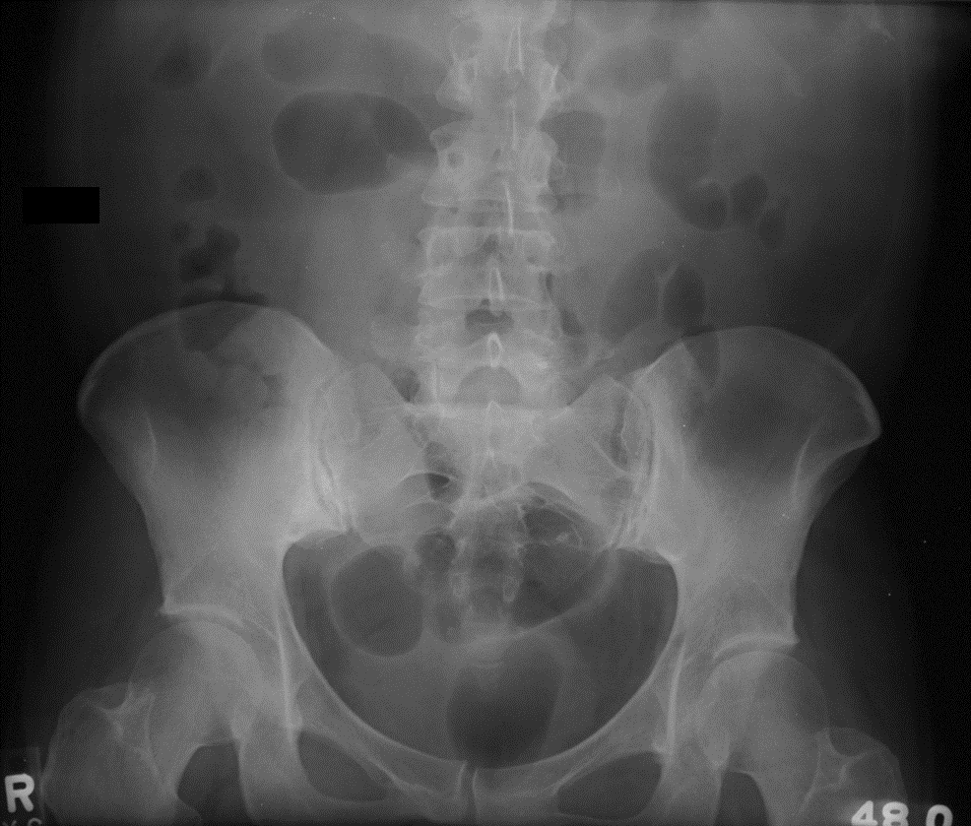
Abdominal Radiographs
Single view – supine (typically for tube placement)
Multiple views: supine & upright or decubitus
Normal
  Small amount of gas in up to 4 nondistended SB loops < 3 cm
  Gas may be seen in stomach and nondistended colon (up to 6 cm diameter)
Shrake PK et al. Radiographic evaluation of suspected Small bowel obstruction. Am J Gastroent (1991) 86: 175-178
Maglinte DDT et al. Radiology of small bowel obstruction. Abdominal Imaging 2005 (30): 160-178.

Slide 17
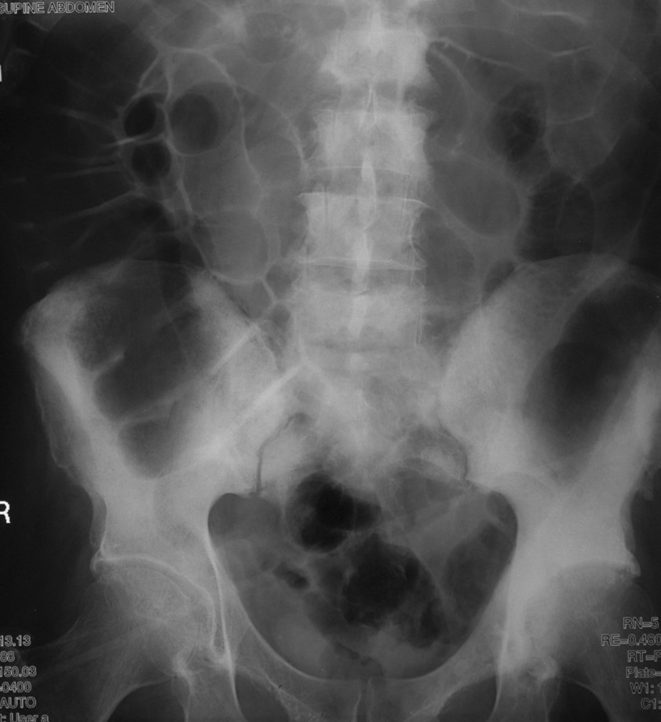
Adynamic ileus
Diffuse gaseous distention of small and large bowel, to the rectum
Often post-operative
May be seen with neurogenic bowel or patients of pain medication

Slide 18
SBO on Abdominal Radiographs
What to look for-
  Small bowel distention (> 3 cm)
  > 2 AF level, AF level > 2.5 cm, AF level differing > 2cm in height from one another in same small bowel loop
  Small bowel to colonic diameter ratio > 0.5
Diagnostic accuracy in 50-60%
Sensitivity of 66% in proven SBO
Baker SR . ACR Appropriateness Criteria on SBO- A critique of term and its terms. ACR 2007; 443-445.
Silva AC, et al. Small bowel obstruction: what to look for. RadioGraphics 2009; 29:423–439.

Slide 19
SBO on Abdominal Radiographs
Abnormal – nonspecific (equivocal) gas pattern:
  At least 1 loop of borderline or mildly dilated (3 cm or more)
  3 or more AF level, colonic and fecal distribution normal
  (reactive or reflex ileus (stasis), low grade obstruction, medication induced)
Probable SBO:
  Multiple dilated gas filled SB, relatively small or moderate colonic gas
  (acute inflammation, appy, divert- warrant CT)
Unequivocal SBO:
  Multiple dilated gas filled SBO in gasless colon- urgent attention
[dilated colon and SB= colonic ileus or obstruction]
Maglinte DDT et al. Radiology of small bowel obstruction. Abdominal Imaging 2005 (30): 160-178.

Slide 20
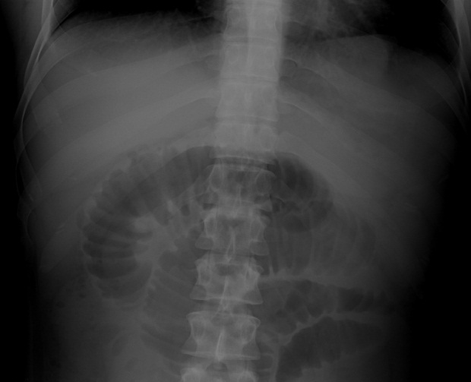
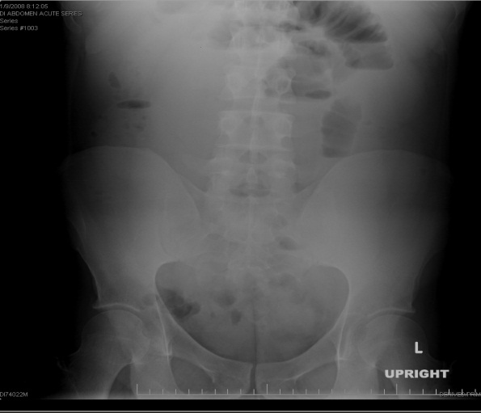
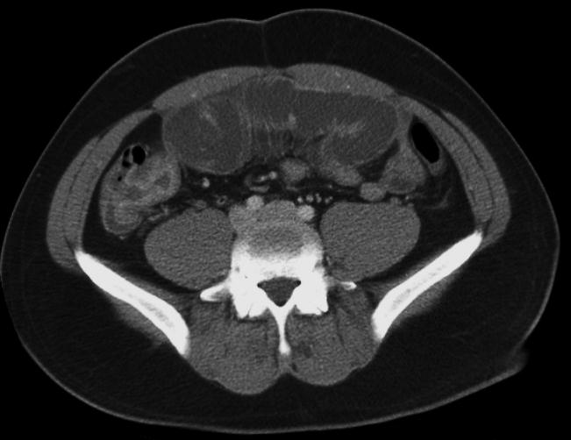
Small Bowel Obstruction
ER-Acute onset abdominal pain.
- Multiple dilated loops of small bowel with paucity of gas in the colon
Small bowel obstruction- secondary to stricture from Crohn disease (arrow)

Slide 21
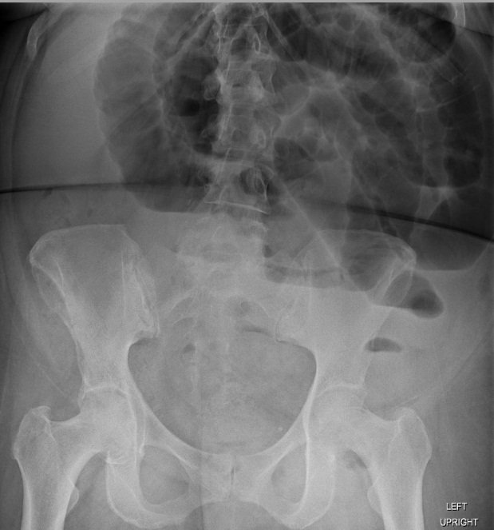
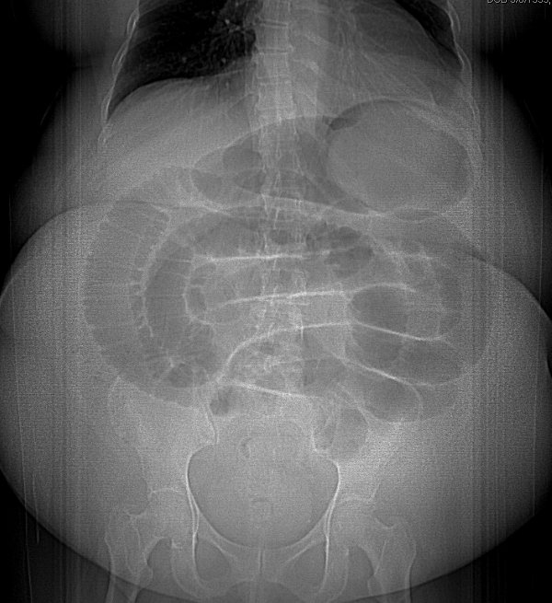
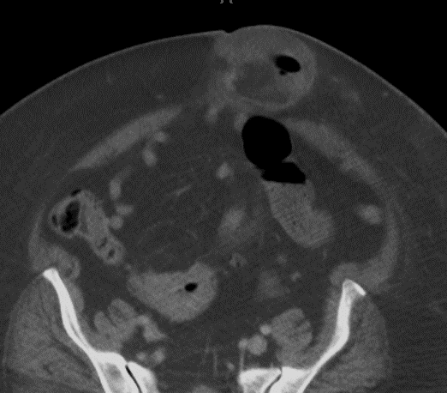
SBO from incarcerated umbilical hernia
Acute abdominal pain, distention and vomiting
- Multiple dilated loops of small bowel transitioning to upper mid pelvis. Absent gas in the colon.
Small bowel obstruction- secondary to incarcerated umbilical hernia (arrow)

Slide 22
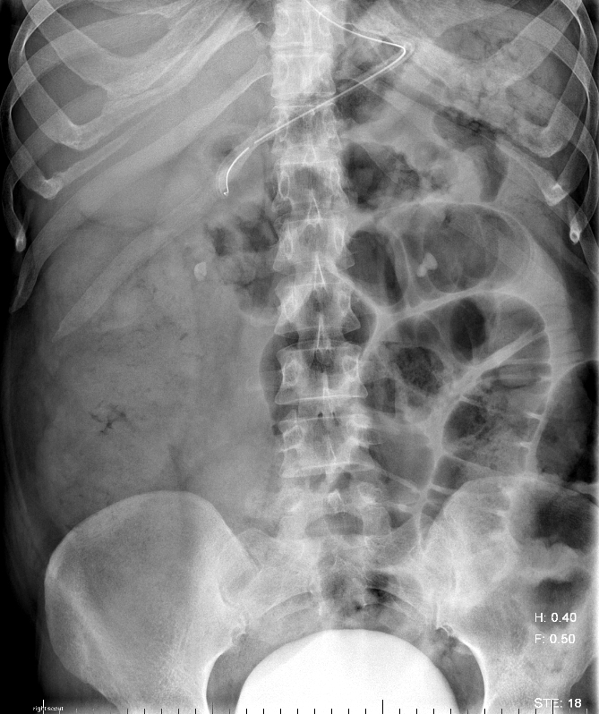
Cystic fibrosis with DIOS
Dilated gas filled small bowel loops with some particulate material, as well as large amount of stool in the colon.
In cystic fibrosis, increased mucus secretion causes more thickening and retention of the stool leading to constipation and distal intestinal obstruction syndrome (DIOS)

Slide 23
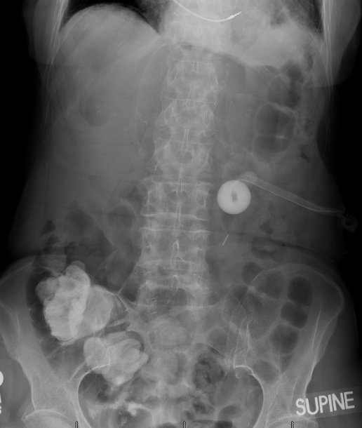
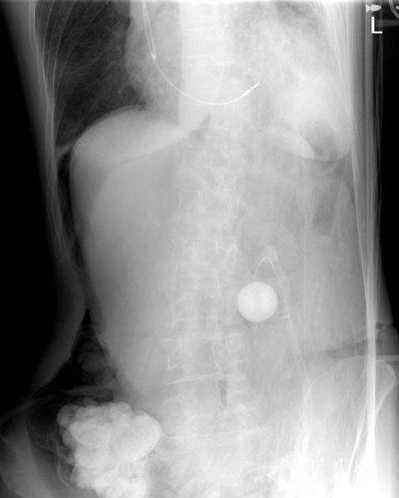
Free intraperitoneal air
Supine view: Increased central abdominal lucency
Especially, increasing lucency from lateral to medial
over the right upper quadrant
* Upright or decubitus view needed for confirmation
Left lateral decubitus shows free air
in the nondependent right abdomen
(arrows)

Slide 24
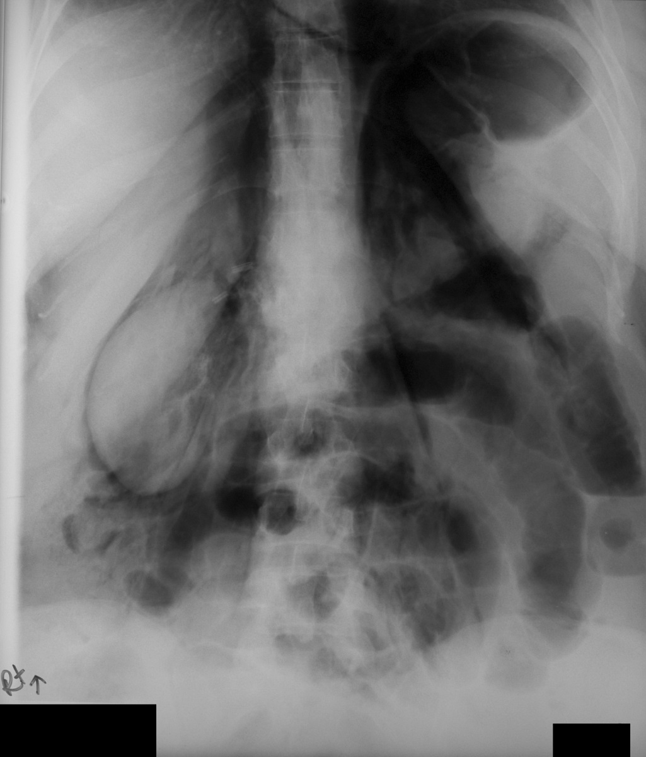
Retroperitoneal free air
In contrast to intraperitoneal free air, retroperitoneal free air outlines the kidneys (arrows), psoas muscle (arrowheads), contiguous with midline mediastinum
Status post ERCP- acute abdominal pain

Slide 25
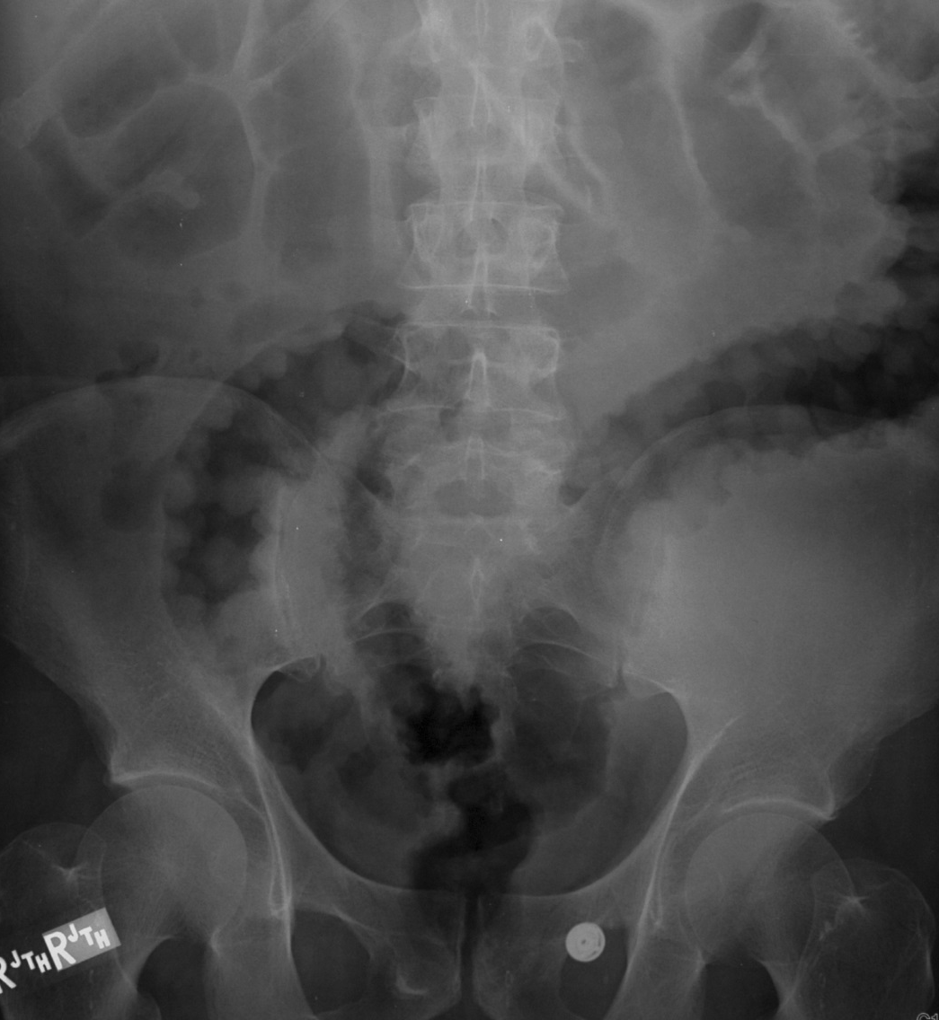
Colitis
Bowel wall thickening (small or large bowel)
More common with colon- focal or diffuse mural thickening – “thumb-print” sign
Seen with inflammatory, infectious or ischemic colitis
Patient with C. difficile colitis causing diffuse
Wall thickening (arrows)

Slide 26
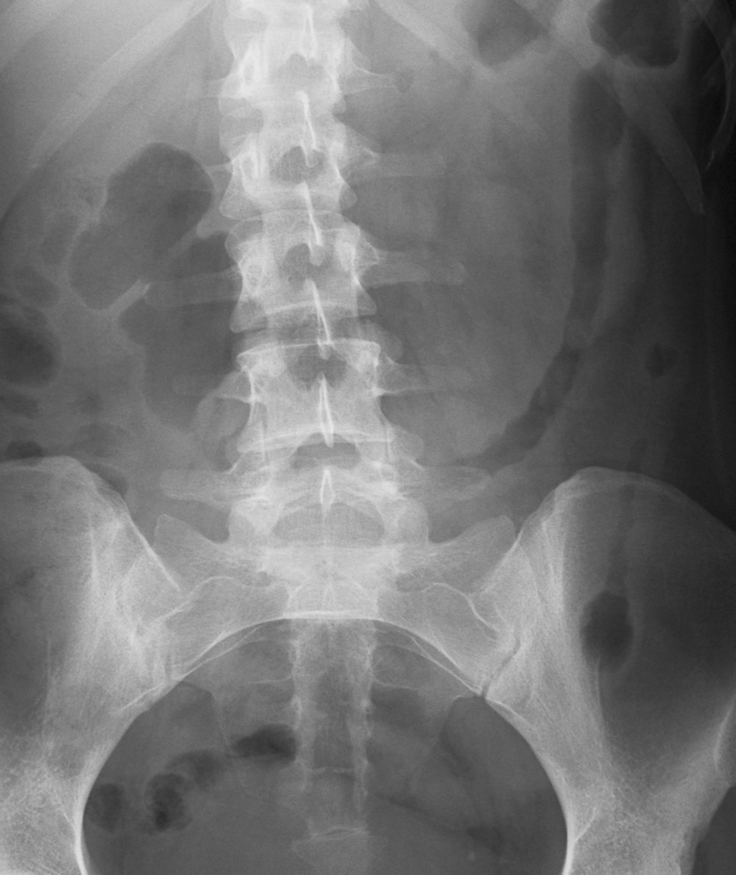
Active Ulcerative colitis
Diffuse wall thickening and intramural edema/inflammation in ulcerative colitis cause featureless colon (loss of haustral pattern)- “lead-pipe colon”
Ulcerative colitis with acute flare causing
featureless left colon (arrows). Right colon as normal haustra (arrowhead)

Slide 27
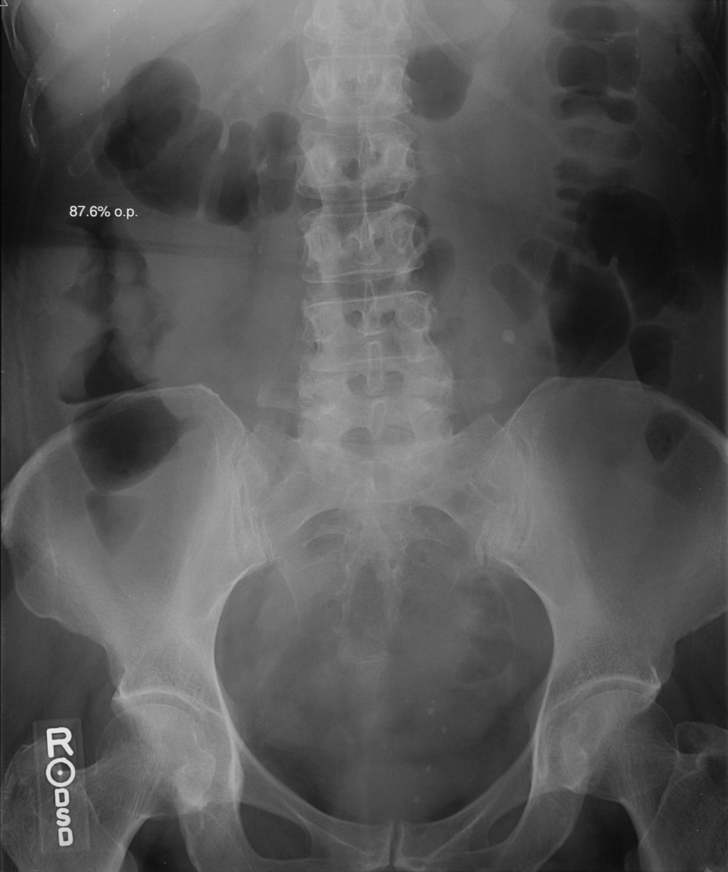
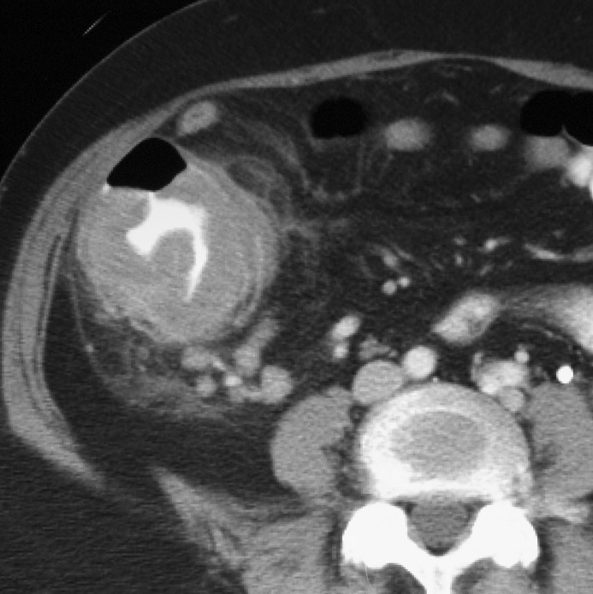
Focal wall thickening- Colon Ca
Segmental/ focal, asymmetric and irregular wall thickening/bowel gas pattern is suspicious for tumor and warrants further evaluation with CT/MR and or endoscopy
Focal irregular bowel gas pattern in ascending colon concerning for wall thickening (arrows).
CT and endoscopy confirmed colon cancer (arrowhead)

Slide 28
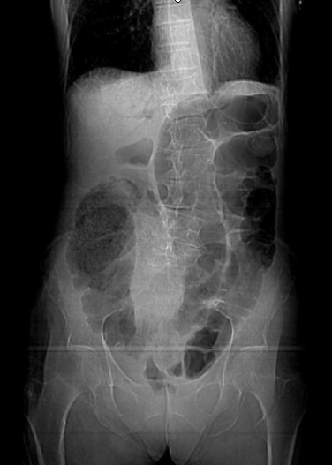
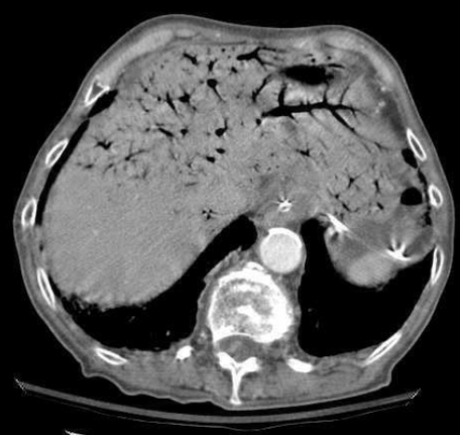
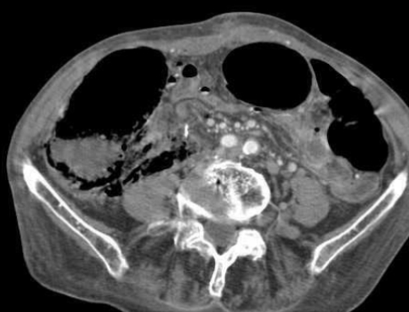
Bowel Ischemia
Portal V gas
Pneumatosis
Linear lucency along bowel gas should be carefully looked for- that suggests pneumatosis (arrows). Careful attention to any peripheral linear branching lucencies in the RUQ is needed to identify portal venous gas (arrowhead). Together, these findings are most concerning for bowel ischemia and warrants emergent CECT

Slide 29
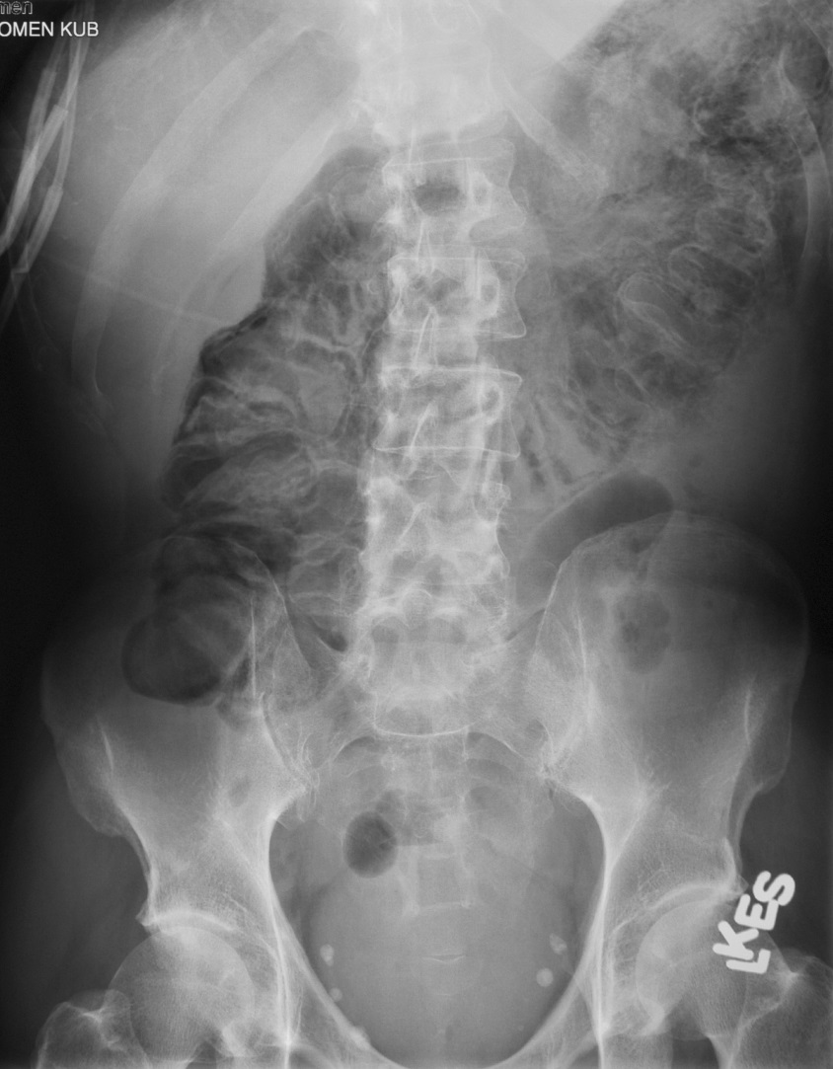
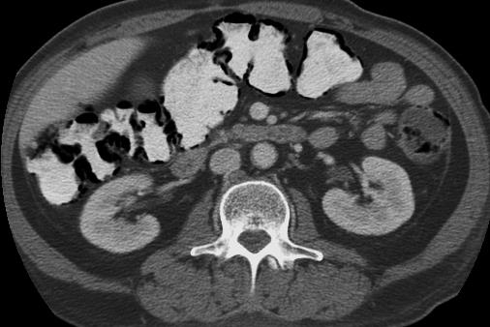
Pneumatosis in post chemotherapy
While pneumatosis on radiographs is most concerning feature for bowel ischemia, this finding has been associated with benign conditions that can cause mucosal friability/break with intramural gas.
COPD, post chemotherapy, chronic steroid use, autoimmune disease, connective tissue disorders, post endoscopy
CT necessary to confirm benign nature
Findings of lack of bowel obstruction, bowel wall thickening, fat stranding, mesenteric edema- helpful in delineating from ischemic bowel.

Slide 30
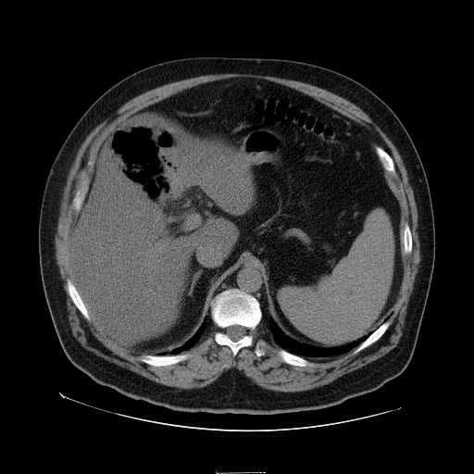
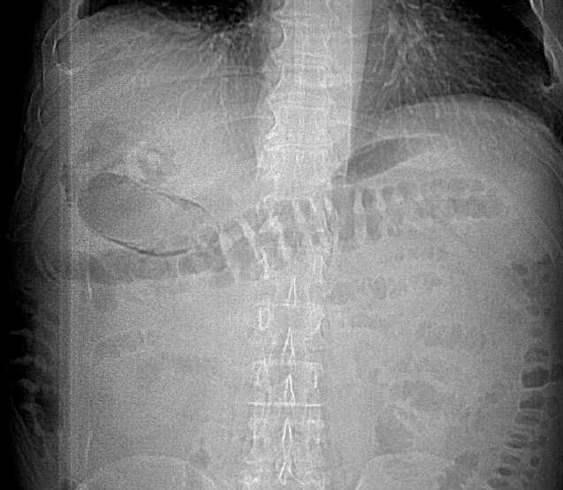
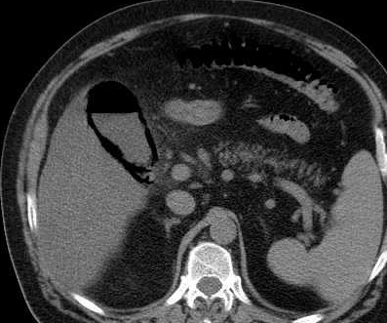
Emphysematous cholecystitis with liver abscess

Slide 31
Gastric drainage tube (large-bore)
No radiopaque tip (as seen with Dobhoff tube)
Ideal position: Side hole (arrow) in the gastric body, past GE junction
Can also be used for nutrition and medication administration

Slide 32
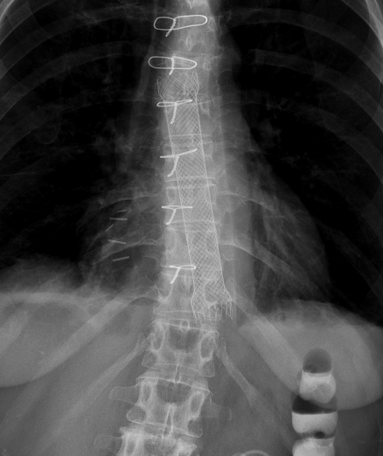
Esophageal Stent
These are covered metallic stent traditionally been used for palliation of dysphagia secondary to malignancy
Now also used for perforations, leaks, fistulae, or strictures
Gu E, Wasnik AP, et al. Annual Meeting Society of Abdominal Radiology, March 2016, Hawaii

Slide 33
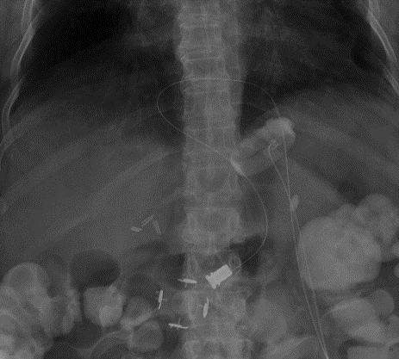
Lap Gastric band
Bariatric weight loss device, band placed around the proximal stomach to create small proximal pouch
Has a band (long arrow), a subcutaneous port (short arrow) and connecting tube (arrowhead)
Phi (φ) angle *
  Angle formed by spinal column and longitudinal axis through the gastric band
  Should be less than 58˚
Udager KG, Wasnik AP, et al. Emerg Radiol 2013; 21:309-319

Slide 34
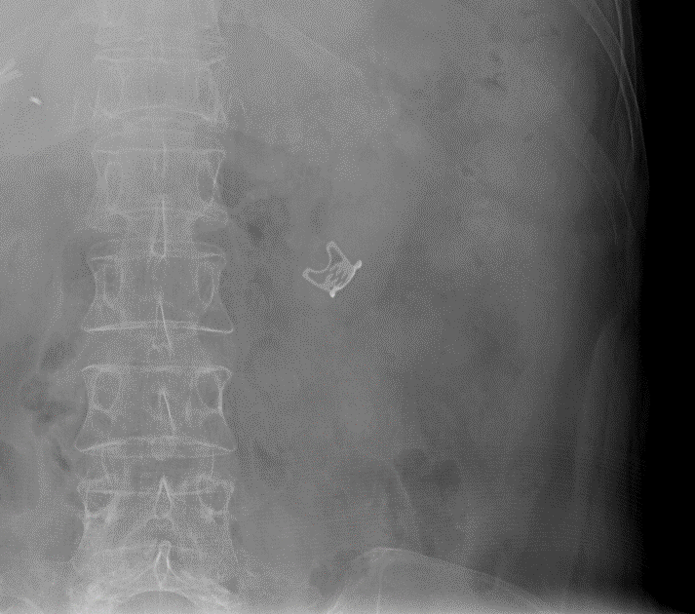
Bear-claw Endoclip
Special type of endoclip (arrow)
Relatively new device used for endoscopic closure of large gastrointestinal defects, including sites of gastrointestinal bleeding, perforations, or fistulas

Slide 35
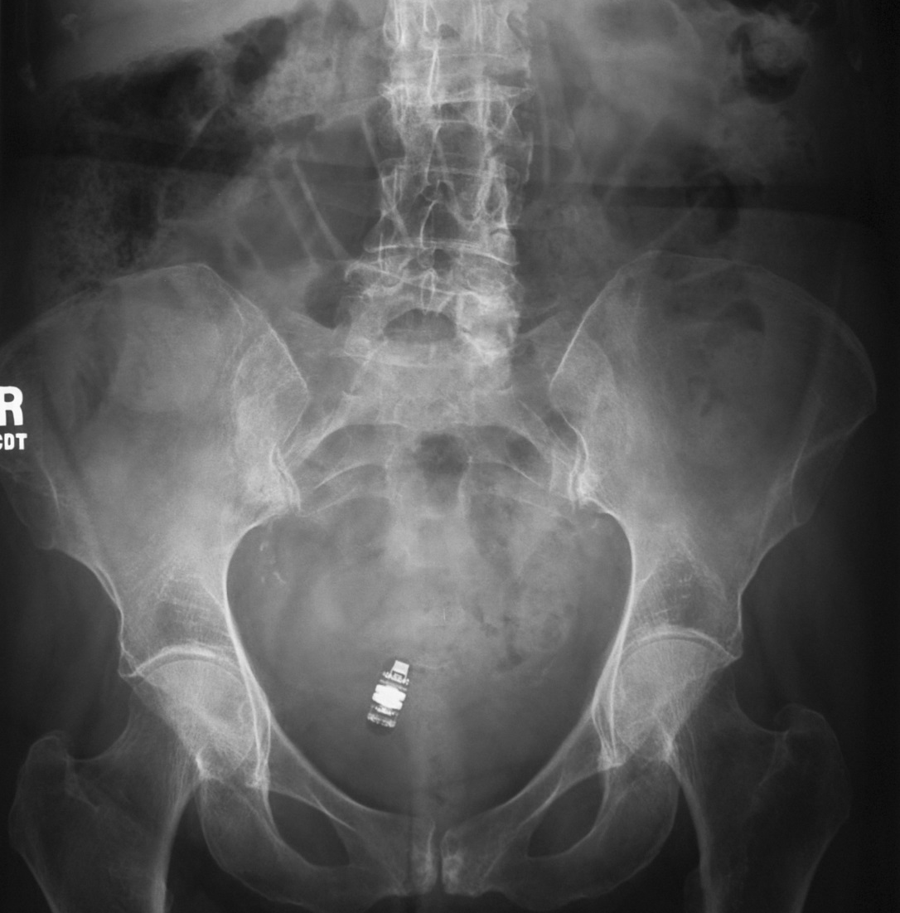
Enteric Endoscopic capsule
Capsule endoscopy is a relatively new tool that allows for endoscopic imaging of the small bowel
The primary indication is for evaluation of GI bleeding after negative workup by conventional endoscopy

Slide 36
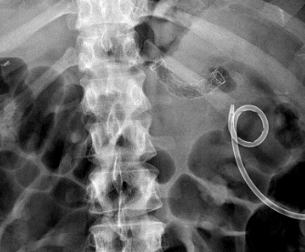
Cyst gastrostomy stent
Endoscopic cystogastrostomy (arrow) is a relatively new development for endoscopic treatment of pancreatic pseudocysts as an alternative to surgical cystogastrostomy or percutaneous drainage
Stents are placed endoscopically between the stomach and pancreatic pseudocysts
New dumbbell-shaped stents have been developed to reduce the risk of migration seen with straight tubular stents
A percutaneous pigtail drainage catheter
(arrowhead) in the left hemiabdomen also seen

Slide 37
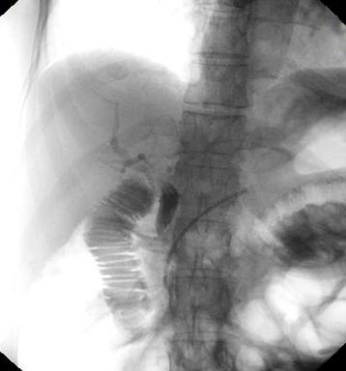
Pancreatic duct stent
Pancreatic duct stent (arrow) often placed during endoscopic retrograde cholangiopancreaticography (ERCP) as a prophylaxis to avoid post ERCP pancreatitis
Typically, migrate and excreted in 5-8 days

Slide 38
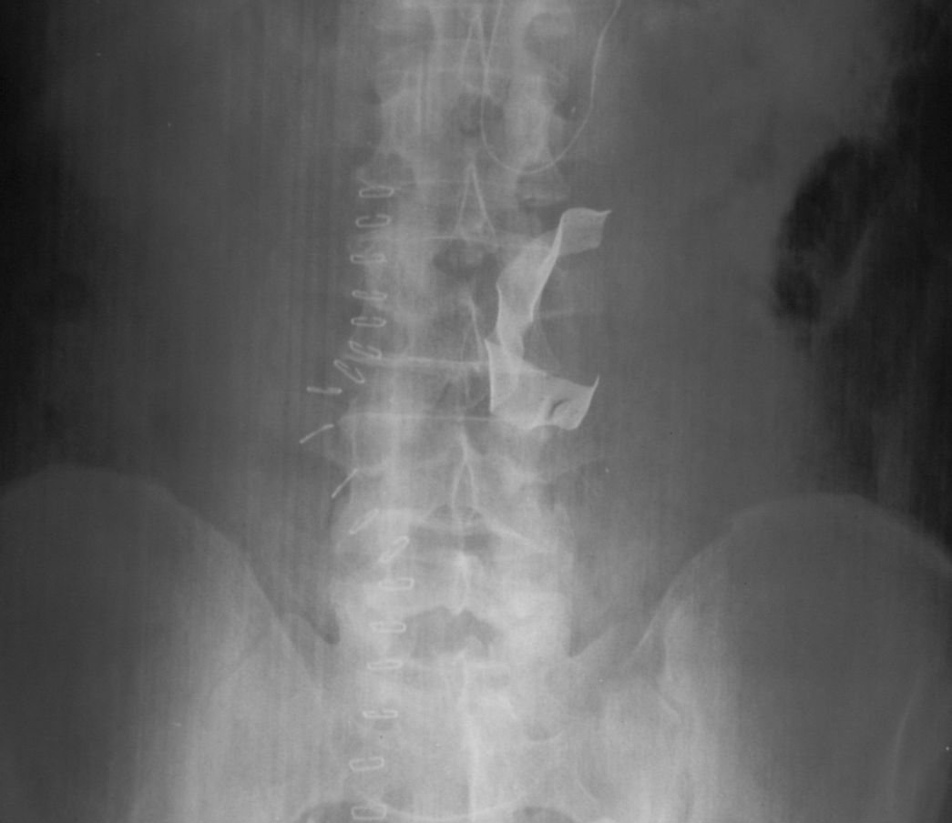
Lap Sponge
A band-like radio-opaque structure (arrow) in the recent post-op radiograph should always be looked with high suspicion of missed surgical sponge, and warrants immediate communication with the clinical team for sponge count mismatch
In rare occasions, these are deliberately left for patient’s unstable clinical status at the time of surgical and for second look surgery

Slide 39
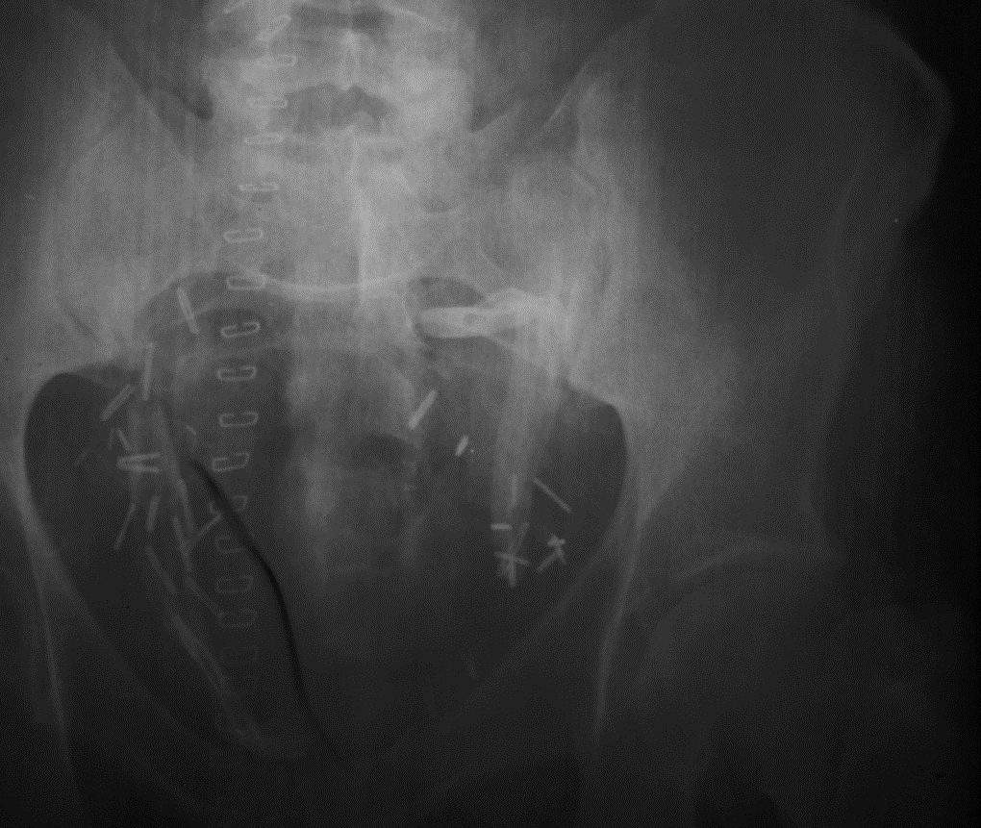
Jackson-Pratt surgical drain
Surgical J-P drains (arrowheads) are seen as radio-opaque band like structure with a radiolucent tubing in the surgical bed with multiple surgical clips (long arrows) and skin staples (short arrows)
These are used to drain post-operative fluid/seroma

Slide 40
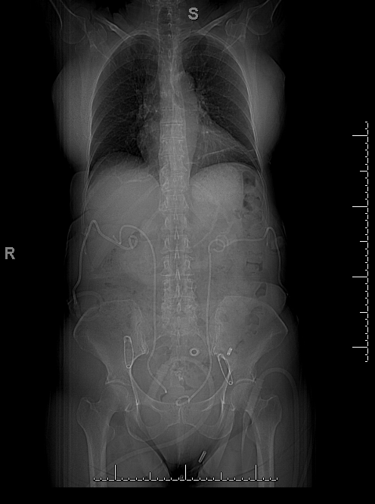
Nephrostomy tubes and Ureteral stents
Percutaneous nephrostomy (arrows) tubes used to treat obstructive uropathy/ hydronephrosis, ureteral injury/tumor
Loop should be at the level of renal hilar region, existing along the flanks
Ureteral stents (arrowhead) used for ureteral obstruction, leak, tumor
Proximal loop should be coiled at renal hilar region and distal loops in the bladder region

Slide 41
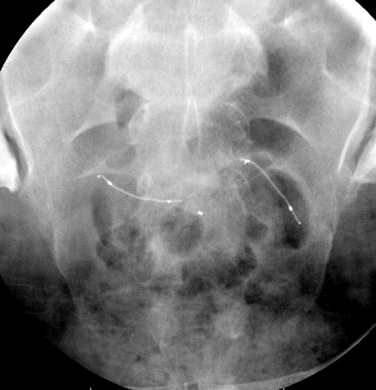
Essure contraception device
Minimally invasive procedure for contraception
Coils placed in the fallopian tubes, leading to fibrosis and occlusion
Appropriately positioned coils should lie across the uterotubal junction
Hysterosalpingography performed 3 months after placement is necessary to ensure proper positioning and confirm tubal occlusion

Slide 42
Osseous Metastases
During abdominal radiograph evaluation, careful attention to osseous structure is crucial
In this patient with prostate cancer, diffuse bone sclerosis from patients extensive sclerotic osseous metastases noted

Slide 43
Urinary Tract Calculi
Calcifications in the urinary tract should be actively sought out in abdominal radiographs
Clinical history can be often helpful
Patients may present with loin pain, with or without radiating pain to groin; hematuria is another useful feature which should make the radiologist to assess for urinary tract calculi
However, bladder calculi may be asymptomatic

Slide 44
Urinary Tract Calculi
Radiographs have lower sensitivity for detecting urinary tract calculi ( less than 60%)
The ability to detect urolithiasis on abdominal radiographs depend on its content
Urinary tract calculi made of uric acid tend to be radiolucent, while those composed of calcium tend to be radiopaque

Slide 45
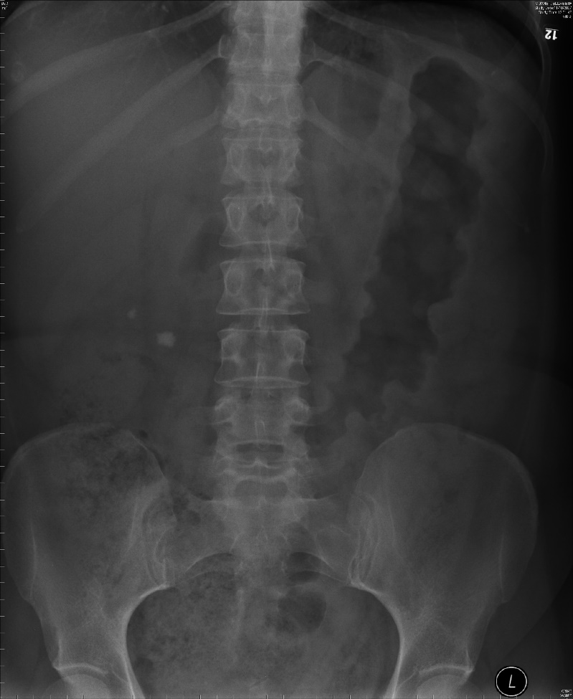
Renal Calculi
Patient presenting with right loin pain:
Right renal cacluli are seen. Also note presence
of thumb printing – Patient had ulcerative colitis

Slide 46
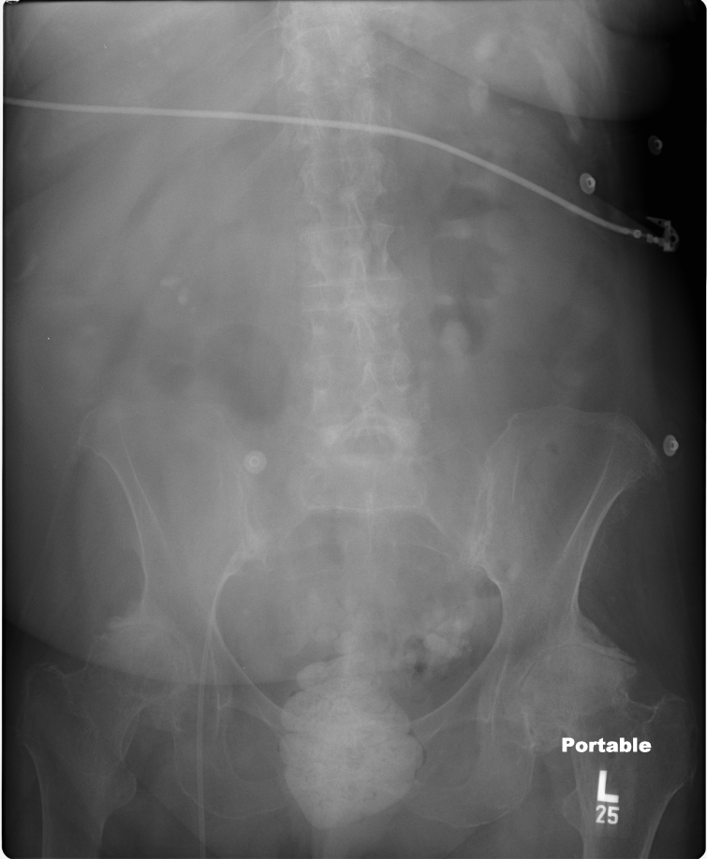
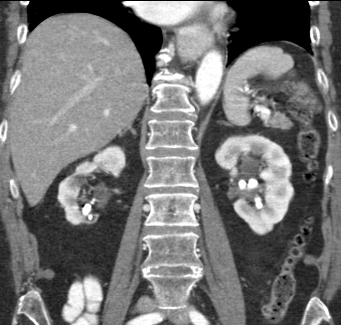
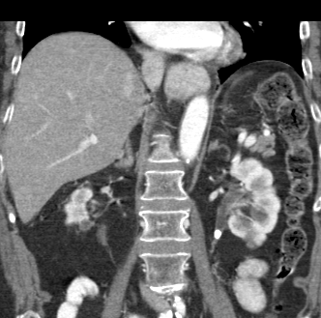
Renal Calculi
46 year old male with abdominal pain and hematuria:
Abdominal radiograph shows bilateral renal stones and left ureteric calculus.
CT scan shows the calculi more clearly and also depicts mild left hydronephrosis and hydorureter due to the obstructing proximal left ureteric stone

Slide 47
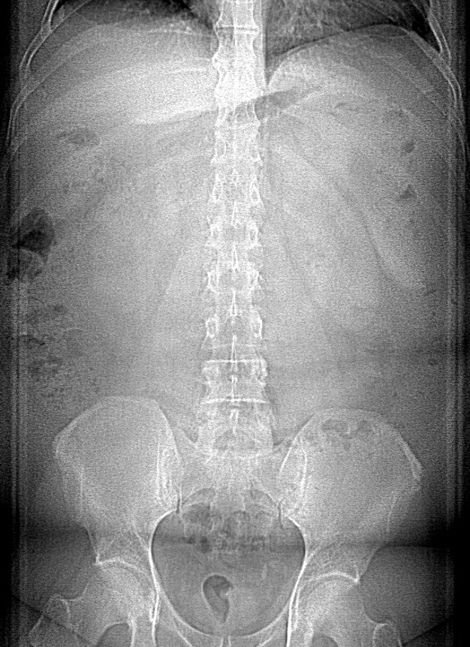
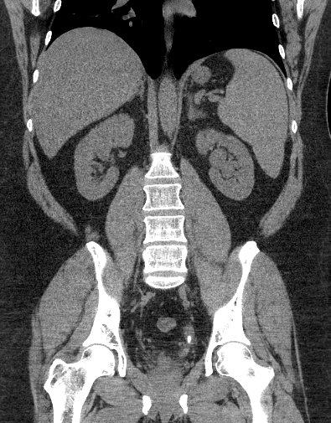
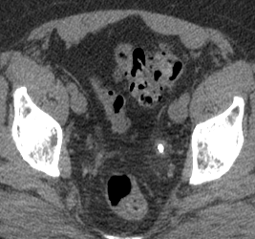
Ureteric Calculus
33 year old patient with acute left lower abdominal pain. There is a subtle calcific focus in the expected region of left ureter. CT renal stone protocol confirmed left ureteric stone

Slide 48
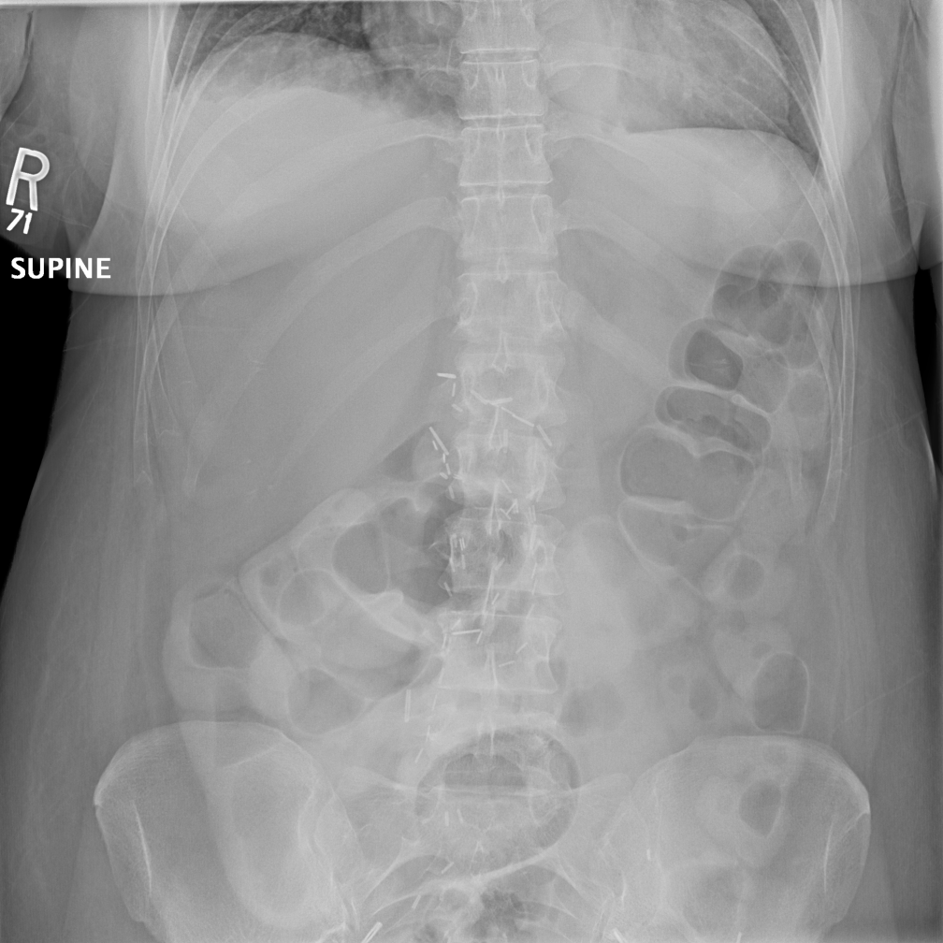
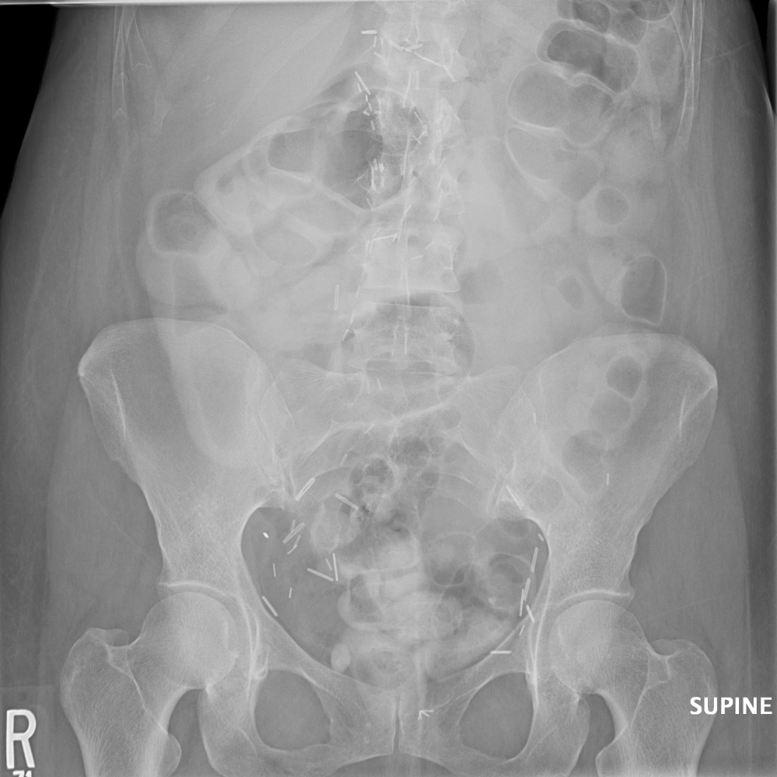
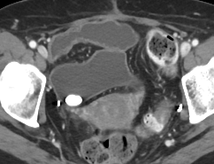
Bladder Calculus
52 year old patient with known metastatic urothelial carcinoma presented with abdominal distension: Abdominal radiographs do not show any evidence of abdominal obstruction or pneumoperitoneum. Incidental note was made of a 1.5 cm bladder calculus, which was confirmed on a staging CT scan.

Slide 49
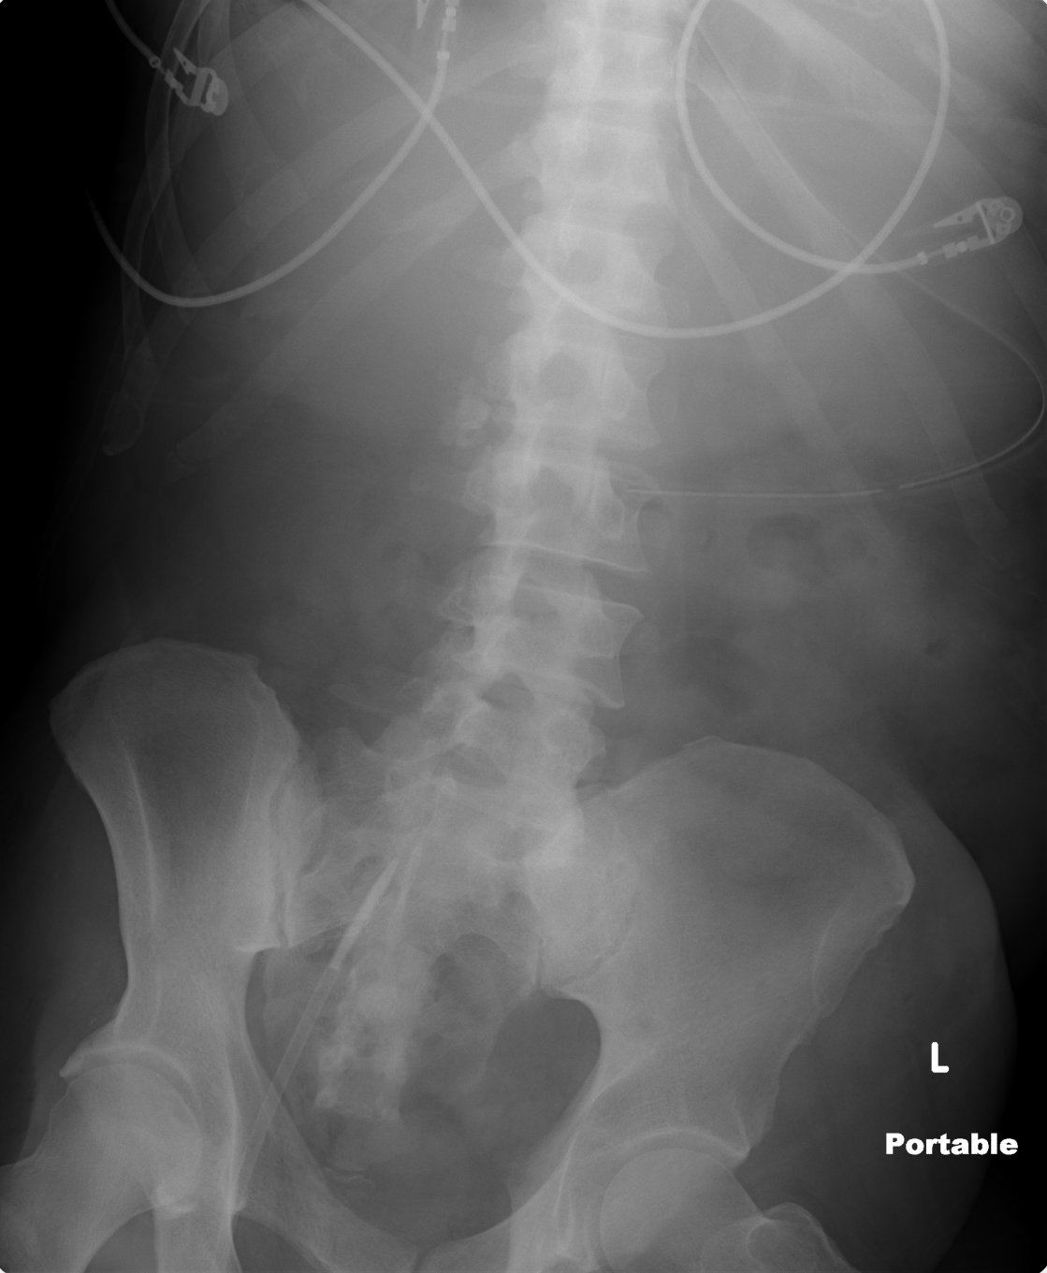
Gallstones
Abdominal radiographs may reveal gallstones
Only 15% of the gallstones are visible on radiographs ( non-calcified cholesterol stones are radiolucent)
This may be an incidental finding or patients may present with acute right upper quadrant pain/ biliary colic
Look for complications related to gallstones including gallstone ileus

Slide 50
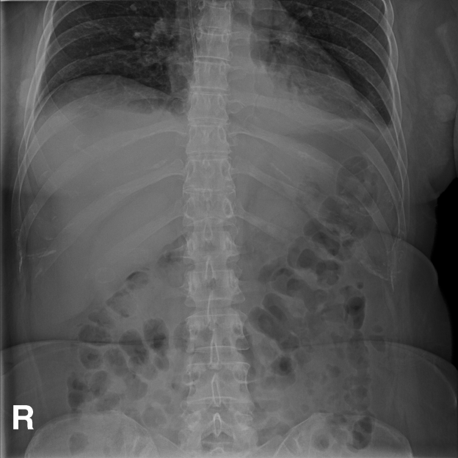
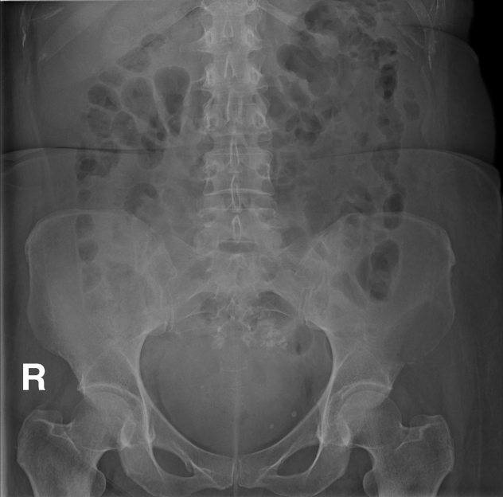
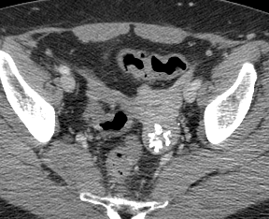
Uterine fibroids
52 year old patient with known metastatic urothelial carcinoma presented with abdominal distension: Abdominal radiographs do not show any evidence of abdominal obstruction or pneumoperitoneum. Incidental note was made of a 1.5 cm bladder calculus, which was confirmed on a staging CT scan.

Slide 51
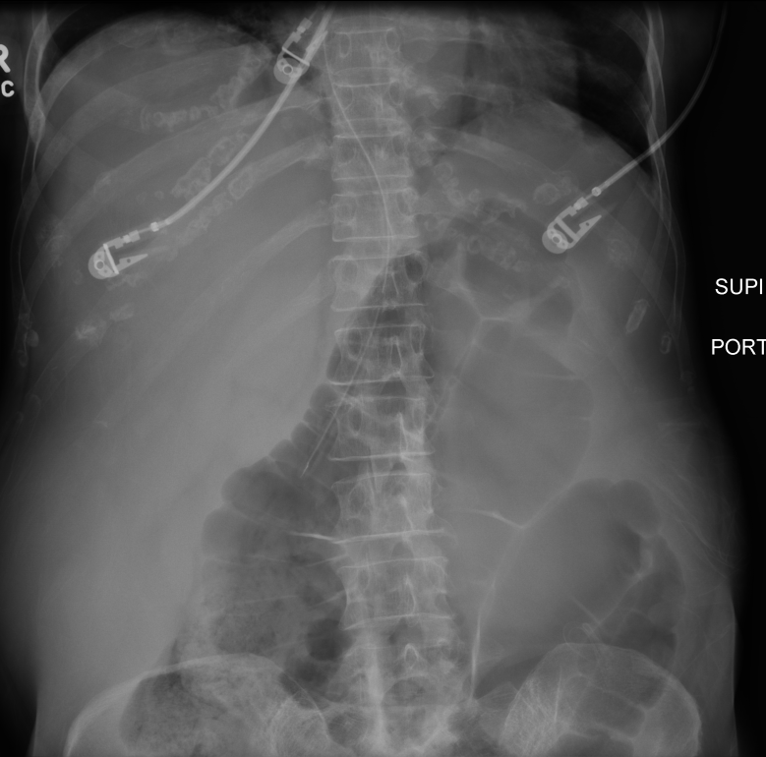
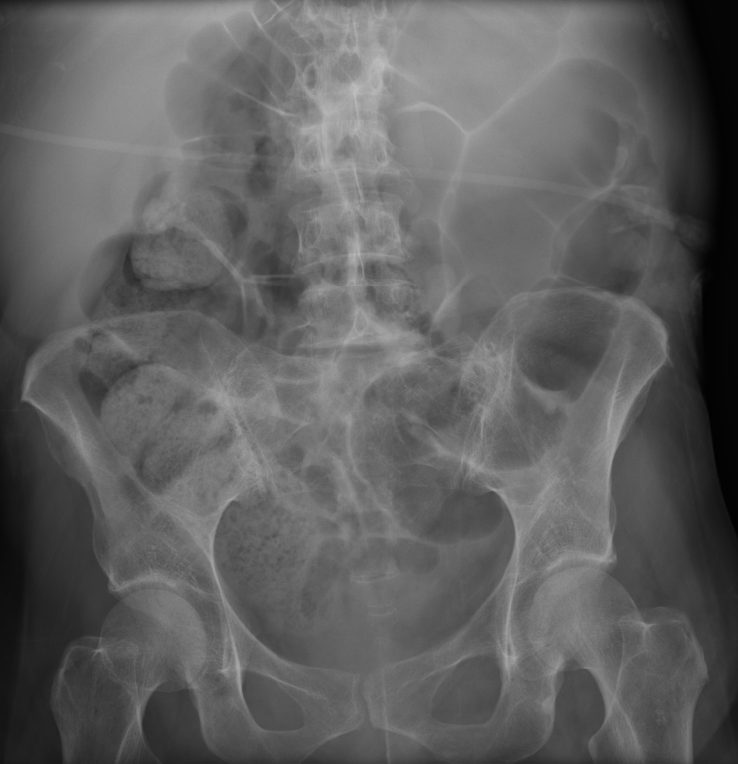

Organomegaly
44 year old patient with leukemia presented with abdominal distension: Abdominal radiographs showed ileus. There is also hepatomegaly and splenomegaly.
CT scan was performed after 1 week. Marked hepato-splenomegaly is clearly seen. Bone marrow confirmed leukemia.
Abdominal radiographs are not done for evaluating organomegaly. However, abdominal radiographs may be the first imaging modality to show this finding.
Hepatomegaly is defined as liver size >17 cm. Splenomegaly is defined as a spleen size >13 cm.

Slide 52
Summary
Attention to technique and clinical questions is important. Clinical history is often helpful
Apart for bowel findings and gas patterns, careful attention to lower chest, solid viscera, calcifications, bones and medical devices is needed
In cases with findings of unclear etiology, discussion with referring team is helpful
Unexpected or urgent radiographic findings should be promptly conveyed to the service as these may need further cross-sectional imaging

