Slide 1


How To Interpret Breast MRI
Kathryn Zamora, MD, MPH
University of Alabama Birmingham
Rebecca Leddy, MD
Medical University of South Carolina

Slide 2
Indications for MRI
Screening
  High-risk
  Intermediate risk (may be considered)
  Occult contralateral breast malignancy in the setting of newly diagnosed breast cancer (3-5%)
  Breast augmentation
Extent of Disease
  Multifocality and multicentricity
  Invasion of deep fascia
  Lumpectomy with positive margins
  Neoadjuvant therapy
Additional evaluation of clinical or imaging findings
  Recurrence of breast cancer
    Including patients with reconstruction
  Metastasis of Unknown primary
  Lesions characterization

Slide 3
Organized and Systematic Approach
Prior to interpretation review the following
  Clinical History
  MRI Technique
  Previous Exams

Slide 4
Quality Control Evaluation
Adequate Enhancement
Poor positioning
Field of View
Motion
Inadequate fat suppression

Slide 5
Look for Contrast Bolus
Contrast bolus is easily identified in the heart.
T1
SUBTRACTION
The bolus may be difficult to evaluate on TI
No Contrast
SUBTRACTION
Contrast

Slide 6
Evaluate the Field of View
?
More superior images do not include the Axilla
Ultrasound demonstrates an abnormal level 1 axillary lymph node not imaged on the MRI
?
Left upper outer quadrant IDC
FOV is too small

Slide 7
Asses for Motion
Motion may limit evaluation of subtle non mass enhancement and may cause mis-registration artifact on subtraction images.
Mis-registration artifact from T1 hyperintense material in the ducts may appear as non mass enhancement on the MIP and subtraction images.
T1 Pre Contrast FS
MIP
Subtraction
Use T1 pre and post to confirm if enhancement is real

Slide 8
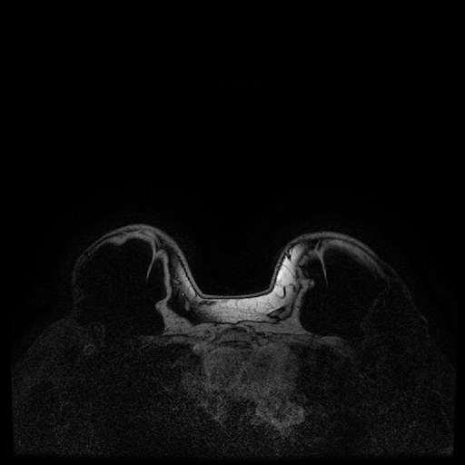
Evaluate for Adequate Fat Saturation
Inadequate Fat Sat limits evaluation of the region.

Slide 9
Evaluate Background Parenchymal Enhancement (BPE)
NOT related to breast density
Evaluate Maximum Intensity Projection (MIP) and 1st post contrast sequence
MINIMAL
MILD
MODERATE
MARKED

Slide 10
Image Interpretation
Sequences:
T2 weight imaging
T1 non fat sat images
Post Contrast
  Maximum Intensity Projection (MIP)
  Source images (not subtracted)
  Subtracted
    axial and sagittal
Kinetics
Correlate with mammogram and ultrasounds

Slide 11
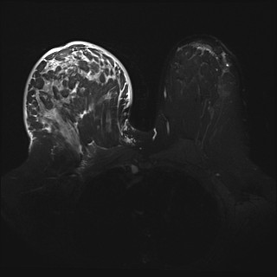
T2 weighted sequences
T2 hyperintense lesions have a higher likelihood of being benign
  (Exception: mucinous carcinoma)
Edema
Skin changes
Fluid collections
Lymph nodes
Fibroadenomas (sometimes)
Fibrocystic change
Cysts
Duct ectasia
Inflammatory Breast Cancer - Breast Edema and Skin Thickening

Slide 12
T2 Hyperintense mass
Dark Internal Septations
T2
Subtraction
Fibroadenoma
Notes:
Fibroadenoma

Slide 13
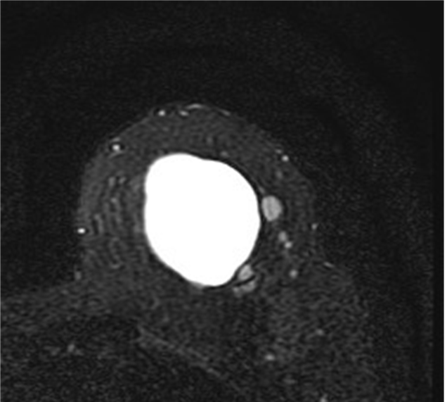
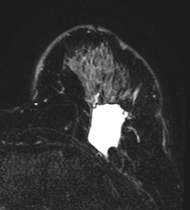
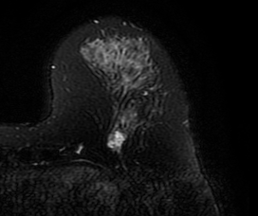
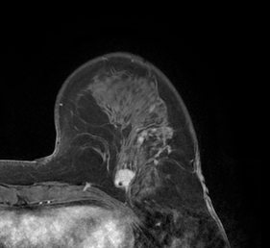
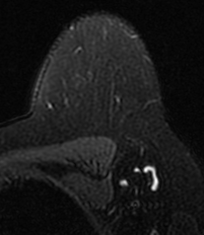
T2 Hyperintense Lesions
CAUTION
Cyst
Post Operative Seroma
T2
T1 Postcontrast
Mucinous Carcinoma
may be T2 hyperintense
Lymph Node

Slide 14
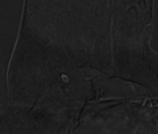
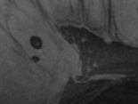
T1 Non Fat Sat
T1 post contrast fat sat
Asses for fat
  Fat containing masses
  Fat necrosis
  Lymph nodes
Evaluate margin and mass effect
Demonstrate susceptibility artifact (blood, clips)
T1 non fat sat
T1 hyperintense fat
Benign lymph node

Slide 15
T1 Non Fat Sat
Subtraction
T1 non fat sat
Hamartoma
Fat Necrosis
Subtraction
T1 post contrast fat sat
T1 non fat sat
Notes:
47 year with left idc s/p mastectomy who wants reconstruction

Slide 16
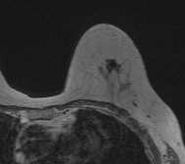
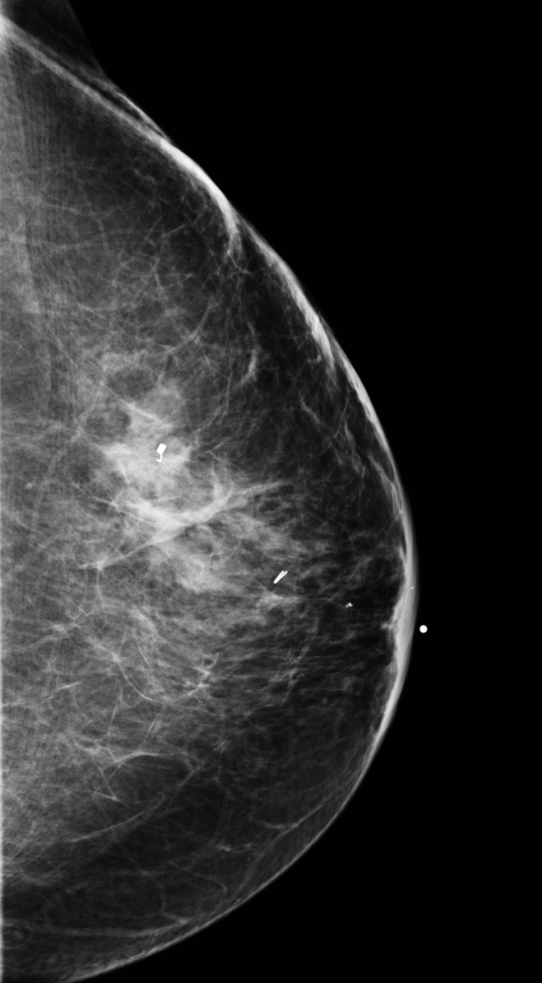
Susceptibility Artifact
clip
T1 non fat sat

Slide 17
Post Contrast Imaging
Review peak subtraction images
  Identify areas of enhancement
  Determine if it is real (exclude artifact)
    Interrogate pre and post imaging
  Location (quadrant, clock)
  Characterize the type of enhancement
  Associated features: Involvement skin, nipple, chest wall

Slide 18
Characterize Types of Enhancement
MRI BIRADS Terminology: Types of enhancement (Mass versus Non-mass enhancement)

Slide 19
Non-mass enhancement
Distribution
  SEGMENTAL
Internal Enhancement pattern
  CLUMPED
MIP
Subtraction

Slide 20
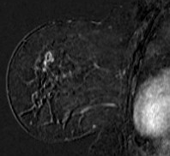
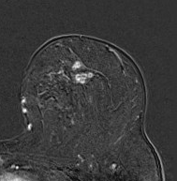
Non-mass enhancement
Distribution
  FOCAL
Internal Enhancement pattern
  CLUSTERED RING
Sagittal Subtraction
Axial Subtraction

Slide 21
Mass
Shape
  IRREGULAR
Margins
  NOT CIRCUMSCRIBED
  IRREGULAR
Internal Enhancement pattern
  HOMOGENOUS
Sagittal Subtraction
Sagittal MIP

Slide 22
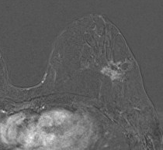
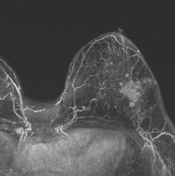
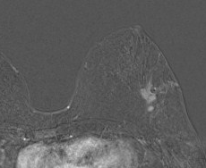
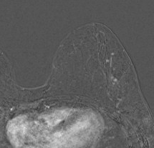
Maximum Intensity Projection MIP
Shape
  IRREGULAR
Margins
  NOT CIRCUMSCRIBED
  IRREGULAR
Internal Enhancement pattern
  HOMOGENOUS
Multiple additional satellite masses
Total Extent of Disease
Axial Subtraction

Slide 23
Further characterization of enhancement
Analyze region of enhancement on other sequences
  T1 non Fat Sat
  T2 weighted images
  T1 post contrast non subtracted (source)
  Sagittal post delayed
    Size, distribution, position, shape
Evaluate the delayed imaging
  Especially important in neoadjuvant response to therapy examination
  Source images (not subtracted):
    Evaluate musculature, axilla, skin, findings outside breast, nipple areolar complex
    Pectoralis muscle involvement is not considered chest wall invasion
Correlate with mammogram and ultrasounds

Slide 24
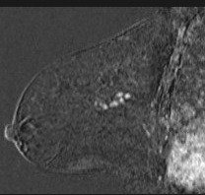
Sagittal Imaging
Further characterization of enhancement
Aids in evaluation of size, distribution, position, shape

Slide 25
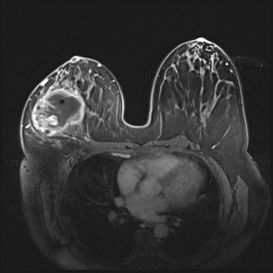
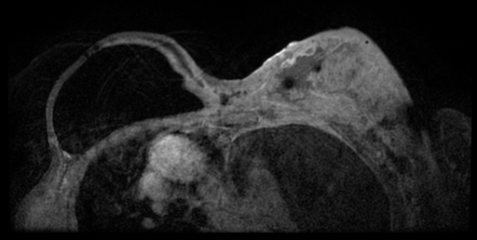
Source (Non subtracted) Imaging
Evaluate involvement chest wall, musculature, skin, nipple areolar complex
Axilla
Evaluate findings outside breast
Pectoralis Muscle
Chest wall
Pectoralis Muscle Invasion Chest Wall Invasion

Slide 26
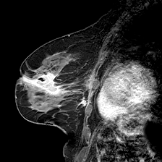
Source (Non subtracted) Imaging
Evaluate involvement chest wall, musculature, skin, nipple areolar complex
Axilla
Evaluate findings outside breast
Nipple areolar complex
T1 post contrast fat sat

Slide 27
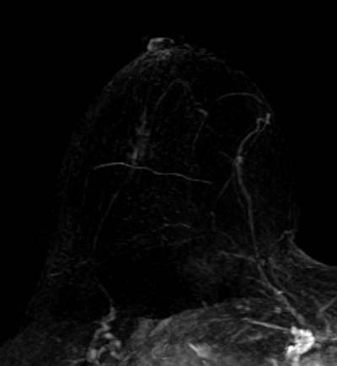
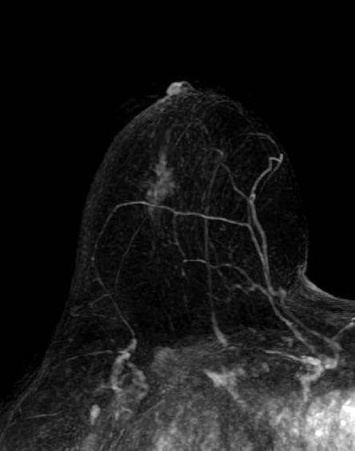
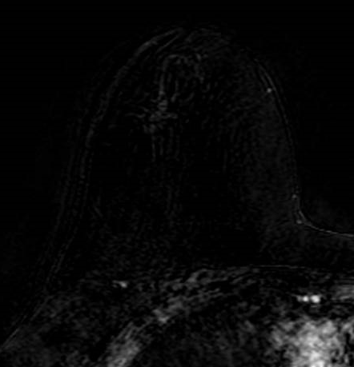
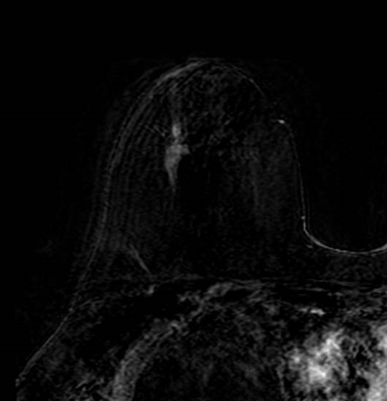
Delayed Post Contrast Imaging
Response to Neoadjuvant Systemic Therapy
Delayed post contrast may assist in the detection of residual disease in patient undergoing neoadjuvant systemic therapy
MIP early post contrast
MIP delayed post contrast
Subtraction early post contrast
Subtraction delayed post contrast

Slide 28
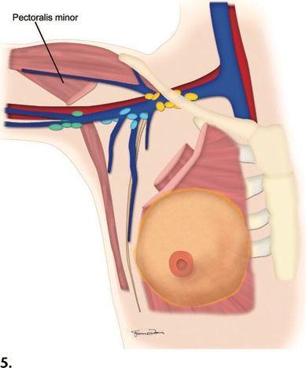
Evaluation of Axillary
Lymph Nodes
Level I - lateral to the lateral border of the pectoralis minor muscle
Level II - between the medial and lateral borders of the pectoralis minor muscle and also include the interpectoral (Rotter’s) lymph nodes.
Level III - medial to the medial margin of the pectoralis minor muscle and inferior to the clavicle.
Pectoralis Minor
LEVEL 3
LEVEL 2
LEVEL 1
Notes:
American Joint Committee on Cancer’s Staging System for Breast Cancer, Eighth Edition: What the Radiologist Needs to Know

Slide 29
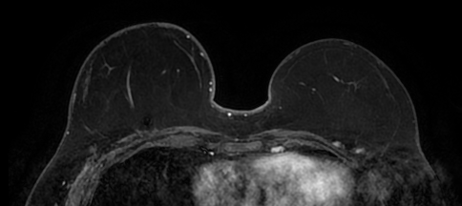
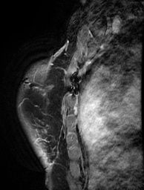
Evaluation of Lymph Nodes
Internal mammary chain lymph nodes
  Changes the radiation field
  5mm or greater
Axial T1 post contrast fat sat
Enlarged internal mammary chain lymph node
Sagittal T1 post contrast fat sat

Slide 30
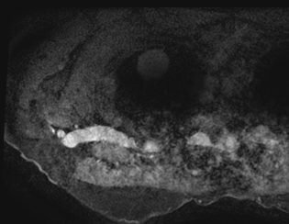
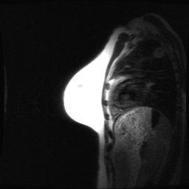
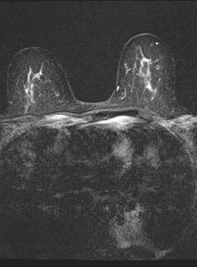
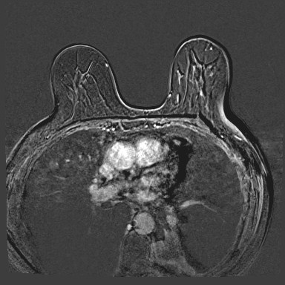
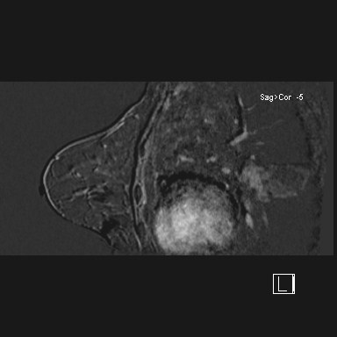
Evaluation of Areas Outside of Breast
Non breast finding
  Review localizer images
  T2
  Source images (non subtracted)
T1 POST FS
LOCALIZER
Phyllodes pulmonary metastasis
Lung Cancer incidentally seen breast MRI

Slide 31
KINETIC Evaluation
Evaluate LAST
May assist in final management
If suspicious finding identified on kinetics, then review
  Possibly a benign lymph node
  Area of fat necrosis

Slide 32
Kinetic Curves
Type 1
  Rapid rise and persistent
  6% change of malignancy
Type 2
  Rapid rise and plateau
Type 3
  Rapid rise and washout
  29-77% chance of malignancy

Slide 33
Summary
Apply an Organized and Systematic Approach
Review indication, history and prior exams
Evaluate Exam Quality
Determine Background Parenchymal Enhancement
Identify imaging findings and evaluate thoroughly on all sequences
Utilize kinetics
Remember to look outside of breast for any abnormalities

