Slide 1


Approach to Normal MRI Brain

Slide 2
MRI Sequences
T1 and T2 weighted sequences:
On T1: white matter appears white & grey matter appears grey & CSF is black
On T2: It is the opposite. CSF is hyperintense, thalamus is darker than the corpus striatum (putamen & caudate) which are darker than cortical grey

Slide 3
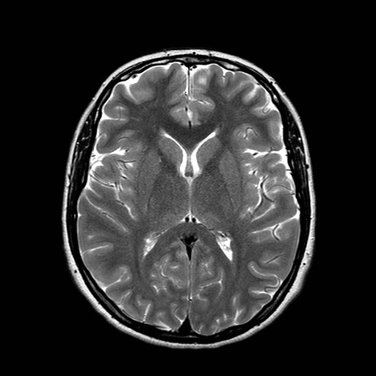
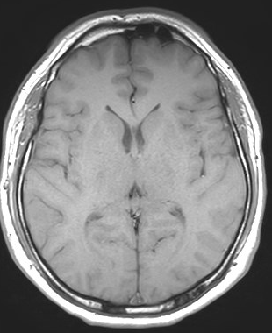
Examples of T1 and T2 images
Foramen
of
Monro
Lentiform
Nucleus
Caudate
Nucleus
Thalamus
  T 1 weighted T2 weighted

Slide 4
T1 hyperintense (bright) lesions i.e. short T1 lesions
High protein: e.g. Rathke cleft cyst
Mineralization
Fat & cholesterol
Subacute hemorrhage (Meth Hb)
Subacute thrombus
Manganese (e.g. in striatum in liver disease)
Melanin

Slide 5
T1 hypointense (dark) lesions i.e. lesions with T1 prolongation:
CSF
Edema
Chronic hemorrhage
Air
flow in blood vessels
Low protein

Slide 6
T2 hyperintense (bright) lesions i.e. long T2
Sensitive for many pathologies, edema or gliosis
Edema
Gliosis
CSF

Slide 7
T2 hypointense (dark) lesions i.e. short T2
Calcification
Air
Fibrous tissue
Acute hemorrhage
Very chronic hemorrhage (hemosiderin)
High protein
Calcium
flow in blood vessels
Metal

Slide 8
FLAIR (fluid-attenuated inversion recovery)
Sensitive but not specific
a type of T2 but CSF is black.
FLAIR: Helps identify pathologies. shows areas next to CSF (periventricular) very well. Also good for juxtacortical areas.
Inferior quality to other sequences in posterior fossa and spinal cord.

Slide 9
FLAIR
Helps differentiate VR space from Lacunar infarct
Causes of FLAIR hyperintensity in sulci
SAH
High protein (meningitis, neoplastic)
High oxygen tension (intubation & ventilation)
Artifact.

Slide 10
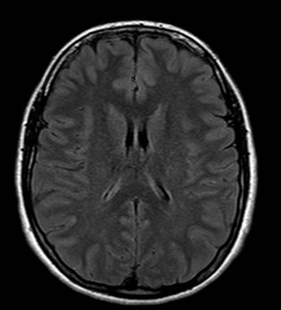
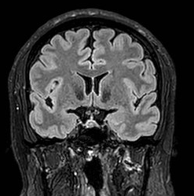
FLAIR image
Suppression
Of normal
fluid in
Ventricles & sulci

Slide 11
Diffusion weighted imaging
Diffusion imaging uses diffusion of water molecules. Calculates apparent diffusion coefficient ADC that can be displayed on a separate scan.
Detects changes in local deoxy- and oxy-hemoglobin ratios, helps localize cognitive (including language) & other functions
Apparent diffusion coefficient, ADC:
Decreased in cytotoxic edema i.e. opposite to diffusion i.e. true DW restriction i.e. infarct or abscess.
Increased from a T2 effect ‘T2 shine-through’ i.e. same as diffusion.
Restricted diffusion= high signal on DWI & low signal on ADC

Slide 12
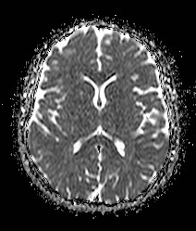
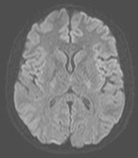
Images of DWI and ADC
DWI
ADC

Slide 13
Increased DWI seen in
acute ischemic stroke
Important to evaluate for diffusion restriction also in
encephalitis like herpes
focal seizure
Infections (like abscess, CJD)
Tumors and tumor treatment response (egs like medulloblastoma, epidermoid cyst)
Asses extent of diffuse axonal injury
Asses active demyelination

Slide 14
GRE & SWI sequences
Detects hemorrhage (hemosiderin) well. Low intensity (called susceptibility artifact or T2* effect).
Diffuse axonal injury
Hypertension and amyloidosis
Multiple cavernomas
Evaluation of Venous sinus/cortical vein thrombosis.
Infections

Slide 15
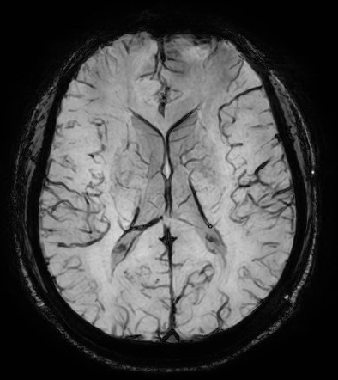
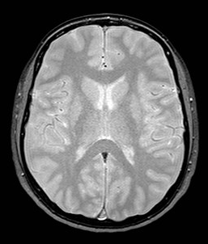
GRE and SWI
T2 *
SWI

Slide 16
Normal structures that enhance on MRI
Structures outside the blood-brain barrier like
Dura
Adenohypophysis and pituitary stalk
Pineal gland
Choroid plexus
Nasal mucosa
Tuber cinereum
Area postrema

Slide 17
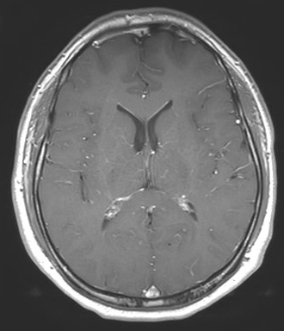
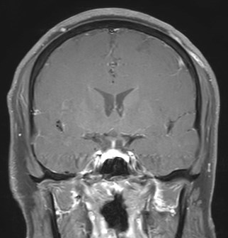
T1 +Gadolinium
Enhancing
Choroid
Plexus
Enhancing
Pituitary gland
& stalk

Slide 18
Disruption of normal blood brain barrier causes enhancement of different lesions on MRI.
Enhancement may be seen in :
Tumors
Infections
Inflammatory conditions such as active demyelinating lesions
Subacute areas of ischemia

Slide 19
Sagittal images
Scroll and look at midline image (in the mid-sagittal plane) from bottom to top. Then look laterally at the parasagittal planes. Observe the normal and abnormal structures.
Foramen magnum & base of skull including cerebellar tonsils
Clivus and nasopharynx
Fourth ventricle and Cerebellar vermis
Sella, pituitary & optic chiasm
Corpus callosum
Superior sagittal sinus
Visualized cervical spine

Slide 20
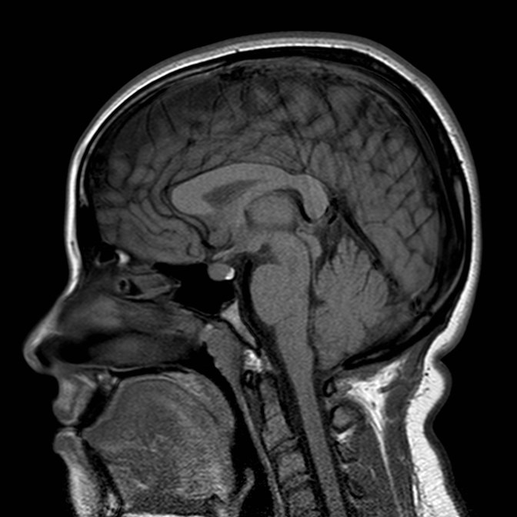
Corpus
Callosum
Calvarial
marrow
Pituitary
Mamillary body
Clivus
Cerebellar Tonsils

Slide 21
When interpreting the axial images follow a systematic approach. Scroll through the MRI from bottom to top interpreting each of these systems or areas at a time. The CSF system (ventricles, cisterns and sulci), the brain matter (grey matter structures and white matter structures), the vessels and venous sinuses, the meninges and skull and adjacent tissues. And finally the extended search i.e. review areas (paranasal sinuses, orbits, nasal cavity, visualized tongue and face).

Slide 22
Ventricles, cisterns & sulci
When ventricles, cisterns, fissures or sulci are “squashed” we use the term effaced. When they are large we just describe them as large or enlarged. The different CSF spaces should be interpreted together for example, effaced sulci tell us that the enlarged ventricles likely represent hydrocephalus. Whereas enlarged sulci and enlarged ventricles likely represent brain volume loss
Ventricles:
Lateral ventricles (frontal, occipital & temporal horns), Third ventricle, fourth ventricle
Cisterns & fissures:
Quadrigeminal plate cistern, interpeduncular cistern, ambient cistern, suprasellar cistern
Sulci:
Appearance: effaced, obscured
Ventriulo-sulcal proportionality

Slide 23
Brain Grey & white matter
Midline shift
Grey white differentiation
Structures:
Caudate nucleus, Internal capsule, Putamen & globus pallidus, thalamus.
Other structures: centrum semiovale, midbrain, pons, medulla, cerebellum

Slide 24
Vessels: arteries, veins & venous sinuses
Arteries: basilar, carotid arteries, vertebral artery, middle cerebral arteries
Venous: Superior sagittal sinus, torcula, transverse sinus, sigmoid sinus, internal jugular vein

Slide 25
Meninges
Dural involvement/enhancement look at (falx, tentorium, CP angle)
Leptomeningeal enhancement look at (basal cisterns, cerebellar folia, sulcal perivascular spaces)

Slide 26
Extended search
Sella, pituitary & optic chiasm
Paranasal sinuses (ethmoidal, sphenoid, frontal, mastoid), temporal bone/ears
Orbits
Nasopharynx, Oropharynx

