Slide 1
HOW TO APPROACH THE RADIOGRAPHIC DIAGNOSIS OF FRACTURES AND DISLOCATIONS
Charles S. Resnik, M.D.
Professor of Radiology
University of Maryland School of Medicine

Slide 2
HOW NOT TO MISS FRACTURES OR DISLOCATIONS
Follow every cortex
Lines and curves are good, angles are bad
Follow every articular surface
Make sure each is congruent with its partner
Radiolucent or sclerotic fracture lines
Think in three dimensions
Look in every corner
Remember satisfaction of search

Slide 3
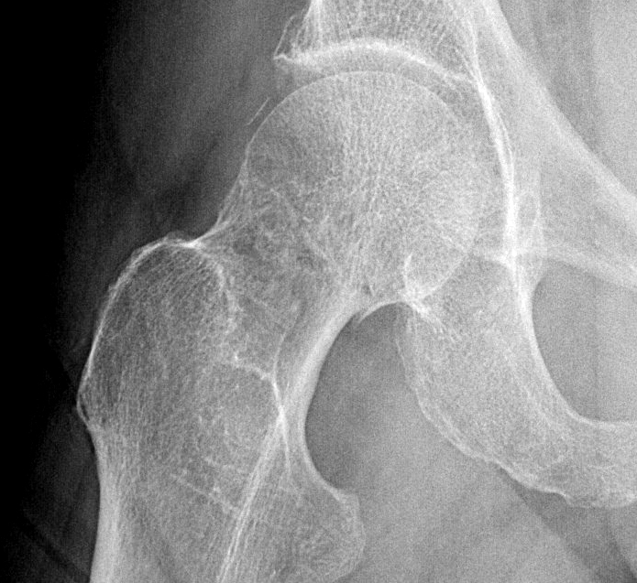
Follow every cortex

Slide 4
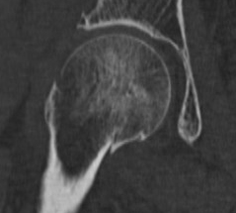
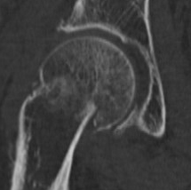
Follow every cortex
Fracture

Slide 5
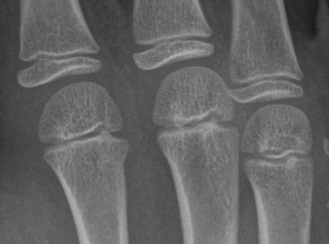
Follow every cortex

Slide 6
Follow every cortex
Lines and curves are good (normal)

Slide 7
Follow every cortex
Lines and curves are good (normal)
Angles are bad (fracture)

Slide 8
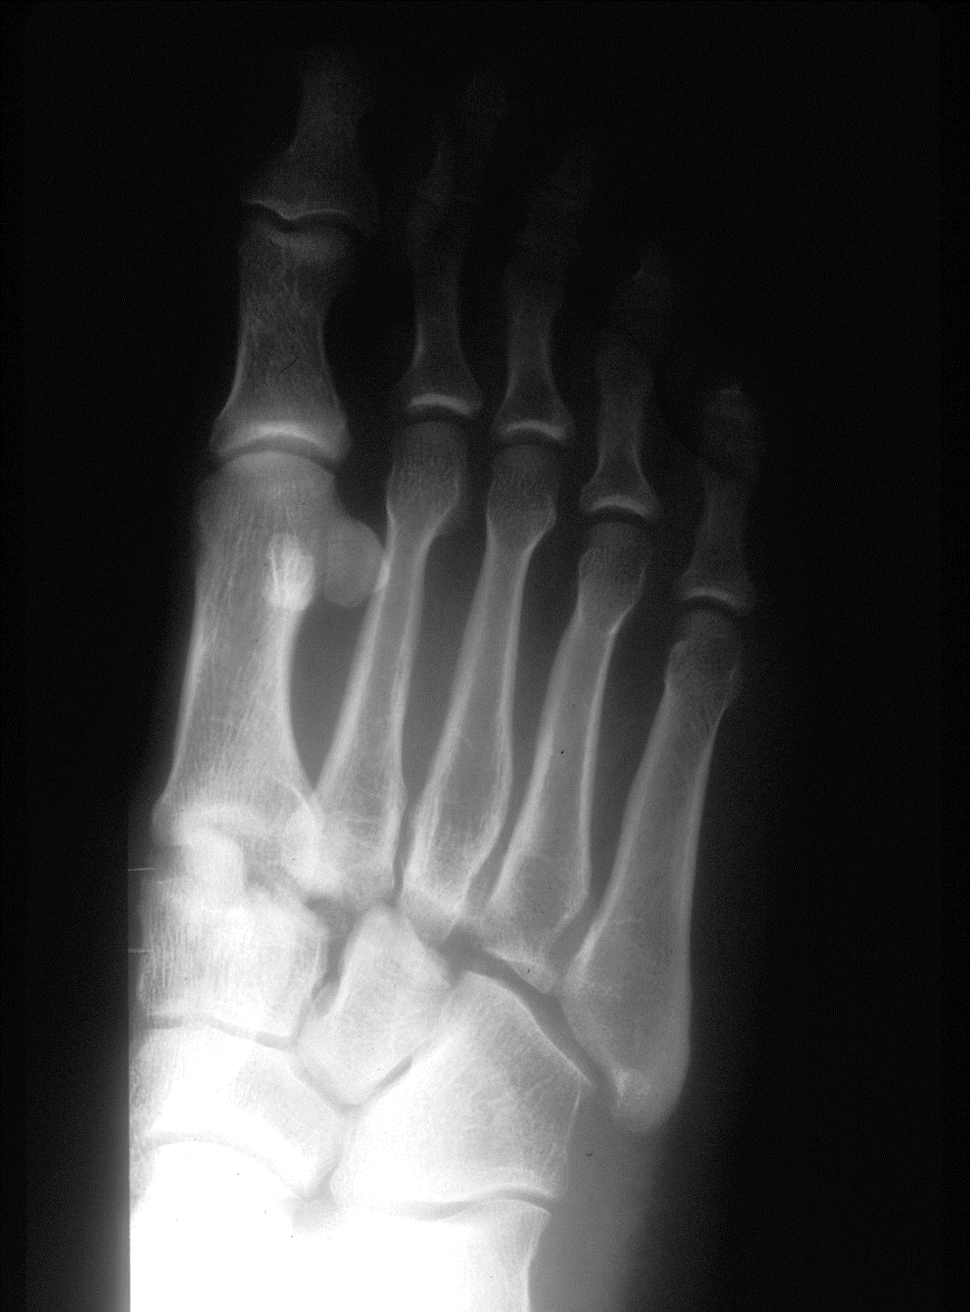
Follow every articular surface

Slide 9
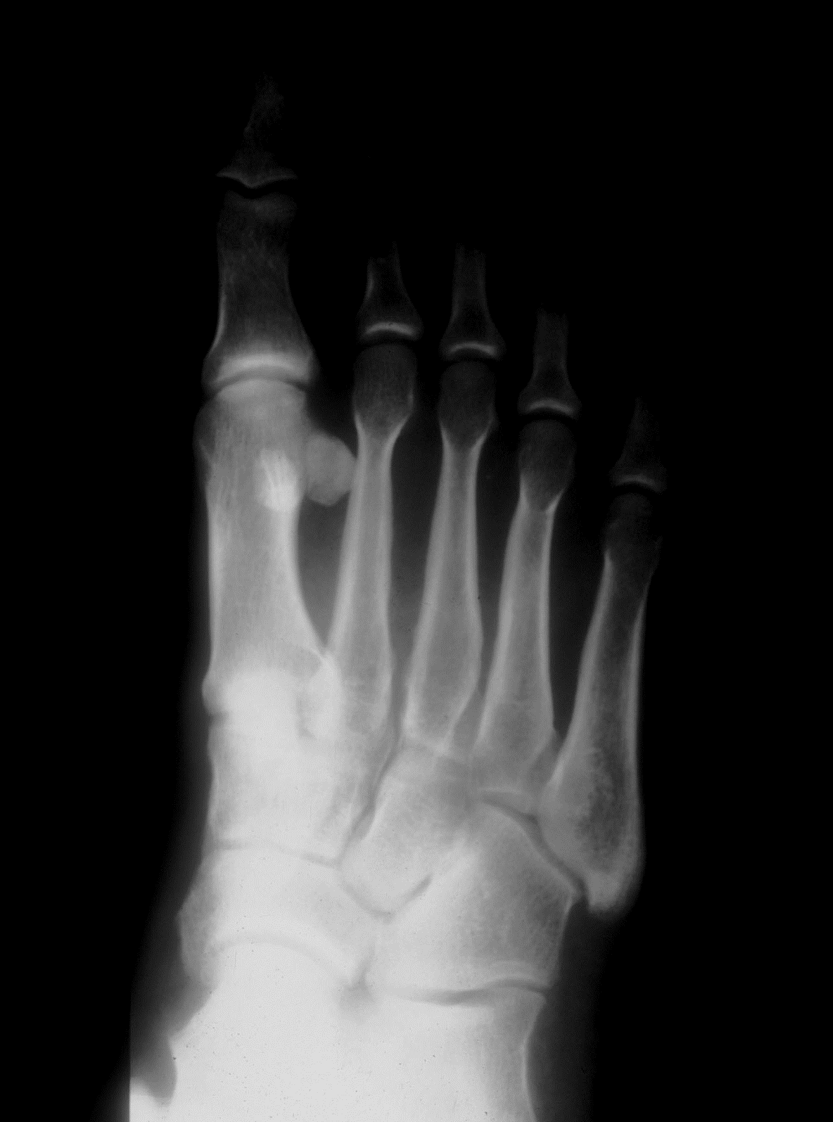
Follow every articular surface
Pre-injury comparison
Normal

Slide 10
Follow every articular surface
Pre-injury comparison
Dislocation
Normal

Slide 11
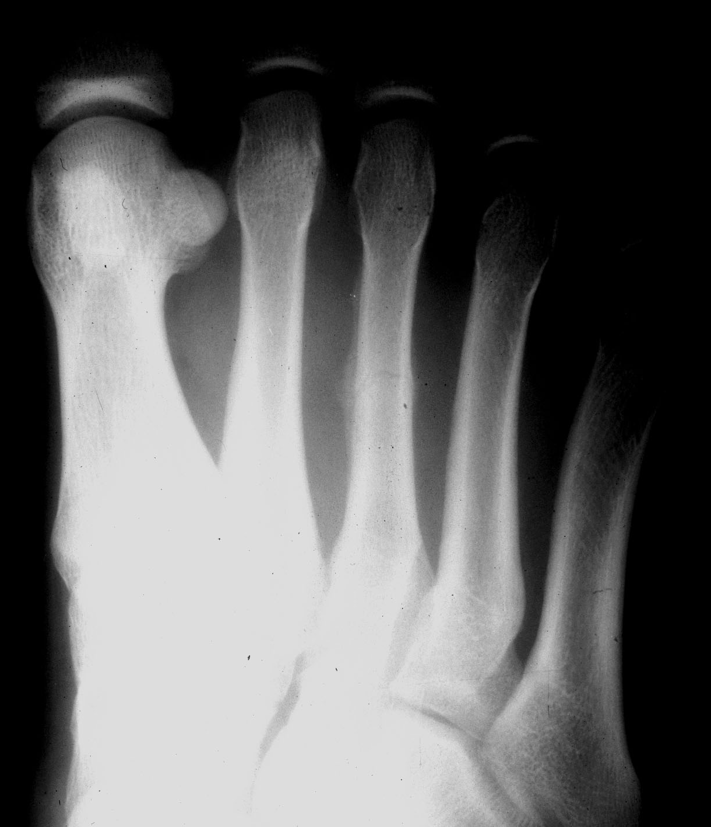
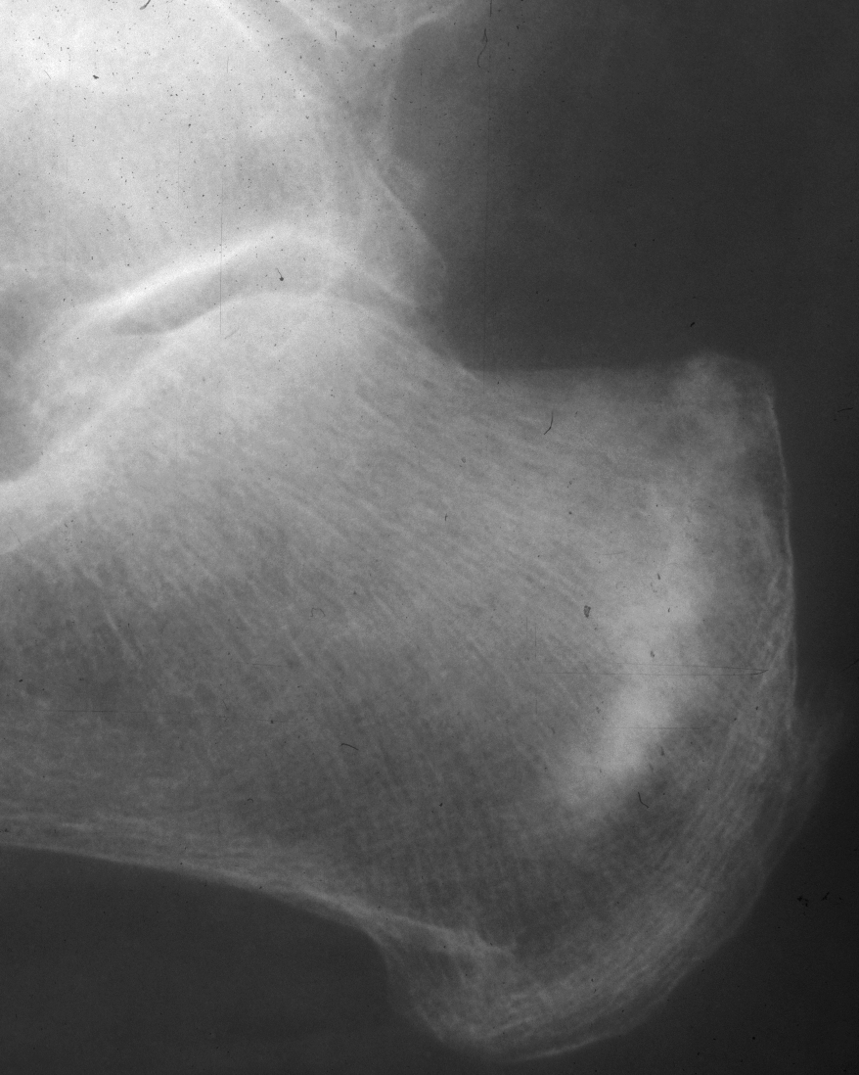
Radiolucent fracture line
Sclerotic fracture line

Slide 12
Radiolucent stress fracture
Sclerotic stress fracture

Slide 13
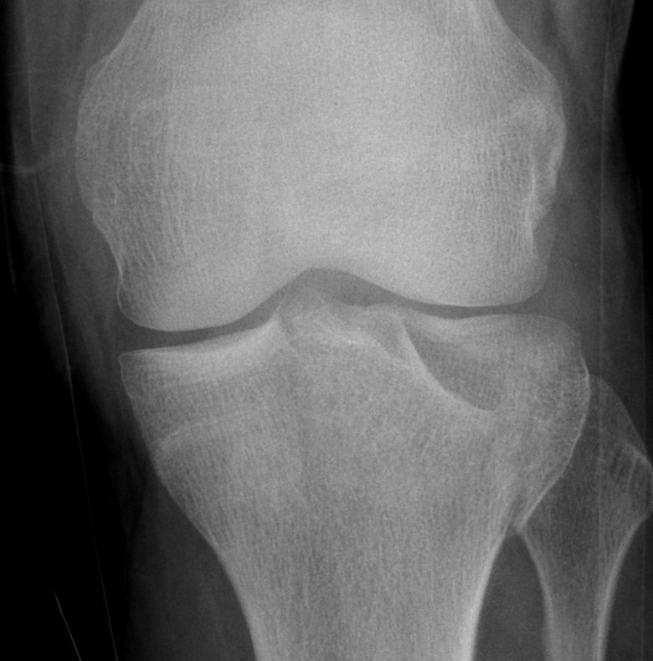
Think in three dimensions

Slide 14
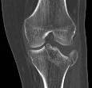
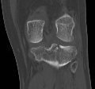
Think in three dimensions
Depressed fracture

Slide 15
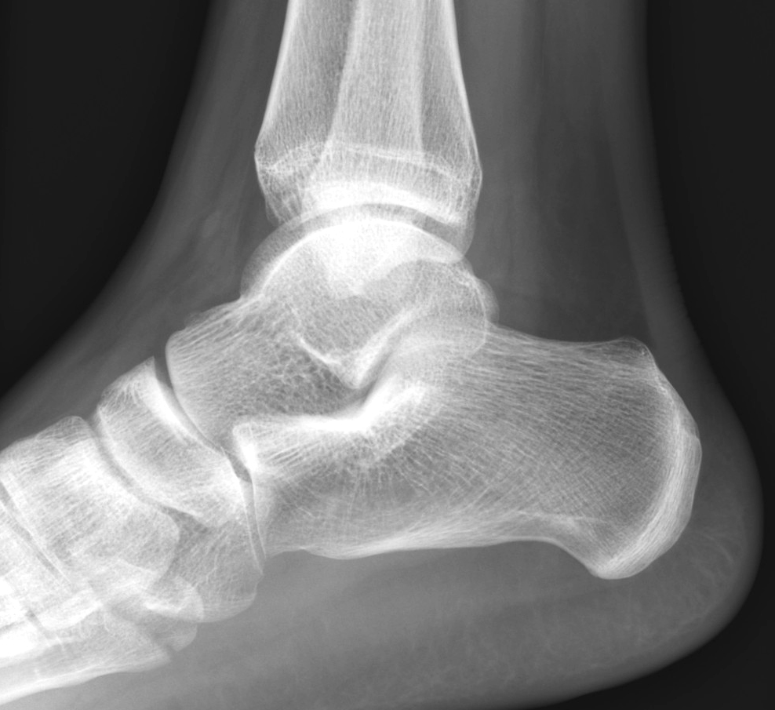
Look in every corner

Slide 16
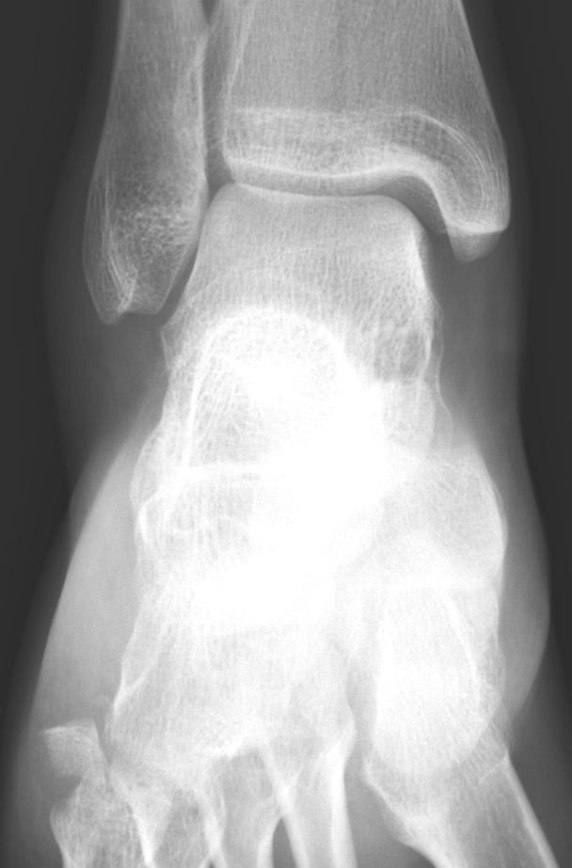
Look in every corner

Slide 17
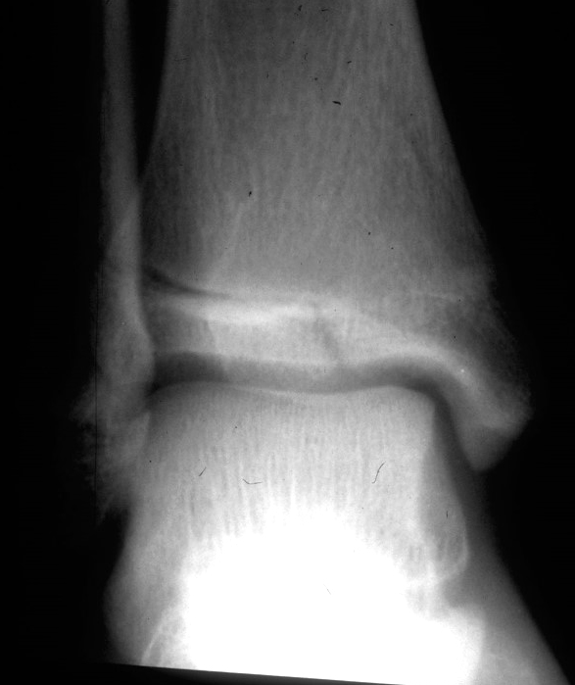
Remember satisfaction of search

Slide 18
Remember satisfaction of search
Fracture

Slide 19
Remember satisfaction of search
Second fracture
Fracture

Slide 20
Remember satisfaction of search
Triplane fracture
Coronal component
Sagittal component

Slide 21
HOW NOT TO MISS FRACTURES OR DISLOCATIONS
Follow every cortex
Lines and curves are good, angles are bad
Follow every articular surface
Make sure each is congruent with its partner
Radiolucent or sclerotic fracture lines
Think in three dimensions
Look in every corner
Remember satisfaction of search

