Slide 1


How to Approach an Abdominal CT
Shelby Fishback
Keith Herr

Slide 2
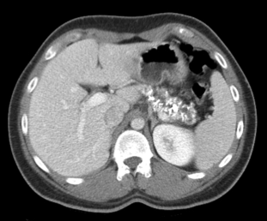
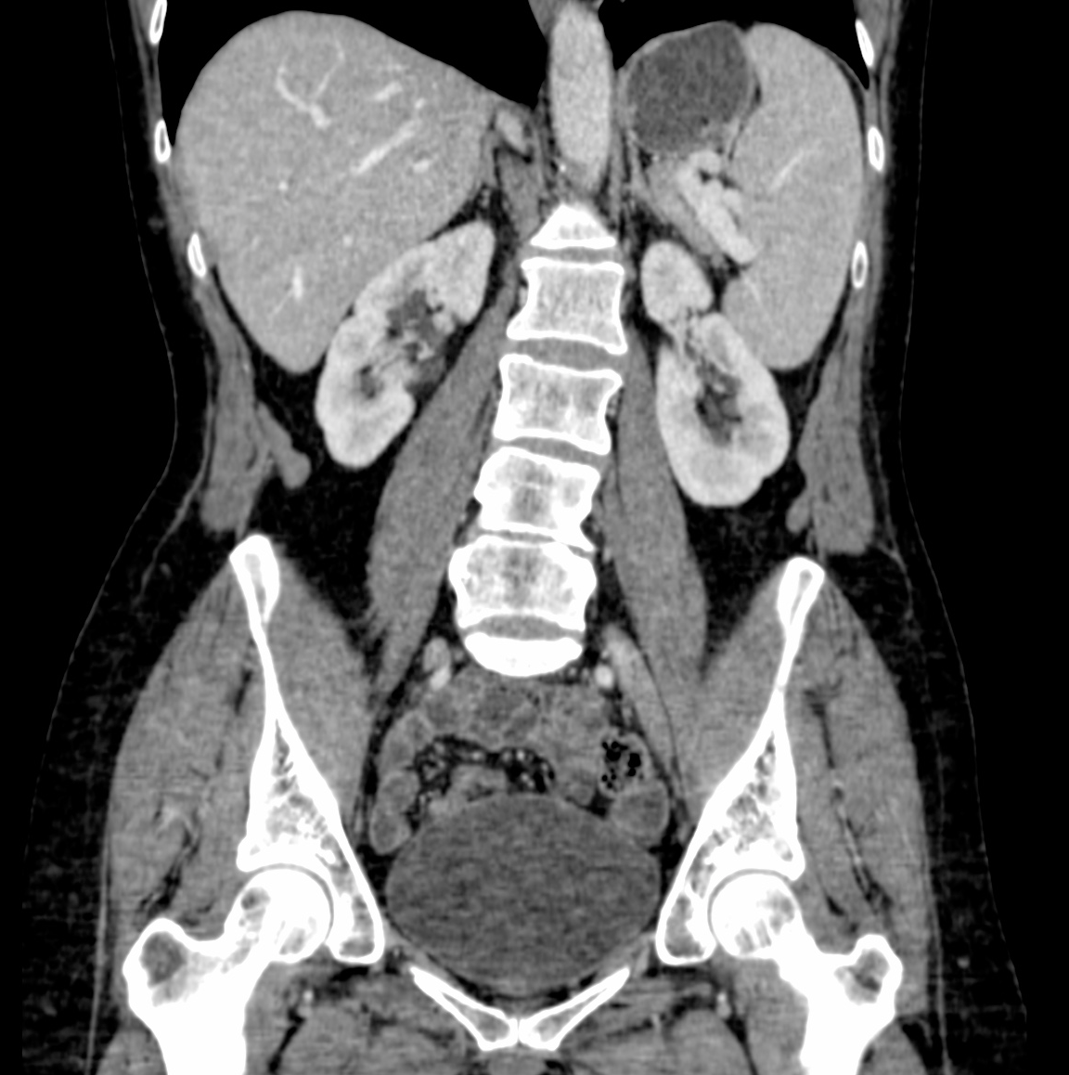
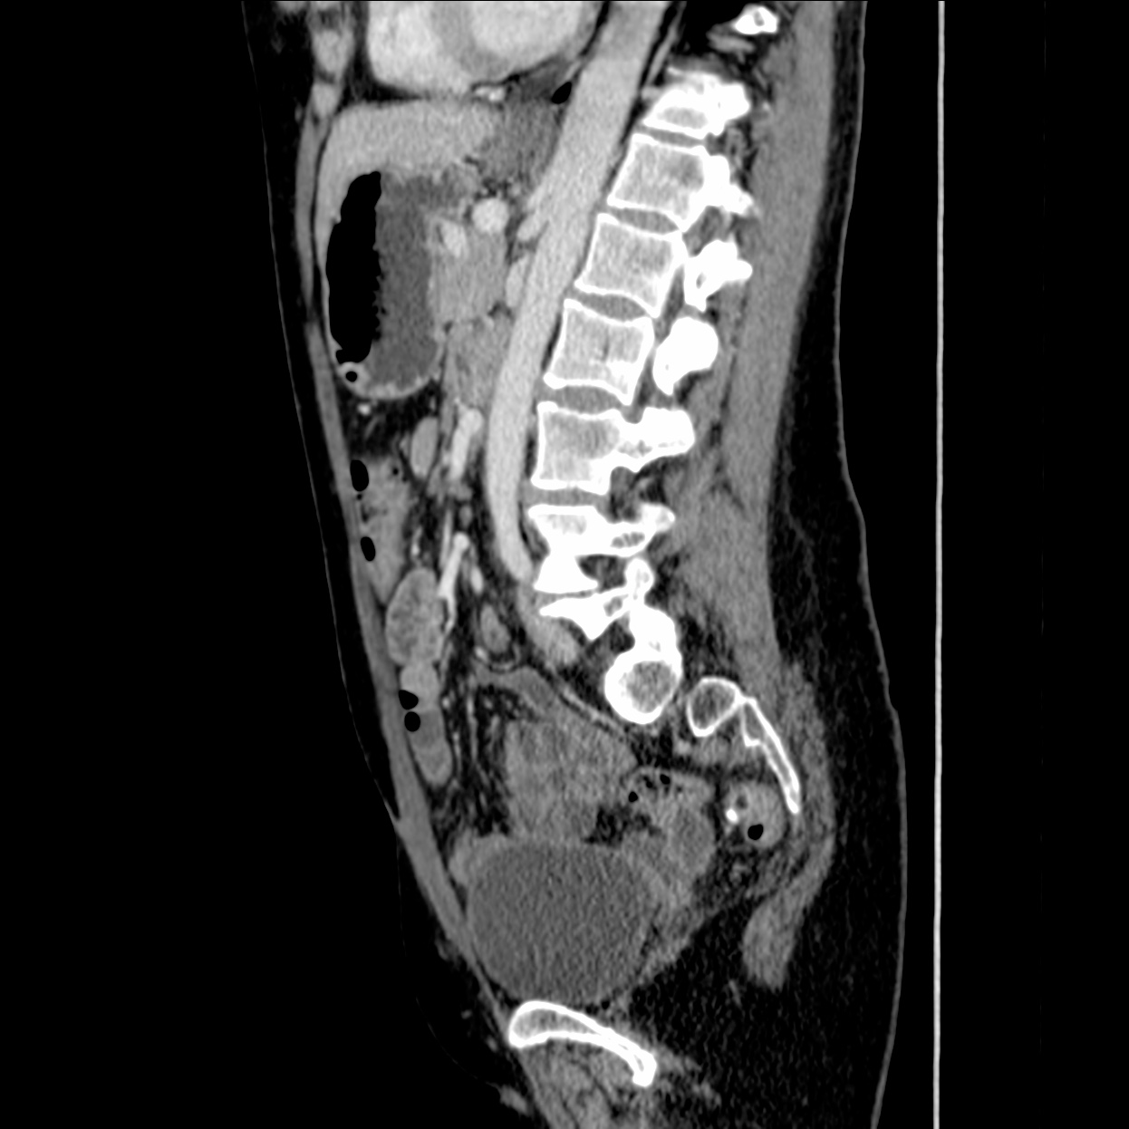
Technique
CT of the abdomen and pelvis:
oral (water or barium-based) and IV contrast
Images obtained during the portal venous phase (~70 second delay)
Images acquired in the (trans)-axial plane and computer reformats images into the coronal and sagittal planes. Axial images are predominantly used.
(Trans-)axial plane
Coronal plane
Sagittal plane

Slide 3
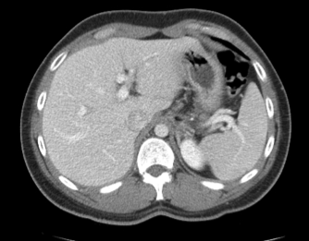
Approach- Checklist: Liver/Biliary Tree
Attenuation
Surface contour
Focal lesions (Couinaud segments)
Gallbladder
Biliary tree: intrahepatic & extrahepatic

Slide 4


Approach- Checklist: Liver/Biliary Tree
“Smooth liver surface and normal attenuation.”
Attenuation
Surface contour
Focal lesions (Couinaud segments)
Gallbladder
Biliary tree: intrahepatic & extrahepatic
Attenuation of liver and spleen is similar

Slide 5
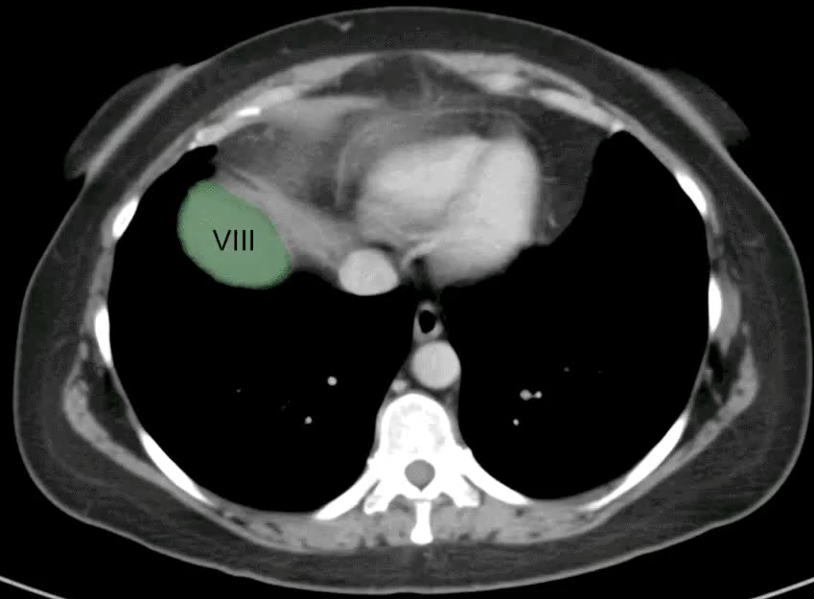
Approach- Checklist: Liver/Biliary Tree
Attenuation
Surface contour
Focal lesions (Couinaud segments)
Gallbladder
Biliary tree: intrahepatic & extrahepatic
The oblique horizontal plane of portal veins (purple arrows)
separates segments 2, 4a, 8 and 7 from 3, 4b, 5 and 6. The
middle HV and gallbladder fossa separate R and L lobes.

Slide 6
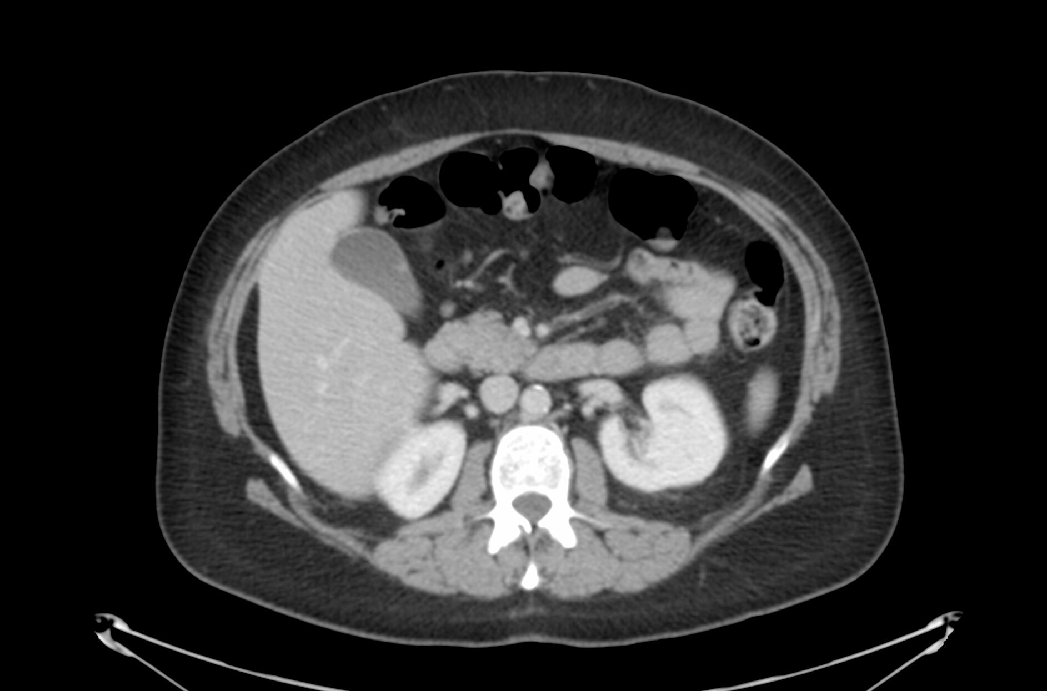
Approach- Checklist: Liver/Biliary Tree
Attenuation
Surface contour
Focal lesions (Couinaud segments)
Gallbladder
Biliary tree: intrahepatic & extrahepatic
“The gallbladder is thin-walled. No gallstones.”
Note absence
of inflammatory “stranding.”

Slide 7
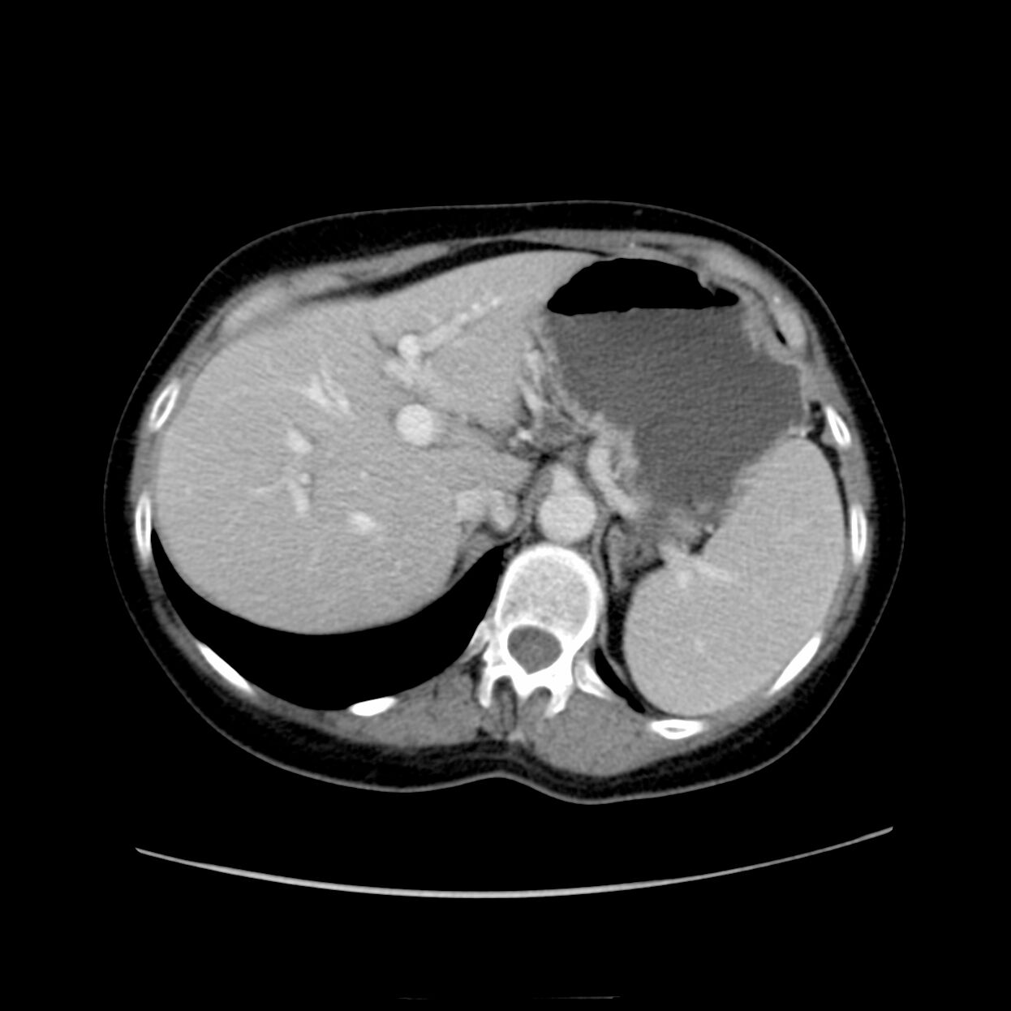
Approach- Checklist: Liver/Biliary Tree
Attenuation
Surface contour
Focal lesions (Couinaud segments)
Gallbladder
Biliary tree: intrahepatic & extrahepatic
Ducts appear as hypoattenuation on ONE side of portal vein branch.

Slide 8
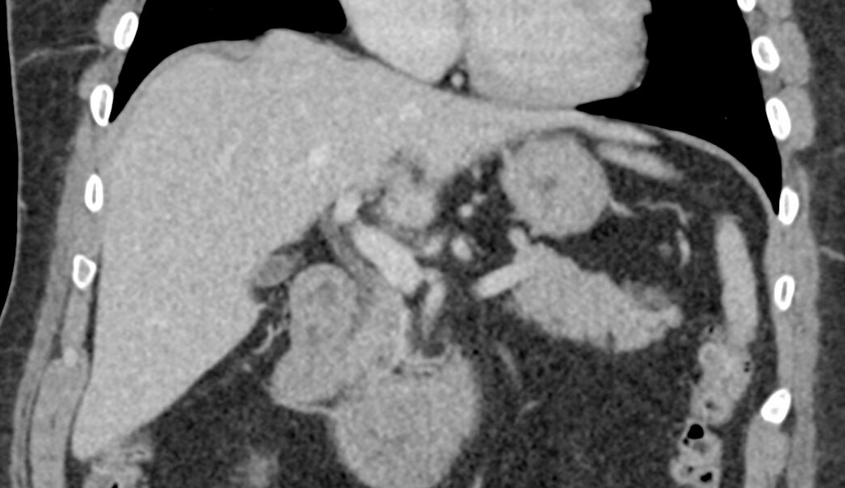
Approach- Checklist: Liver/Biliary Tree
Attenuation
Surface contour
Focal lesions (Couinaud segments)
Gallbladder
Biliary tree: intrahepatic & extrahepatic
“No extrahepatic biliary ductal dilatation.”
Follow the extrahepatic biliary tree to head of pancreas. Coronals may help.

Slide 9
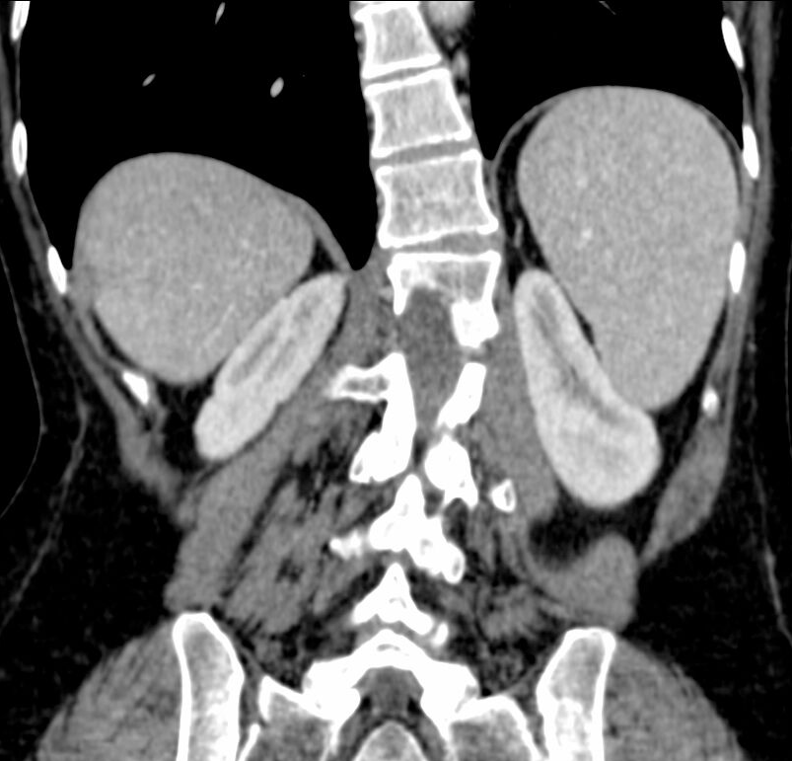
Approach- Checklist: Spleen
1. Look for lesions, such as masses, infarcts. (“Lesion” is term of art for any focal abnormality).
2. Use coronals to assess size
3. Screen vasculature (thrombosis, occlusion) – follow splenic vein to its connection to the portal vein. Many radiologists review splenic vasculature as part of their general vasculature search, and also include the portal and superior mesenteric veins.
size in cm
“The spleen is normal in size without suspicious lesions.”

Slide 10
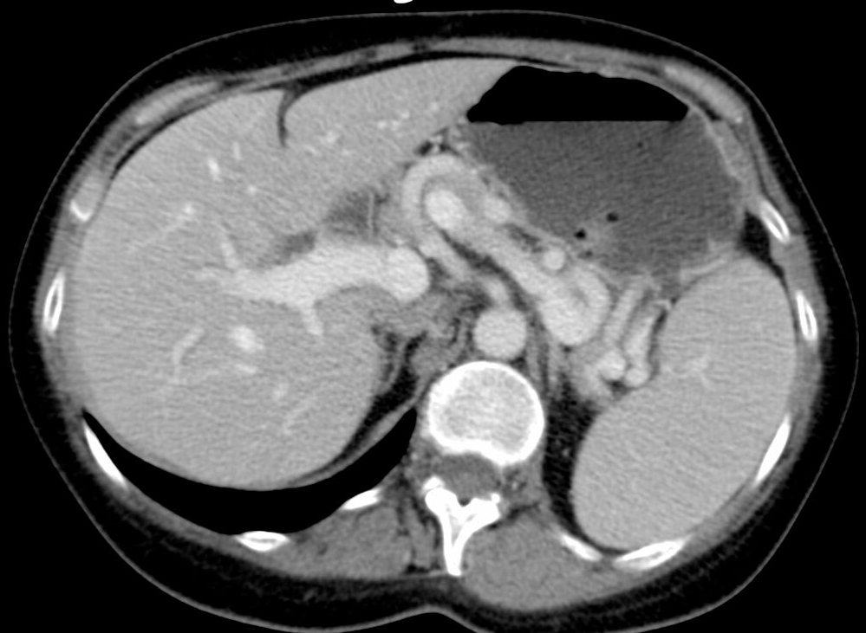
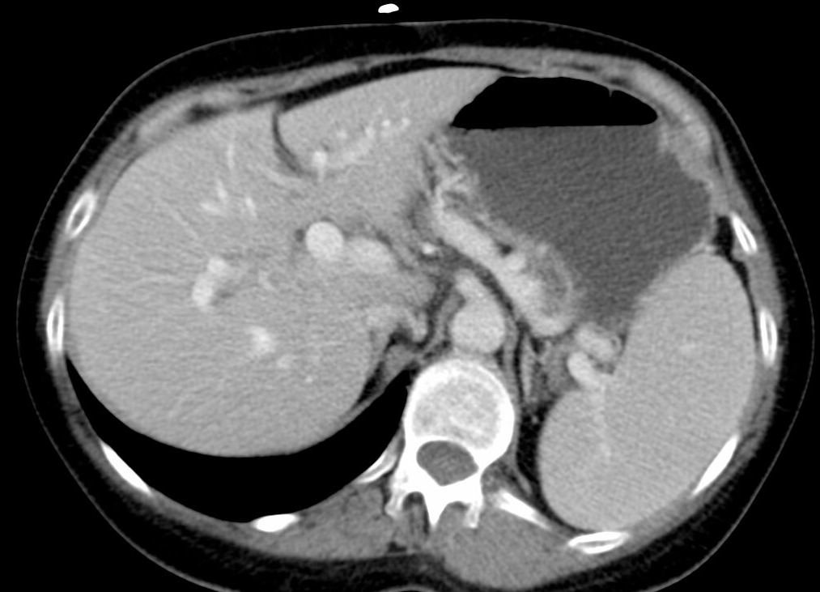
Approach- Checklist: Adrenal Glands
“No adrenal nodules.”
The right adrenal gland appears to be connected to the IVC
The left adrenal gland appears above and anterior to the left kidney.

Slide 11
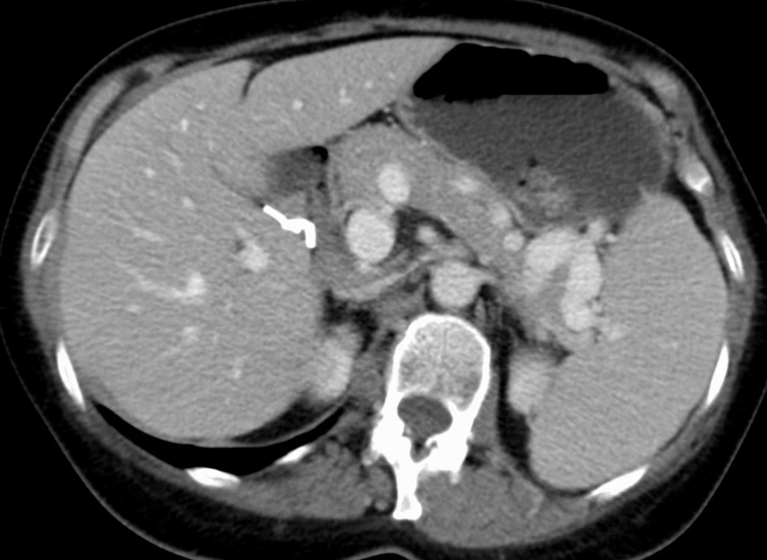
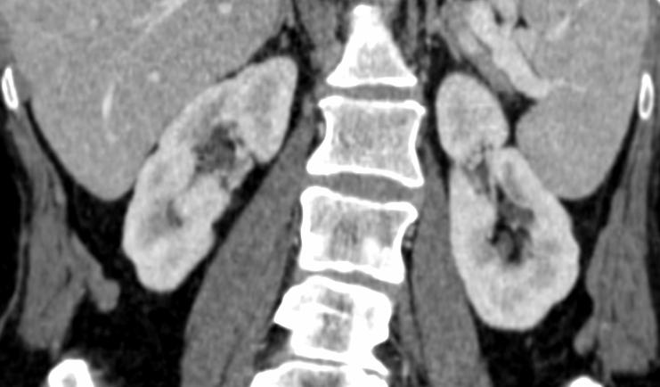
Approach- Checklist: Kidneys and ureters
1. Look for symmetric enhancement.
2. Look for hydronephrosis and calculi.
3. Try to follow the ureters to the urinary bladder (not always possible!).
4. Coronals increase sensitivity for detecting polar lesions.
“Kidneys enhance symmetrically. No suspicious masses or calculi. There is mild bilateral hydronephrosis.”

Slide 12
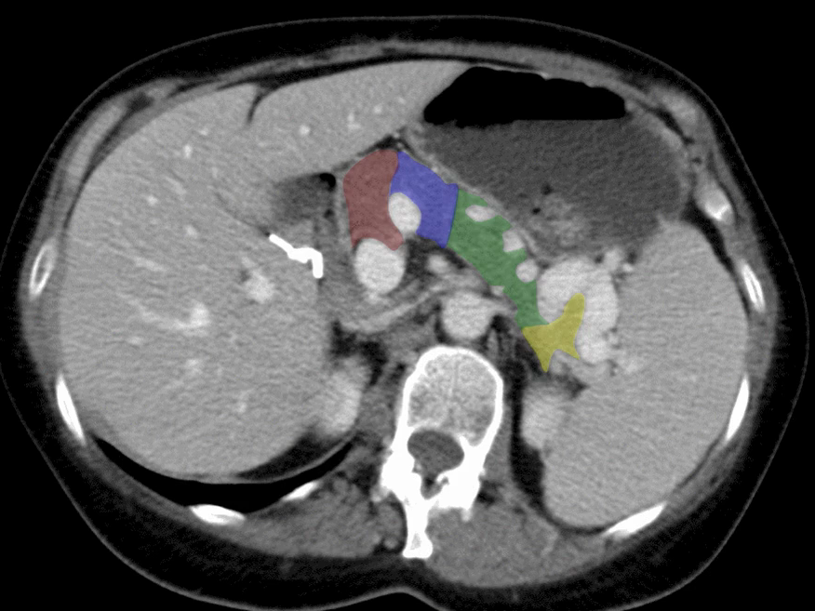
Approach- Checklist: Pancreas
1. Look for uniform enhancement
2. Look for ductal dilatation
3. Look for masses
4. Look for calcifications
5. Look for inflammatory change or fluid around the pancreas
“Uniform parenchymal enhancement without masses. Normal duct. No peripancreatic inflammatory changes.”
Tail
Neck
Body
Uncinate
Neck

Slide 13
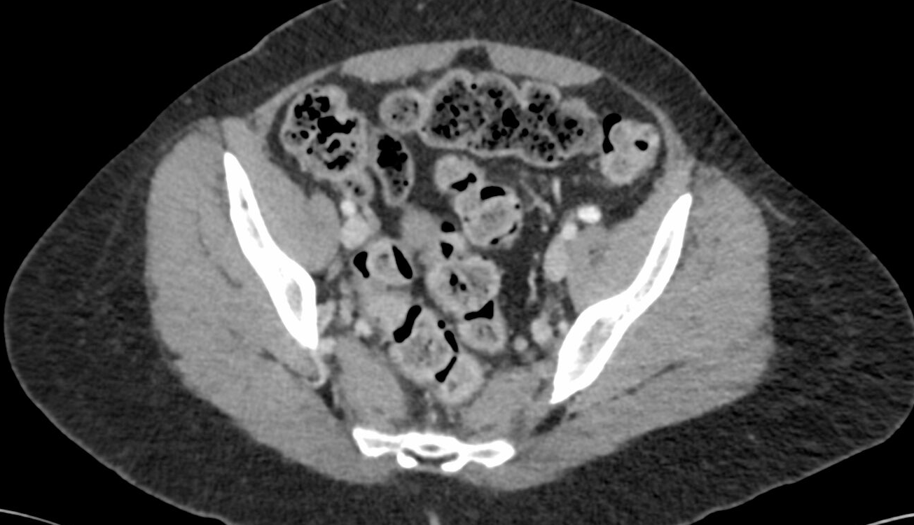
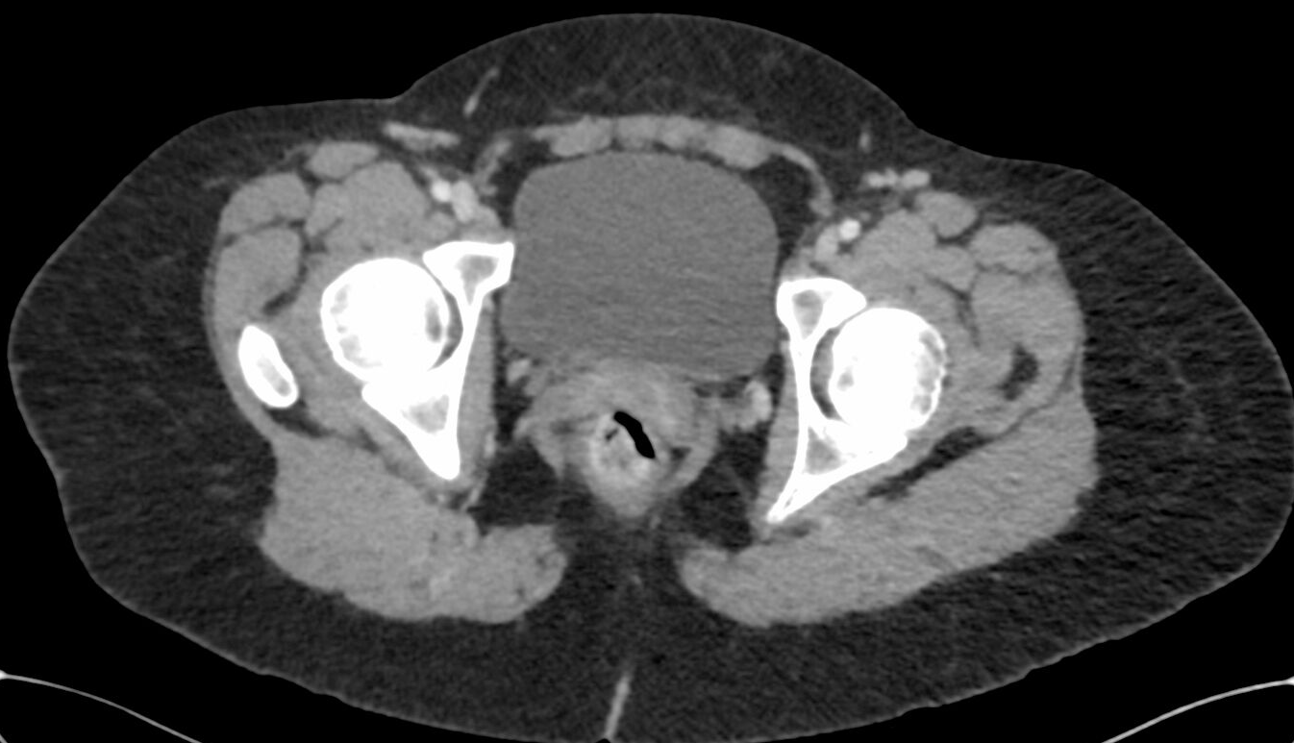
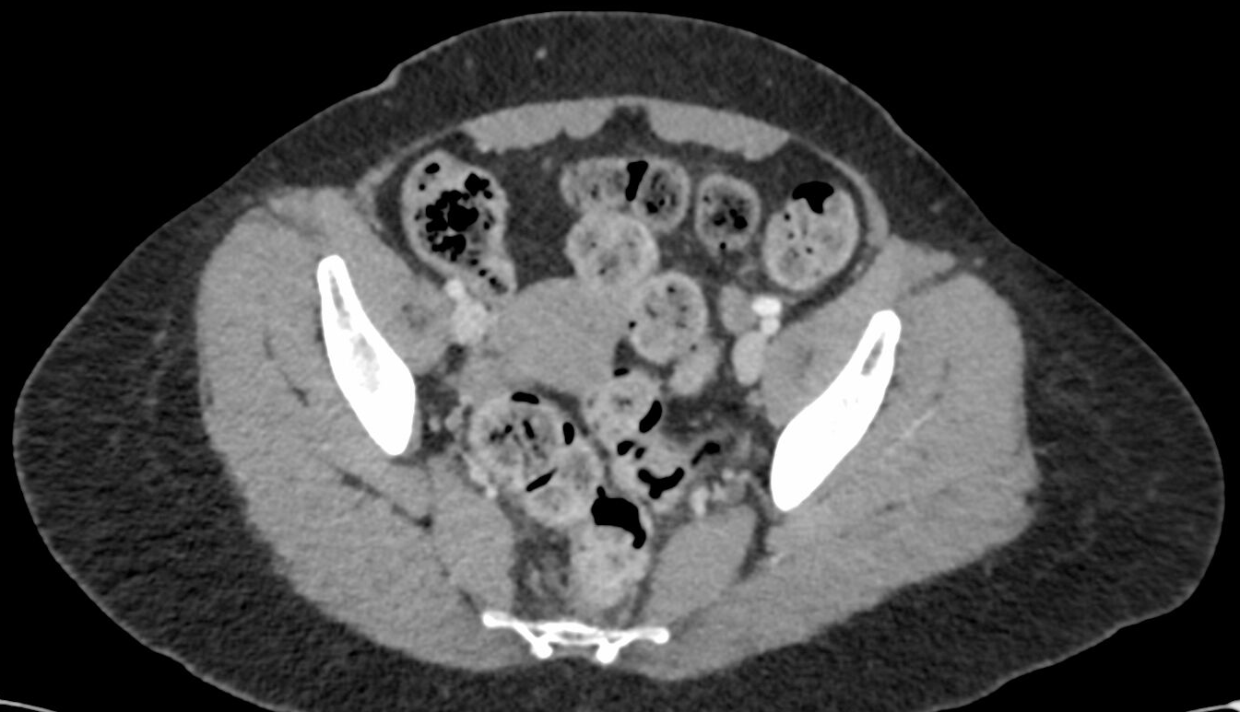
Approach- Checklist: Colon
For the colon, start at the rectum and follow the
colon backwards.
Look for:
    Diverticula and inflammation
    Wall thickening
    Dilatation
Transverse
Ascending
Rectum
Sigmoid

Slide 14
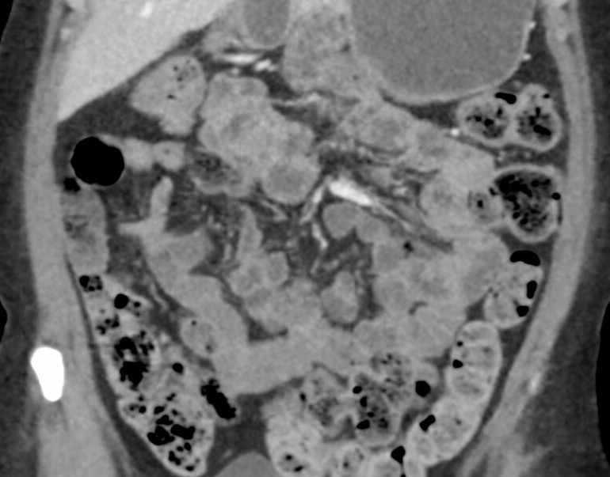
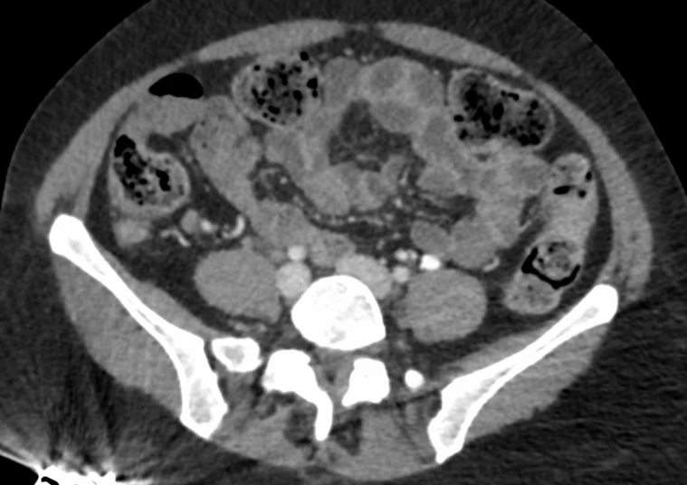
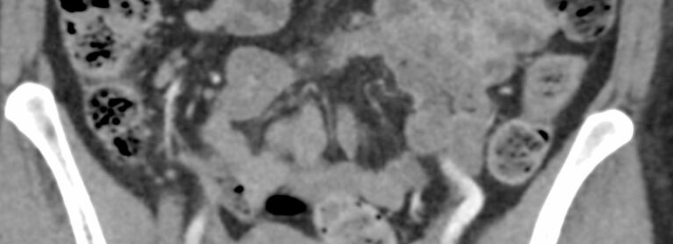
Approach- Checklist: The Appendix
What if you can’t find the appendix on axials?
Find fatty ileocecal valve on coronal; the appendix must come off of colon DISTAL to this!
Scroll back and forth till you find it!
“The appendix is normal in caliber without inflammatory change.”
APPENDIX!
Cecum

Slide 15
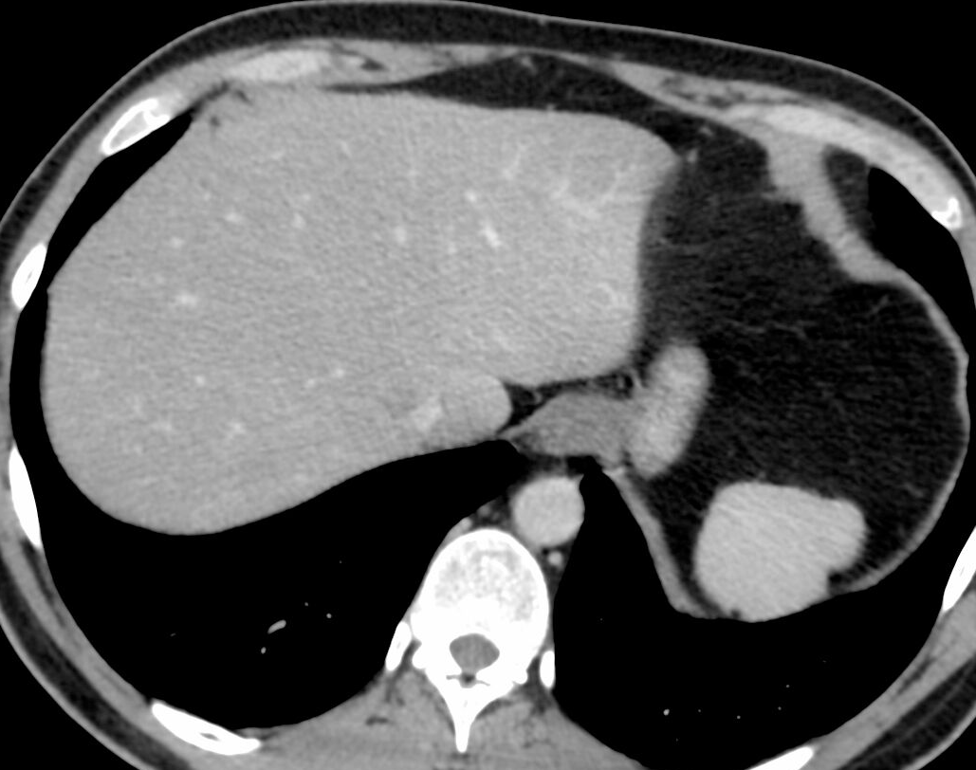
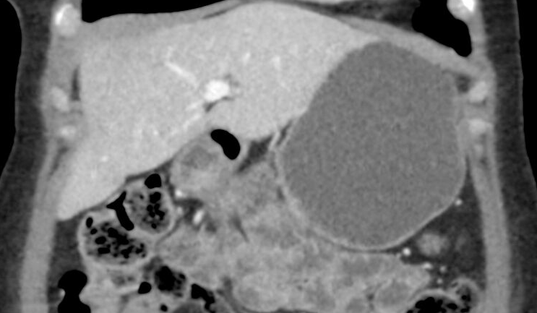
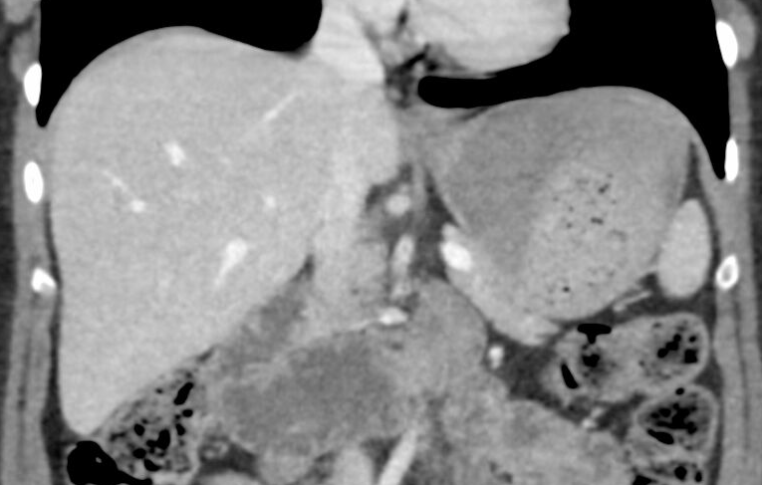
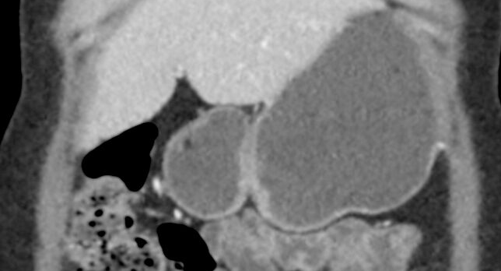
Approach- Checklist: Bowel/peritoneum/mesentery
Pylorus
Coronals are used here to demonstrate anatomy. Usually, the stomach and duodenum are reviewed on axial images.
Duodenal bulb
GE junction
Descending
Stomach anatomy best on coronals.
Vertical
Horizontal

Slide 16
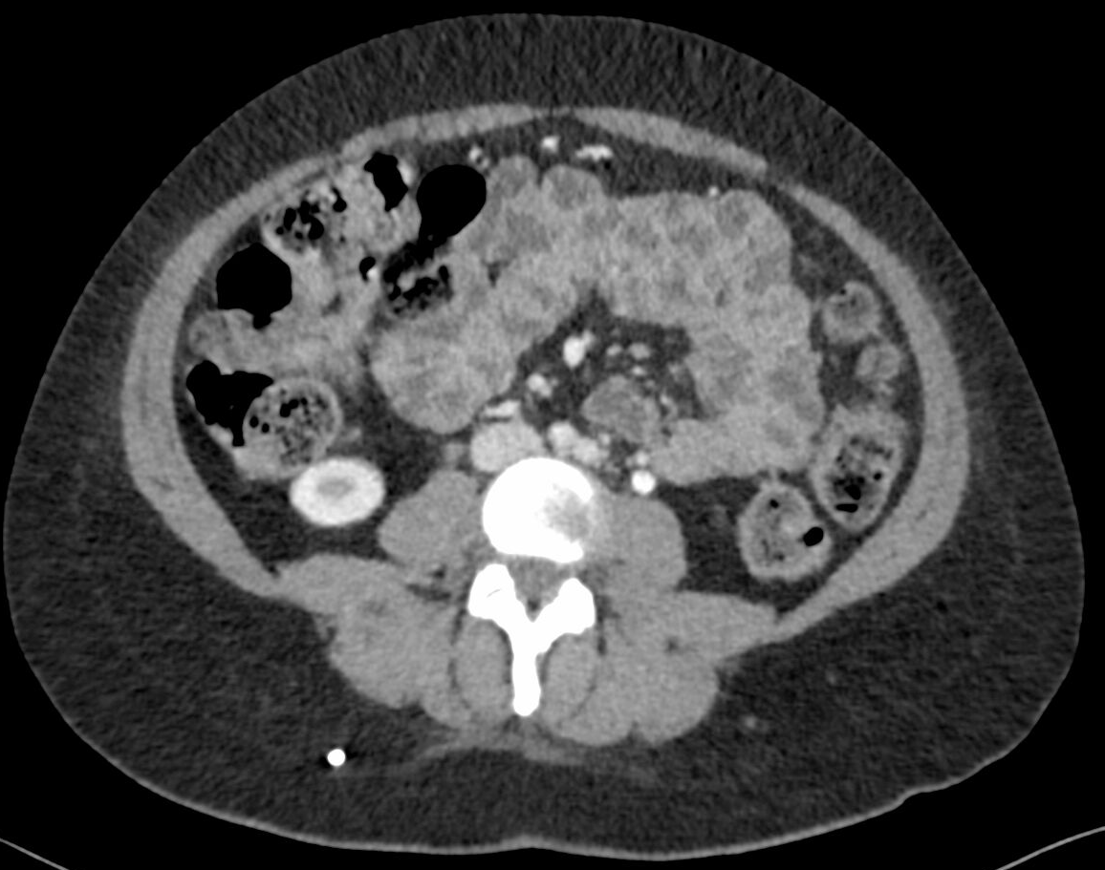
Approach- Checklist: Bowel/peritoneum/mesentery
Divide the abdomen in right and left halves and screen for pathology as you scroll.
Use this opportunity to assess for mesenteric abnormalities, including free air/gas and LAD.
“No bowel dilatation or abnormal wall thickening.”

Slide 17
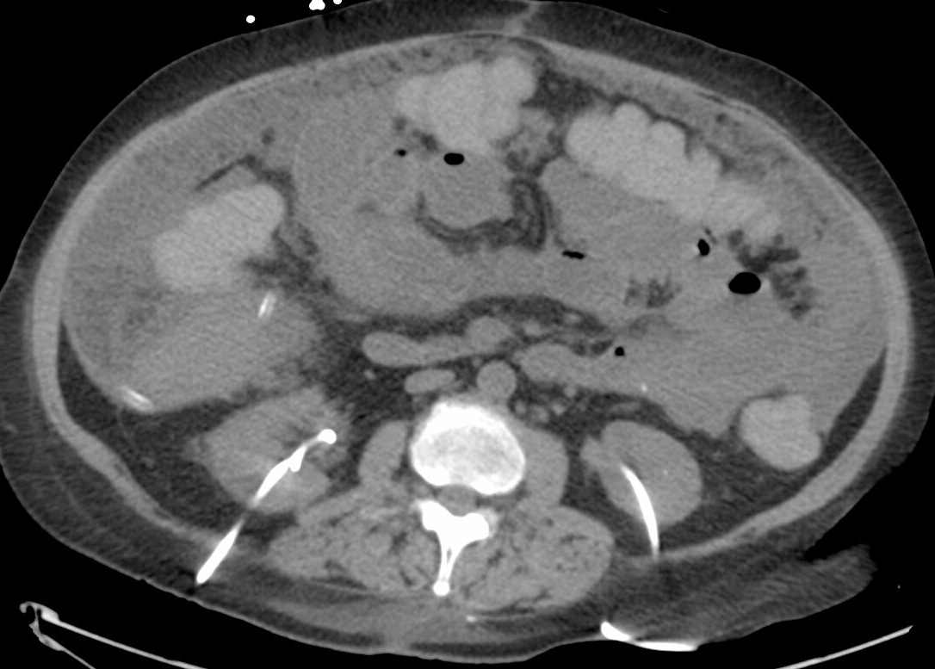
Approach- Checklist: Bowel/peritoneum/mesentery: Example of abnormal
“Omental ‘caking’ is noted, consistent with peritoneal carcinomatosis”
Ascites
Peritoneal drain
Nephroureteral stent

Slide 18
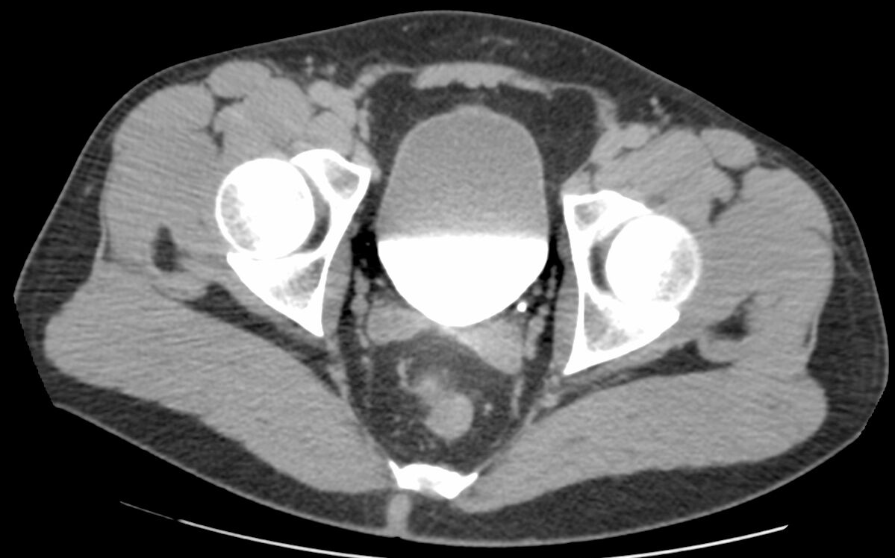
Approach- Checklist: Pelvis
“Urinary bladder contains excreted contrast. Normal wall thickness.”
Rectovesical excavation (cul-de-sac in females) a great place to look for a small amount of free fluid.
Seminal vesicles
Pelvic side walls are a good place to look for enlarged lymph nodes.

Slide 19
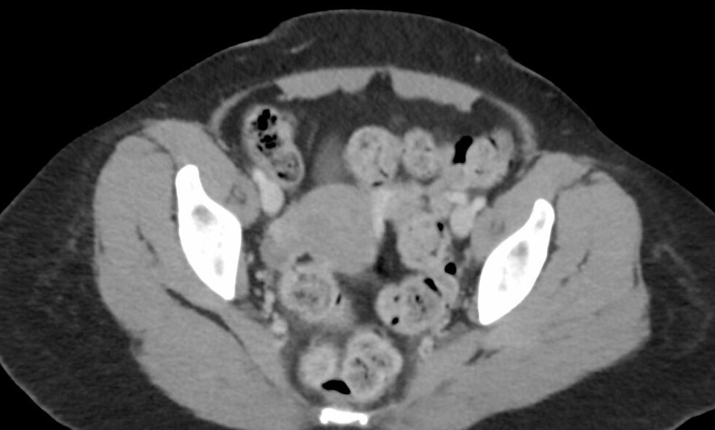
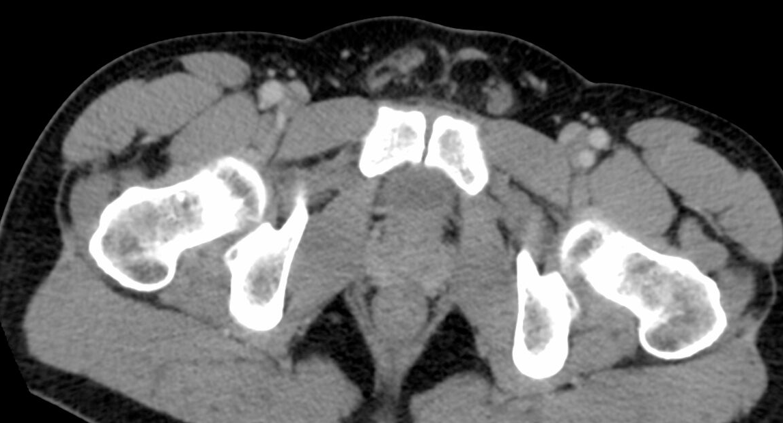
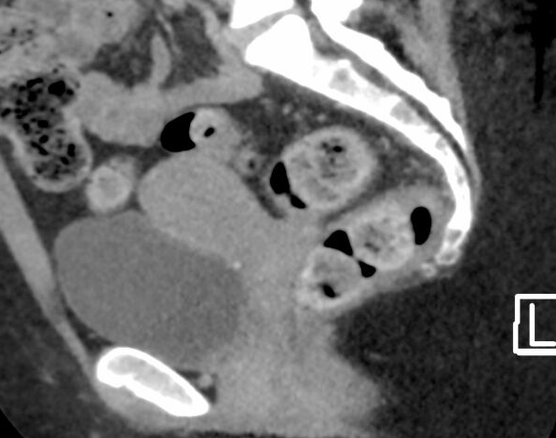
Approach- Checklist: Pelvis
Uterine fundus
Bladder
Right ovary
Prostate
Rectum
Uterus, cervix and vagina seen best on sagittal.
“Prostate gland is normal in size”
.
“Uterus and adnexa are normal.”
.

Slide 20
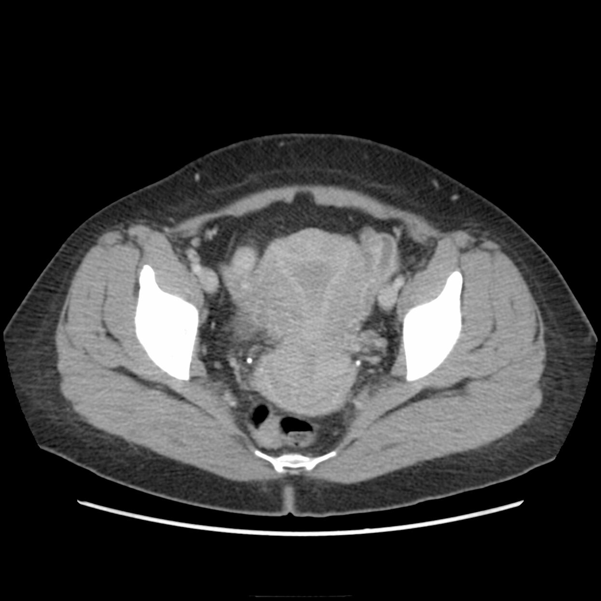
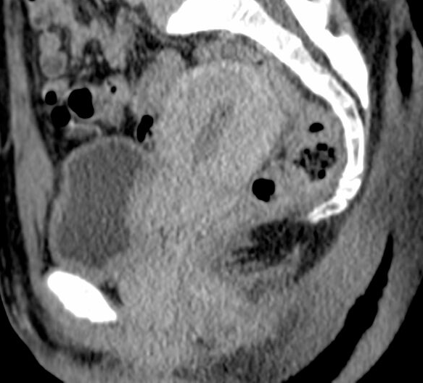
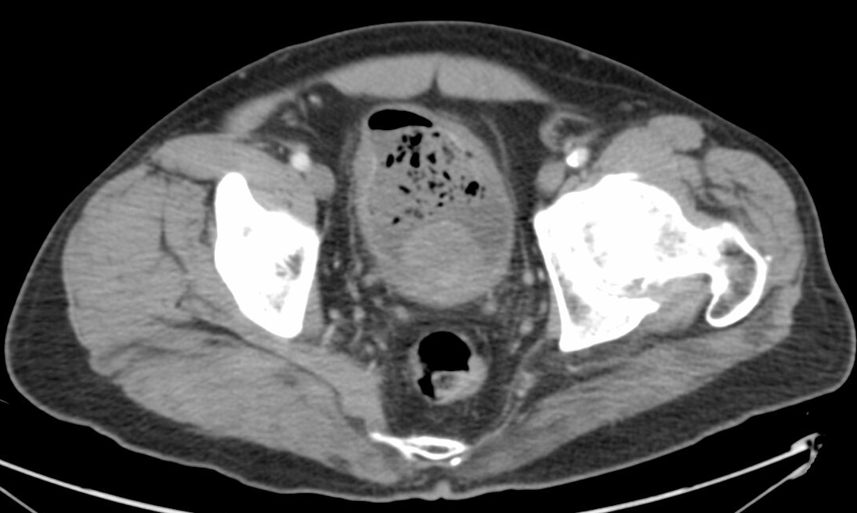
Approach- Checklist: Pelvis: Examples
“Dilated right fallopian tube, consistent with hydrosalpinx .”
Physiologic endometrial thickening
“The bladder wall is thickened and intraluminal gas is present, consistent with emphysematous cystitis.”
“Median lobe of the prostate gland is enlarged.”

Slide 21
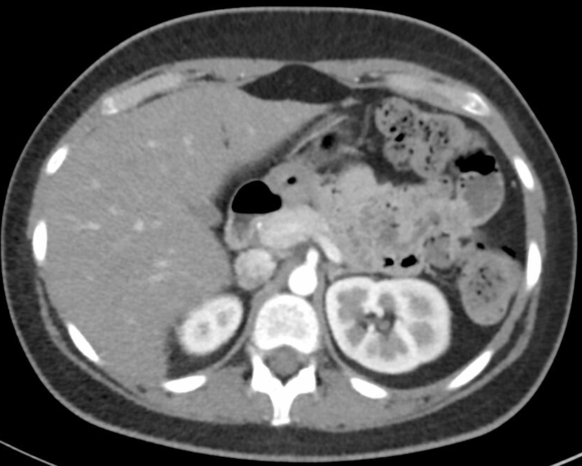
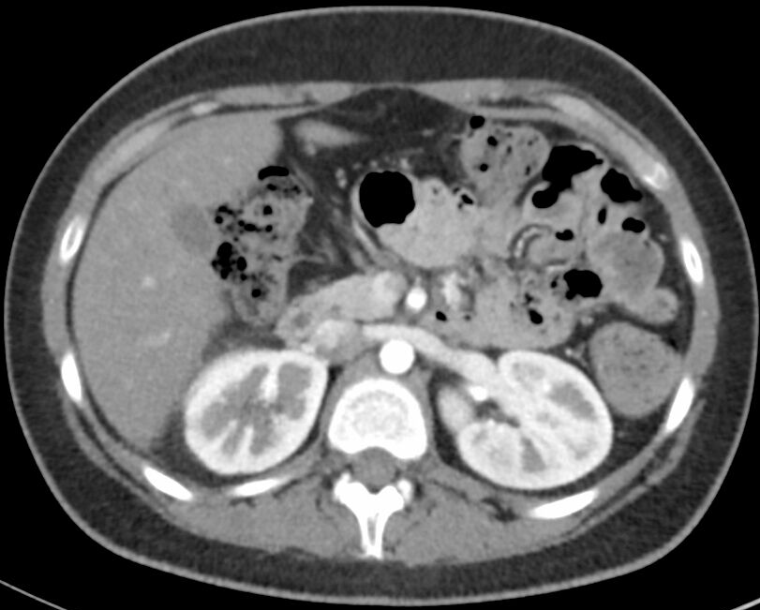
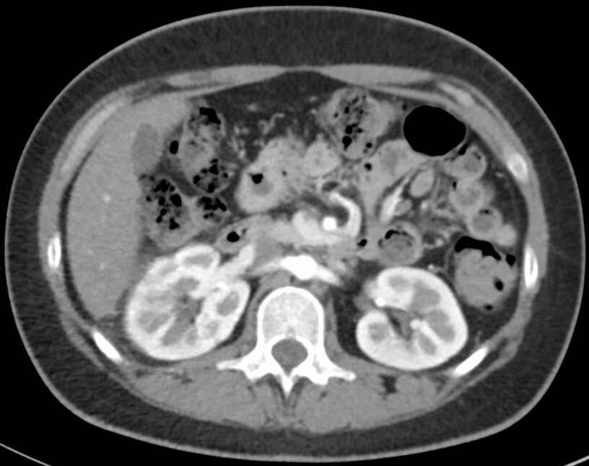
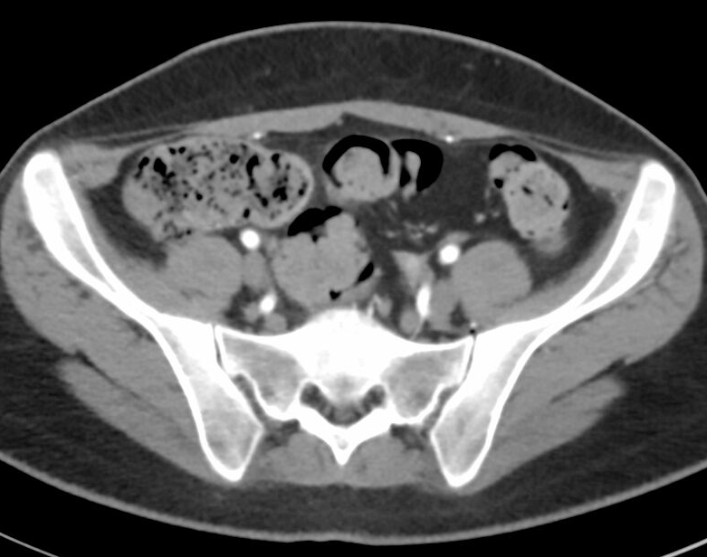
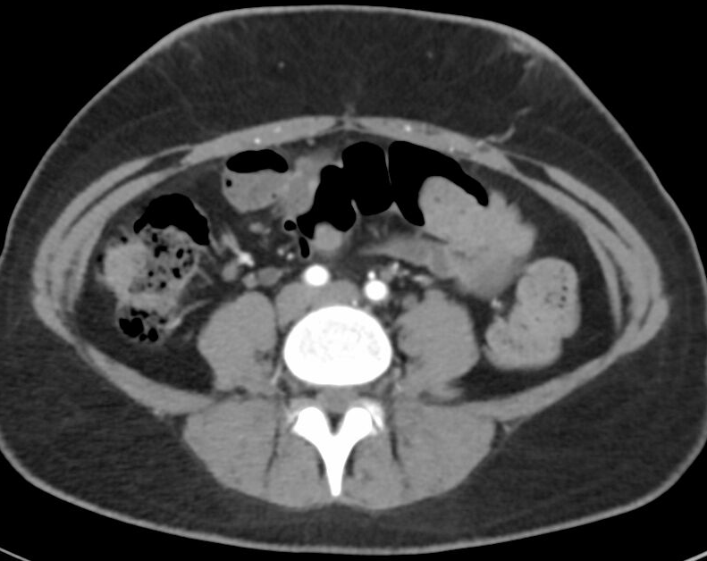
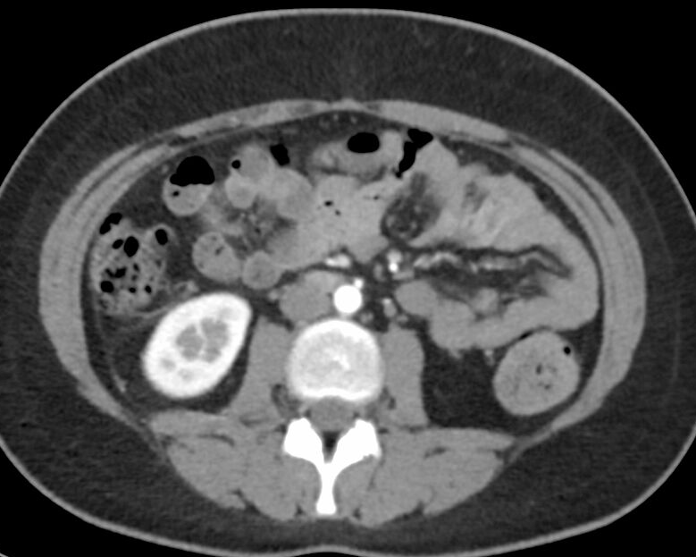
Approach- Checklist: Vasculature: Arteries
Renal
SMA
Aorta
Celiac
External iliac
Common iliac
IMA
Internal iliac

Slide 22
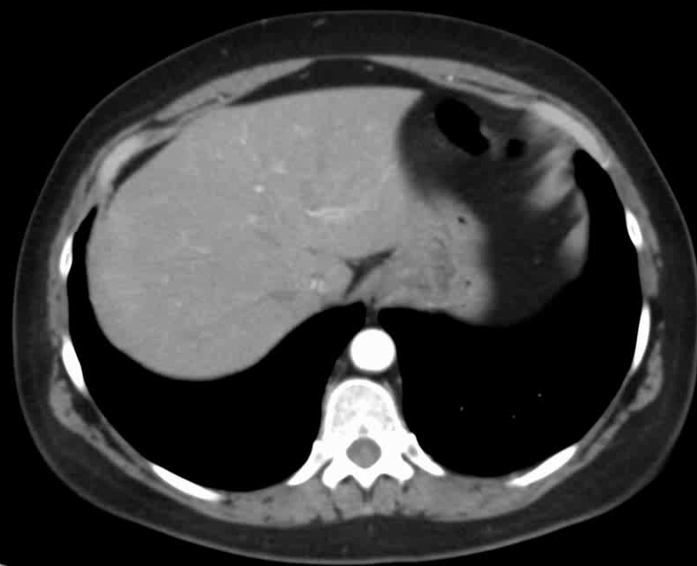
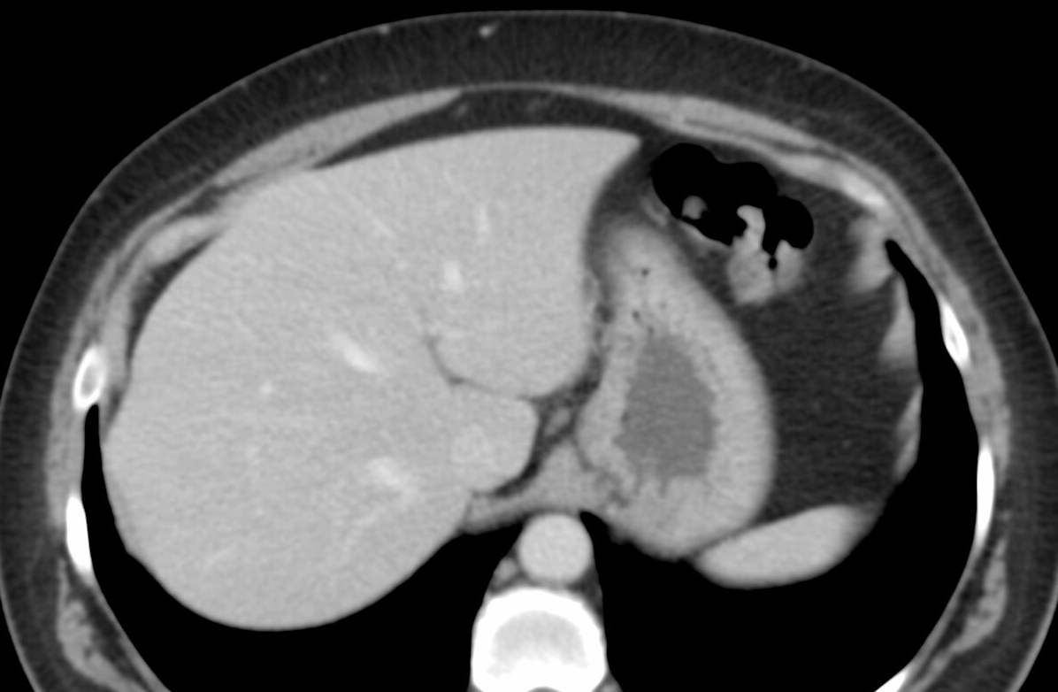
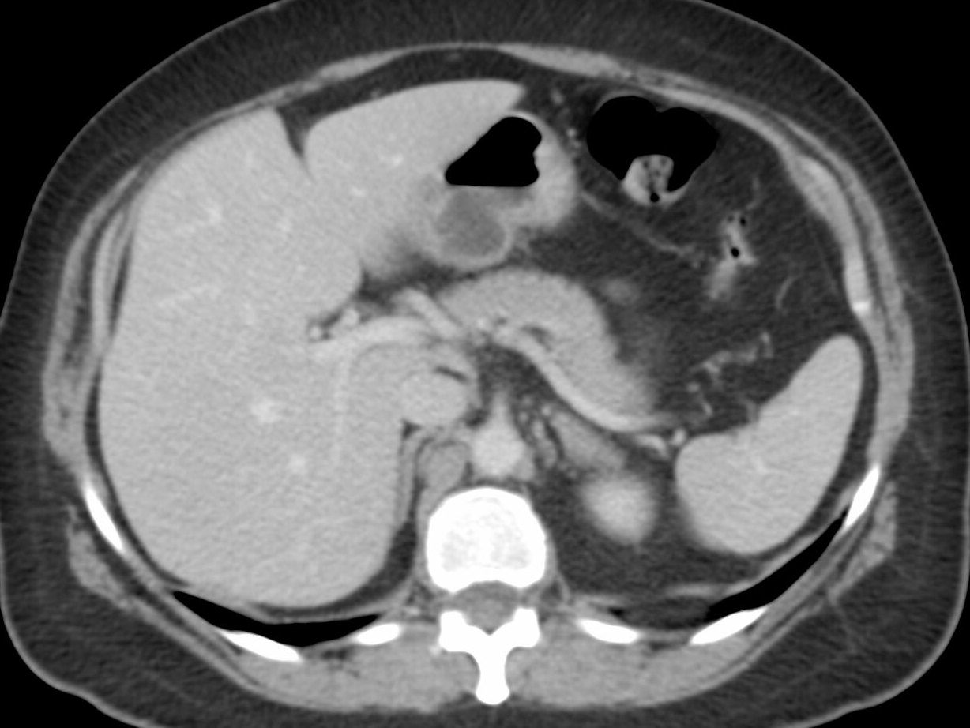
Approach- Checklist: Vasculature: Hepatic/Splenic
Follow the hepatic veins to the IVC.
Many radiologists look at the hepatic vasculature separately from the liver.
Follow the intrahepatic portal veins to the main portal vein.
Splenic vein

Slide 23
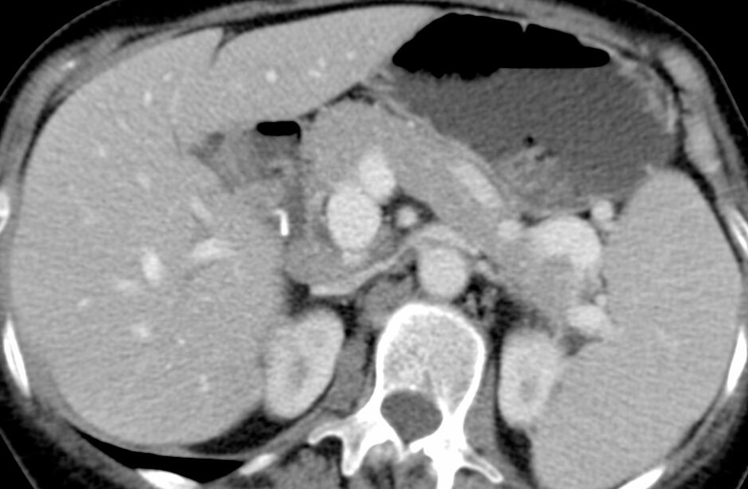
Approach- Checklist: Lymph nodes
Screening for lymph node abnormality is best done at the time of a review of the vasculature, as lymph nodes “co-travel” with the vasculature. Lymph node “stations” are named, for the most part, for their corresponding vessel (eg, “right external iliac chain lymph nodes”).
Additional sites for lymph nodes are around the liver hilum (“periportal”) and within the gastrohepatic ligament
Retroperitoneal Lymph Nodes
“No pathologically enlarged retroperitoneal lymph nodes.”
Paracaval
Preaortic
Portocaval
Paraaortic
Aortocaval

Slide 24
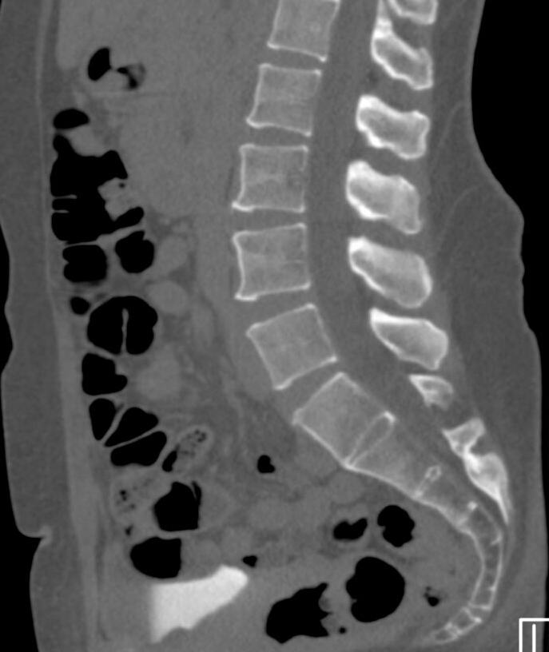
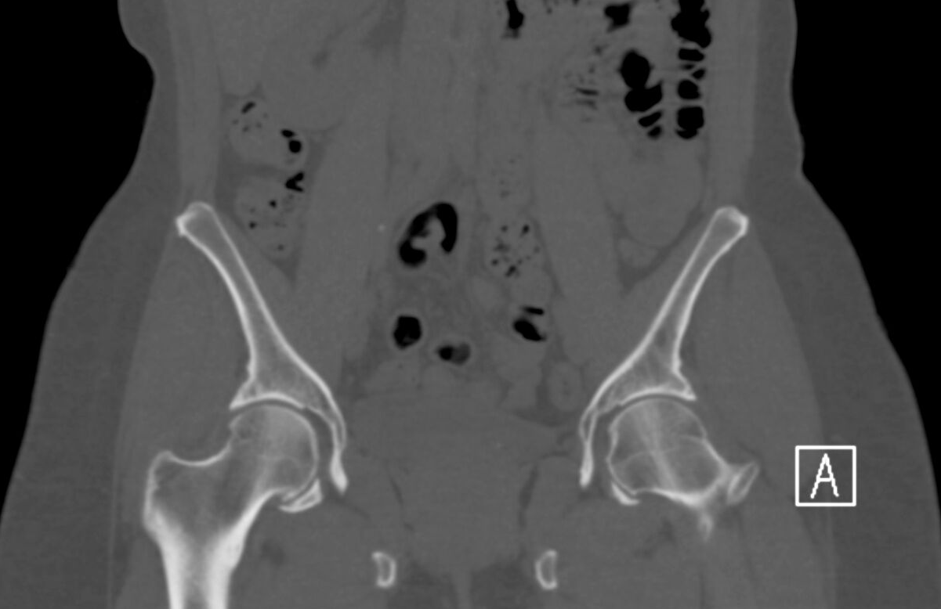
Approach- Checklist: Bones/soft tissue
1. On soft tissue windows, divide body into anterior and posterior halves; scroll from bottom to top and look anteriorly (eg. contusions, hernias), then scroll from top to bottom.
2. On bone windows, use axials to interrogate: visualized femurs, innominate bones, sacrum/coccyx, vertebrae, visualized ribs (eg, fractures, metastatic disease).
3. On bone widows, use sagittals to look for degenerative disk disease and compression fractures; coronals for hips (eg AVN, fractures, arthritis)
“Spinal alignment is normal. No compression fractures or degenerative disk disease.”

Slide 25
Review…
Axial images are your workhorse!
Liver
Gallbladder and biliary tree
Spleen (check coronals)
Adrenal glands
Kidneys (check coronals) and ureters
7. Pancreas
8. Vasculature (and lymph nodes)
Peritoneum (and lymph nodes)
Colon (and appendix), stomach and duodenum
Pelvis (and lymph nodes)
Body wall and bones (axials and reformats)

