Slide 1



How to approach a
Shoulder MRI
Kristen E. McClure, MD
Lukas M. Trunz, MD

Slide 2
Routine Shoulder MRI Protocol
Seq. | FOV | Matrix/ Nex | Slice | TR | TE | TI | ETL | BW
Axial PD FSE FatSat | 12-14 | 512 x 256 2 | 4/ 0.5 | 2000- 3000 | 20- 40 |  | 8 | 16
Cor Oblique FSTIR | 16-18 | 256 x 192 2 | 4/ 0.5 | > 1500 | 20- 40 | 3.0 T: 180 1.5 T: 150 0.7 T: 100 0.3 T: 70 | 8 | 16
Cor Oblique T1 SE NonFatSat | 16-18 | 256 x 256 1 | 4/ 0.5 | 400-800 | minimum |  |  | 16
Sag Oblique T2 FSE NonFatSat | 14-16 | 256 x 192 1 | 4/ 1 | > 2000 | 90- 110 |  | 8 | 16

Slide 3
MR Arthrogram of the Shoulder
Seq. | FOV | Matrix/ Nex | Slice | TR | TE | ETL | BW
Axial T1 SE FatSat | 12-14 | 256 x 192 2 | 3/ 0.5 | 400-800 | minimum |  | 16
Cor Oblique T1 SE FatSat | 14-16 | 256 x 192 2 | 3/ 0.5 | 400-800 | minimum |  | 16
Cor Oblique PD FSE FatSat | 14-16 | 256 x 192 2 | 3/ 0.5 | >1500 | 30-50 | 8 | 16
Sag Oblique T1 SE NonFatSat | 14 | 256 x 192 1 | 4/1 | 400-800 | minimum |  | 16
ABER T1 SE FatSat | 14 | 256 x 192 2 | 3/ 0.5 | 400-800 | minimum |  | 16

Slide 4
Step by step approach
Evaluate for Impingement:
  Check for a subacromial spur on the Coronal T1 non-fat saturated sequence
  Check for an Os acromiale on the Coronal T1 non-fat saturated and the Axial Proton Density (PD) fat saturated sequences
  Check for AC joint osteoarthritis on the Coronal STIR, Axial PD fat saturated and Coronal T1 sequences.
Evaluate the acromioclavicular (AC) joint:
  Check on the Coronal STIR for marrow edema, capsular edema/disruption, and ligamentous integrity or injury (including the coracoclavicular ligament)
  Evaluate alignment

Slide 5
Step by step approach
Subacromial/ Subdeltoid Bursa:
  Using the Coronal STIR evaluate for bursitis, excess fluid or hydroxyapatite deposition
Rotator Cuff tendons:
  Using the Coronal STIR to evaluate the supraspinatus and infraspinatus tendons (remember to check the anterior most footprint of the supraspinatus):
    Check for tendinosis: tendon thickening, attenuation, and/or intrasubstance signal alteration, hydroxyapatite deposition
    Check for partial thickness, interstitial, and full thickness tearing

Slide 6
Step by step approach
Rotator Cuff tendons (continued):
  Confirm the findings on Sagittal oblique T2 non fat saturated and Axial Proton Density fat saturated sequences 🡪 on these sequences you get a better look at the infraspinatus tendon in its entirety
  Measure tendon tears in the AP dimension on the Sagittal oblique T2 non fat saturated images
  Measure tendon retractions on the Coronal T2 fat saturated sequence.
  Evaluate the integrity of the subscapularis and teres minor tendons on the Axial PD fat saturated and the Sagittal oblique T2 non fat saturated sequences.

Slide 7
Step by step approach
Long Head Biceps Tendon (LHBT):
  Evaluate the integrity of the LHBT on the Axial PD fat saturated sequence and confirm it on the Coronal STIR sequence (the intra- articular portion can commonly be evaluated on the Sagittal oblique T2 non fat saturated sequence as well)
  Evaluate the location of the LHBT at the level of the lesser tuberosity on the Axial PD fat saturated sequence
  Evaluate for subluxation/ dislocation of the LHBT

Slide 8
Step by step approach
Rotator Cuff Muscle Bulk:
  Evaluate on the Sagittal oblique T2 non fat saturated sequence 🡪 fatty streaking/replacement can be confirmed on the Coronal T1 non fat saturated sequence
Rotator Interval:
  Evaluate if the fat within the rotator interval is preserved or infiltrated on the Coronal T1 non fat saturated sequence 🡪 Confirm with Sagittal oblique T2 non fat saturated and Coronal STIR sequence

Slide 9
Step by step approach
Glenohumeral Joint:
  Evaluate for alignment
  Check the Coronal STIR and Axial PD fat saturated sequences for:
    Presence of a joint effusion
    Synovitis
    Intraarticular bodies
  Evaluate the hyaline cartilage for partial or full thickness defects on the axial PD fat saturated and Coronal STIR sequences

Slide 10
Step by step approach
Glenohumeral Joint (continued):
  Evaluate for labral tears on Coronal STIR and Axial PD fat saturated sequences. Evaluate for:
    abnormal morphology, intrasubstance signal alteration, displaced fragments, paralabral cysts, etc.
    extension of a labral tear into the LHBT, glenohumeral ligament, rotator interval
  Evaluate the inferior glenohumeral ligament for injury, thickening, or periligamentous edema on the Coronal STIR sequence

Slide 11
Step by step approach
Notches:
  Evaluate for mass/ mass effect in the suprascapular and spinoglenoid notch, and within the quadrilateral space on the Coronal STIR and Sagittal oblique T2 non fat saturated sequences
Bone Marrow:
  Evaluate for osseous contusion/ fractures, Hill-Sach’s deformity, bony Bankart on Axial PD fat saturated, Coronal STIR, Coronal T1 and Sagittal oblique T2 non fat saturated sequences

Slide 12
Step by step approach
Final Survey + Localizer:
  Using the Axial PD fat saturated, make a final survey of the surrounding soft tissues and Scapula for any additional abnormalities

Slide 13
Common Cases

Slide 14
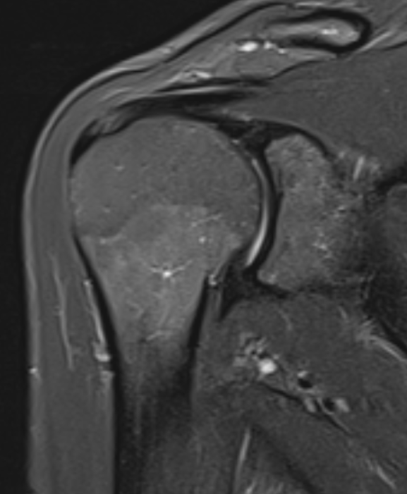
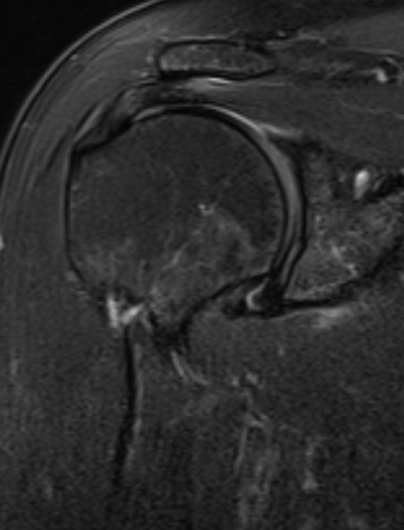
Rotator cuff tendinosis/tear
Mucoid degeneration
Supraspinatus tendon most
commonly affected
Tendon thickening with increased
signal intensity (T1 + T2)
Grading: mild, moderate
severe
Cor STIR
Cor T2 FS

Slide 15
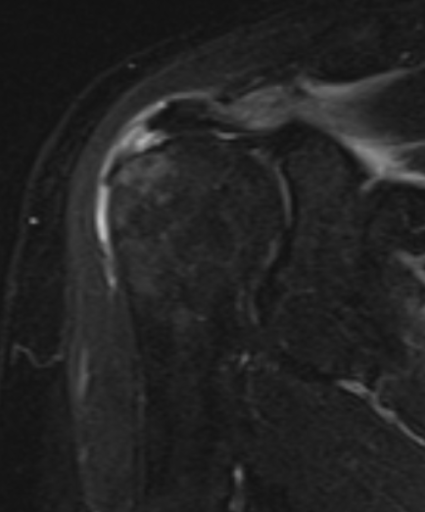
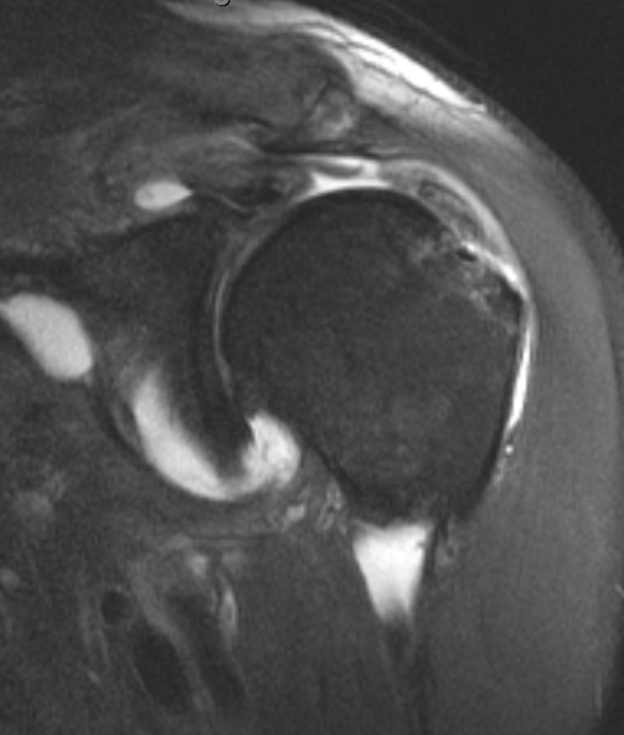
Tears in normal tendons are rare
(trauma)
Partial vs. full thickness vs. complete
tears need to be differentiated
Gap in the tendon filled with fluid
Tendon
retraction
Full thickness anterior leading edge supraspinatus tear , with reactive marrow edema in the underlying greater tuberosity
Large full thickness supraspinatus tear

Slide 16
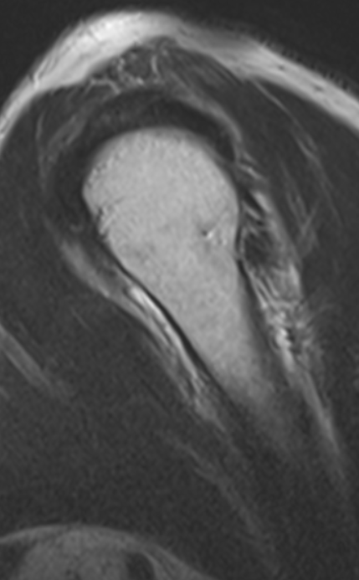
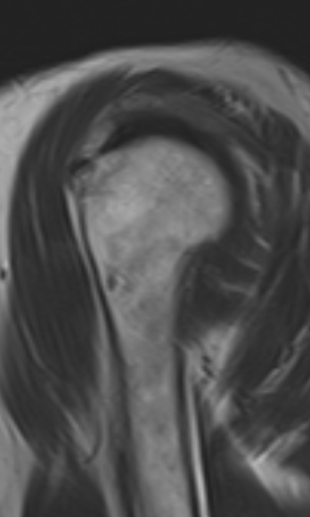
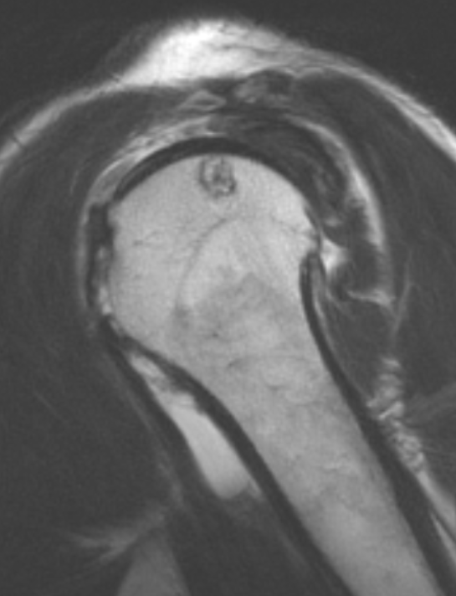
Intact rotator cuff
Full thickness tear
Large full thickness tear

Slide 17
Superior labrum anterior-posterior (SLAP) tear
Results from repetitive avulsive stress from the origin of the long head biceps tendon
Common symptoms besides pain include clicking/popping
Most important differential diagnosis are normal labral variants
Best seen on MR arthrography (MRA)
Best plane to assess for SLAP tears is coronal oblique (but use all three planes)

Slide 18
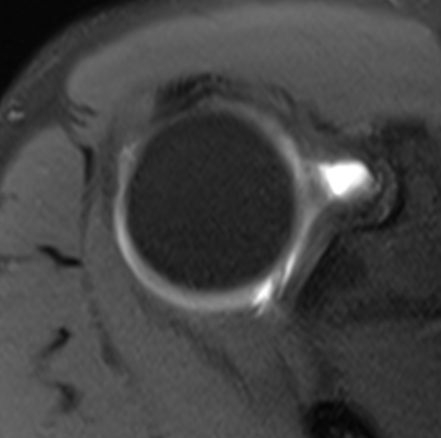
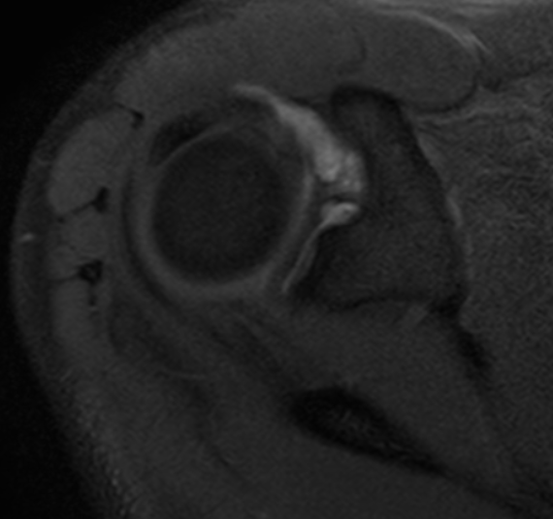
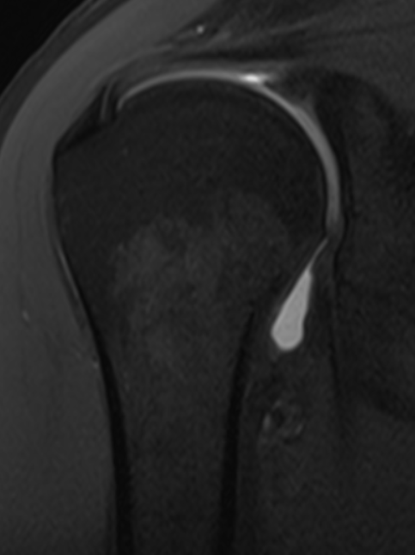
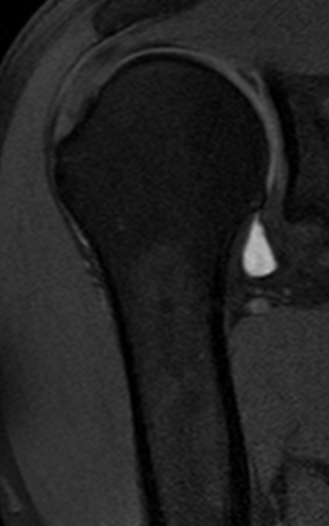
MRA- Normal labrum
MRA- SLAP
Contrast points laterally

Slide 19
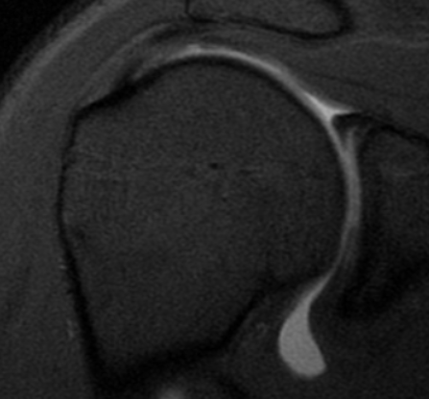
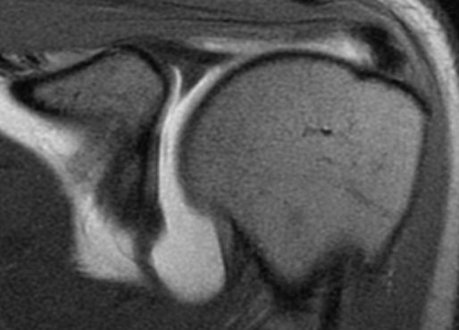
Sublabral recess (normal variant)
Compared to SLAP tear, contrast points medially/towards the glenoid
MRA- Right shoulder
Normal labrum
MRA- Left shoulder

Slide 20
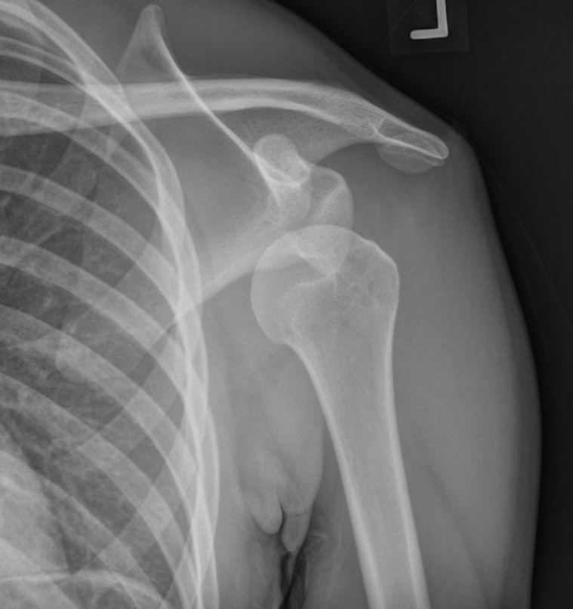
Anterior shoulder dislocation
95% of shoulder dislocations
Vey high recurrence rate in young patients (90% in
<20 years old)
Humeral head is displaced anteriorly, inferiorly, and medially
Often associated with Hill Sachs and Bankart lesions

Slide 21
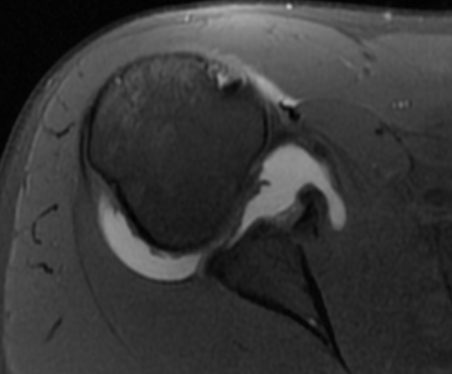
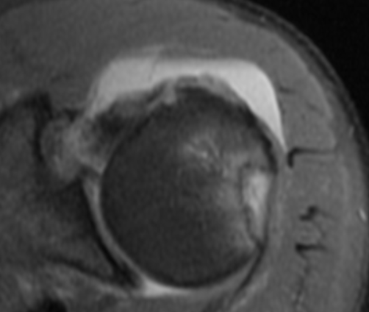
Large osseous Bankart fracture of the anteroinferior glenoid with an articular step off after a recent anterior shoulder dislocation
Large Hill-Sachs lesion of the
posterolateral humeral head with
reactive osseous edema

Slide 22
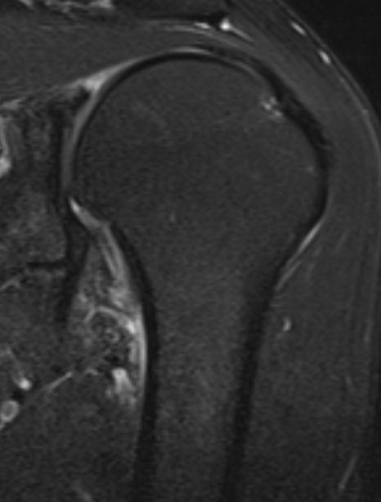
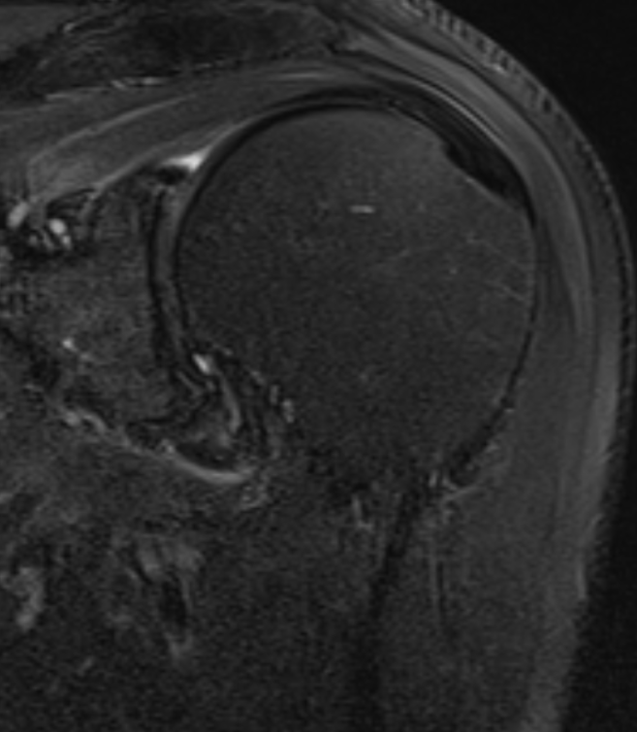
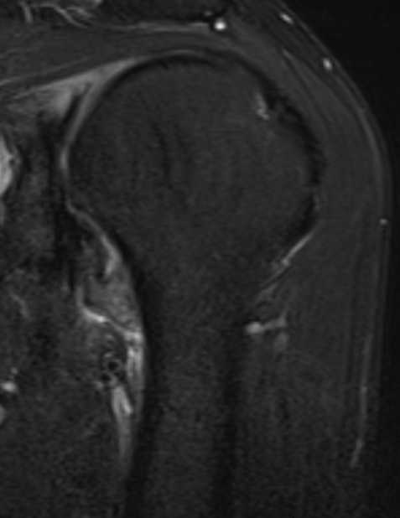
Adhesive capsulitis
’Frozen shoulder’
Presents with shoulder pain and
decreased range of motion due to
synovial inflammation and capsular
fibrosis
Pericapsular thickening/edema within
the axillary recess , a typical location
for adhesive capsulitis

Slide 23
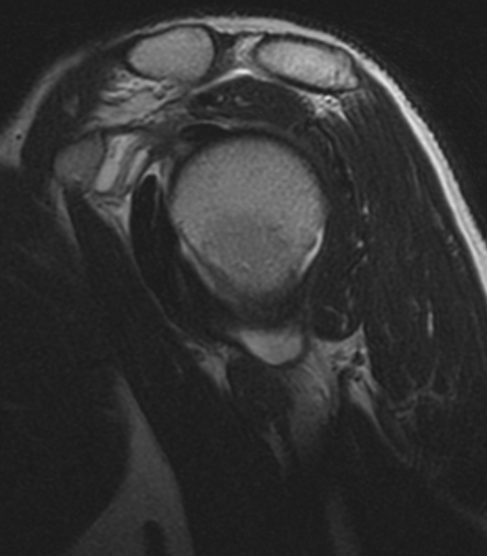
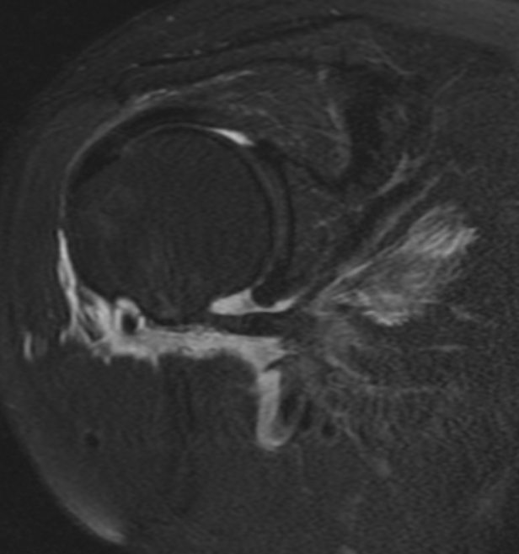
Evalaute the CHL for thickening.
Evaluate the fat within the rotator
Interval for infiltration or edema.
Infiltration in the rotator interval and thickening of the coracohumeral ligament (CHL) are hallmarks of this condition
Typical findings on arthrography are extravasation of contrast with relatively low glenohumeral joint volume
Sag T2 non-FS
MRA shows extravasation of contrast into the subscapularis tendon

Slide 24
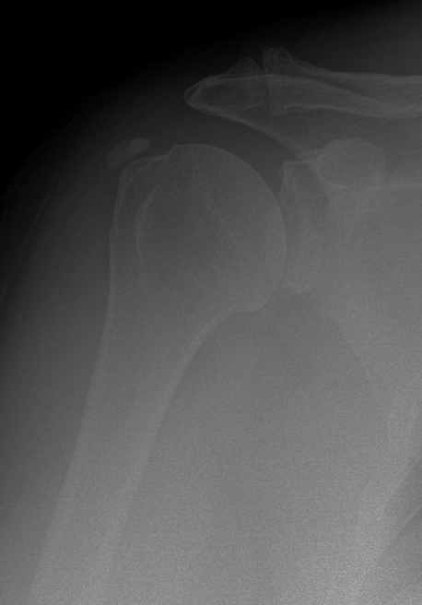
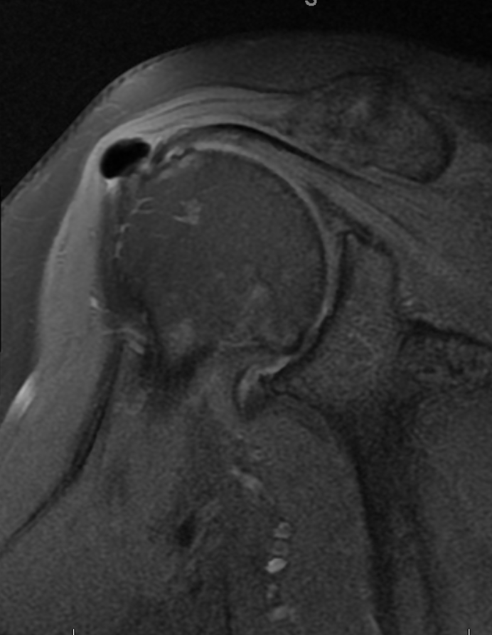
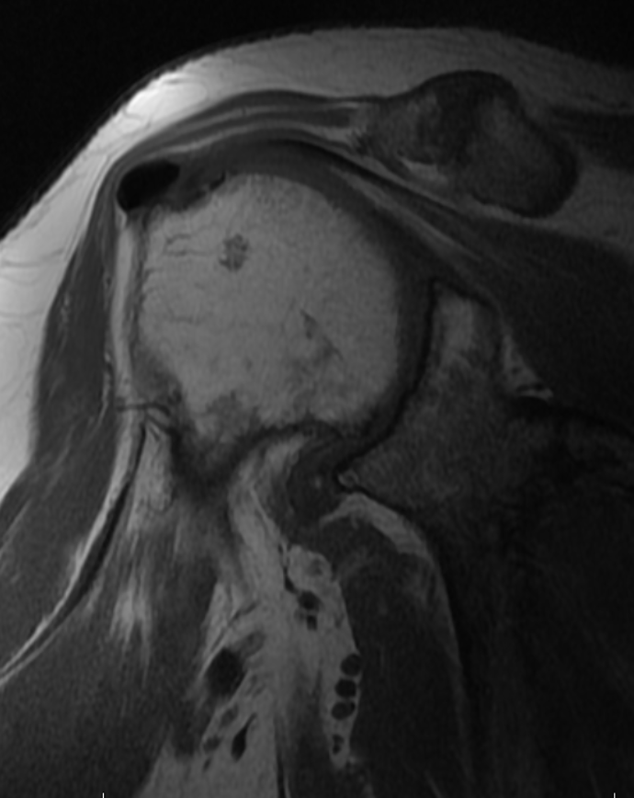
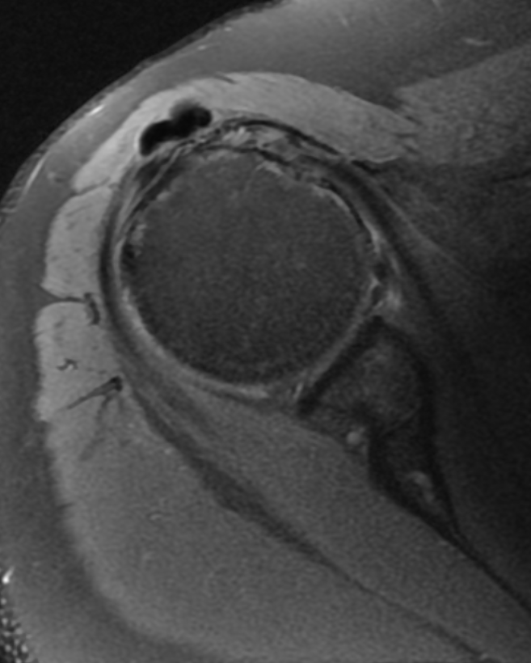
Calcific tendinosis
Hydroxyapatite deposition, in this case located in the supraspinatus tendon (most common)
Calcification adjacent
to the greater tuberosity
Low signal on all sequences (can blend in with the tendon in less obvious cases)
Can demonstrate blooming artifact on gradient echo sequences (not shown)

Slide 25
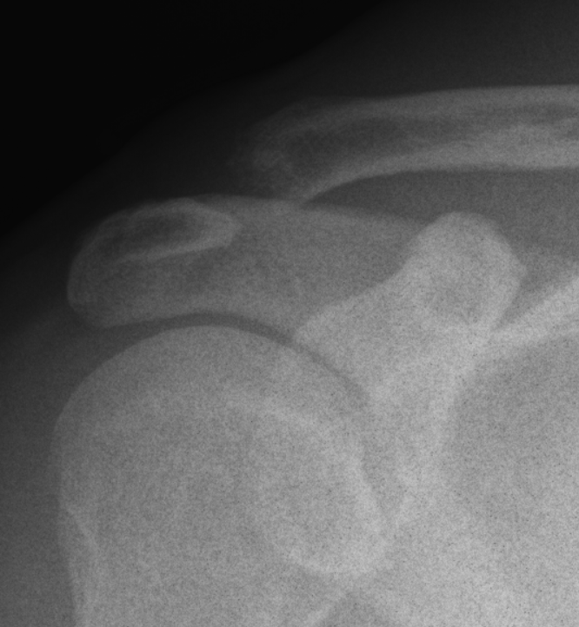
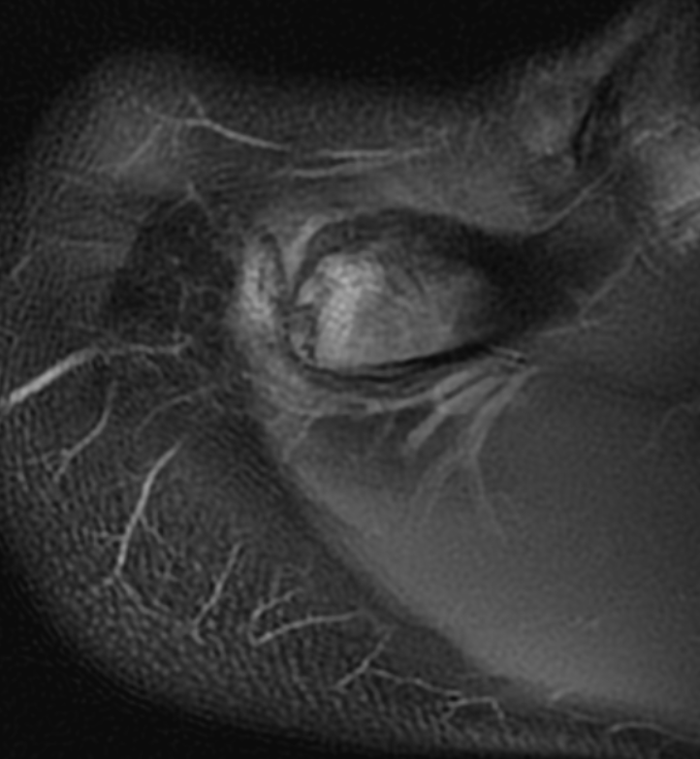
Distal clavicular osteolysis (DCO)
Radiograph demonstrates resorption
of the distal clavicle
Axial PD MRI in a different patient demonstrates
intense bone marrow edema in the distal clavicle,
which is out of proportion to the acromion

Slide 26
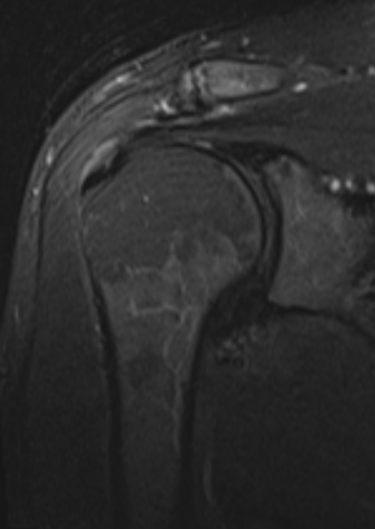
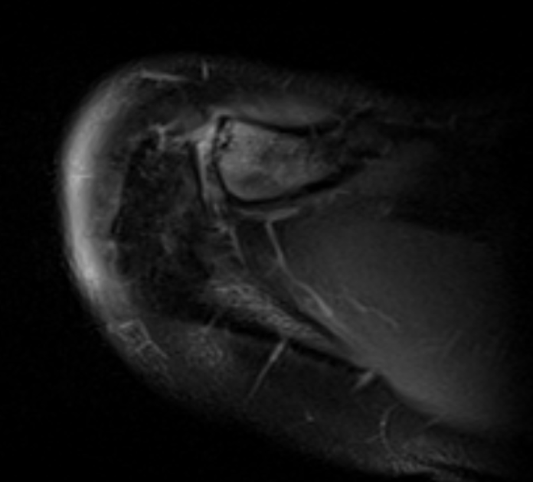
Intense marrow edema in
the distal clavicle with an
nondisplaced subchondral
fracture , an associated
finding
DCO is classically described
in weightlifters (repetitive
microtrauma), but occurs
also in the posttraumatic
setting (after AC joint injury)

Slide 27
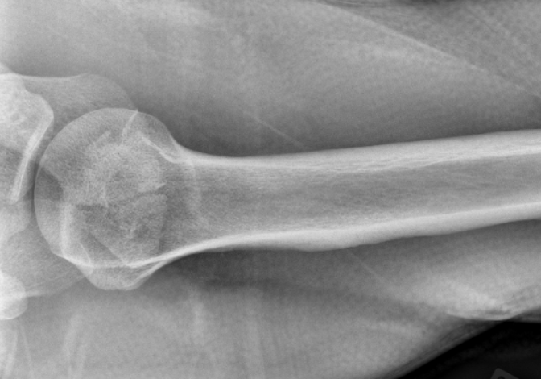
Os acromiale
Unfused acromial apophysis
3 ossification centers of the acromion:
  Preacromion (most distal)
  Mesoacromion (mid)
  Metaacromion (proximal)
Normal apophysis can be unfused until age of 25
On MRI evaluate for signal intensity in the acromial
synchondrosis 🡪 stable vs. unstable
Unstable os acromiale have questionable
association with impingement and subsequent
rotator cuff tendinopathy
Linear lucency with sclerotic margins
Fracture has typically an oblique orientation
Axillary view

Slide 28
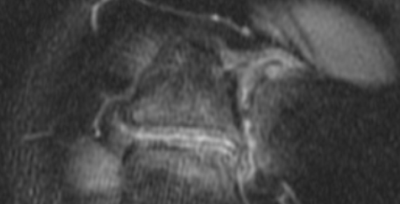
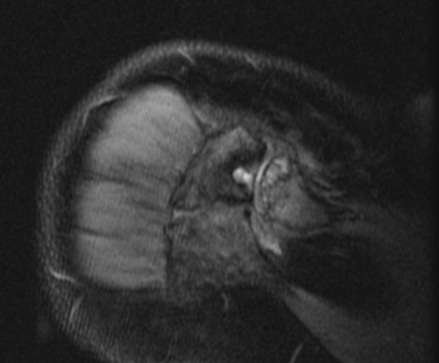
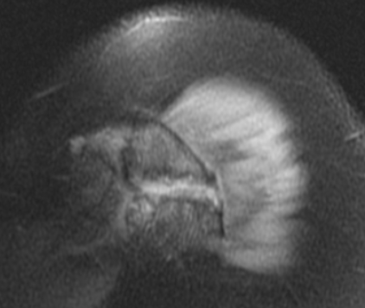
High signal spanning the synchondrosis.
In addition there is adjacent bursitis , may
represent features of impingement
No features of active osseous stress response

