Slide 1



How to approach a
Knee MRI
Kristen E. McClure, MD
Lukas M. Trunz, MD

Slide 2
Routine Knee MRI Protocol
Seq. | FOV | Matrix/Nex | Slice | TR | TE | ETL | BW
Sag PD FSE NonFatSat | 14-16 | 512 x 256 2 | 4/0.5 | 3000 | 15-20 | 8 | 16
Sag T2 FSE FatSat | 14-16 | 256 x 256 2 | 4/0.5 | 2000 | 70-80 | 8 | 16
Cor T1 SE NonFatSat | 16-18 | 256 x 192 1 | 3/0.5 | 400-800 | Minimal |  | 16
Cor T2 FSE FatSat | 16-18 | 256 x 256 2 | 3/0.5 | >2000 | 70-80 | 8 | 16
Axial T2 FSE FatSat | 14-16 | 256 x 256 2 | 3/0.5 | >2000 | 70-80 | 8 | 16

Slide 3
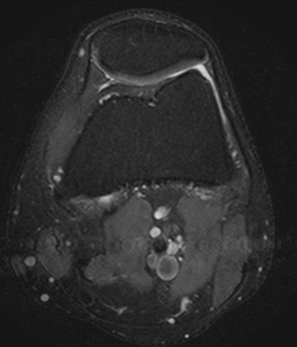
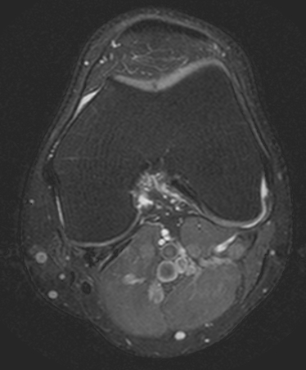
Step by step approach
Evaluate for Fluid:
  Axial T2 fat saturated sequences
  Joint effusion: present or absent
  Baker’s cyst: present or absent
Normal joint fluid.
No joint effusion.
No Baker’s cyst.
No fluid located between the
medial head gastrocnemius and
semimembranosus.

Slide 4
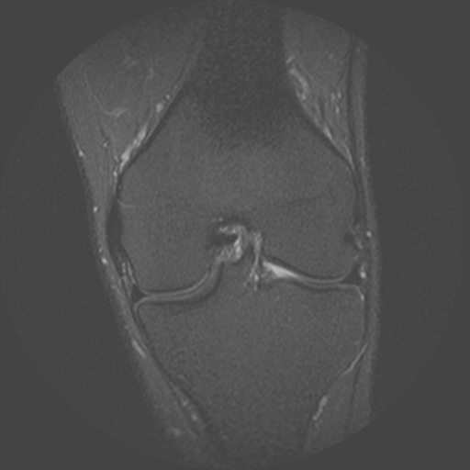
Step by step approach
2. Evaluate for Osseous Contusions or Fractures:
  Check T2 fat saturated sequences and confirm fractures on Coronal T1 non-fat saturated sequences
Normal marrow signal on coronal fluid
sensitive imaging of the knee.

Slide 5
Step by step approach
Evaluate the Medial Compartment:
  On the Sagittal Proton Density (PD) sequence: Check for the medial meniscus (MM) → tear present or absent
  Make sure to follow the posterior horn all the way to the posterior root attachment
  Check for abnormal meniscal morphology or displaced fragments

Slide 6
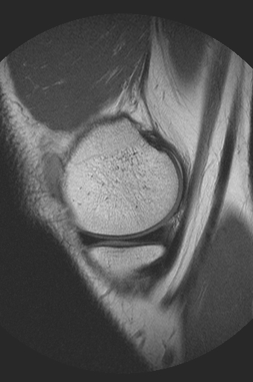
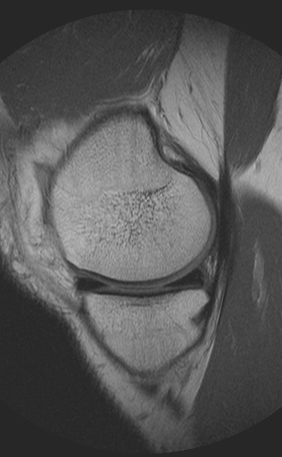
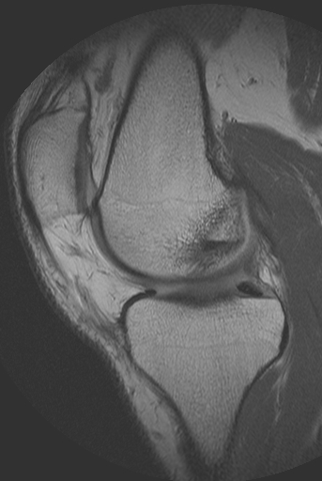
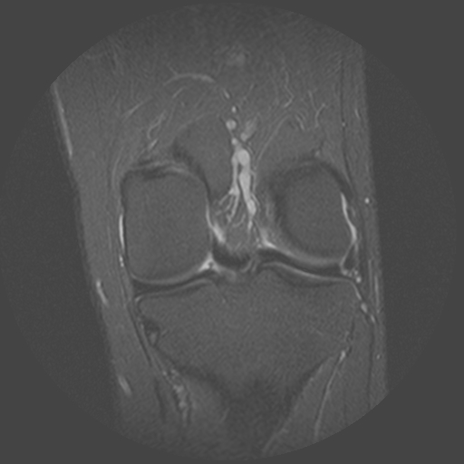
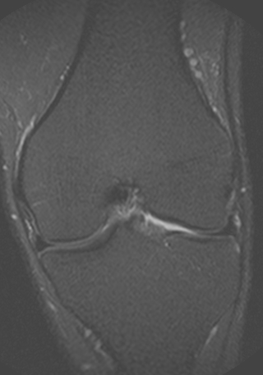
Medial
Compartment
Normal insertion of the posterior root of
the medial meniscus.
Normal appearance of the
medial meniscus body and hyaline cartilage on coronal imaging.
Normal appearance of the medial meniscus
on sagittal proton density imaging
Normal appearance of the
medial meniscus posterior horn and
root on coronal imaging.

Slide 7
Step by step approach
Medial Compartment (continued):
  On the Coronal T2 fat saturated sequence: MM → evaluate the meniscal body (not well seen on sagittal sequences)
  Look for secondary signs of meniscal tears: linear subchondral marrow edema, parameniscal cysts, parameniscal soft tissue edema, adjacent periligamentous edema, adjacent chondrosis
  Check the medial compartment hyaline cartilage for partial thickness and full thickness defects on the Coronal and Sagittal T2 fat saturated sequences

Slide 8
Step by step approach
Evaluate the Lateral Compartment:
  On the Sagittal PD sequence: Check for the lateral meniscus (LM) → tear present or absent; remember the anterior root of the lateral meniscus blends with the fibers of the ACL (speckled appearance at the anterior root is normal)
  On the Coronal T2 fat saturated sequence: LM → evaluate the meniscal body
  Look for secondary signs of meniscal tear: linear subchondral marrow edema, parameniscal cysts, parameniscal soft tissue edema, adjacent periligamentous edema, adjacent chondrosis

Slide 9
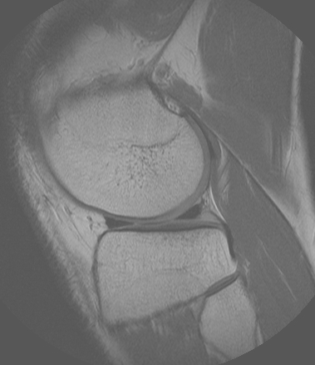
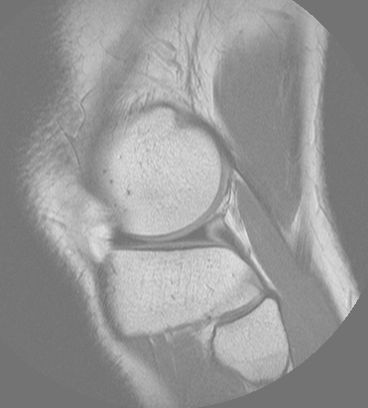
Lateral Compartment
Normal appearance of the lateral meniscus
body, posterior horn, and hyaline
cartilage on coronal imaging.
Normal appearance of the lateral meniscus
on sagittal proton density imaging.

Slide 10
Step by step approach
Lateral Compartment (continued):
  Check the lateral compartment hyaline cartilage for partial thickness and full thickness defects on the Coronal and sagittal T2 fat saturated sequences
Anterior and Posterior Cruciate Ligaments (ACL + PCL):
  On the Axial T2 fat saturated and Coronal T2 fat saturated sequences check for the integrity of the ACL and PCL.
    Origin of the ACL is found at the level of the lateral patellar facet
    Follow both ACL bundles (anteromedial and posterolateral) to the insertion at the tibial eminence (confirm the ACL integrity on the Coronal T2 fat saturated sequence
    PCL Integrity can be evaluated on several sequences, including Axial T2 fat saturated, Coronal T2 fat saturated, or Sagittal T2 fat saturated sequences.

Slide 11
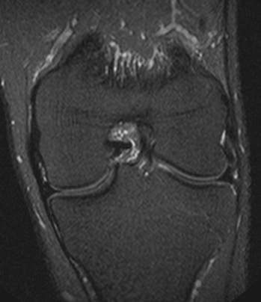
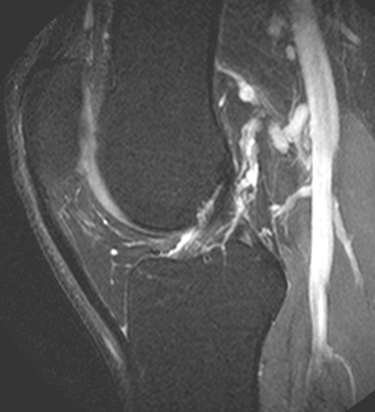
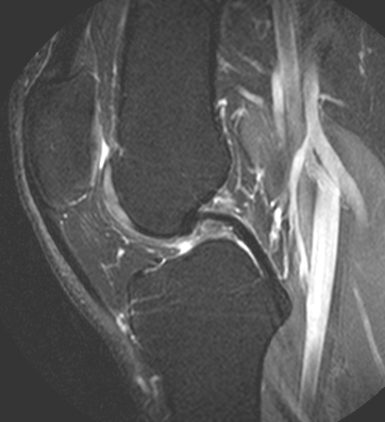
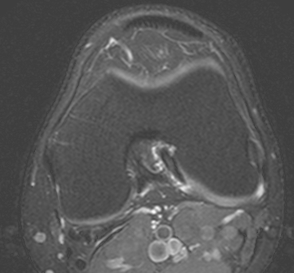
Anterior and Posterior Cruciate Ligaments
Normal appearance of the ACL on coronal,
axial, and sagittal imaging.
Normal appearance of the PCL
on sagittal imaging.

Slide 12
Step by step approach
Medial Collateral Ligament (MCL) and Lateral Collateral Ligament (LCL) Complex:
  Follow the MCL on the Coronal and Axial T2 fat saturated sequences → evaluate both the superficial and deep components
  LCL complex is also evaluated on the Coronal and Axial T2 fat saturated sequences → evaluate the complex anterior to posterior:
    Distal iliotibial band
    Fibular collateral ligament
    Popliteus tendon
    Distal biceps femoris tendon
  Posterolateral corner: Evaluate smaller structures on all 3 imaging planes in the T2 weighted fat saturated sequences

Slide 13
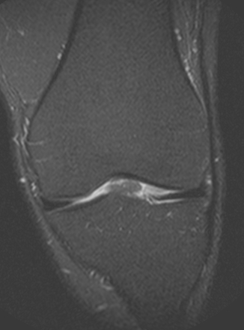
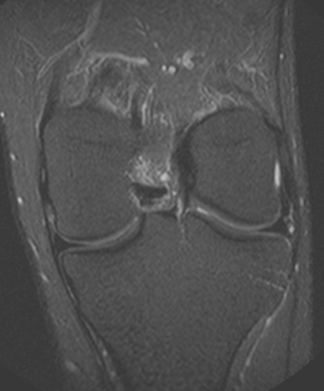
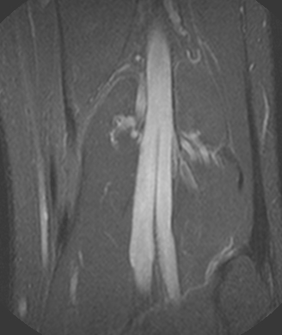
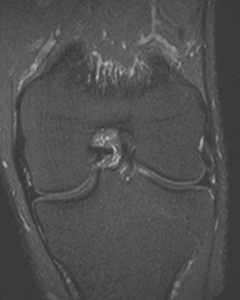
LCL Complex and MCL
Normal appearance of the lateral collateral ligament complex from anterior to posterior
on coronal imaging: distal iliotibial band, fibular collateral ligament and popliteus tendon,
and distal biceps femoris tendon.
Normal appearance of the
medial collateral ligament on
coronal imaging.

Slide 14

Step by step approach
Extensor Mechanism:
  On the Sagittal T2 fat saturated sequence: Check the distal quadriceps and patellar tendon → any abnormalities can be confirmed or further characterized on the Axial T2 fat saturated sequence, including tendinosis or tearing
Patellofemoral Compartment:
  On the Axial and Sagittal T2 fat saturated sequence: Check the patellofemoral compartment cartilage for partial thickness or full thickness hyaline cartilage defects.
  Evaluate patellar and trochlear morphology
    Assess for lateral patellofemoral maltracking (including an TT-TG distance, soft tissue edema in the superolateral aspect of Hoffa’s fat, patella alta, etc.)

Slide 15

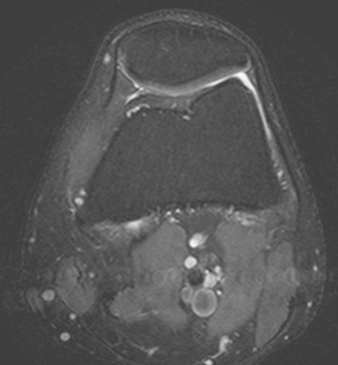
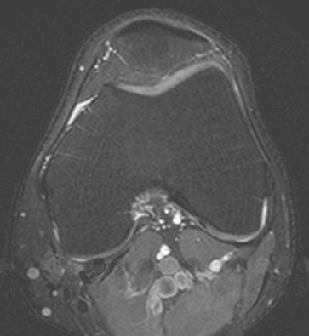
Extensor Mechanism and Patellofemoral Compartment
Normal appearance of the distal quadriceps and patellar tendons (blue arrows).
Normal appearance of the patellar and trochlear hyaline cartilage (red arrows).

Slide 16
Step by step approach
Neurovascular Structures and surrounding soft tissues:
  Perform a final survey of the neurovascular structures and surrounding soft tissues utilizing the Axial T2 fat saturated sequence
Localizer sequences:
  Check for masses, tumors etc. → larger field of view

Slide 17
Common Cases

Slide 18
Meniscus tear
Criteria:
Intrasubstance signal alteration extending to the articular surface → on two consecutive images- 90% accuracy. On a single image only- 55% accuracy for medial meniscus and 30% accuracy for the lateral meniscus
Abnormal Morphology
Important to differentiate from myxoid degeneration (signal alteration NOT extending to the articular surface)
T1/PD weighted: Highly sensitive
T2 weighted: Highly specific

Slide 19
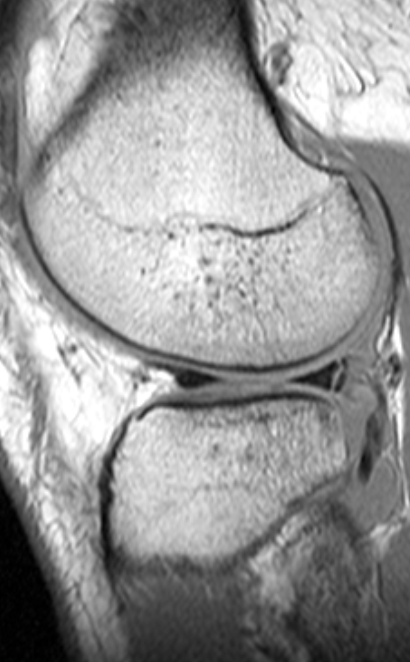
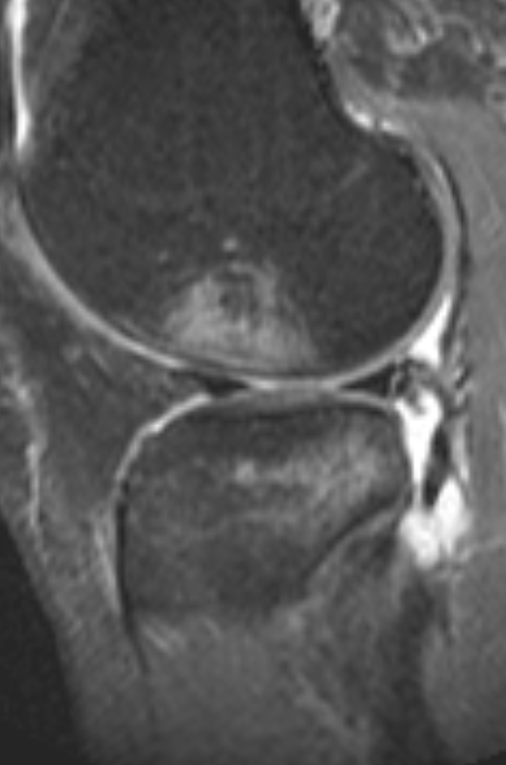
Vertical Tear
Peripheral vertical tear of the posterior horn of the lateral meniscus
Note also the
Pivot shift
osseous contusion
pattern involving
the posterior lateral
tibial plateau and lateral femoral condyle (patient also had an ACL tear)

Slide 20
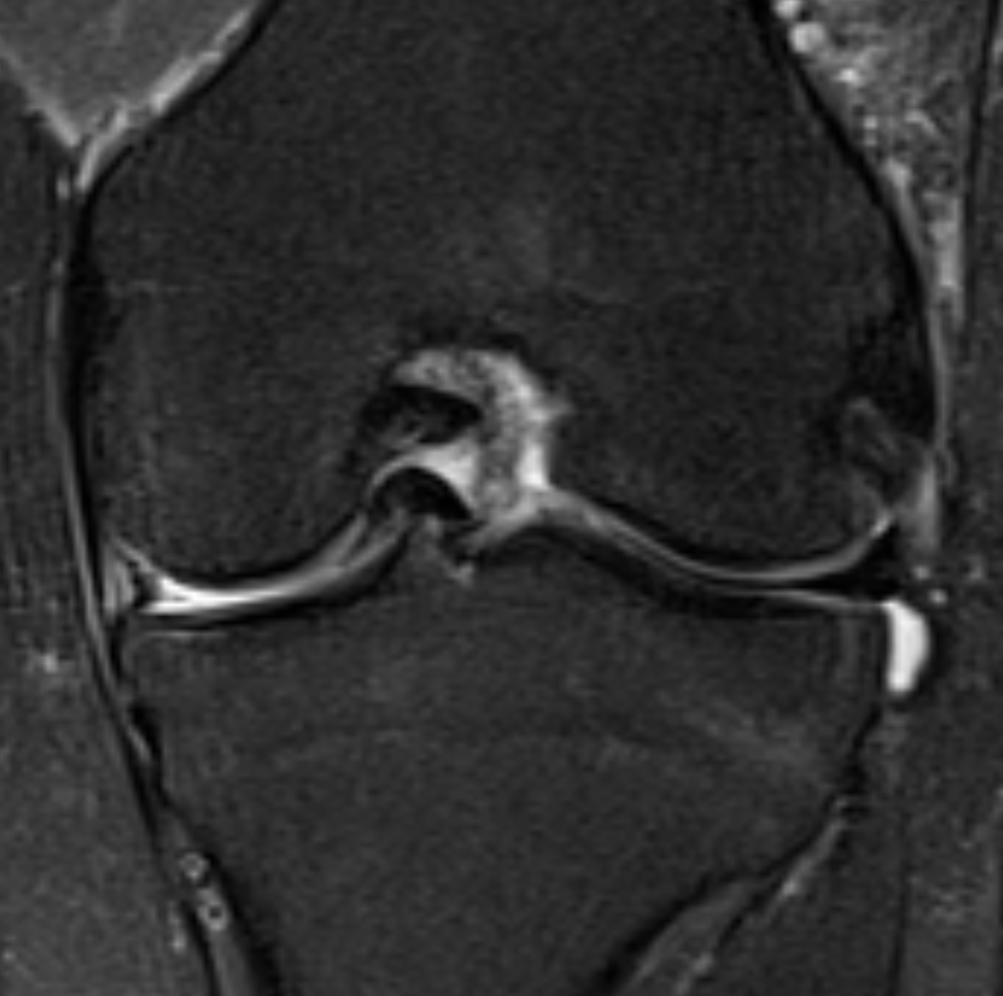
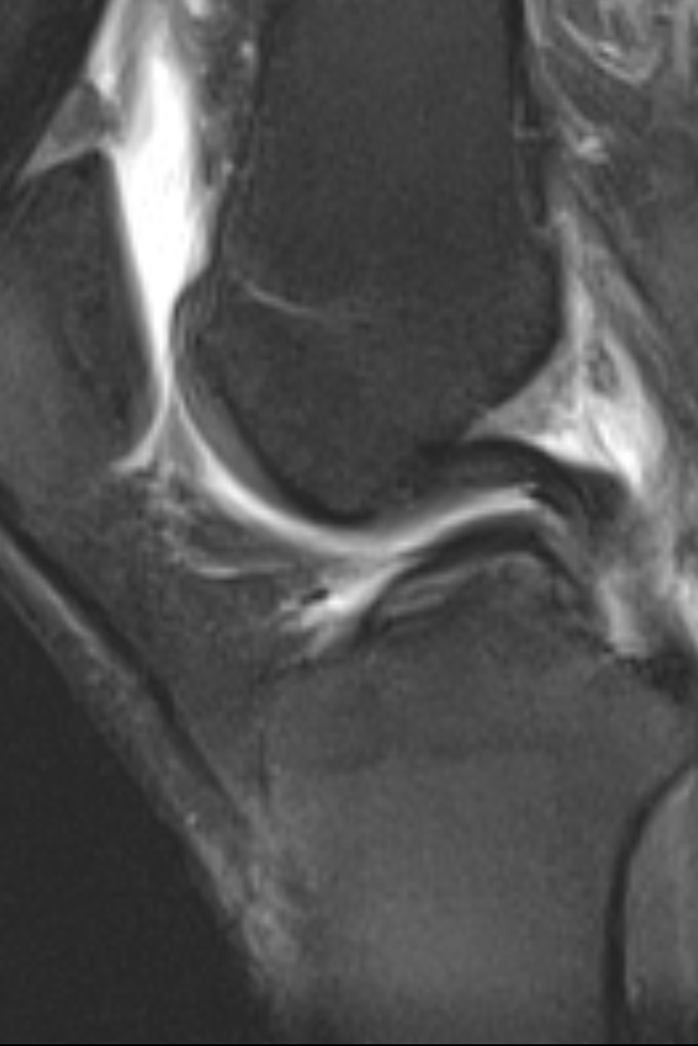
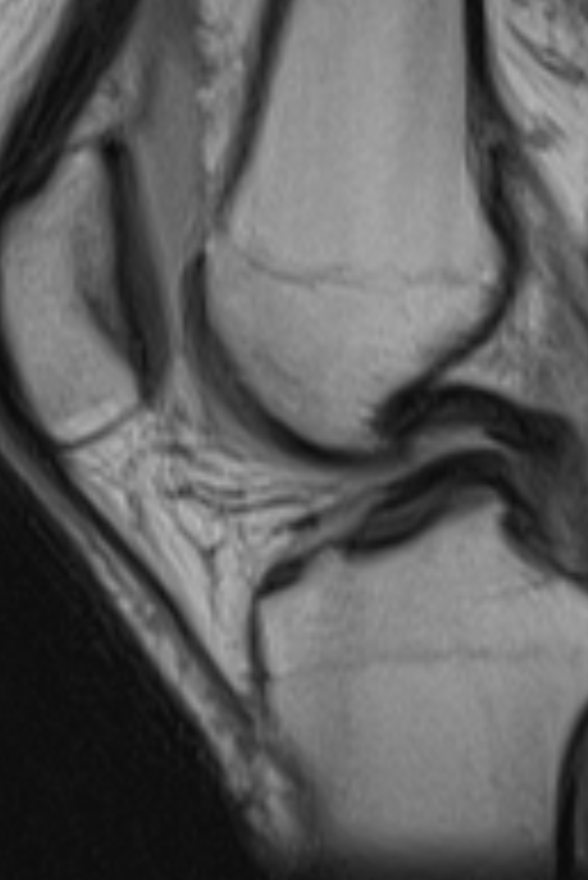
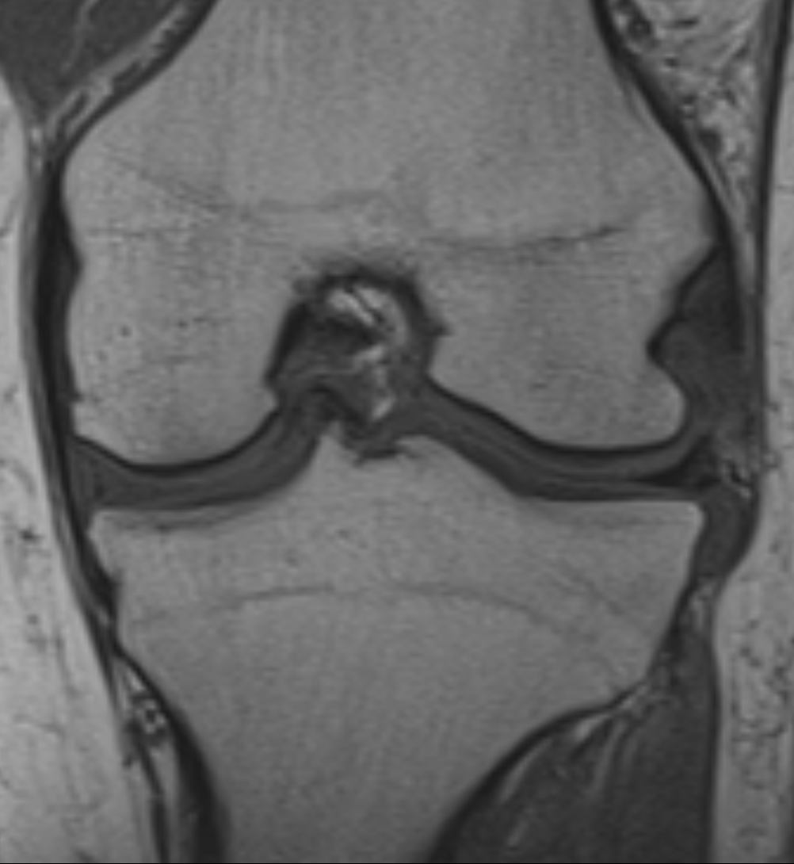
Bucket-Handle tear Medial Meniscus
Extensive vertical, circumferential tear with a flipped fragment into the intercondylar
notch , (most common location for displaced fragment)
PCL
PCL
‘Double PCL sign’
Displaced fragment roughly parallels
PCL (medial meniscus only)

Slide 21
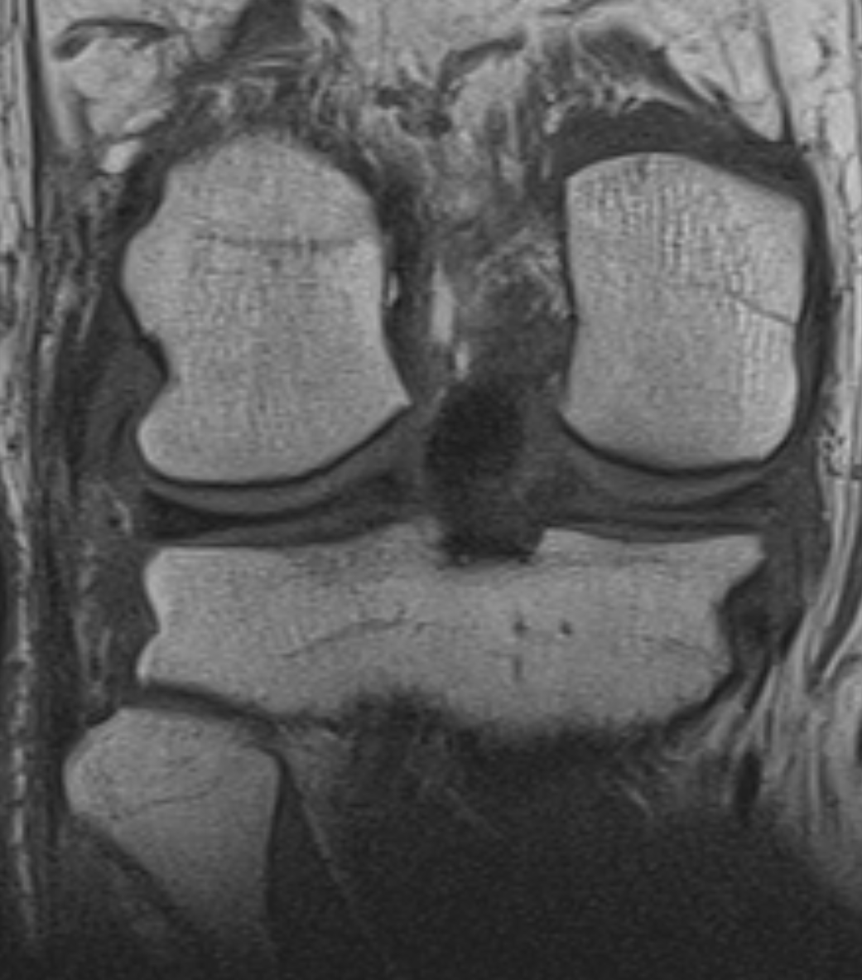
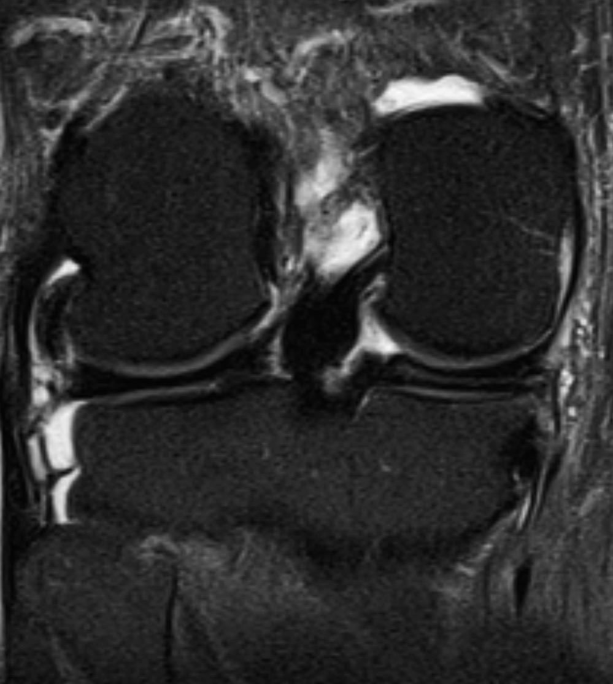
Horizontal (cleavage) tear Medial Meniscus

Slide 22
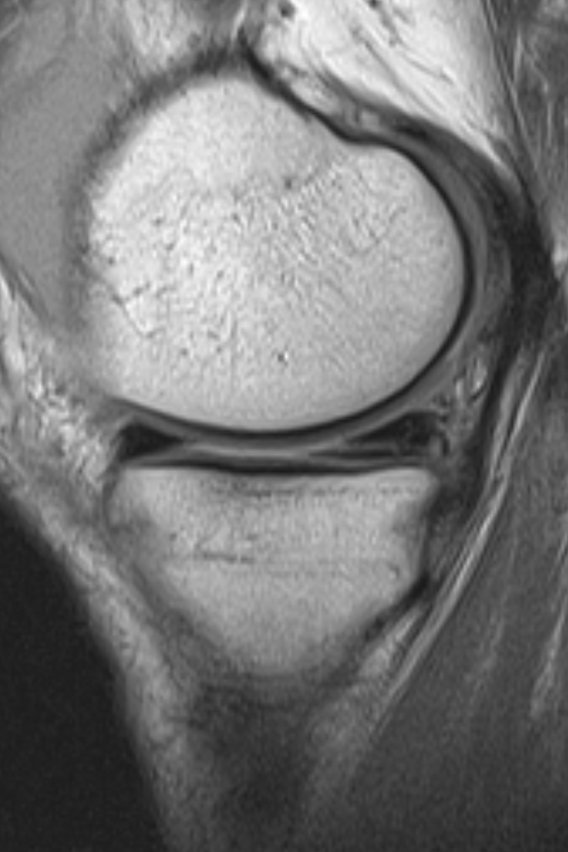
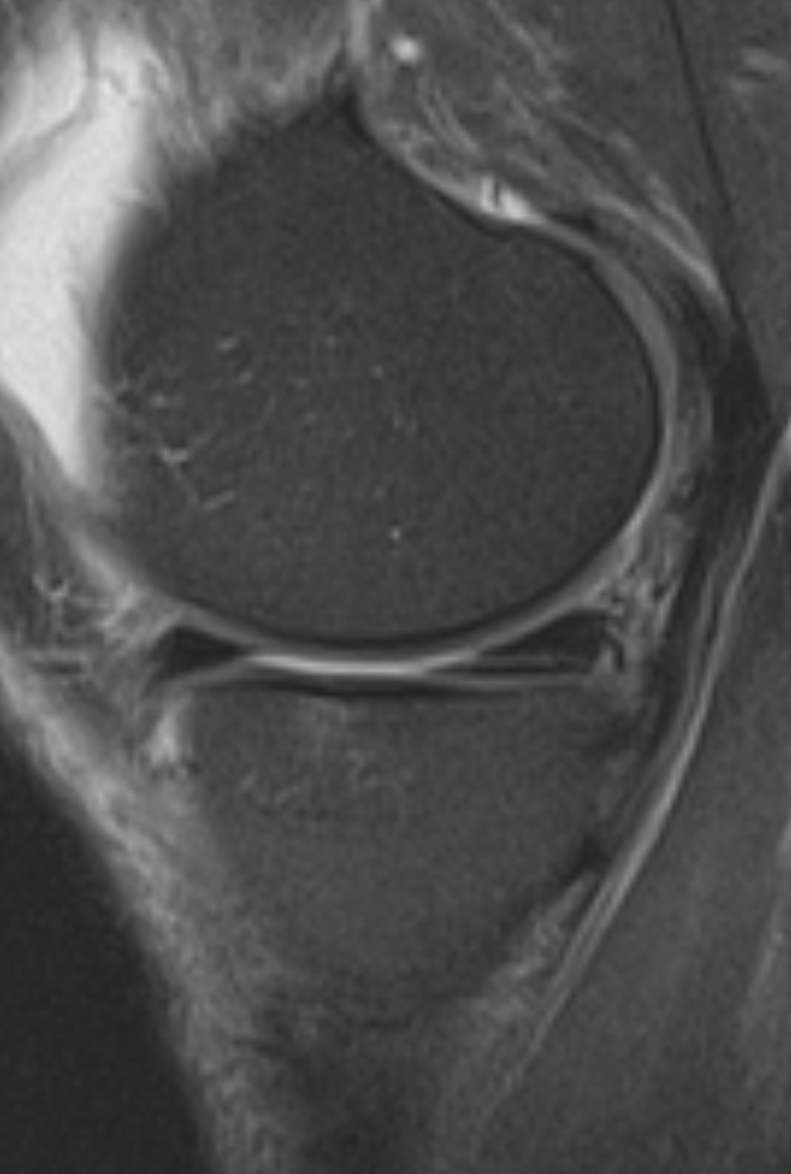
Horizontal cleavage tear
of the body and posterior horn
extending into the posterior root
of the medial meniscus

Slide 23
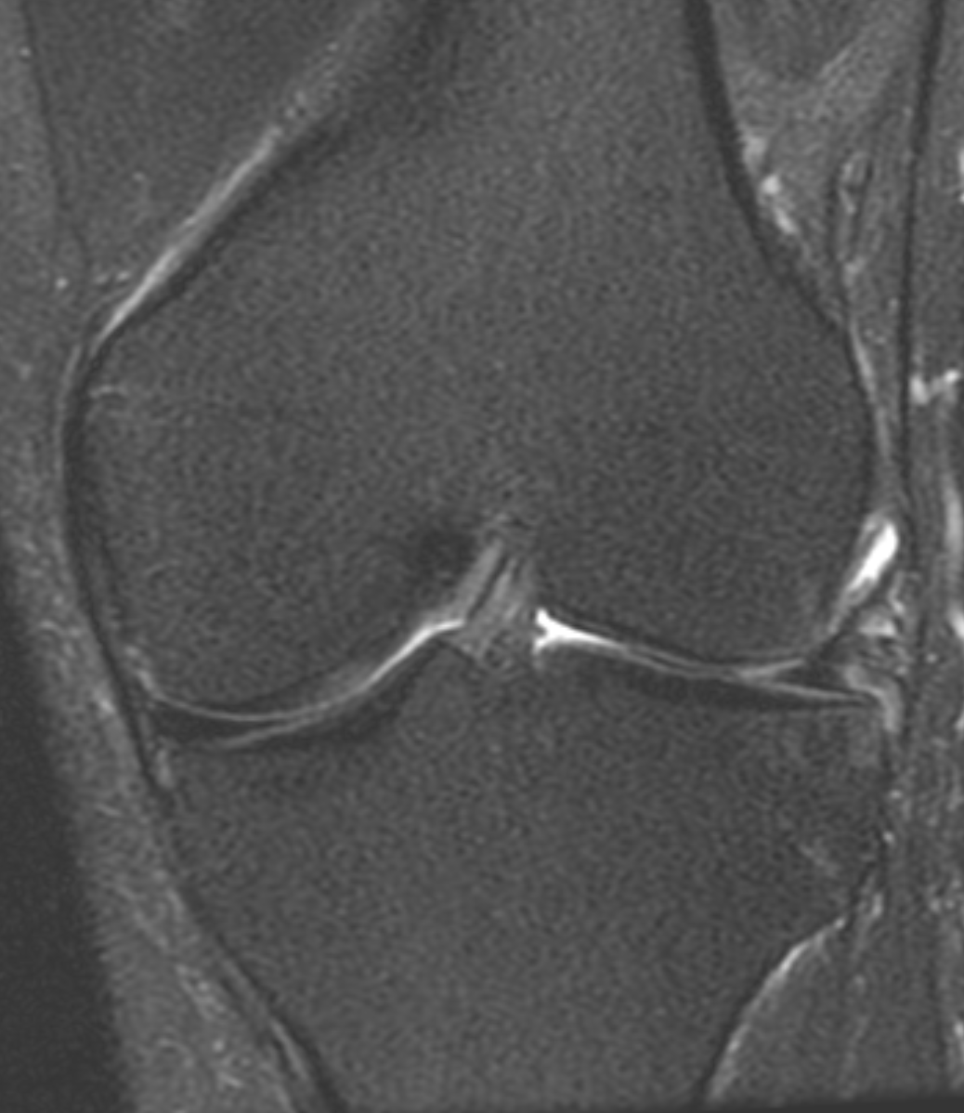
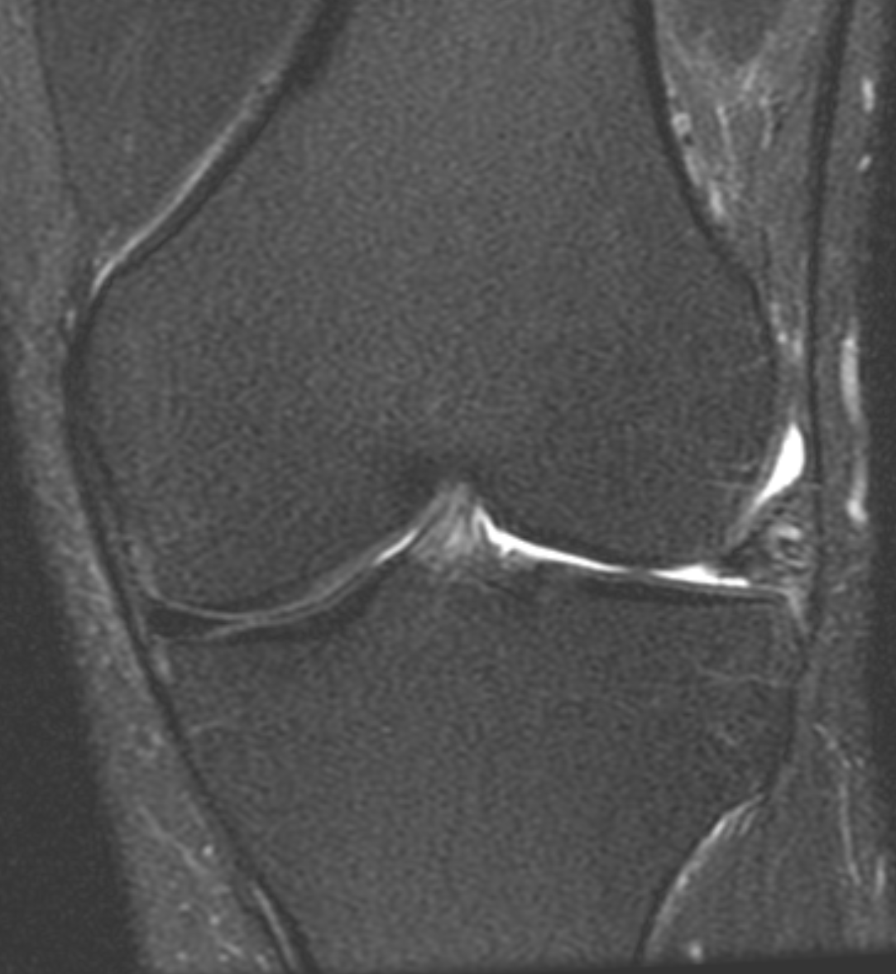
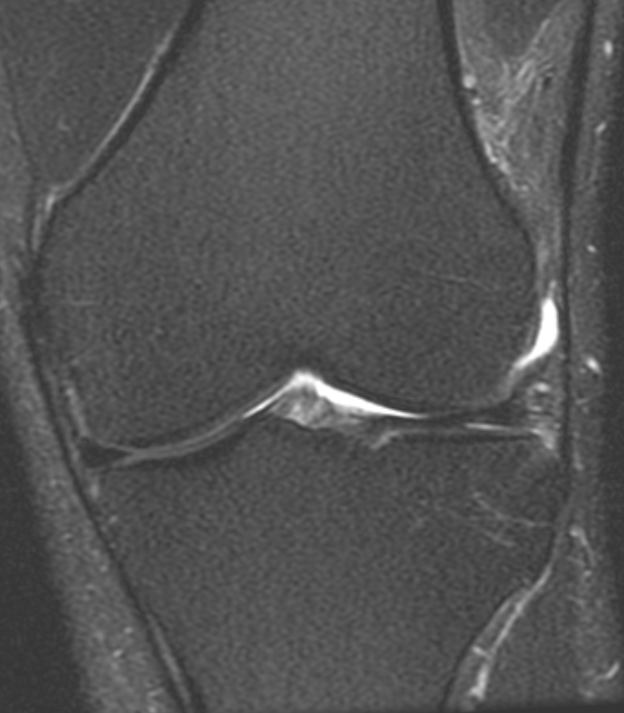
Radial tear Lateral Meniscus
Consecutive images of a coronal T2 fat saturated sequence demonstrates truncation involving the body of the lateral meniscus
, indicating a radial tear

Slide 24
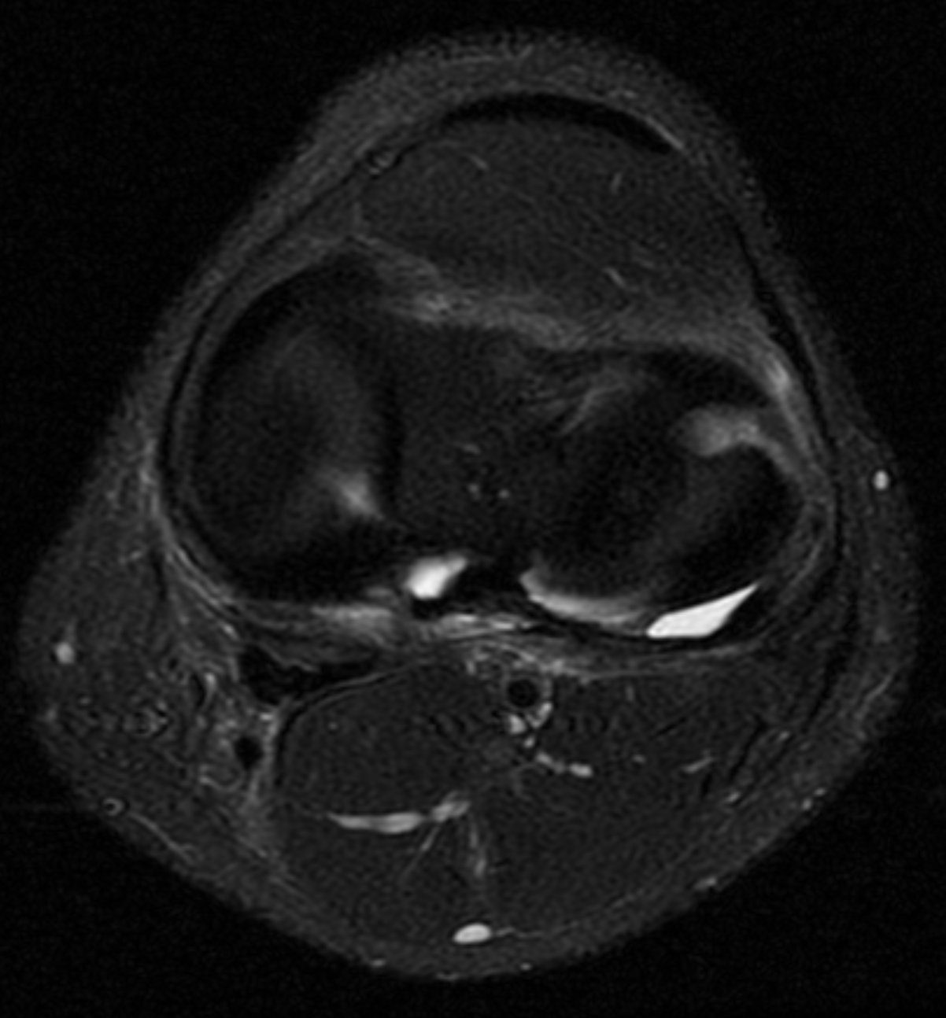
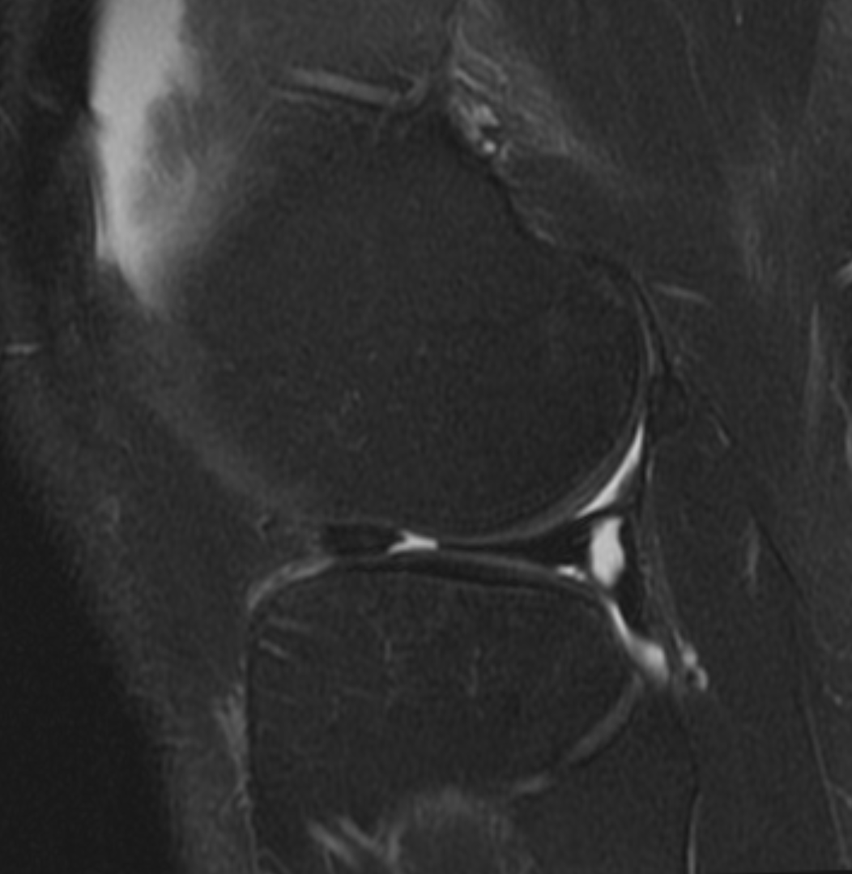
Note that the axial plane can be very helpful in assessing radial tears

Slide 25
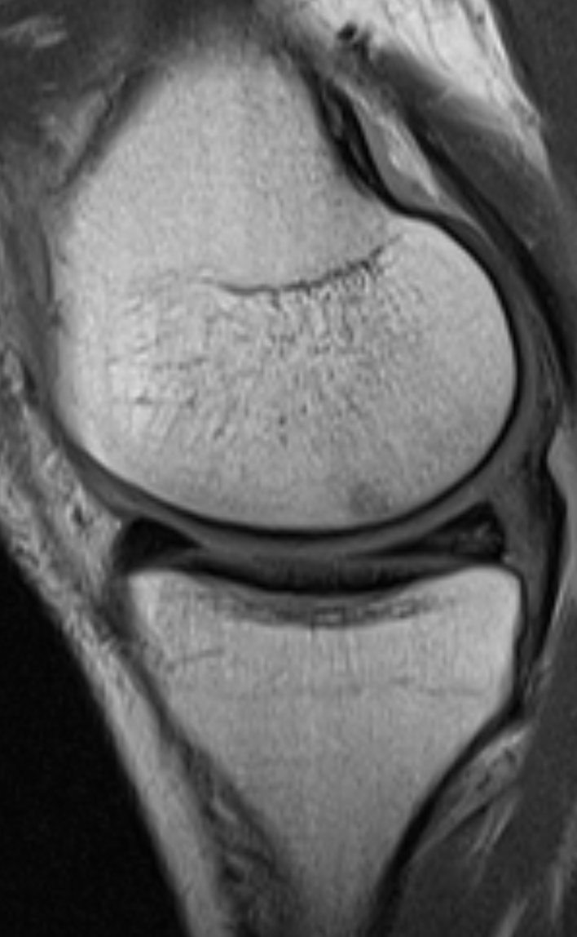
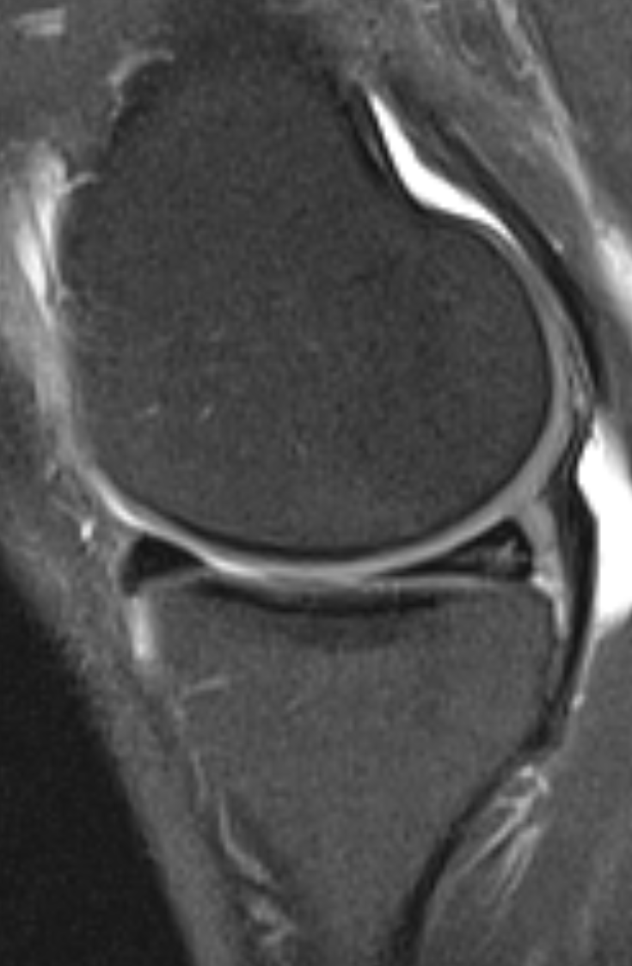
Complex tear
Meniscal tear extending into
more than one plane
Complex tear of the
posterior horn and body
of the medial meniscus

Slide 26
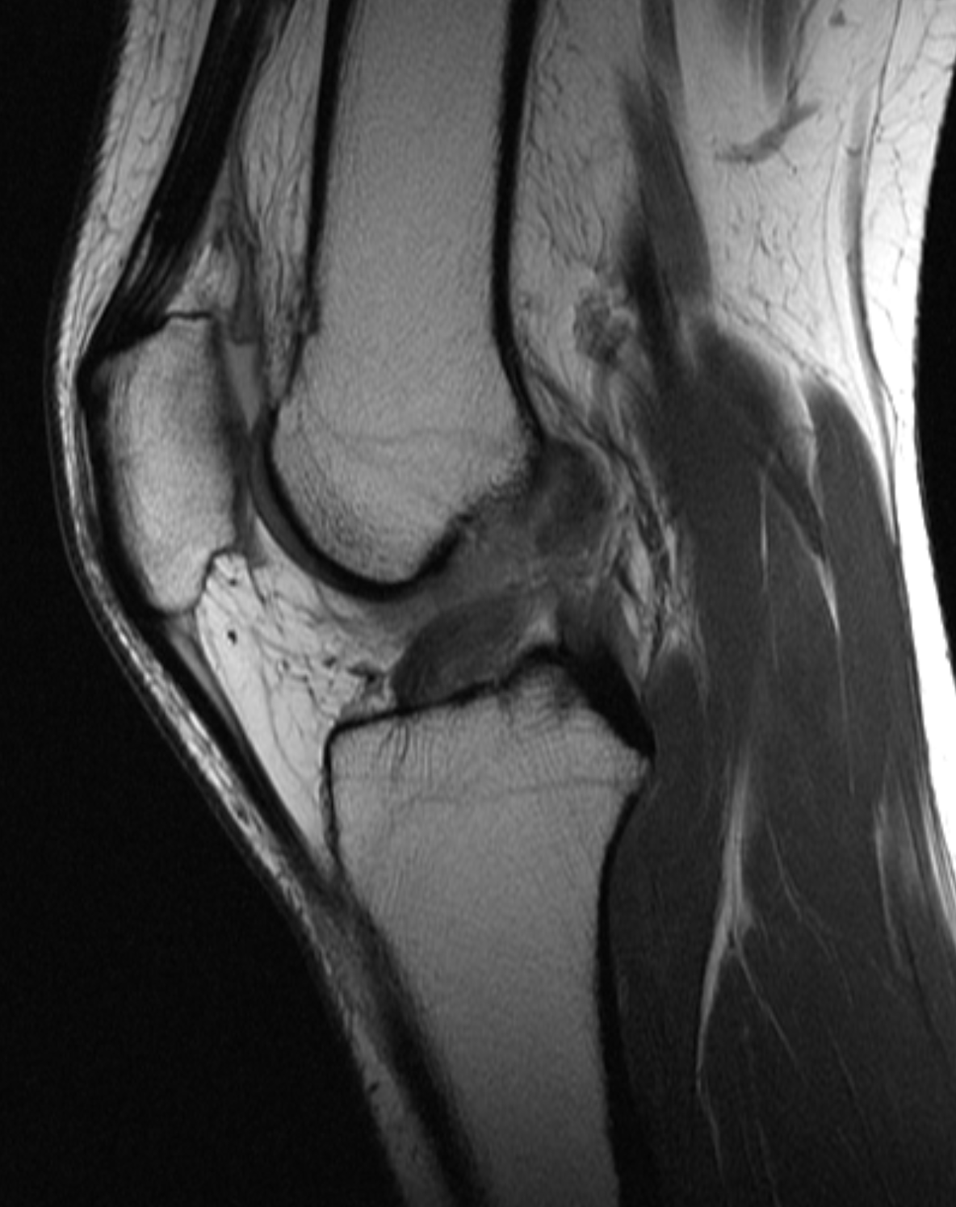
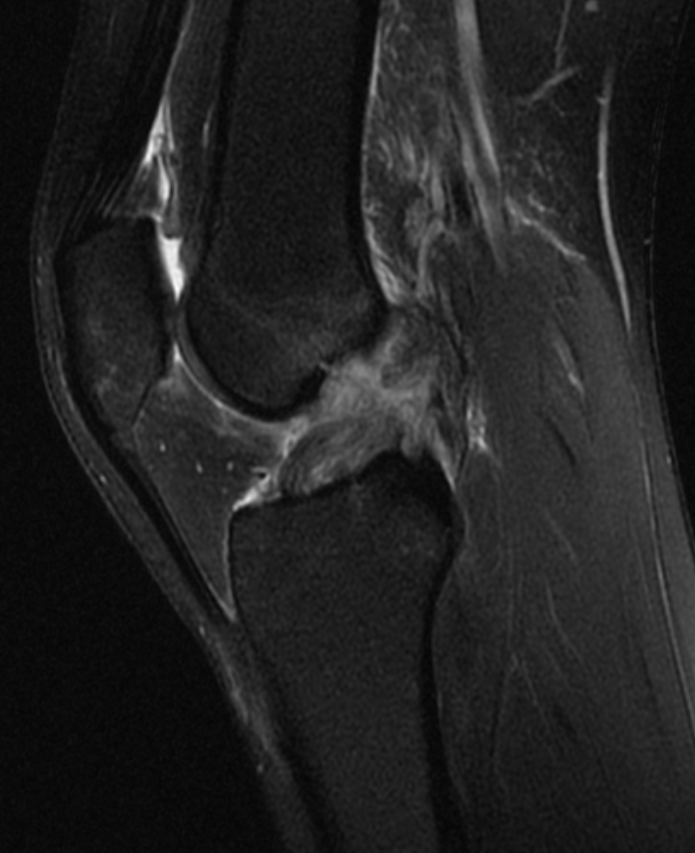
ACL tear
Complete ACL rupture (discontinuity of fibers) centered at its midsubstance

Slide 27
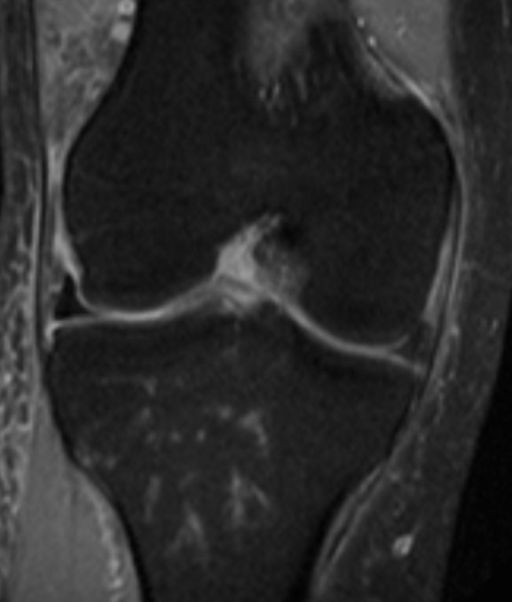
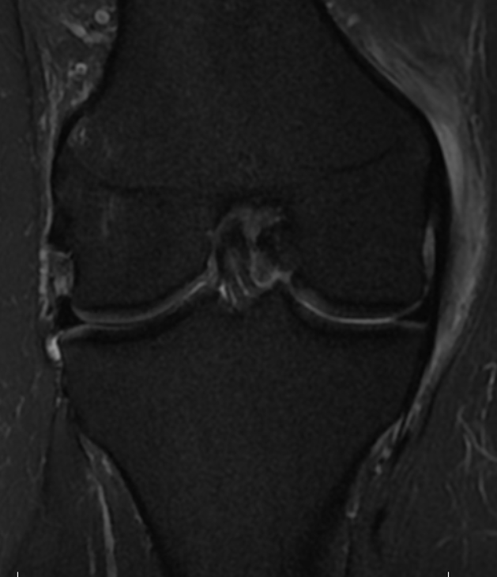
‘Empty sulcus sign’
in a different patient with
a complete tear of the
ACL
Normal appearance of the
ACL in the coronal plane
in a patient with an
intact ACL

Slide 28
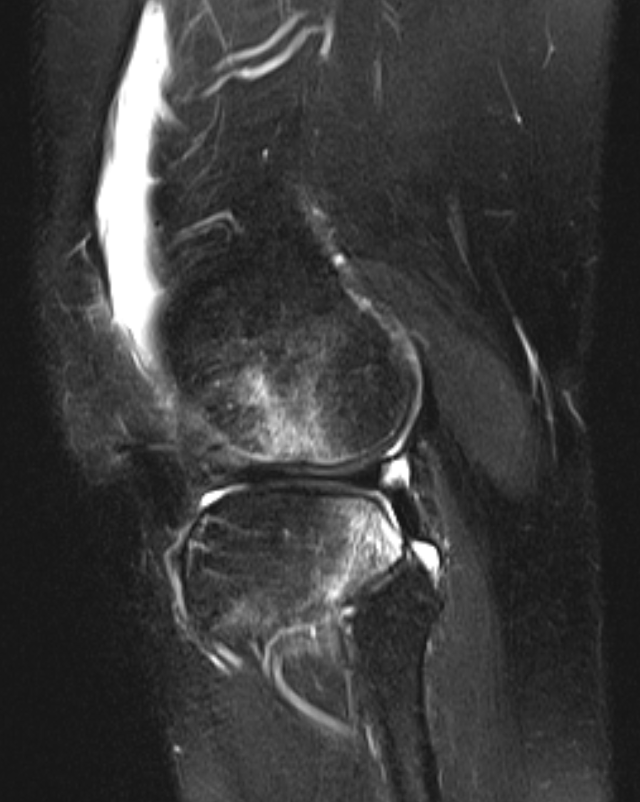
Secondary signs of ACL rupture
Best: Characteristic osseous contusion
pattern (‘Pivot-shift’ mechanism)
Bone marrow edema in the lateral femoral
condyle and posterolateral tibial plateau

Slide 29
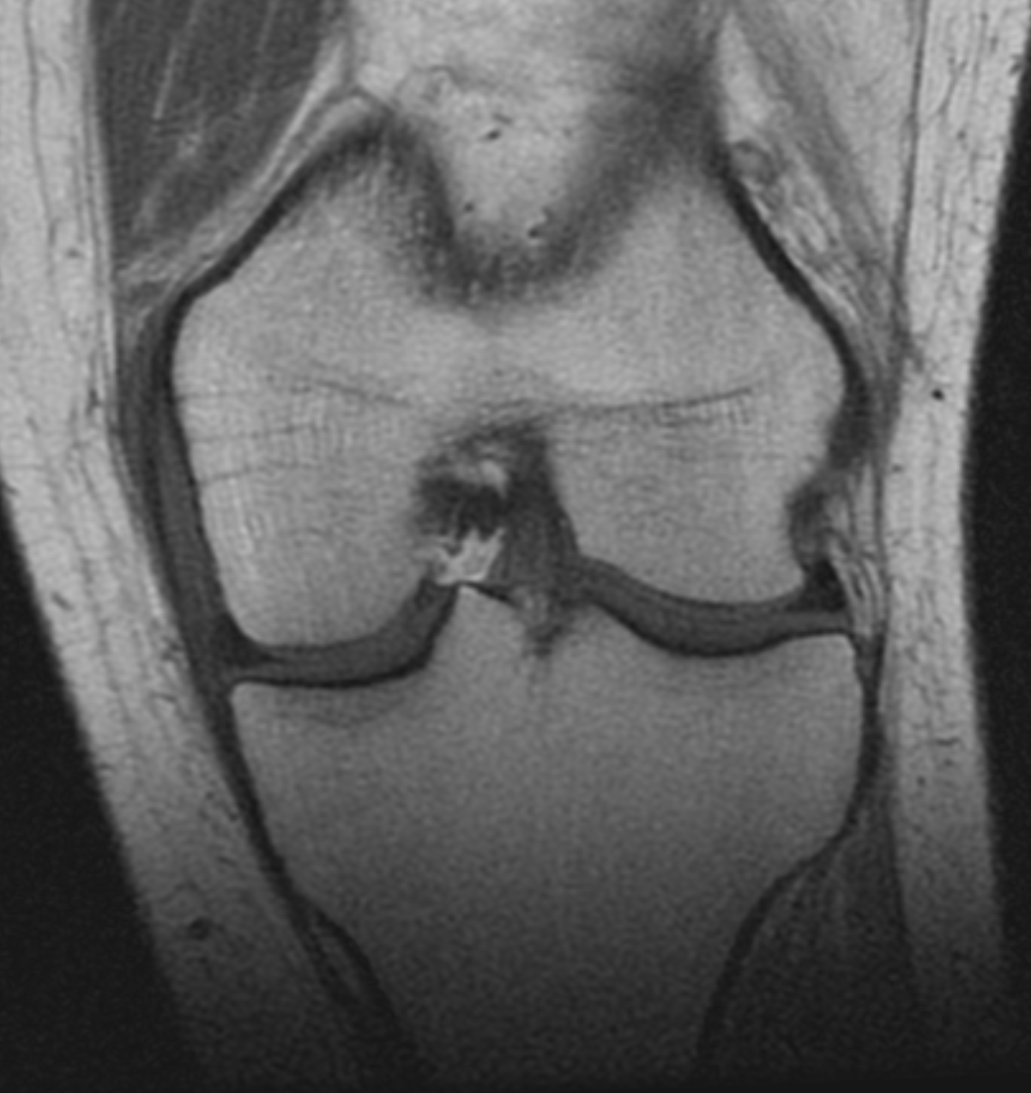
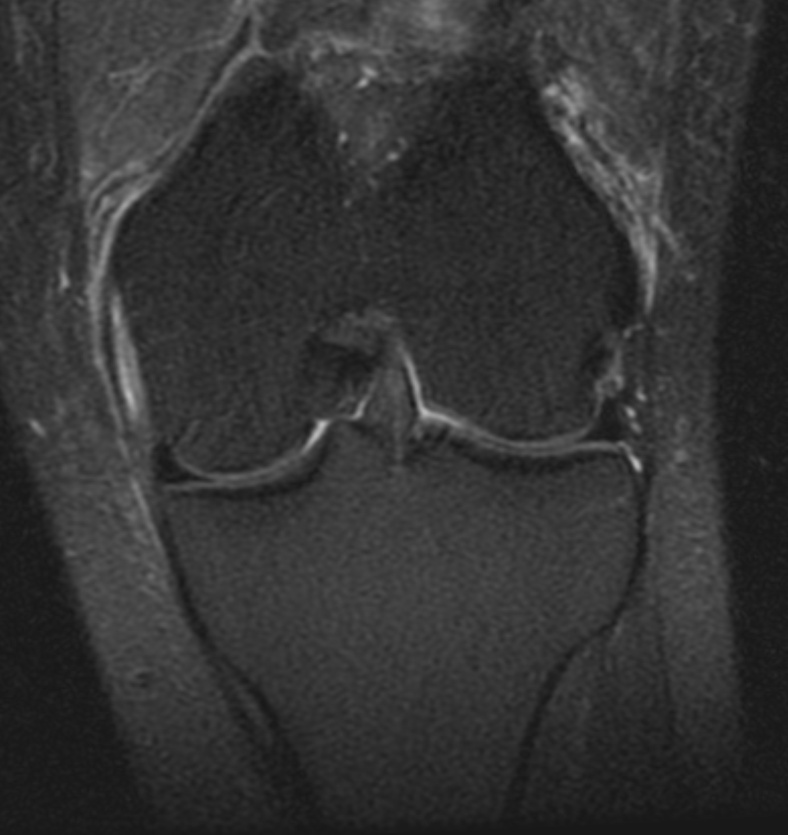
MCL Sprain: Grade I
Grade I = peri-ligamentous edema
(ligament itself is intact)

Slide 30
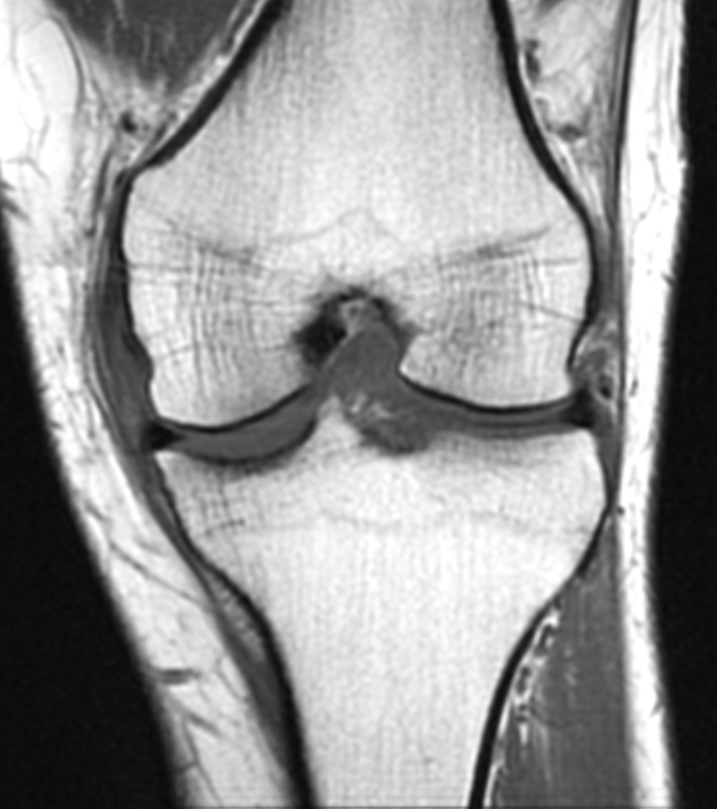
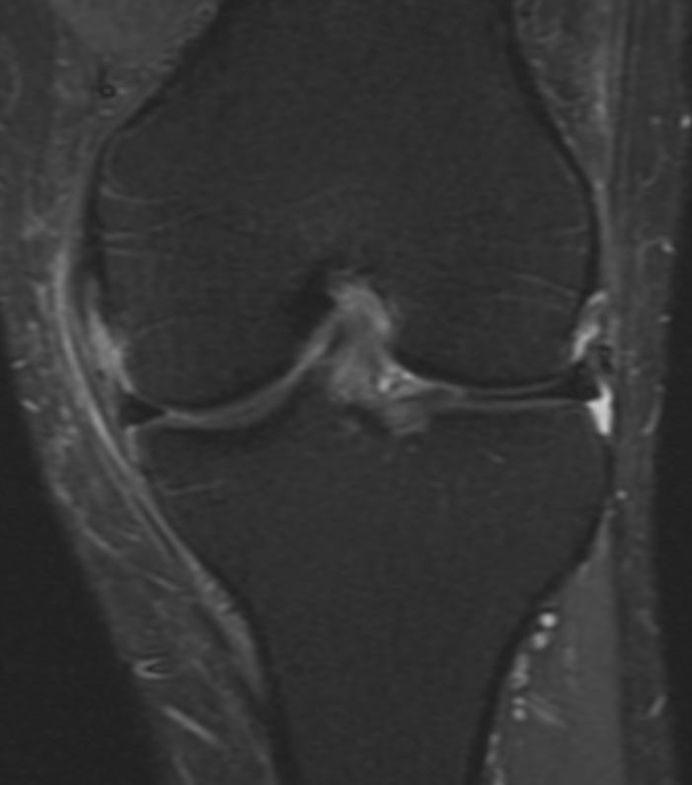
MCL Sprain: Grade II
Grade II = Partial disruption of the fibers with
increased intrasubstance signal

Slide 31
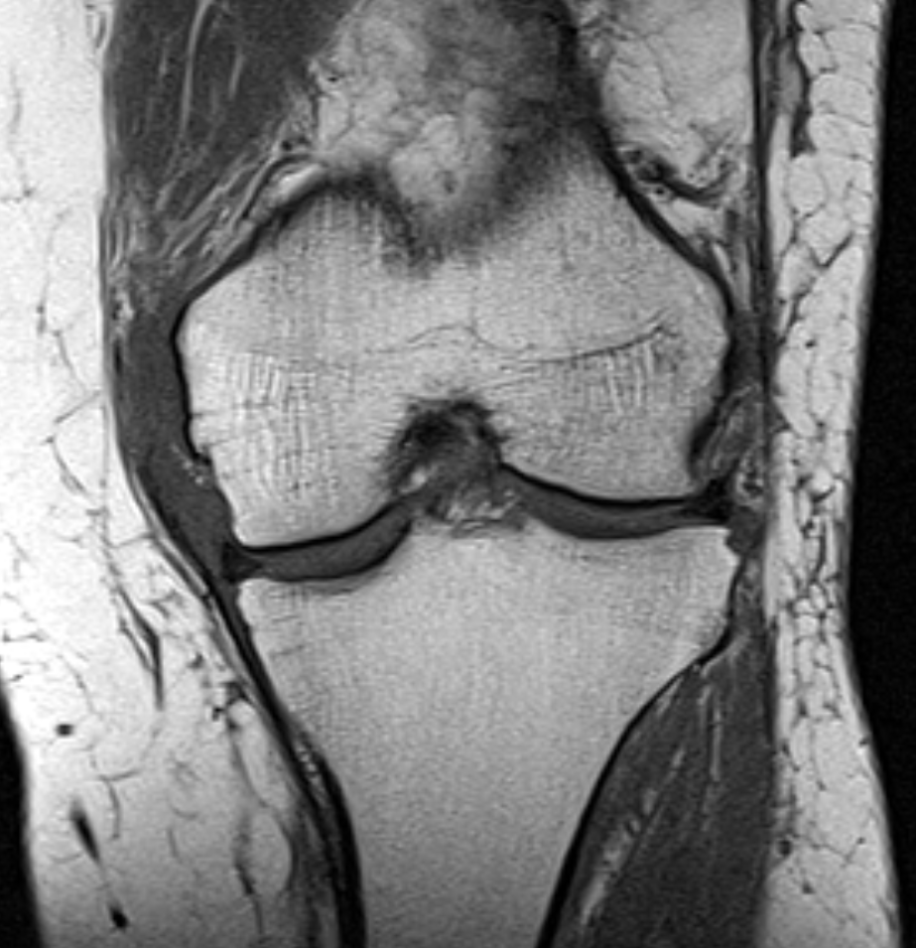
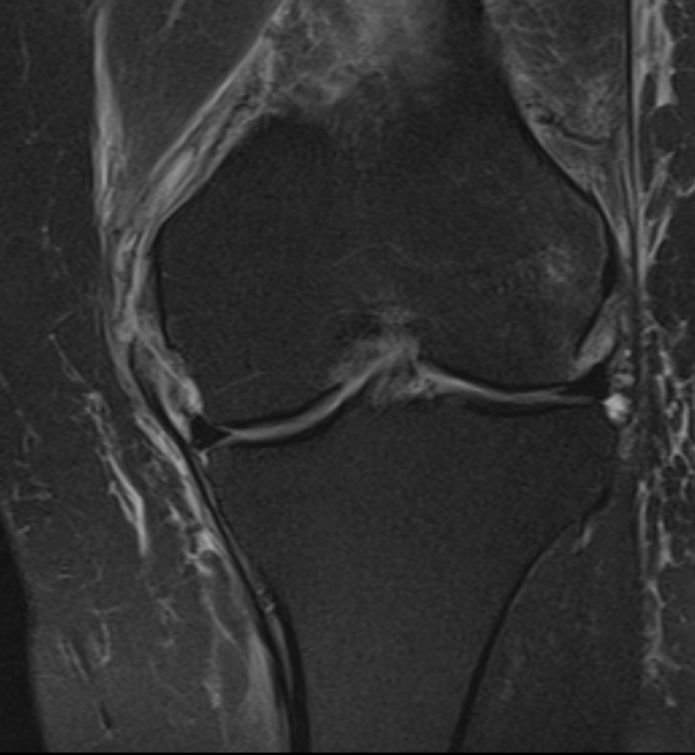
MCL Sprain: Grade III
Grade III = Complete proximal disruption of the
ligament ( superficial fibers)
Note also injury of the meniscofemoral ligament

Slide 32
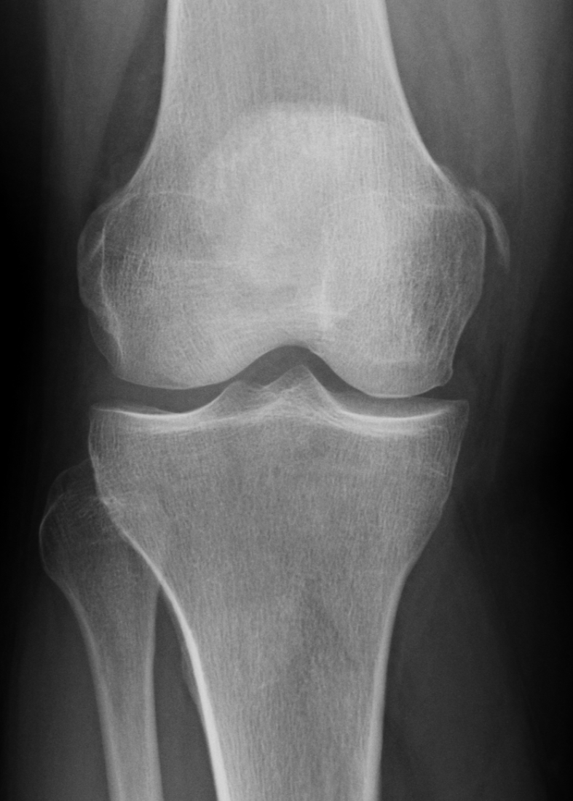
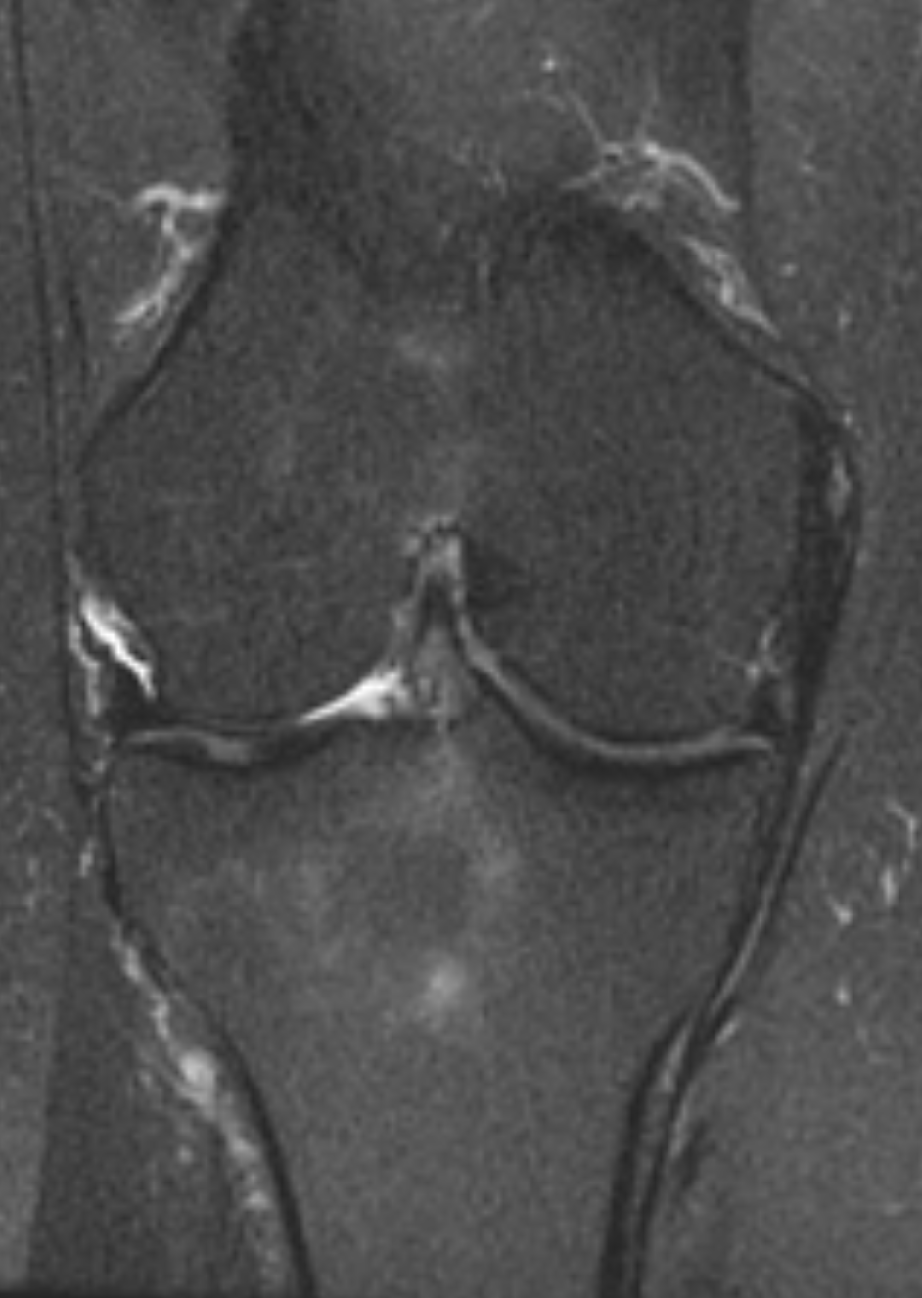
Pellegrini-Stieda lesion
Ossification/calcification
of MCL in a typical location
Result of remote MCL injury
Best seen on radiographs

Slide 33


Subchondral insufficiency fracture
(formerly ‘SONK’)
Subchondral insufficiency
fracture of the medial
femoral condyle
In osteoporotic bone
Weight-bearing surfaces
Often associated with
meniscal tear
Intense associated osseous edema

Slide 34


Subchondral insufficiency fracture of the medial tibial plateau

Slide 35


Lateral patellofemoral maltracking
Lateral patellofemoral maltracking = patellar instability, which increases risk for recurrent patellar dislocations
Most common risk factors: trochlear dysplasia, patella alta (high position of the patella), and lateralization of the tibial tuberosity
Patella alta
A/B =
Insall-Salvati Index
> 1.3 = patella alta
1.5 in this case
B
Patellar and trochlear dysplasia with an
elongated lateral patellar facet and a
shallow trochlear groove
A

Slide 36



TT-TG Distance
Distance from the middle of the tibial tuberosity (TT) and deepest point of the trochlear groove (TG)
A line along the posterior femoral condyles is used as a reference
< 15 mm = normal
15-20 mm = borderline
> 20 mm = marked lateralization of the TT
TT-TG in this case 25mm

Slide 37


Transient patellar dislocation
Lateral transient patellar
dislocation out of the
trochlear groove (usually
a twisting injury)
Findings include typical
osseous contusion pattern
in the lateral femoral
condyle , and medial
patellar facet
Chondral shear fracture
of the medial patellar facet
is a common finding

Slide 38

A different patient with typical findings of transient
patellar dislocation
Tear of the anterior aspect of the medial
patellar retinaculum/MPFL , another
common finding
Note also the shallow appearing
trochlear grove, which can be seen with lateral
patellofemoral maltracking

Slide 39



Quadriceps tendinosis
Mild
Moderate
Severe

Slide 40


‘Jumper’s Knee’
'Jumper’s knee’ = Proximal patellar tendinosis
Partial tear/edema with expansion of the tendon
Often seen in basketball and volleyball players

