Slide 1



How to approach a CXR
Nina Terry
University of Alabama Birmingham

Slide 2
Objectives
Anatomy
Approach
Blind Spots
Common pathology

Slide 3
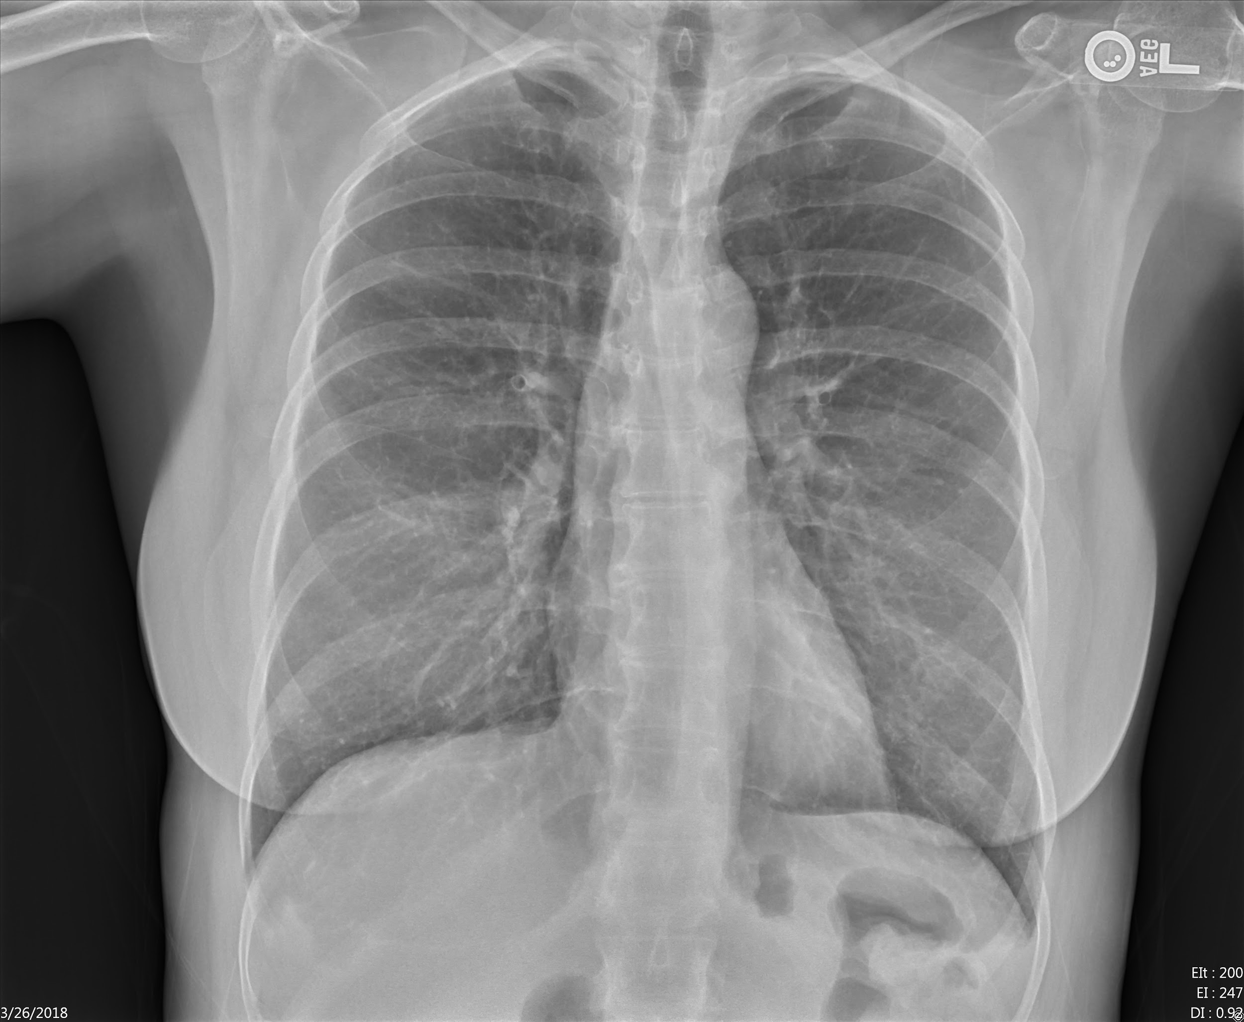
Normal
PA
Trachea
Aortic Arch
Right Hilum
Left Hilum
Right Ventricle
Left Ventricle
Right Diaphragm
Left
diaphragm

Slide 4
Normal
PA
Scapula
Clavicle
Thoracic Spine
Posterior Rib
Anterior
Rib
Stomach
Colon

Slide 5
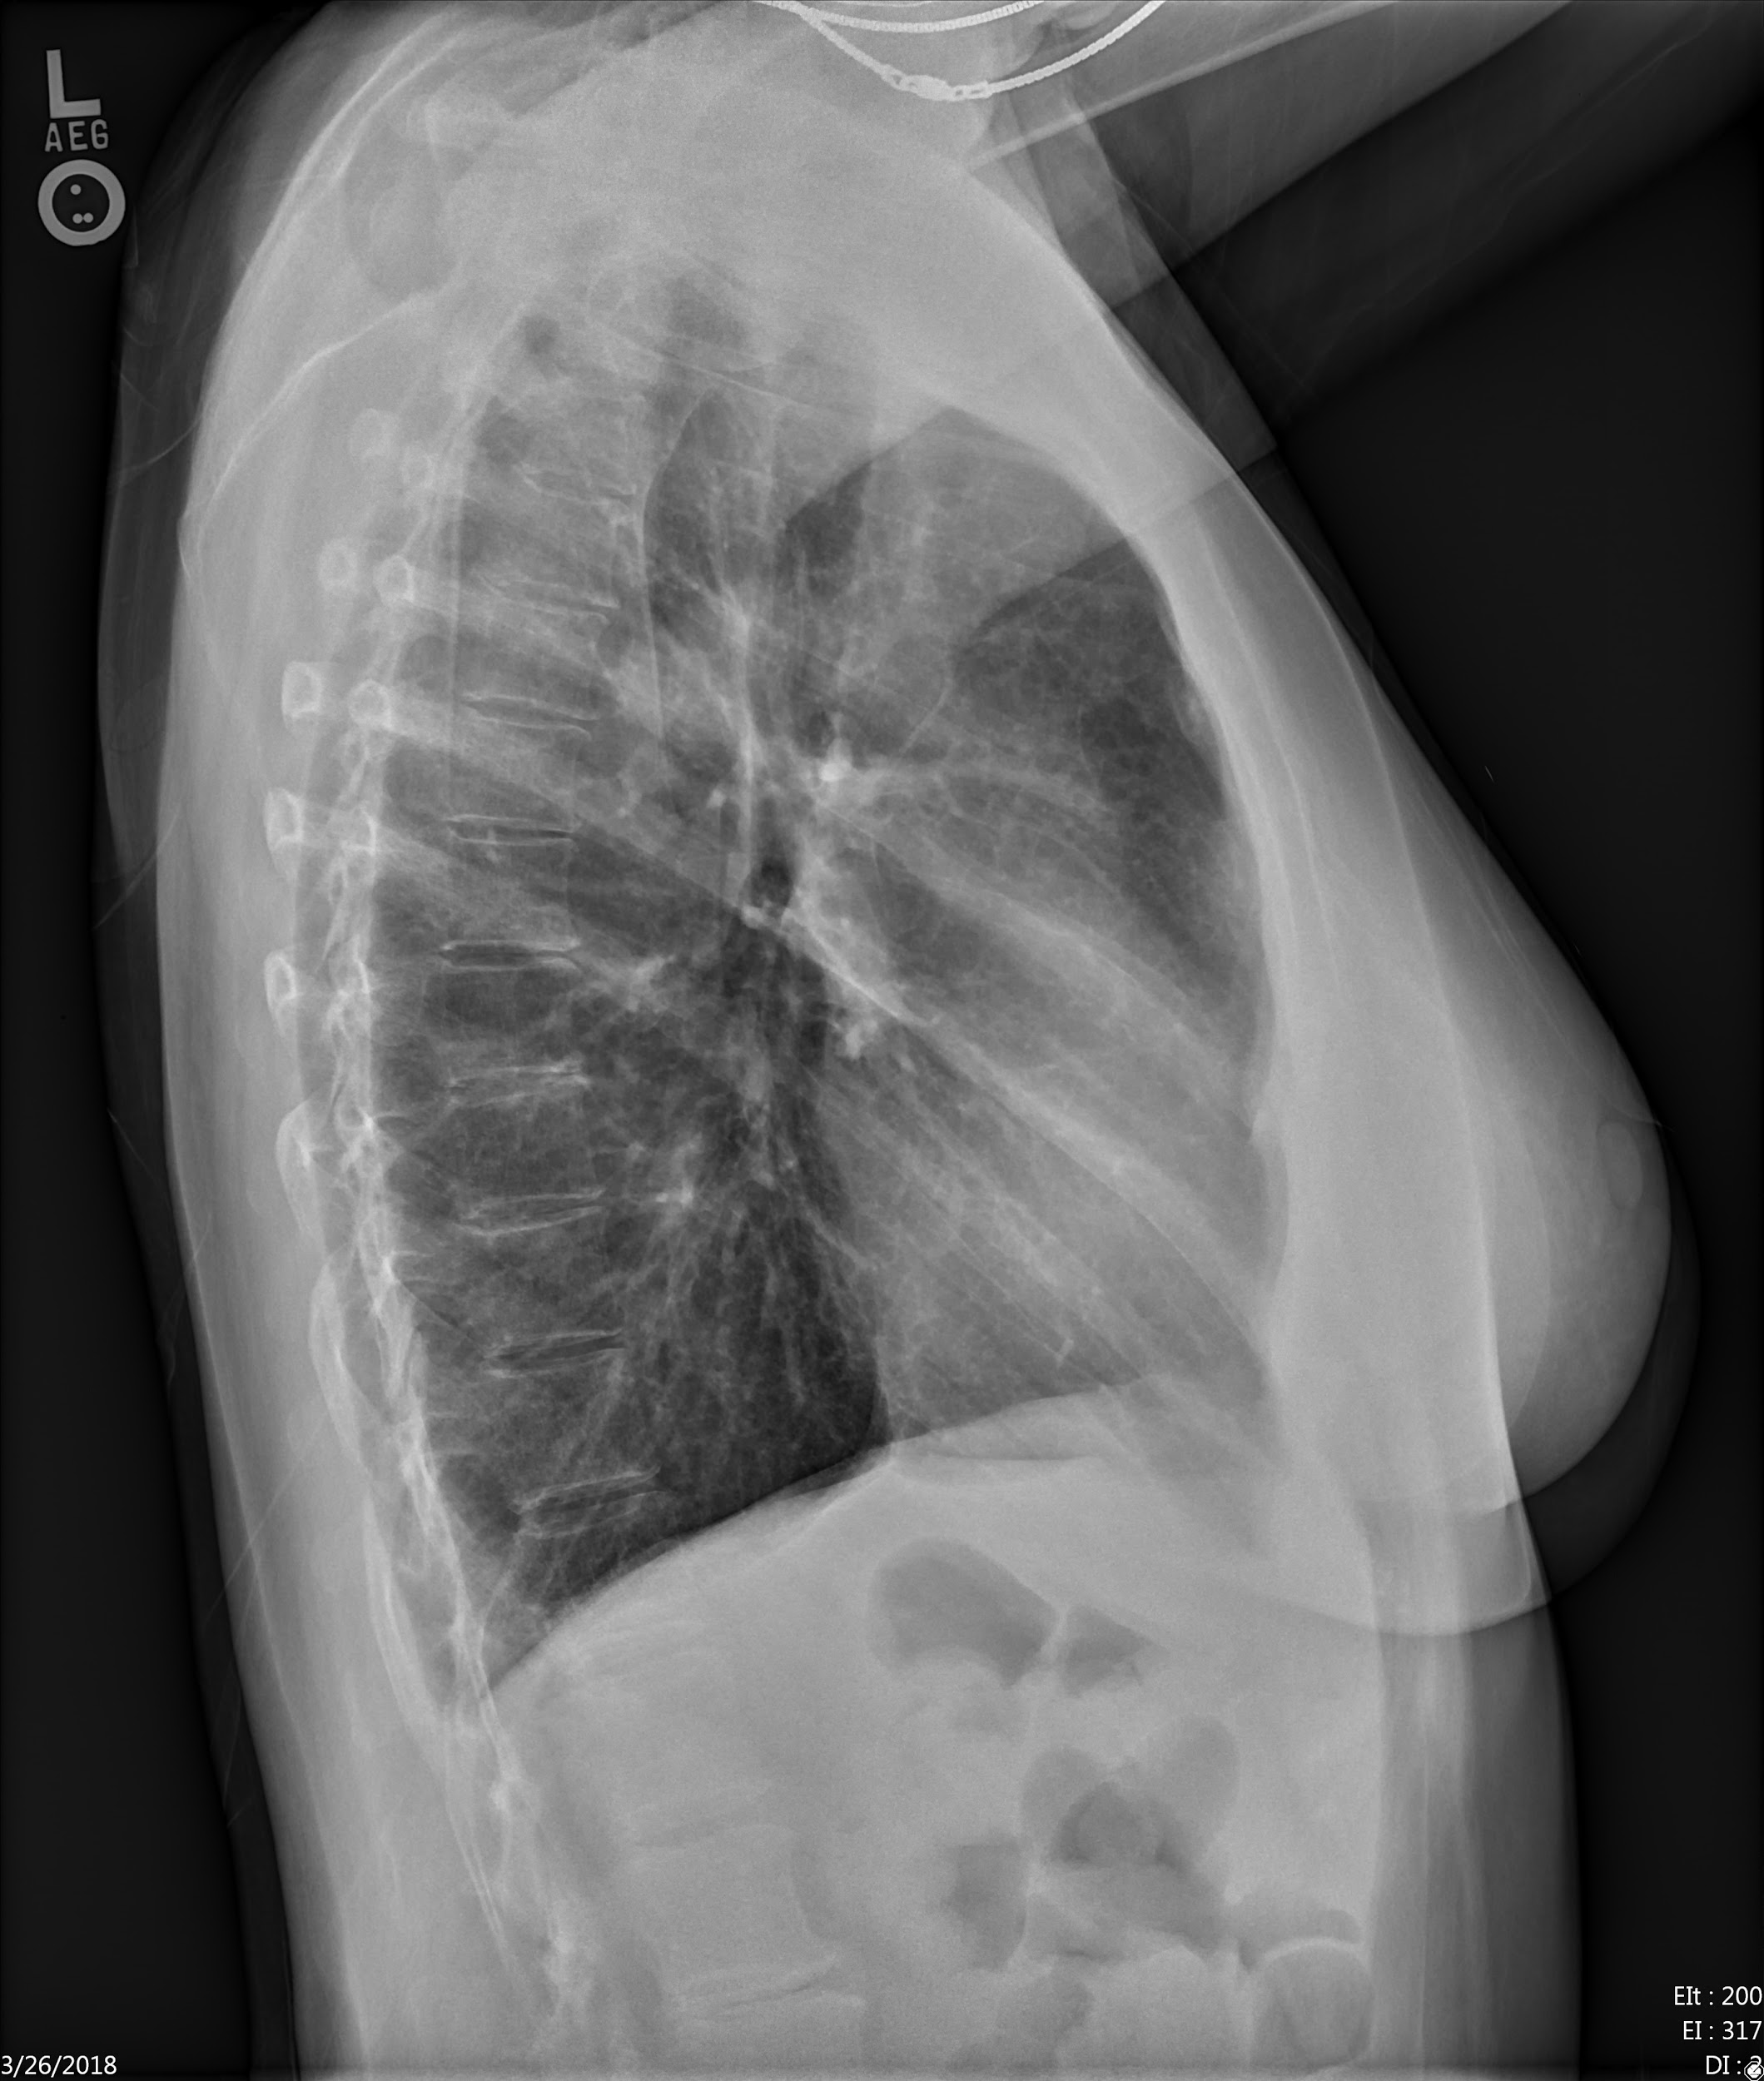
Normal Lateral
Esophagus
Trachea
Sternum
Left atrium
Right Ventricle
Spine
Left ventricle
Diaphragm

Slide 6
Dose
Radiography- Chest
Approximate effective Dose: 0.1mSv
Comparable to Natural Background Radiation: 10 Days
Estimated Lifetime Risk of Fatal Cancer from Examination: 1 in 1,000,000 to 1 in
100,000
https://www.radiologyinfo.org/en/info.cfm?pg=safety-xray#safety-effective-dose-adults Accessed 2.26.2019

Slide 7
Approach to Interpretation
Use a systematic approach
Play special attention to the blind spots
P

Slide 8
Approach to Interpretation-PA
Felson’s Systemic approach: ATMLL
(click to see)
Abdomen
Thorax-soft tissues and bones
Mediastinum

Slide 9
Approach to Interpretation-Lat
Felson’s approach: ATMLL (Click to see)
Abdomen
Thorax-soft tissues and bones
Mediastinum

Slide 10
Approach to Interpretation-PA
Felson’s approach: ATMLL
Look at each lung individually and then at both
Lung-unilateral
Lungs-bilateral
Click to show

Slide 11
Approach to Interpretation-Lat
Felson’s approach: ATMLL
On the lateral the lungs overlap however can define fissures for each lung
Lung-unilateral
Lungs-bilateral
Click to show

Slide 12
Approach to Interpretation
Use a systematic approach
Play special attention to the blind spots
P

Slide 13
Blind Spots
Trachea
Paratracheal Region
r
1.Sternum;
2.Rib
3.Trachea;
4.Paratracheal region
5.Carina
6.Right lung apex
7.Left lung apex
8.Right hilum
9.Left hilum
10, Infrahilar region
11.Right Lung base
12.Retrocardiac left lower lobe;
13. Vertebral body.
Sternum
Carina
Rib
Where Are They All Hiding? Common Blind Spots on Chest Radiography Kathryn L. Humphrey, MD, Carol C. Wu, MD, Matthew D. Gilman, MD, Ahmed H. El-Sherief, MD, Jo-Anne O. Shepard, MD, and Gerald F. Abbott, MD CDR Vol 34, No 21, p.5, October 15,2011

Slide 14
Blind Spots
Right Apex
Left Apex
1.Sternum;
2.Rib
3.Trachea;
4.Paratracheal region
5.Carina
6.Right lung apex
7.Left lung apex
8.Right hilum
9.Left hilum
10, Infrahilar region
11.Right Lung base
12.Retrocardiac left lower lobe;
13. Vertebral body.
Right Hilum
Left Hilum
Right Hilum
Where Are They All Hiding? Common Blind Spots on Chest Radiography Kathryn L. Humphrey, MD, Carol C. Wu, MD, Matthew D. Gilman, MD, Ahmed H. El-Sherief, MD, Jo-Anne O. Shepard, MD, and Gerald F. Abbott, MD CDR Vol 34, No 21, p.5, October 15,2011

Slide 15
Blind Spots
1.Sternum;
2.Rib
3.Trachea;
4.Paratracheal region
5.Carina
6.Right lung apex
7.Left lung apex
8.Right hilum
9.Left hilum
10. Infrahilar region
11.Right Lung base
12.Retrocardiac left lower lobe;
13. Vertebral body.
Infrahilar Region
Right Lung Base
Vertebral Body
Where Are They All Hiding? Common Blind Spots on Chest Radiography Kathryn L. Humphrey, MD, Carol C. Wu, MD, Matthew D. Gilman, MD, Ahmed H. El-Sherief, MD, Jo-Anne O. Shepard, MD, and Gerald F. Abbott, MD CDR Vol 34, No 21, p.5, October 15,2011

Slide 16
Mediastinum
Can you identify the
abnormality?
! Remember the Blind Spots !

Slide 17
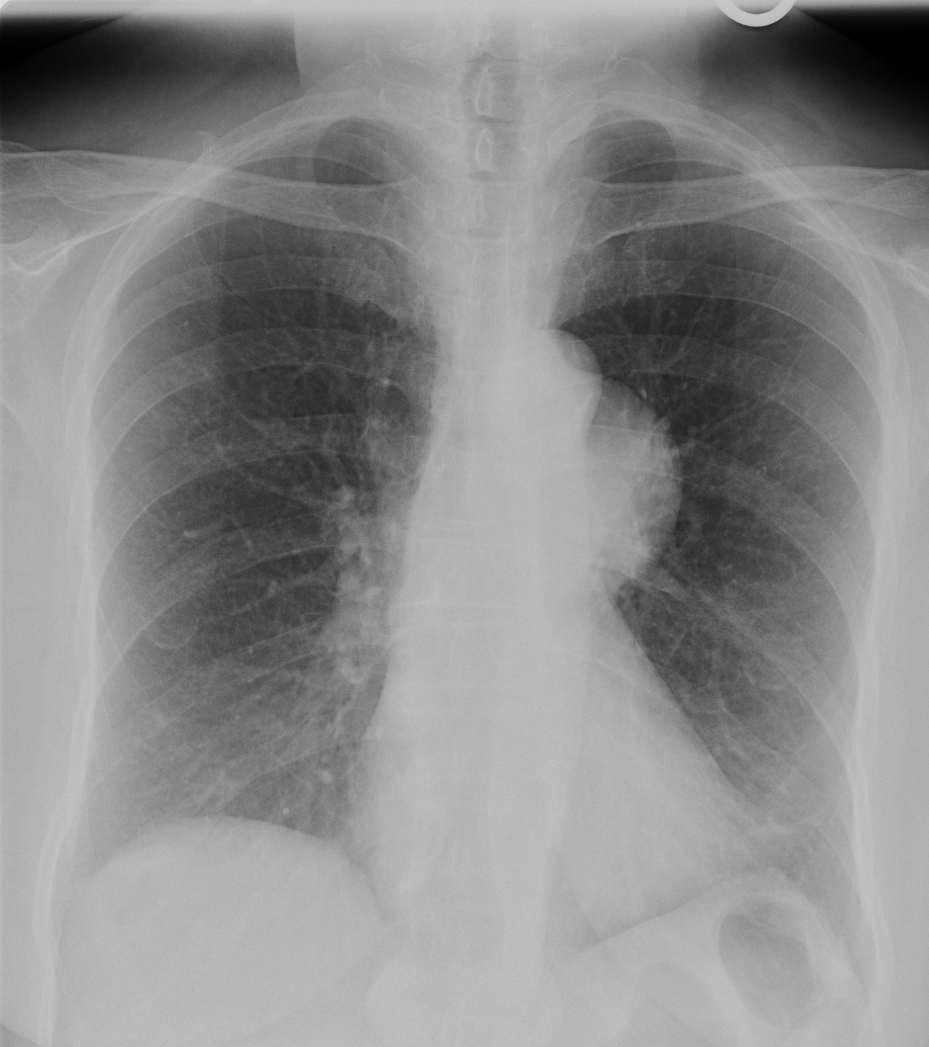
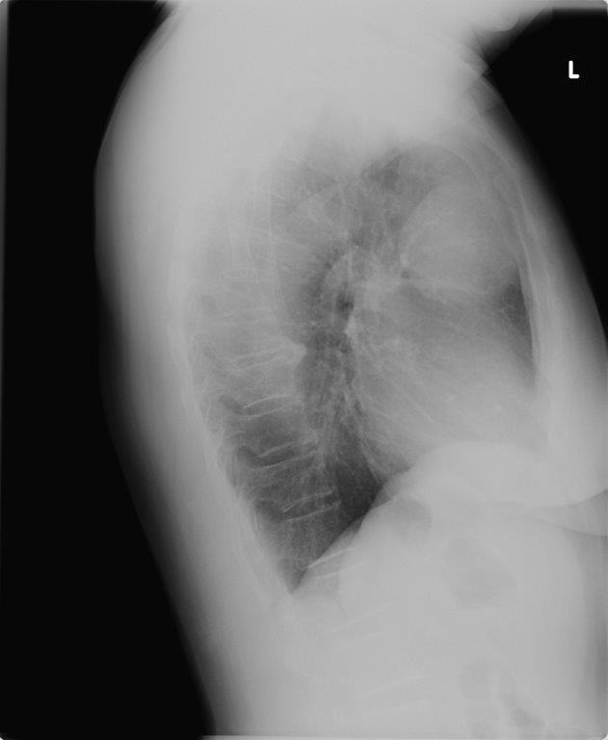
CASE 1
Click to see
Notes:
Anterior mediastinal mass retrosternal space Thyroid goiter

Slide 18
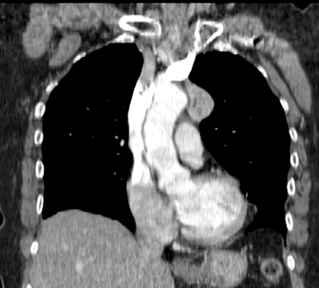
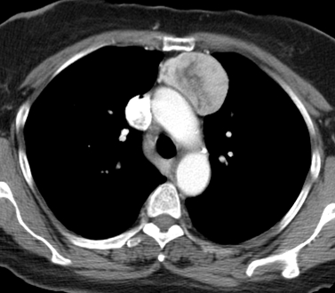
CASE 1
*
*
Anterior mediastinal mass retrosternal space [*]

Slide 19
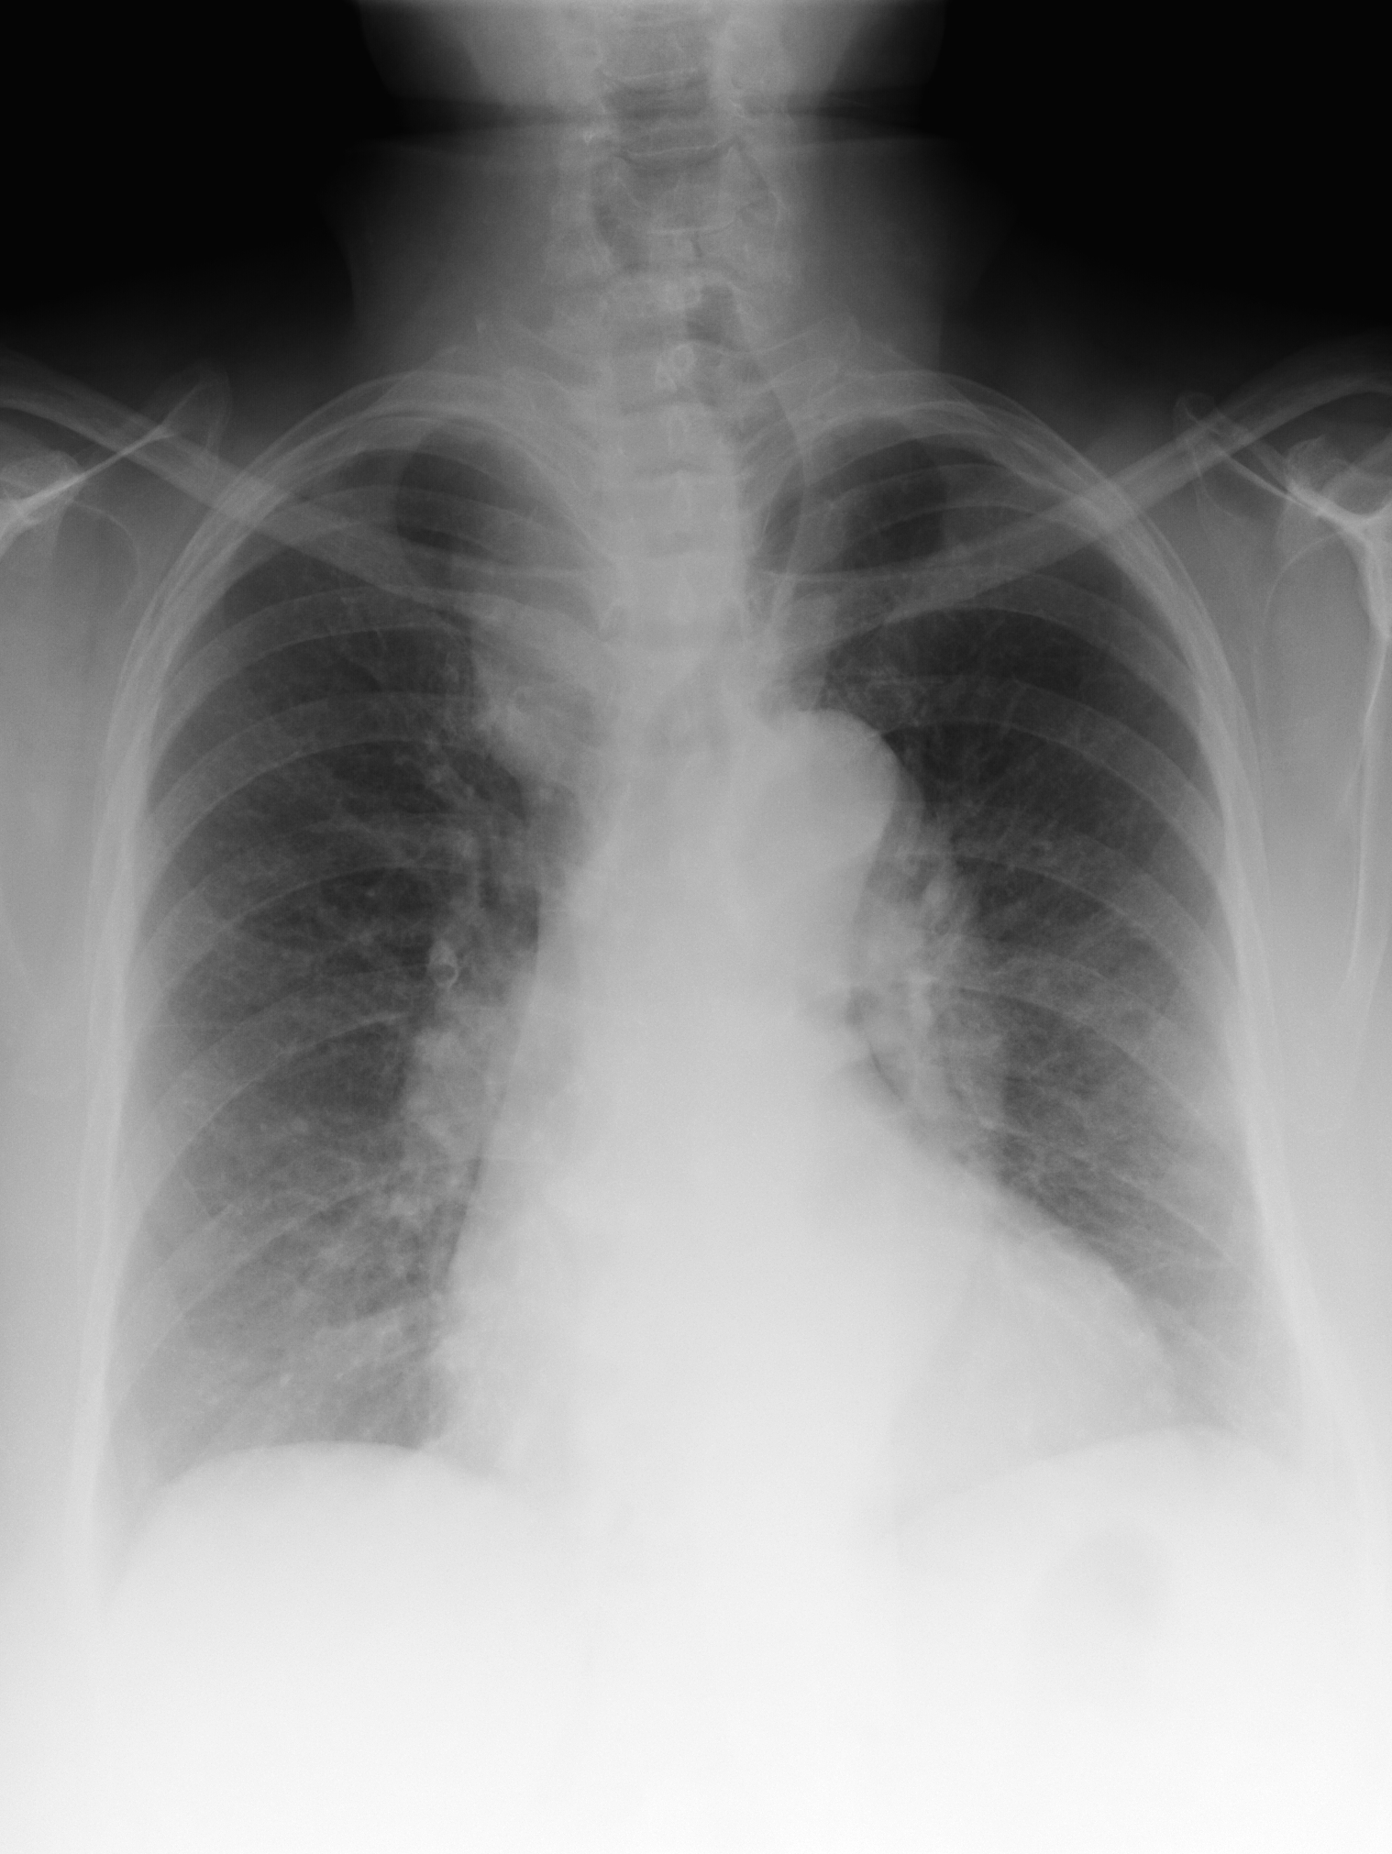
CASE 2
Click twice for answer
Right upper mediastinal mass with trachea deviated to the left
Notes:
Unchanged for 6 years -probable thyroid goiter

Slide 20
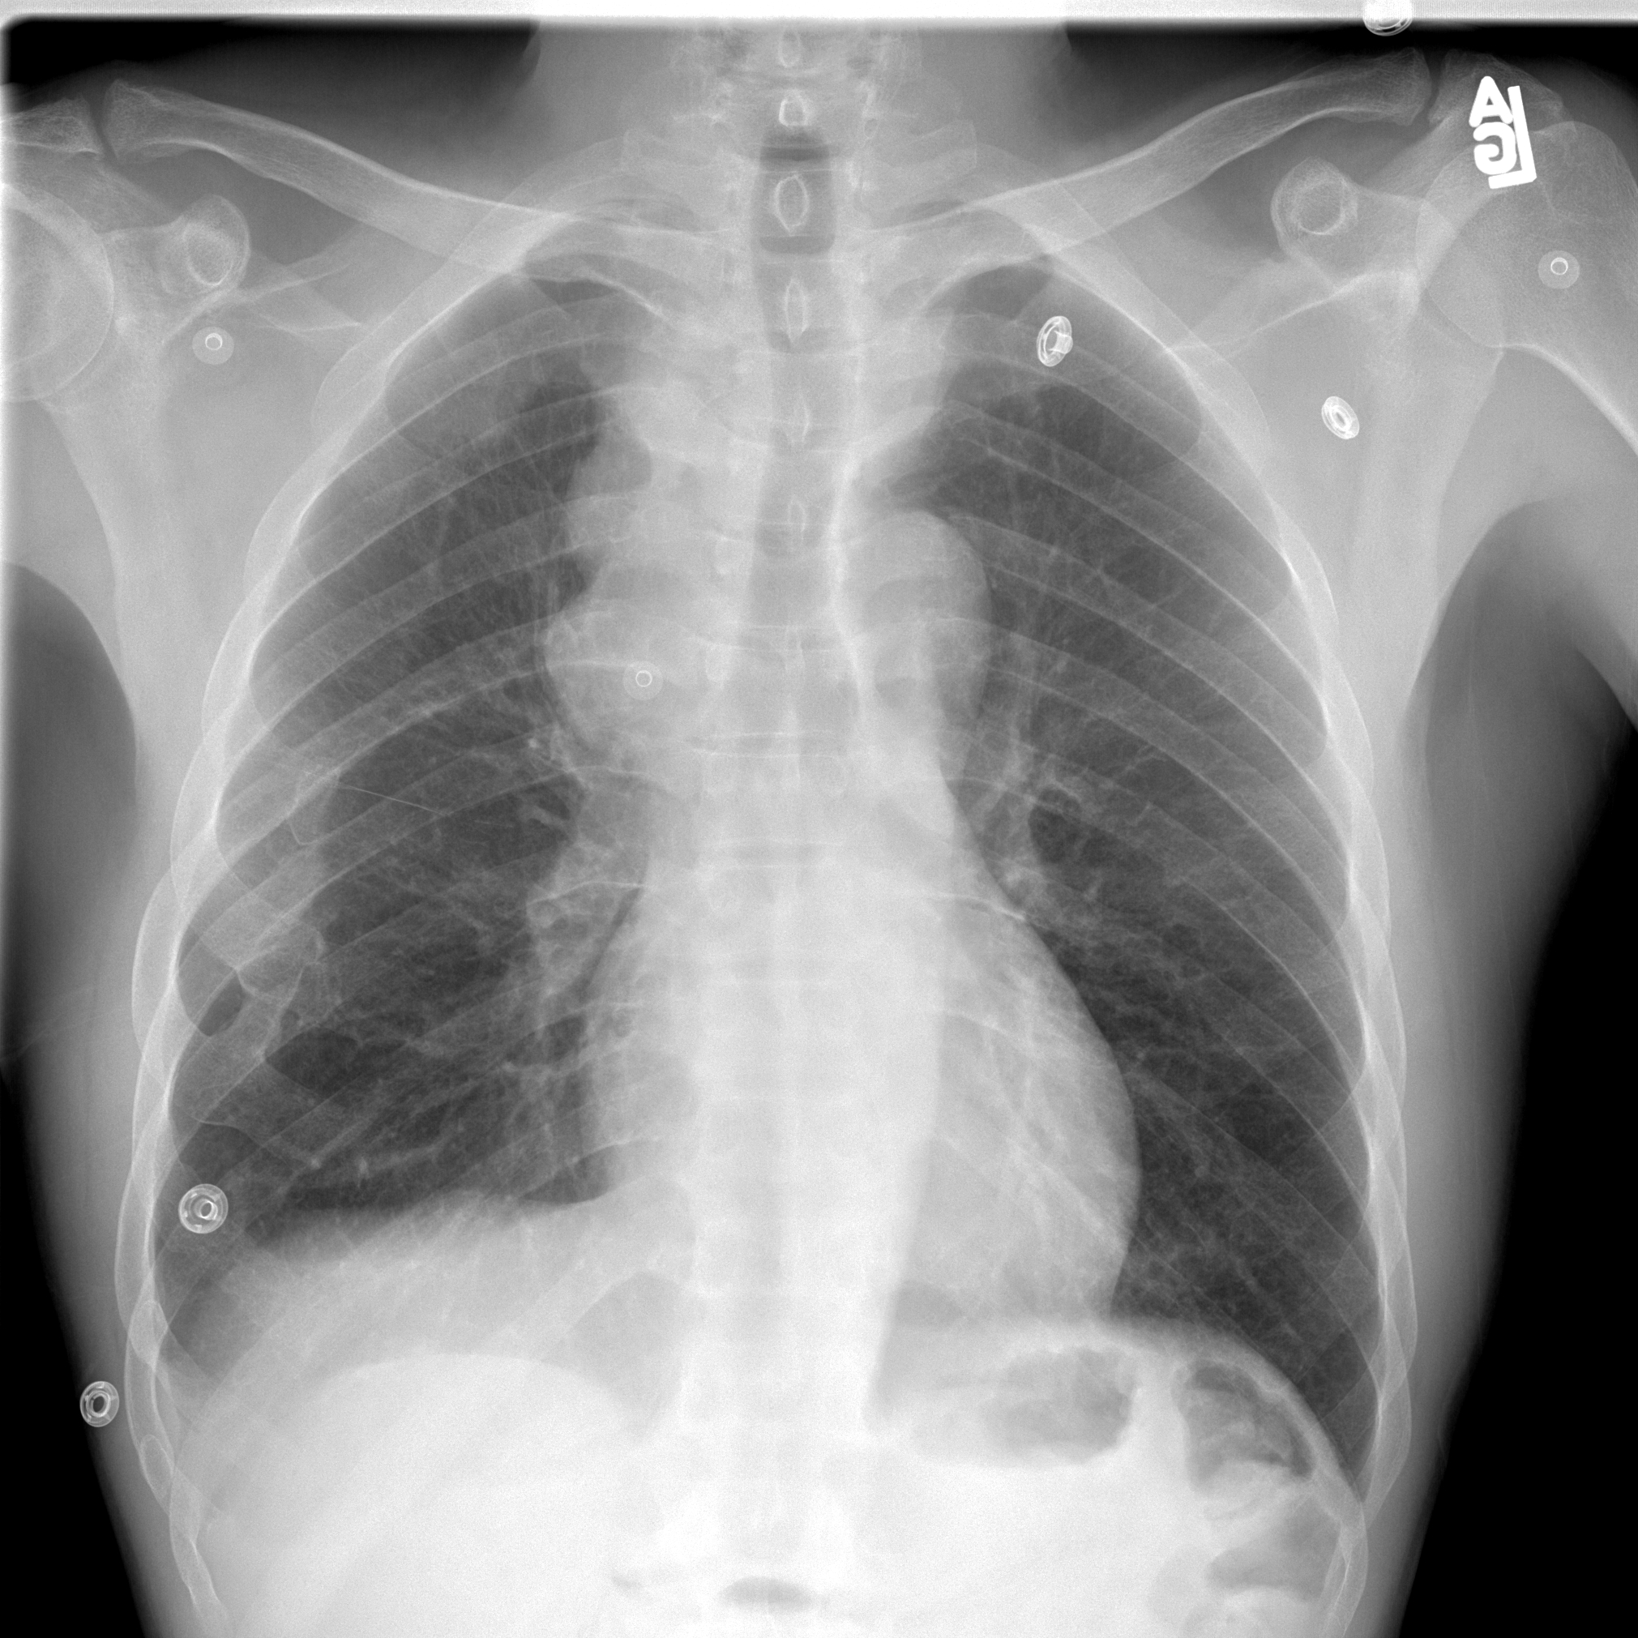
CASE 3
Click twice for answers
Rt paratracheal adenopathy
Notes:
Rt paratracheal adenopathy

Slide 21
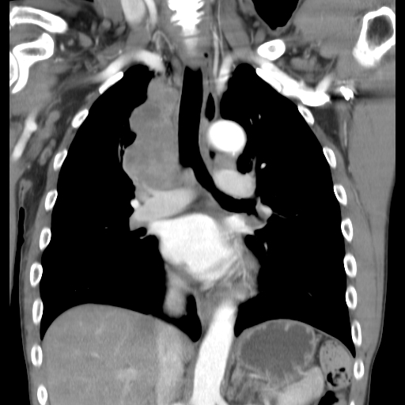
CASE 3
Rt paratracheal adenopathy

Slide 22
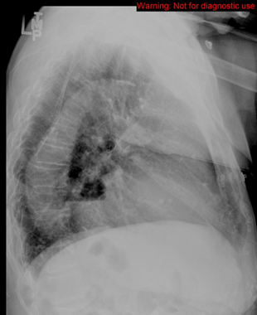
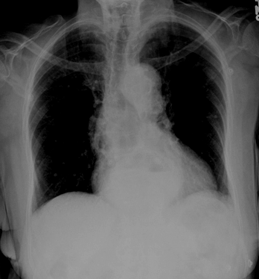
CASE 4
Click for answers
Hiatal Hernia- See the fluid level
Notes:
Hiatal hernia

Slide 23
Lungs
Can you identify the
abnormality?

Slide 24
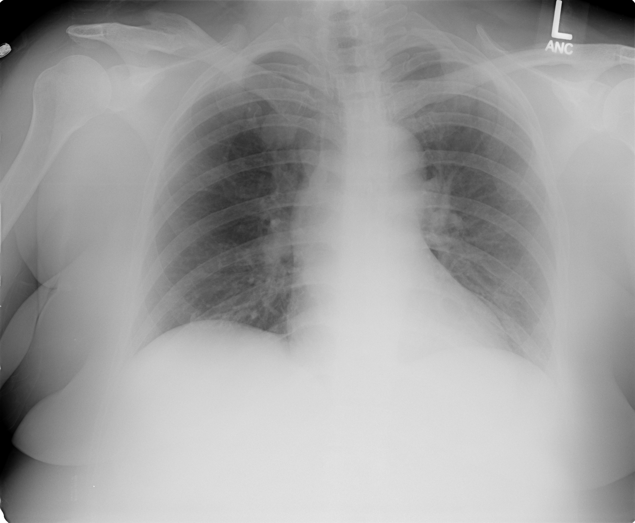
CASE 5
AP View
Is the abnormality in the right lung or the left lung?
See next slide
Notes:
Right

Slide 25
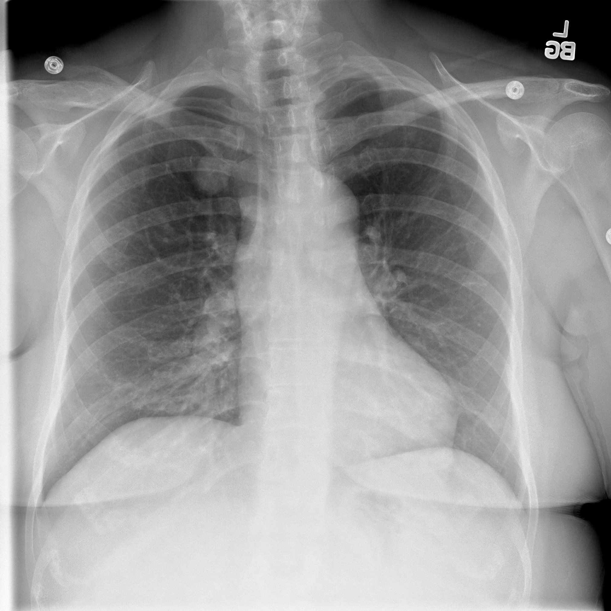
CASE 5
PA view
Is the abnormality in the right lung or the left lung?
Click for answer
Right

Slide 26
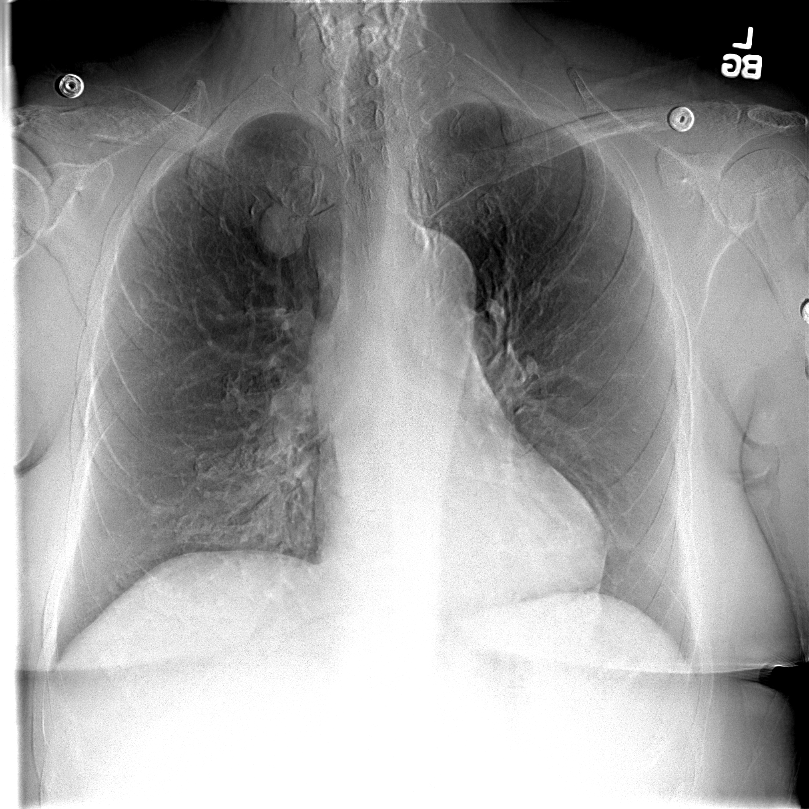
CASE 5
PA view with the bones subtracted
Click for marker
Non calcified lung nodule

Slide 27
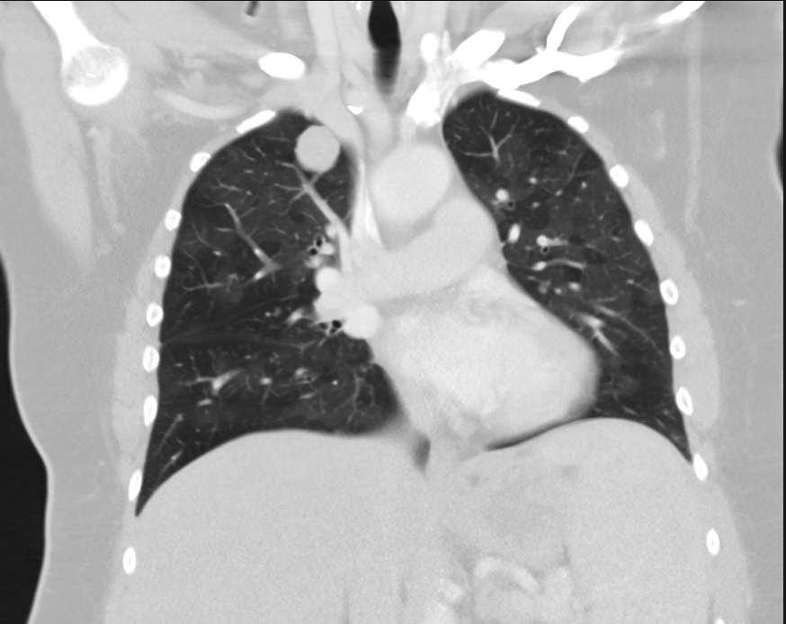
CASE 5
RUL nodule (circle) obscured by bone on the CXR.
Always compare the apices of the lungs, side to side, for differences in density
Coronal CT reconstruction

Slide 28
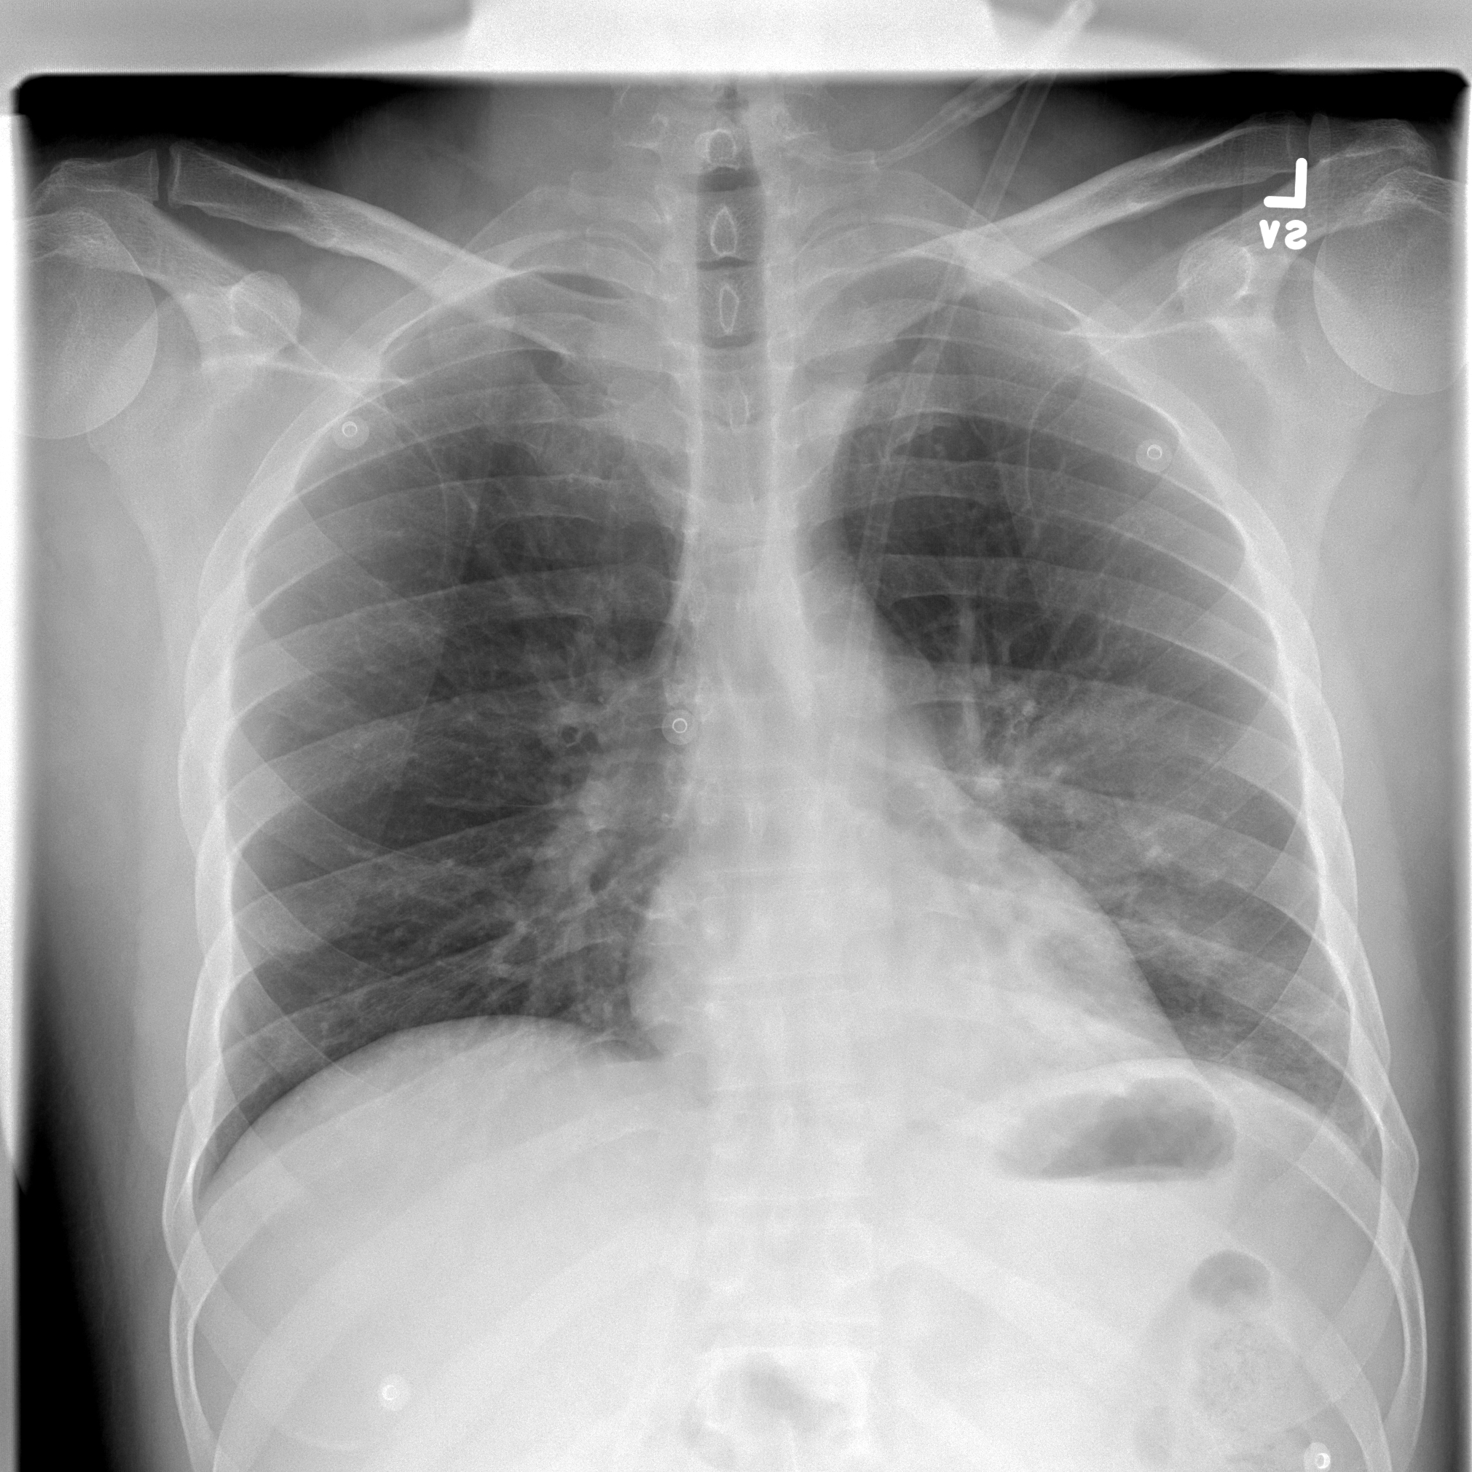
CASE 6
Click for marker
Notes:
LLL pneumonia, Retrocardiac blind spot

Slide 29
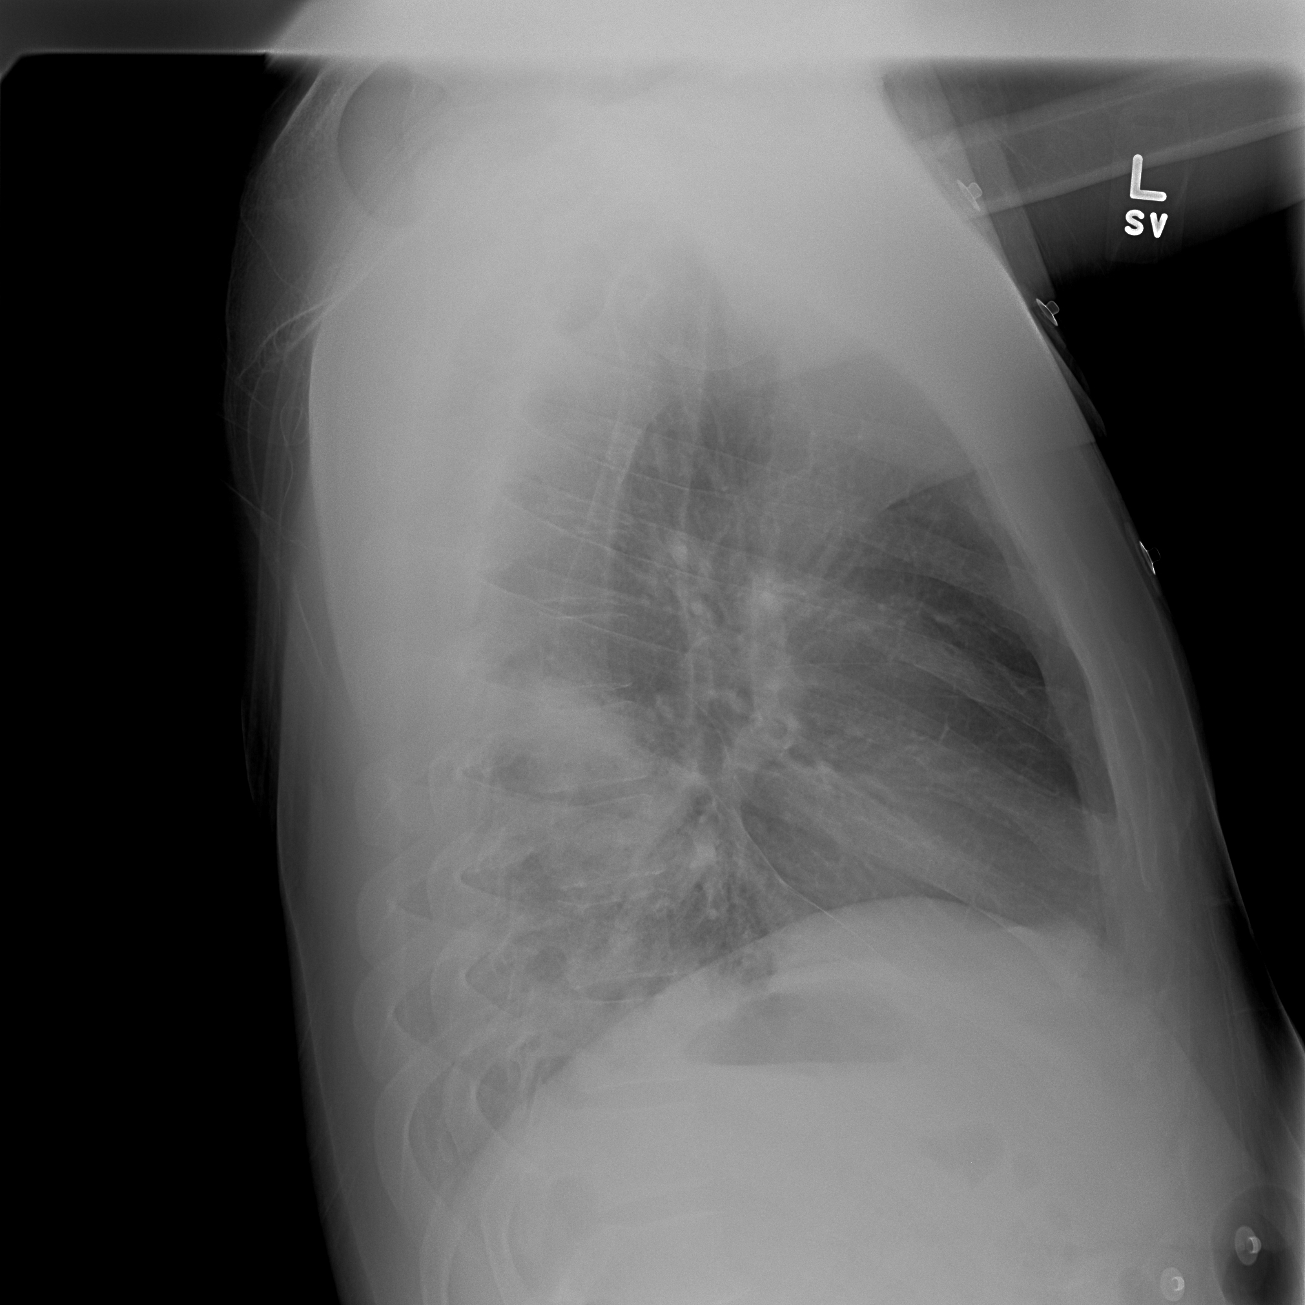
CASE 6
Retrocardiac Left Lower Lobe Pneumonia
R

Slide 30
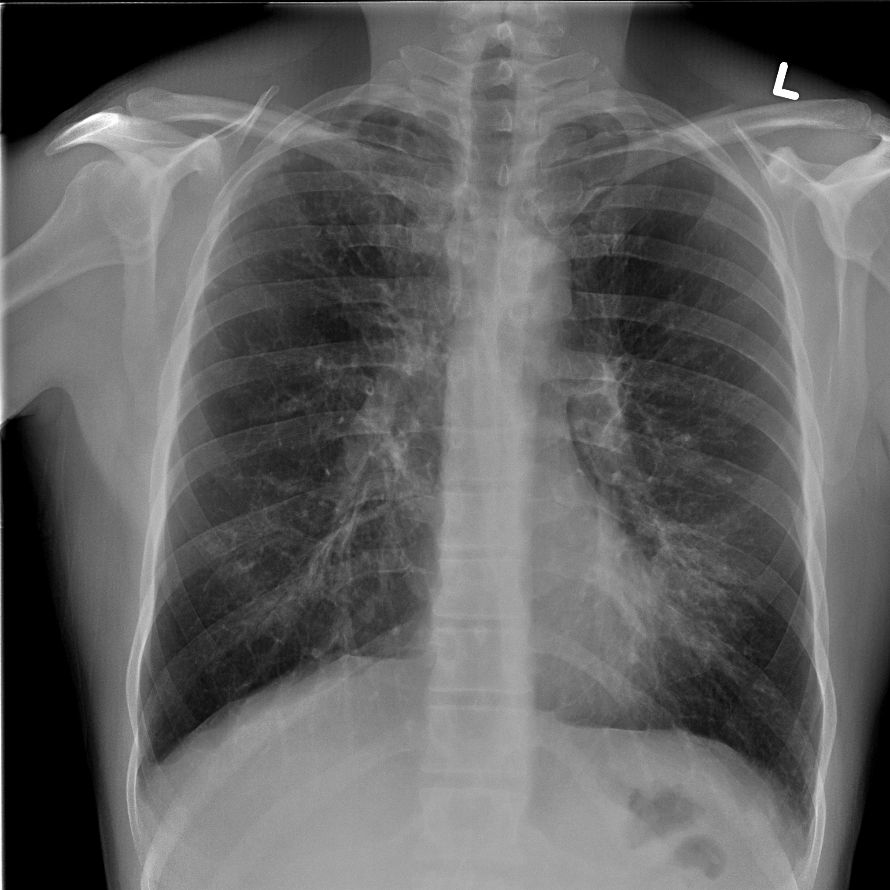
CASE 7
Click for answer
Lingular Pneumonia
Notes:
Lingular pneumonia

Slide 31
Bone and Soft Tissue
Can you identify the
abnormality?

Slide 32
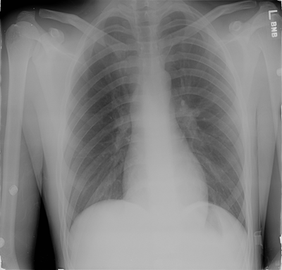
Case 9
Trauma
See next slide
Notes:
Sternum

Slide 33
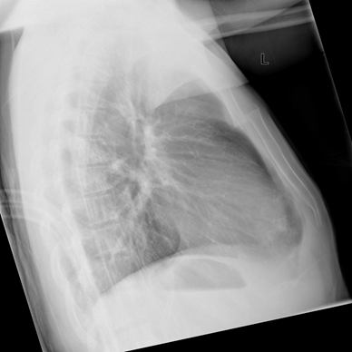
CASE 9
Now can you see the abnormality ?
Click twice
Sternal Blind spot
Notes:
Sternal fracture

Slide 34
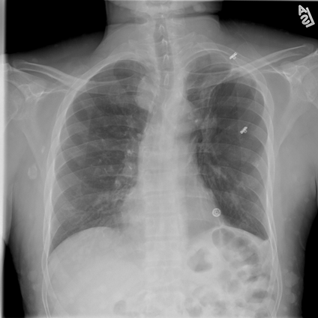
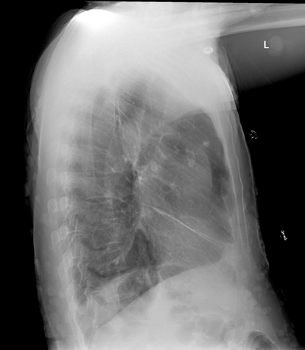
Case 10
Click for answer
Neurofibromatosis with visible skin neurofibromas
Notes:
Skin neurofibromatosis

Slide 35
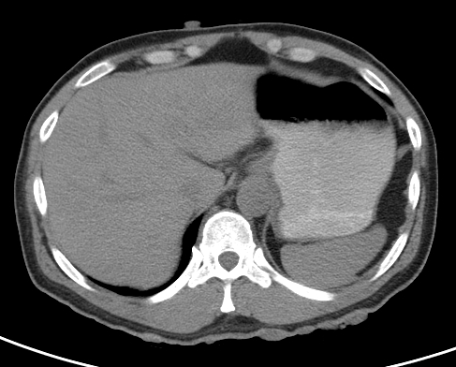
Case 10
Skin neurofibromas

Slide 36
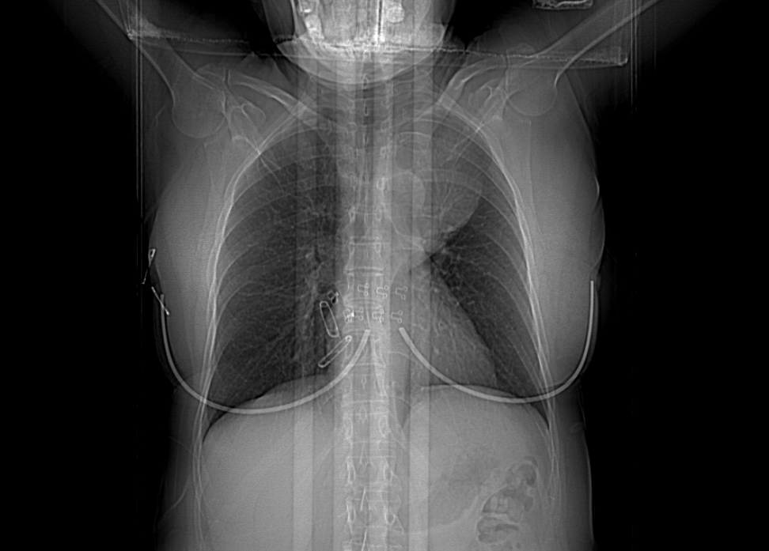
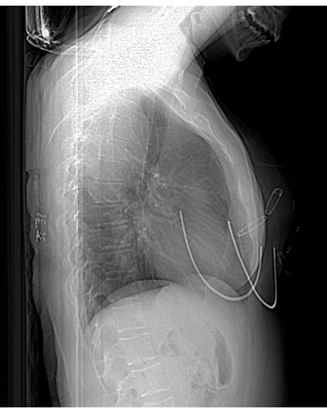
Case 11
Click for additional image
Now can you see the abnormality?
Notes:
Posterior mediastinal mass Paraspinal mass over vertebra

Slide 37
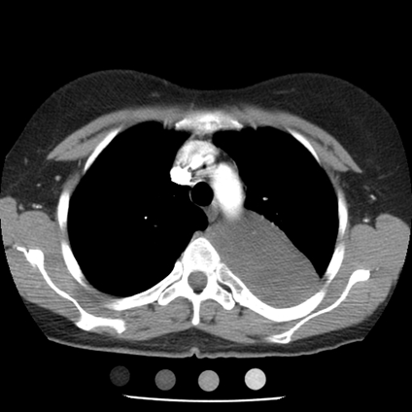
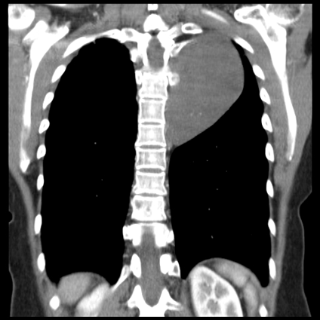
Case 11
Paraspinal mass adjacent to vertebra- Ganglioneuroma
Blind Spot: over the spine and behind the Trachea
Notes:
Paraspinal mass over vertebra ganglioneuroma

Slide 38
Abdomen
Can you identify the
abnormality?

Slide 39
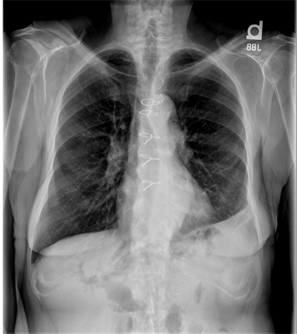
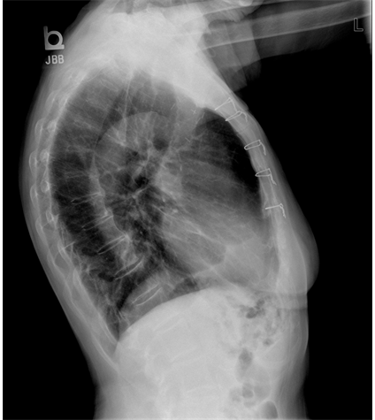
Case 12
Notes:
Air in the biliary ducts

Slide 40
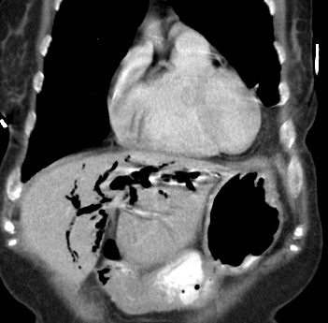
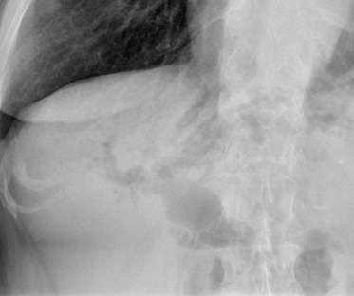
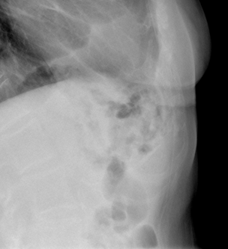
SCase 12
Click for CT
Air in the Biliary tree
Notes:
Air in biliary tree

Slide 41
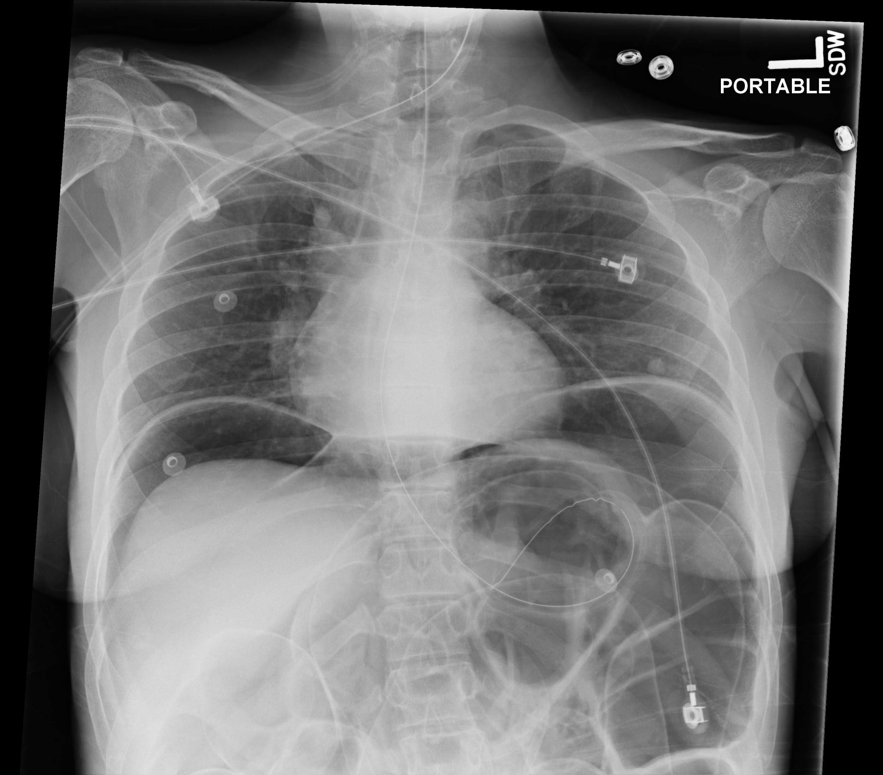
Case 13
Click for answer
Free air under both hemidiaphragms
In the Left Upper Abdomen see air on both sides of the colon wall
Notes:
Free Air and dilated bowel

