Slide 1
How to Approach the Pediatric Elbow Radiograph
Jessica Leschied, MD
C.S. Mott Children’s Hospital
Ann Arbor, MI

Slide 2
Step 1: know your Elbow Ossification Centers (and rough age of appearance)
CRITOE!!
C – Capitellum (1 yr)
R – Radial head (2-4 yrs)
I – Medial (Internal) epicondyle (4-6 yrs)
T – Trochlea (8-11 yrs)
O – Olecranon (9-11 yrs)
E – Lateral (External) epicondyle (10-11 yrs)
H - humerus, U - ulna, R - radius
H
I
E
O
T
C
U
R
R
Notes:
Trochlea quite irregular and fragmented

Slide 3
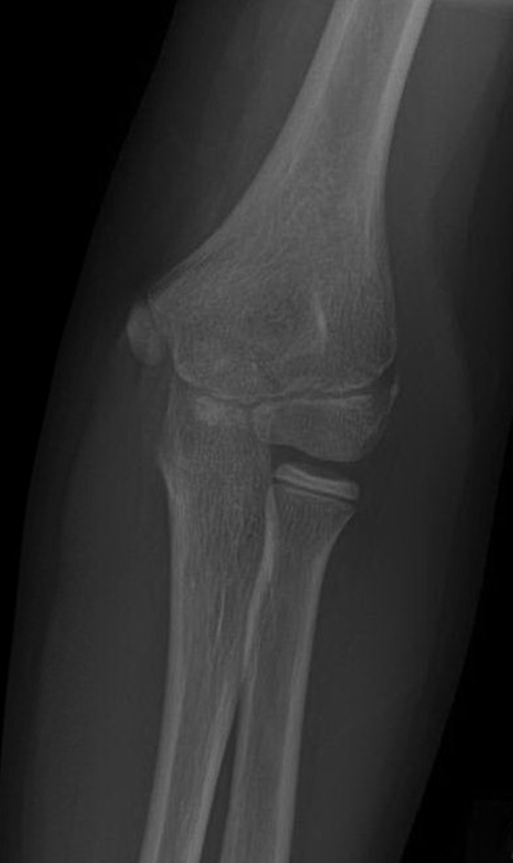
Ossification Centers
Frontal radiograph of elbow in 12 year old girl

Slide 4
Ossification Centers
olecranon
Medial epicondyle
Lateral epicondyle
trochlea
capitellum
Radial head

Slide 5
Step 2: Elbow Fat Pads
Anterior fat pad (highlighted in yellow) – coronoid fossa, normally visible in lateral view with patient in flexion
Posterior fat pad – olecranon fossa, not normally visible
Fat pads are intracapsular
When displaced, they indicate the presence of joint effusion or hemarthrosis, ie. fracture in setting of trauma!

Slide 6
Displaced fat pads

Slide 7
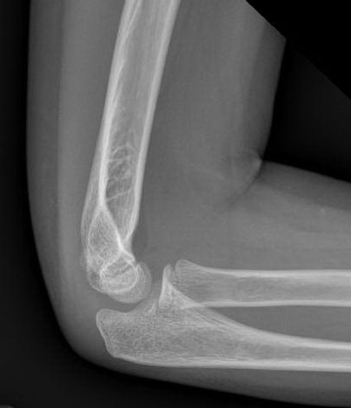
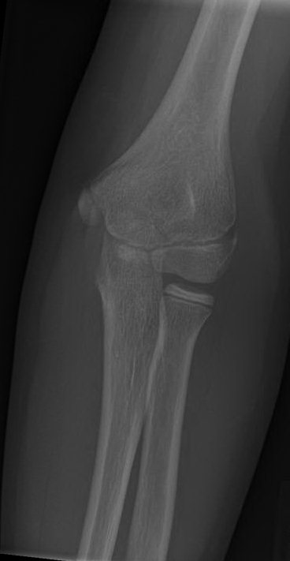
Step 3: Joint Alignment
A) Radiocapitellar line – a line drawn through the center of the radial had should intersect the center of the capitellum on all projections
If it doesn’t – radial head dislocation, radial neck fracture
Radiocapitellar Line on both views

Slide 8
Step 3: Joint Alignment
B) Anterior humeral line – intersects the ossified capitellum through middle or posterior third
If it passes through anterior third or misses capitellum – supracondylar fracture is present

Slide 9
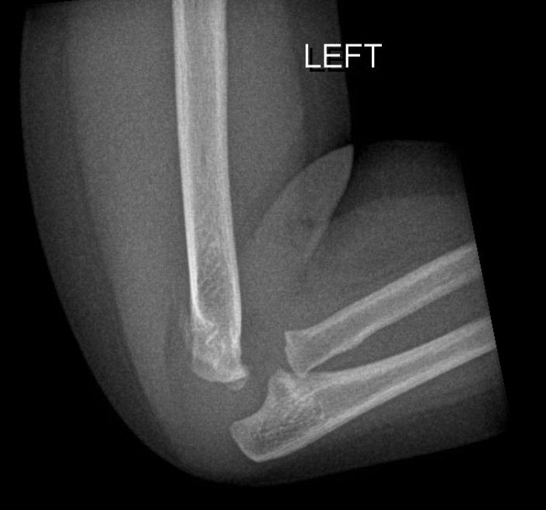
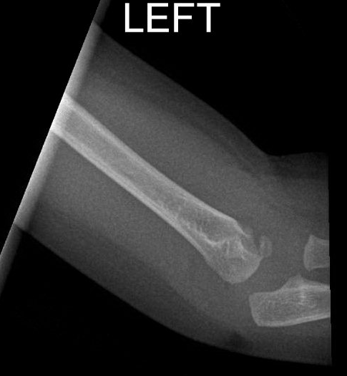
Displaced anterior humeral line, Ex. 1 yo, fall from bed
Displaced
posterior fat pad
Displaced capitellum
Fracture
Notes:
1 yo F, fall from bed, type 2 supracondylar frx

Slide 10
Elbow fractures
Most common fractures in children (65-75%)
Most commonly occurring after FOOSH (hyperextension forces or extreme valgus)
Difficult to detect due to ossification centers
Supracondylar > lateral condyle > medial epicondyle > radial neck, olecranon

Slide 11
Supracondylar fractures
Most common pediatric elbow fracture
Type 1 - non-displaced
Type 2 – displaced with intact posterior cortex
Type 3 – displaced with no cortical contact
Notes:
Vascular injury more common with posterolateral displacement and type 3. Volkmann’s contracture and compartment synd. , flexion- cortex hits ground (implications for splinting position)

Slide 12
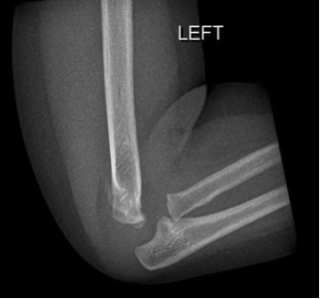
Supracondylar fracture

Slide 13
Lateral condylar fracture
FOOSH with extreme varus force and extension
Notes:
b/c of extensor tendon insertion, enters joint via cartilage b/w capitellum and trochlea, sh type 4, unstable (displaced or intra-articular). Non-displaced – nonoperative rx. Displaced – pinning, 2nd most common frx. Non-union b/c intra-articular and surrounded by synovial fluid

Slide 14
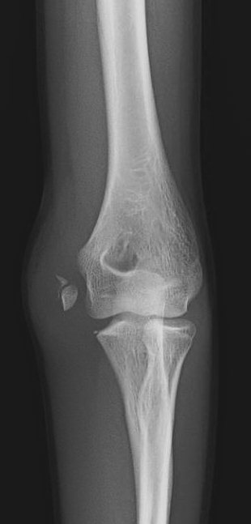
Medial epicondylar fracture
3rd most common fracture
Valgus stress
Commonly associated with elbow dislocation
Notes:
50% associated with elbow dislocation, med epi appears at age 5, fuses at 18-20 yrs

Slide 15
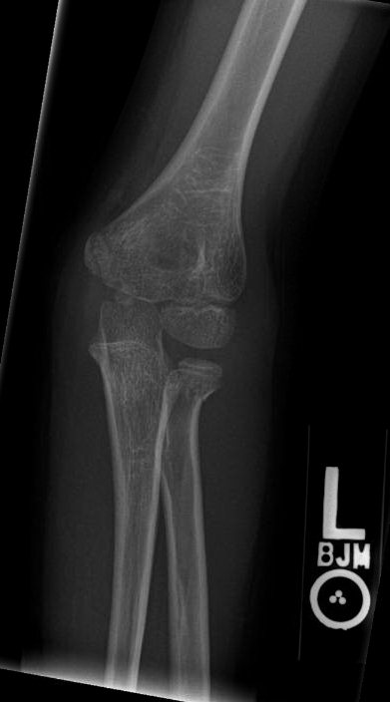
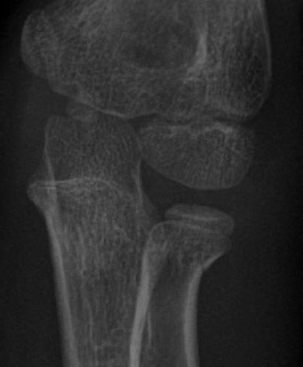
Radial neck fracture
Notes:
7 yo f, fall from scooter, radial neck frx, radiocapitellar line

Slide 16
Test your knowledge!

Slide 17
Name the ossification centers!
Slide 4 for answers!

Slide 18
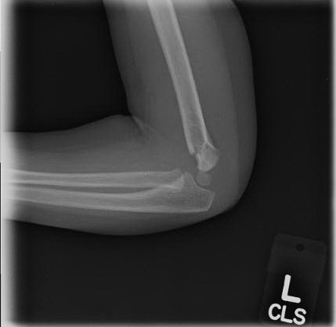
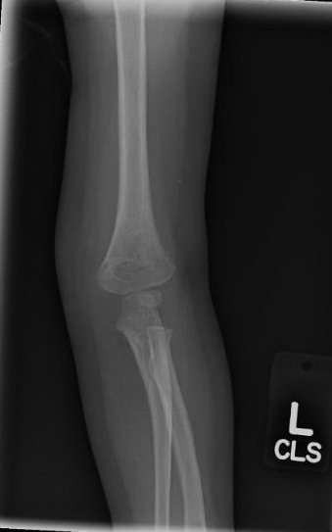
What type of fracture?

Slide 19
Supracondylar Fracture

Slide 20
Summary
Identify ossification centers (CRITOE!)
Use a search pattern - fat pads, alignment (anterior humeral line, radiocapitellar line)
Look for:
Supracondylar fx
Lateral condyle fx
Position of medial epicondyle
Radial neck fx

