Slide 1


How to Approach PE CT
Tran, Jonathan D.O. PGY3; Catanzano, Tara M.D.

Slide 2
Background considerations
Study indications:
  CT pulmonary angiography (CTPA) is performed to evaluate for pulmonary emboli
  Varied clinical presentations including:
    Shortness of breath
    Hypoxia
    Chest pain
    Cough
    Positive d-dimer

Slide 3
Background considerations
Contraindications for CTPA:
  Inadequate IV access
  Contraindications to IV contrast
    Renal impairment
    Contrast allergy
  Inability to lie flat (relative)
  Inability to breath-hold (relative)

Slide 4
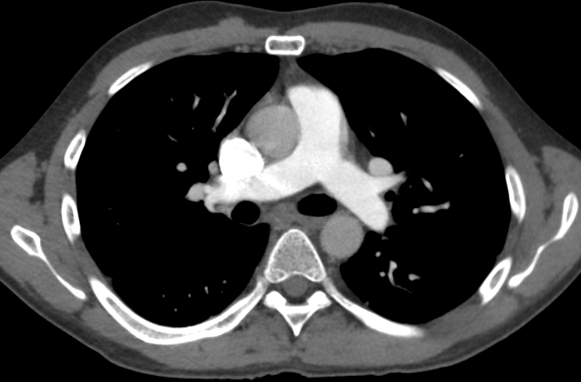
Background considerations
Vessel opacification:
  Timing and contrast bolus are everything
  The pulmonary arteries must be appropriately opacified in order to make a diagnosis of PE
Good vessel opacification

Slide 5
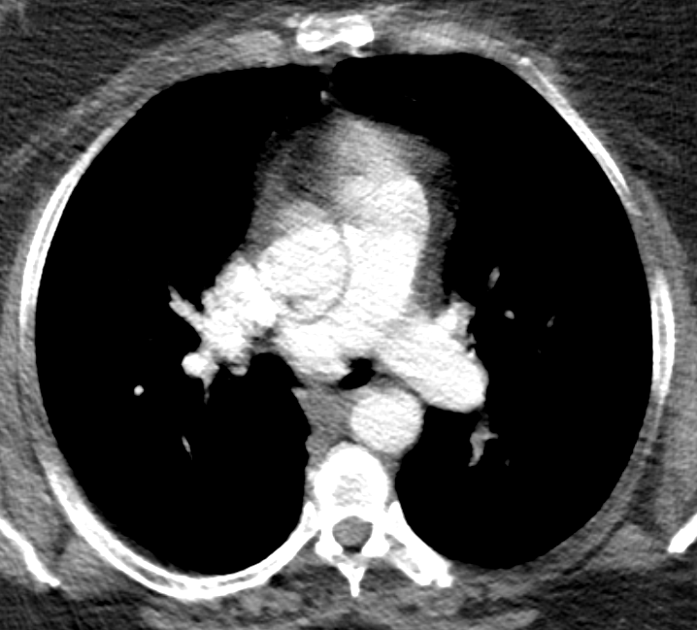
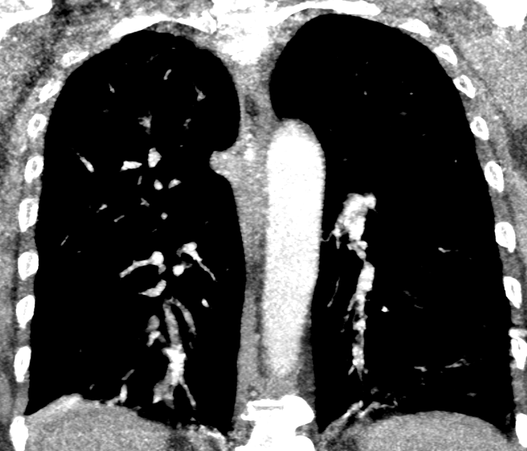
Factors affecting vessel opacification
  Rate of contrast administration - often dependent on IV size and location. Requires 20G or larger, 4cc/second injection
  Circulation time - young patients with fast circulation times have less well opacified vessels than patients with heart or lung disease. Patients with heart failure often have well opacified vessels
  Intrinsic cardiac anatomic abnormalities - patients with congenital heart disease and shunts have unique challenges for timing of contrast bolus for opacification of the pulmonary arteries
  Motion can limit the study
Motion artifact
Notice the poor vessel opacification

Slide 6
Technique
Ensure appropriate IV access - minimum 20G in above wrist upper extremity. May use central line in specific cases if power injector compatible
Study is performed with patient supine, arms over head. Breath hold required for the scan portion of the test.
Scout image obtained and scan area selected. IV is checked for patency.
Test bolus of contrast administered to determine contrast delay.
When scan initiated, patient is instructed to deeply inspire and then hold breath on inspiration.
Contrast is administered IV at a rate of 4cc/second, using the delay determined with the test bolus
Some centers scan from lung bases to apices, some from apices to bases and some only scan the region of the pulmonary arteries. Much of this depends on patient and CT scanner factors

Slide 7
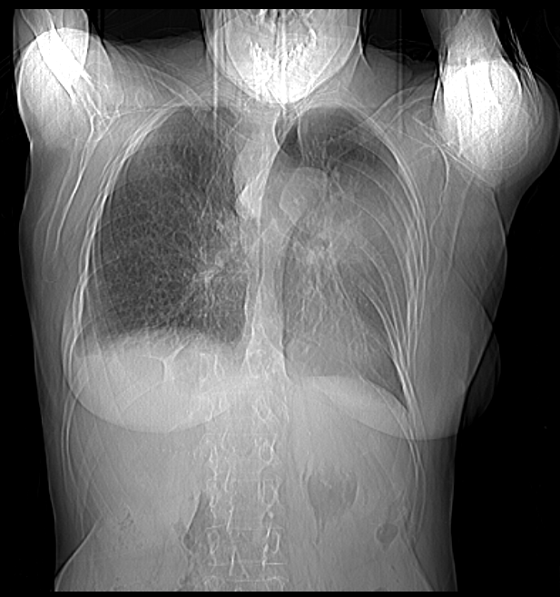
Approach to interpretation
ALWAYS review the scout image - a significant amount of information can be gleaned from the scout, including presence and location of support apparatus, presence of pulmonary edema etc
Left upper lobe opacity was a large lung mass
Notes:
Scout view with LUL mass

Slide 8
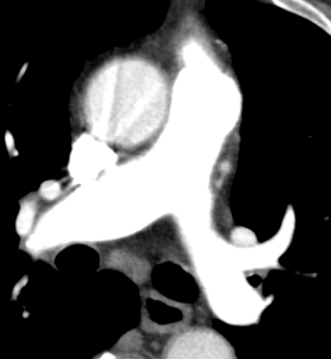
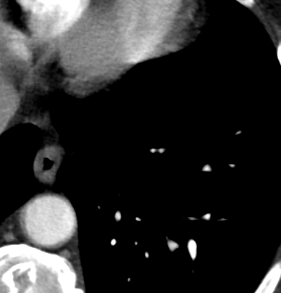
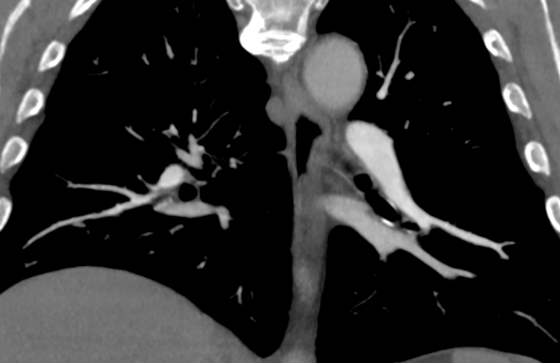
Approach to interpretation
Notice the good opacification, even of subsegmental vessels
Review the axial images
Assess the contrast bolus in the pulmonary arteries - is there adequate opacification and if so, to what level (main PA, segmental or subsegmental branches?)
vein
artery
artery
vein

Slide 9
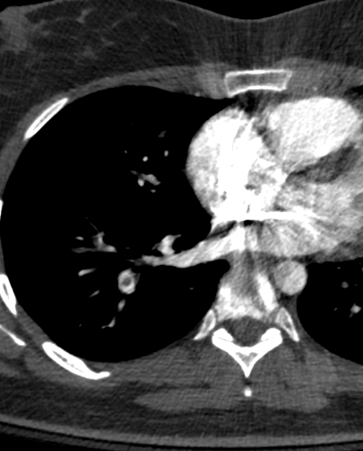
Approach to interpretation
Determine if there are filling defects in the PAs. If so, are they central within the vessel (acute PE) or layering along the walls of the vessel (subacute or chronic PE). Get a sense of the clot burden - is it massive, submassive or only in one or two segmental or subsegmental arteries
Images with clot
Notes:
Central, acute PE

Slide 10
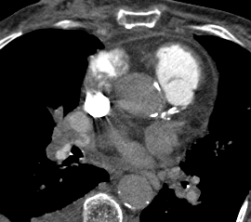
Approach to interpretation
Determine if there are filling defects in the PAs. If so, are they central within the vessel (acute PE) or layering along the walls of the vessel (subacute or chronic PE). Get a sense of the clot burden - is it massive, submassive or only in one or two segmental or subsegmental arteries

Slide 11
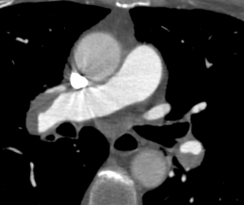
Approach to interpretation
Determine if there are filling defects in the PAs. If so, are they central within the vessel (acute PE) or layering along the walls of the vessel (subacute or chronic PE). Get a sense of the clot burden - is it massive, submassive or only in one or two segmental or subsegmental arteries
Images with clot burden

Slide 12
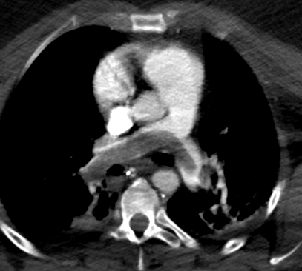
Approach to interpretation
Determine if there are filling defects in the PAs. If so, are they central within the vessel (acute PE) or layering along the walls of the vessel (subacute or chronic PE). Get a sense of the clot burden - is it massive, submassive or only in one or two segmental or subsegmental arteries
Images with clot

Slide 13
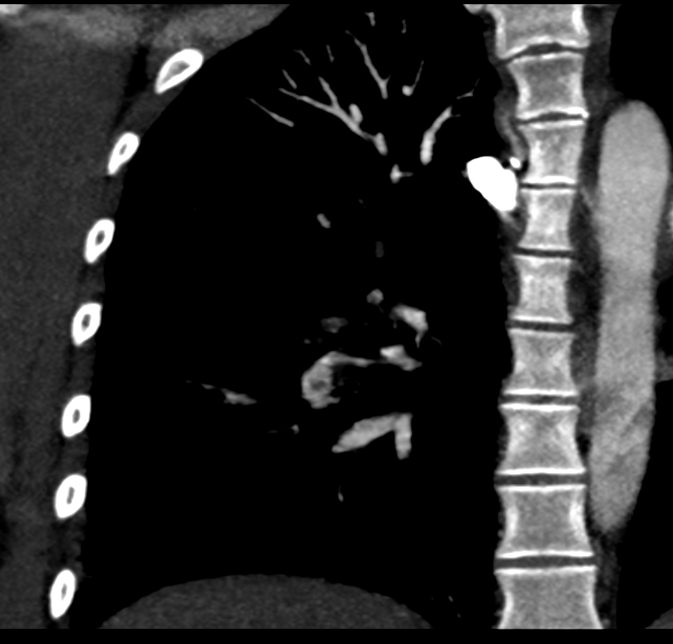
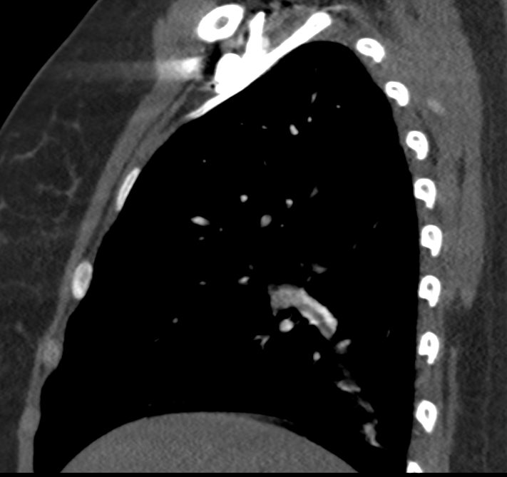
Approach to interpretation
Confirm the findings on coronal and sagittal reformatted images
Coronal and sag images with clot

Slide 14
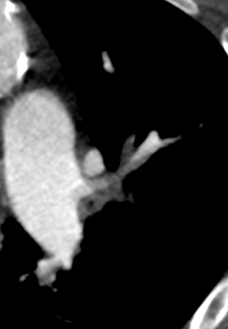
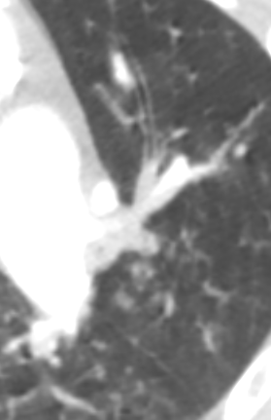
Approach to interpretation: pitfalls
Make sure the “filling defect” is not an artifact or mimic.
Put on “lung windows” to make sure the defect is not mucus in a bronchus.
Follow the vessel back to the hilum to make sure it is an artery, not a vein.
Images with mucus

Slide 15
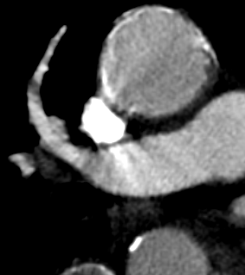

Approach to interpretation: pitfalls
Make sure the “filling defect” is not due to contrast timing or respiratory motion artifacts.
True PEs will appear as filling defects with NO contrast distal to the clot. If there is contrast beyond the “clot”, it is likely an artifact due to bolus timing or motion
Images with artifact
Notes:
Decreased attenuation in a pulmonary artery. Unobscured, shows it is streak artifact from SVC contrast

Slide 16
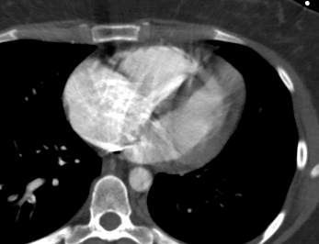
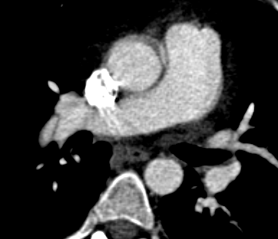
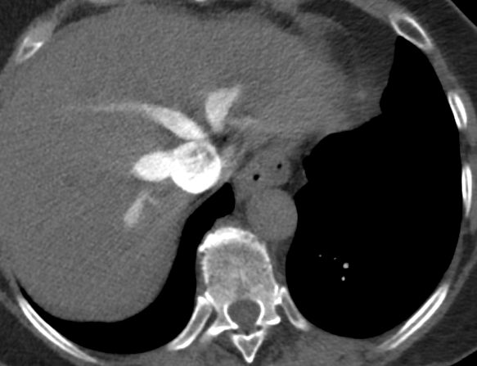
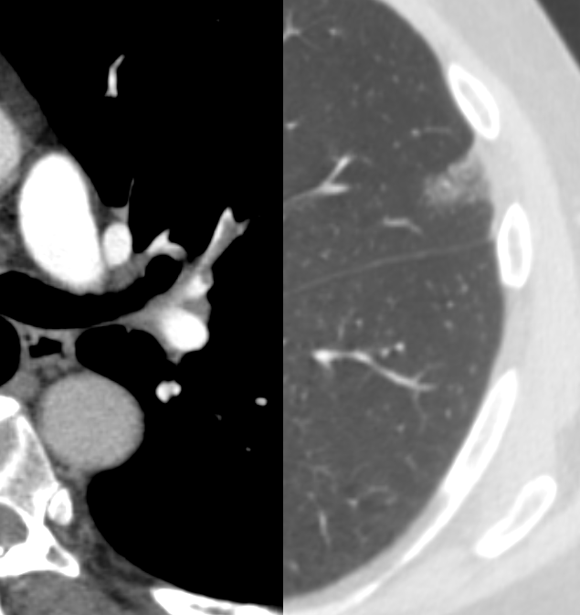
Approach to interpretation: secondary findings
Right heart strain
Pulmonary infarct
intraluminal webs, calcification, thrombus recanalization, and filling defects adherent to the wall that form obtuse angles and concave surfaces
Notes:
TOP LEFT - Flattened interventricular septum, RV/LV > 1, R heart strain
TOP RIGHT – pulmonary web R main
BOTTOM LEFT – IVC and hepatic vein reflux
BOTTOM RIGHT – wedge shape infarct distal to clot, dual windowing

Slide 17
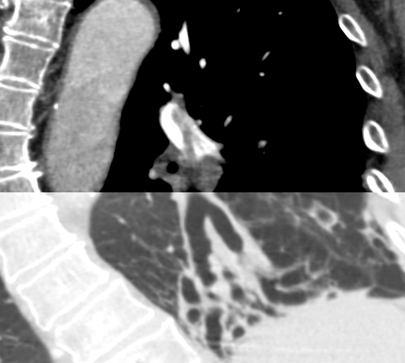
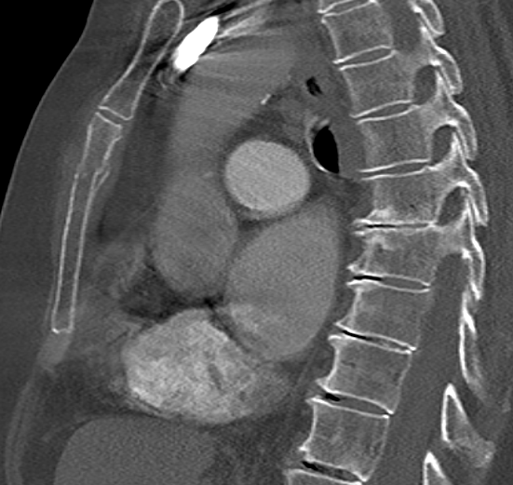
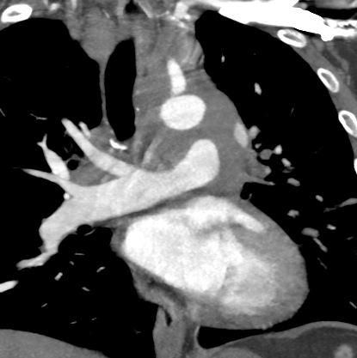
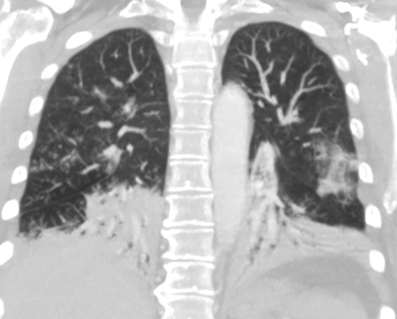
Approach to interpretation: unrelated findings
Avoid satisfaction of search.
Thoroughly assess the lungs, mediastinum, bones and included portions of the abdomen for unrelated, but clinically relevant findings.
Notes:
TOP LEFT – PE, also bronchiectasis
TOP RIGHT – sternal fracture
BOTTOM LEFT – invasive mediastinal mass, small cell lung primary
BOTTOM RIGHT – multifocal pneumonia

Slide 18
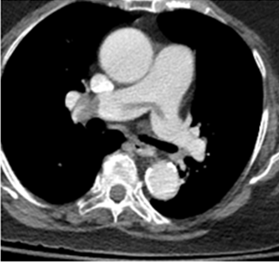
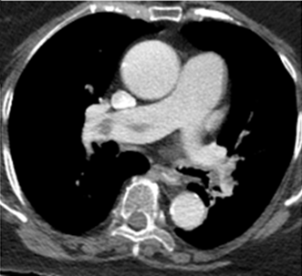
Additional Examples
Note the filling defects in the main and right pulmonary arteries, consistent with pulmonary emboli

Slide 19
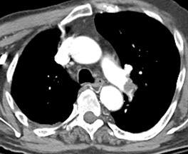
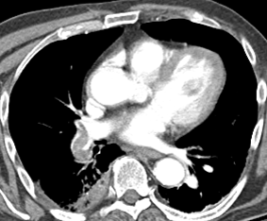
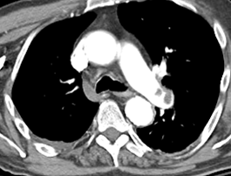
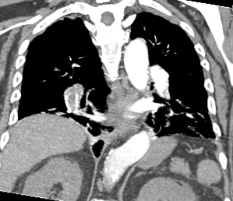
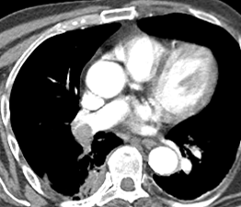
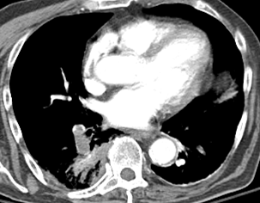
Note the filling defects in the main and right main pulmonary arteries and right lower lobe segmental arteries consistent with pulmonary emboli

