Slide 1


How to Approach Mammograms
Diana L. Lam, MD
University of Washington, School of Medicine
Rebecca J. Leddy, MD
Medical University of South Carolina
Notes:
Diana Lam
Rebecca Leddy
Carol Dell

Slide 2
Patient – Clinical History
Risk factors for breast cancer
  Personal history
  Family history
  Genetic mutation
History of any breast procedures (core needle biopsies, excisional biopsy, lumpectomy)
  Date, location, pathology

Slide 3
Patient – Clinical History
Hormonal Status
  Pre-menopausal / Post Menopausal
  Menstrual cycle phase
  History of exogenous hormone use
History of exogenous hormone use
Symptoms (diagnostic mammography)
  Palpable lump, focal pain, nipple discharge

Slide 4
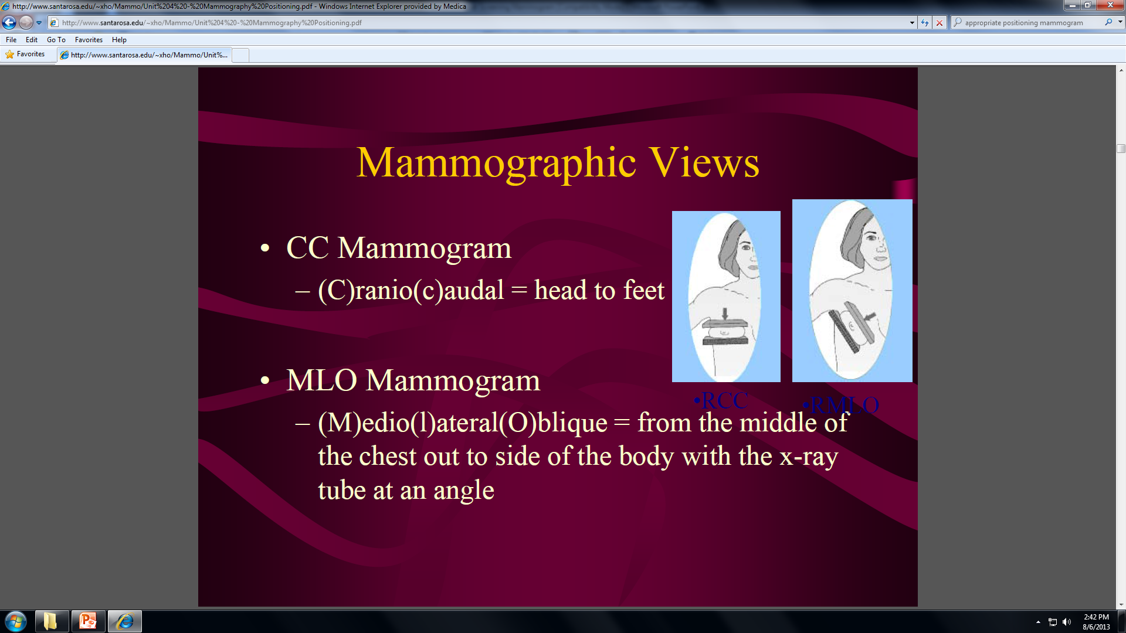
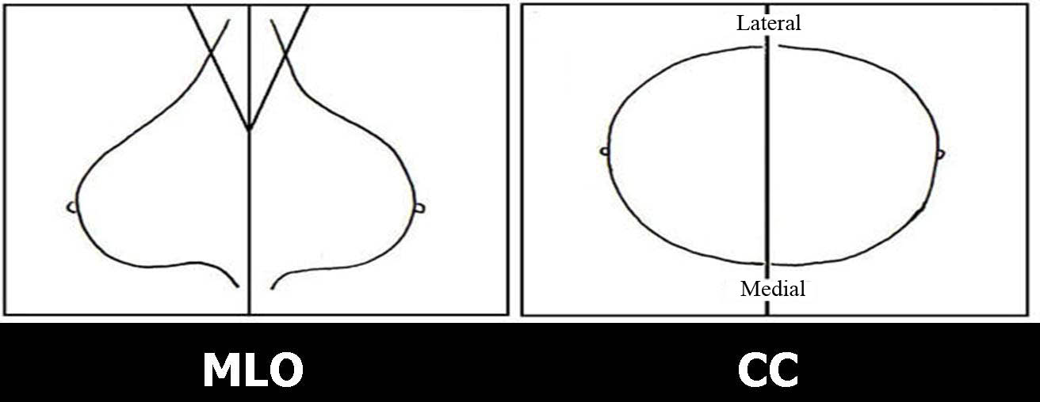
Technique: Screening Mammogram
Both Standard (2d) and tomosynthesis (3D) Mammography
4 standard views taken
  Right/Left Craniocaudal Views (CC)
  Right/Left Mediolateral Oblique (MLO)
Additional views if needed (need to see more lateral tissue, folds in breast, etc.)

Slide 5
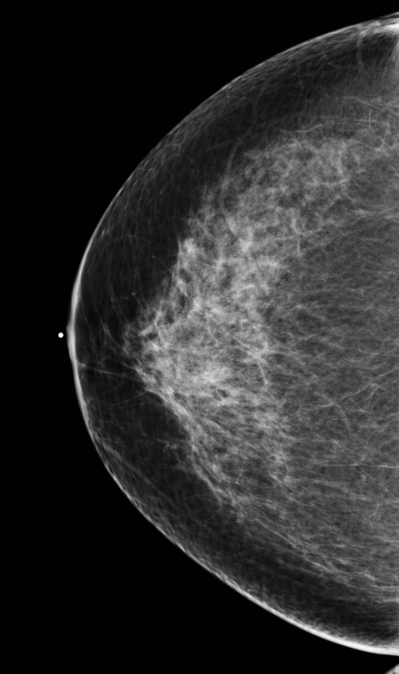
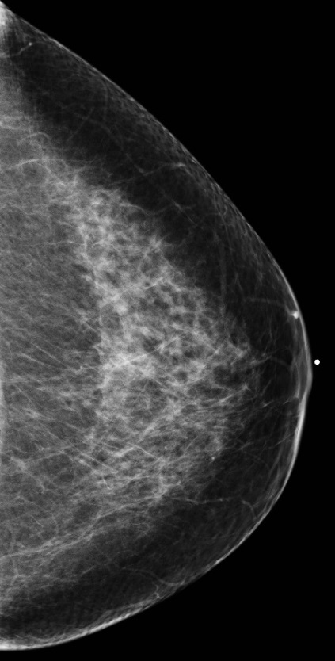
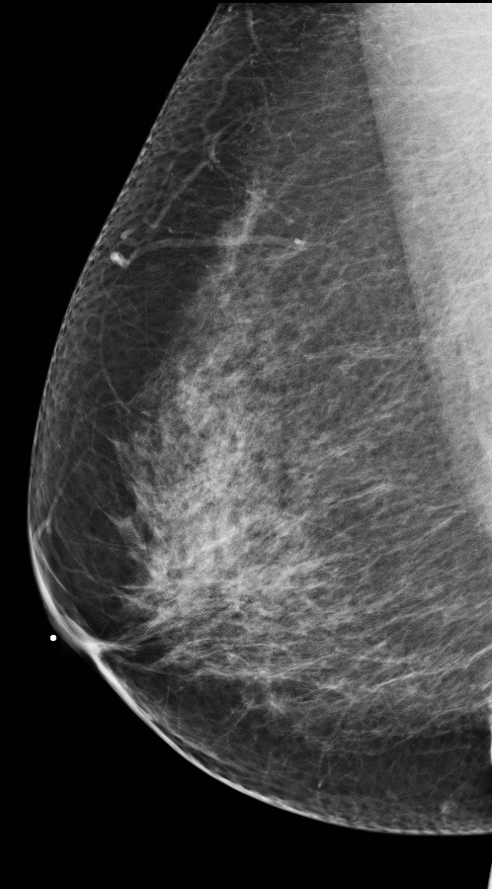
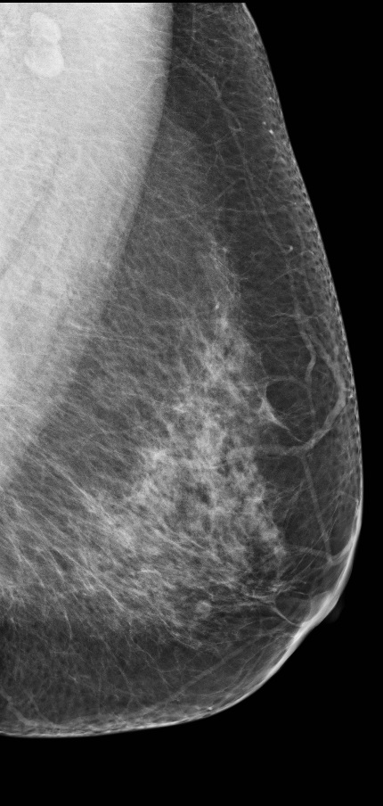
Localization Terminology - Quadrants
Right MLO
Left MLO
Right CC
Left CC
OUTER
(LATERAL)
OUTER
UPPER
(SUPERIOR)
UPPER
LOWER
(INFERIOR)
LOWER
INNER
(MEDIAL)
INNER
Four quadrants:
Upper outer
Upper inner
Lower outer
Lower inner

Slide 6
Approach: Viewing Technique
Focused attention; limit distractions
Read patient history questionnaire
Read previous mammogram report (s)
Standard views on screen positioned same every time including how display old versus new mammograms and tomosynthesis
Compare at least 2 previous mammograms, most recent and older (earliest available)

Slide 7
Systematic Approach Interpretation
Use consistent approach each time
Evaluate technical factors –
  Breast positioning- nipple in profile, open inframammary fold
  Motion/blur
  Deodorant artifacts
  No folds or wrinkles
  Tissue within 1 cm on MLO and CC view draw line from nipple to chest wall
  Pectoralis muscle wide superiorly with convex anterior border

Slide 8
Systematic Approach Interpretation
Use overall and close in (magnifying) search technique
About perception….is there potentially a lesion
“Send” brain to specific look for things…..certain spaces, mass, distortion
Evaluate from a distance:
  Overall breast tissue density
  Symmetry of breast
  Breast contour
  Breast size

Slide 9
Systematic Approach Interpretation
Same search pattern every time
  Square search pattern or
  Split in 3rds: Lateral, mid, medial CC then upper, mid, inferior MLO
  Tomosynthesis (3D Mammography)
    Keep eye same spot scroll back and forth all way through then move on next spot

Slide 10
Systematic Approach Interpretation
Evaluate retroglandular spaces, medial aspect breast CC views, nipple/retroareolar area, axilla, edge of film
Evaluate each view comparing new to old
Evaluate for masses, asymmetries, architectural distortion, calcifications – from distance and closer view – one at time
Beware satisfaction of search and stability (some cancers slow growing may not look that changed previous year)

Slide 11

Breast Anatomy on Mammogram
Nodular white densities = 1-2 mm TDLUs or glandular elements (seen if outlined by fat)
Linear white densities = fibrous strands, coopers ligaments, ducts, vessels
Radiolucent oval= fat (adipose tissue)
Radiopaque homogenous tissue = fibrous connective tissue (structureless; dense)
skin
Glandular tissue
Fibrous bands
Black = fat

Slide 12


Breast Anatomy on Mammogram
Linear white densities = fibrous strands, coopers ligaments, ducts, vessels
Lymph node
Axilla
Vessels
Retroareolar area
Coopers ligaments
Duct
Nipple

Slide 13
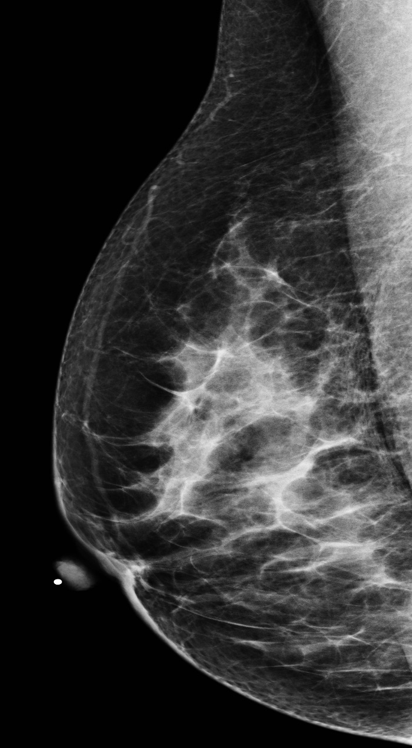

Breast Anatomy on Mammogram
Radiolucent ovals of fat
No straight lines or bulging in fat/glandular interface
Homogenous parenchyma
Circular/oval areas of fatty involution of tissue
R MLO

Slide 14
The Screening Mammogram: What are Radiologists Looking for?
Masses
Calcifications
Focal asymmetries
Other findings
  Architectural distortion
  Nipple retraction
  Skin thickening

Slide 15
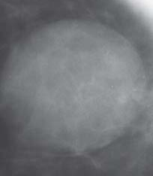

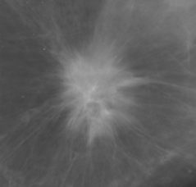
Mammographic Masses
Shape: Round Oval Irregular
Margins: Circumscribed Circumscribed Spiculated

Slide 16
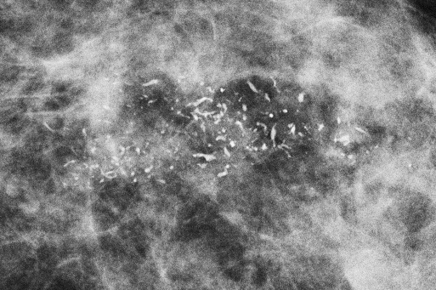
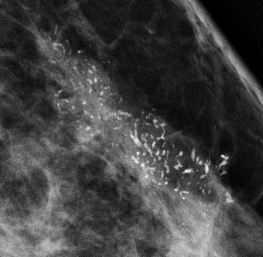
Suspicious Calcifications
The morphology of these calcifications are fine and pleomorphic. Biopsy of these calcifications revealed ductal carcinoma in situ (DCIS).
Notes:
Most are benign and can be dismissed
The goal is to identify new or increasing calcifications or those with suspicious morphology

Slide 17
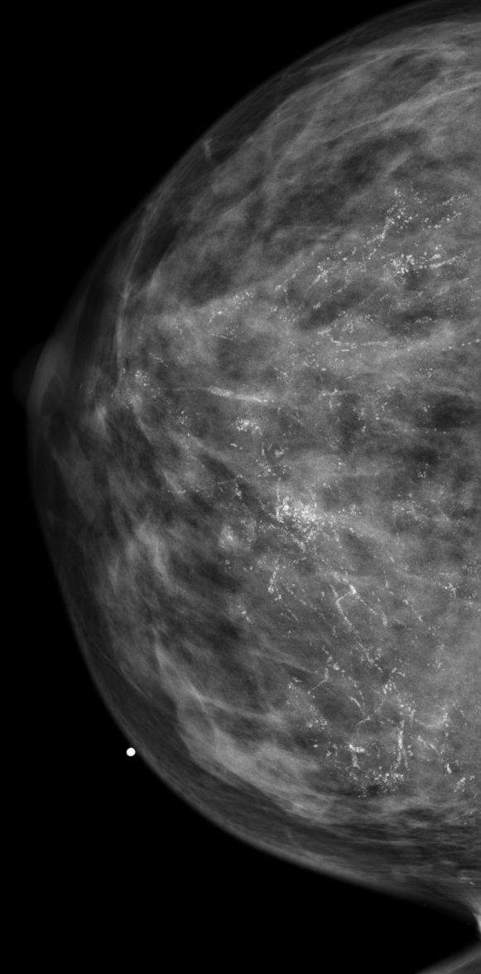
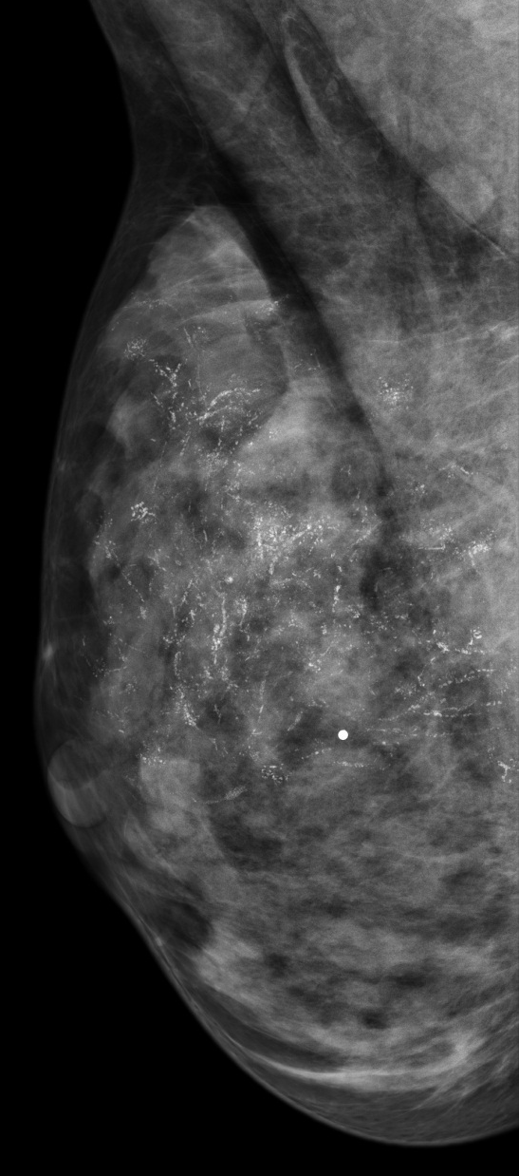
Distribution of Calcifications
These are segmentally distributed calcifications aligning with the pattern of ducts. It is pyramid or cone shaped with the base directed posteriorly.

Slide 18
Developing Asymmetry
PRIOR MAMMOGRAM

Slide 19
Developing Asymmetry
CURRENT MAMMOGRAM

Slide 20
Developing Asymmetry
There is a focal asymmetry which has developed and is denser compared to prior mammogram.
New findings on screening mammogram generally need further work-up with diagnostic mammography.
CURRENT MAMMOGRAM

Slide 21
Architectural Distortion

Slide 22
Architectural Distortion
These are images taken from tomosynthesis (3D) mammography. This shows an area of architectural distortion which appears like a star with the breast tissue being tethered into the central point of the star. This is a suspicious finding and biopsy revealed invasive lobular carcinoma.

