Slide 1




How to Approach Lines and Tubes on CXR
Pauline Germaine
Cooper University Hospital
Nina Terry
University of Alabama Birmingham

Slide 2
How to Approach Lines and Tubes on CXR
Pauline Germaine
Cooper University Hospital
Nina Terry
University of Alabama Birmingham

Slide 3
Approach
Evaluate Lines and Tubes first.
Identify and assess placement of each line/tube individually.
Look for expected complications.
Report all complications present.
Report absence of common complications. (Ex: Right subclavian line is in appropriate position. No pneumothorax.)
Report lines/tubes as being in correct or appropriate position,
NOT as stable.

Slide 4
Endotracheal Tube
Purpose:
  Airway control during assisted ventilation
  Access for airway suctioning
  Potential route for medication administration
Proper placement:
  Should terminate 2-5cm above the carina, or ½ way between carina and clavicles
  Balloon of the tube should not be hyperinflated
Complications:
  Misplacement in the pharynx or right/left mainstem bronchi
  Atelectasis
  Aspiration
  Pneumothorax
  Vocal cord injury
  Tracheal wall injury
  Esophageal dilatation
Notes:
I usually use 2-6 cm for adults but the AJR article on ICU Radiography lists 2-5 cm (AJR:198, March 2012 p563) so we should probably keep that.
Under complication I would add Dislodging teeth and fillings. I have a CT image of a tooth and crown in the right mainstem.

Slide 5
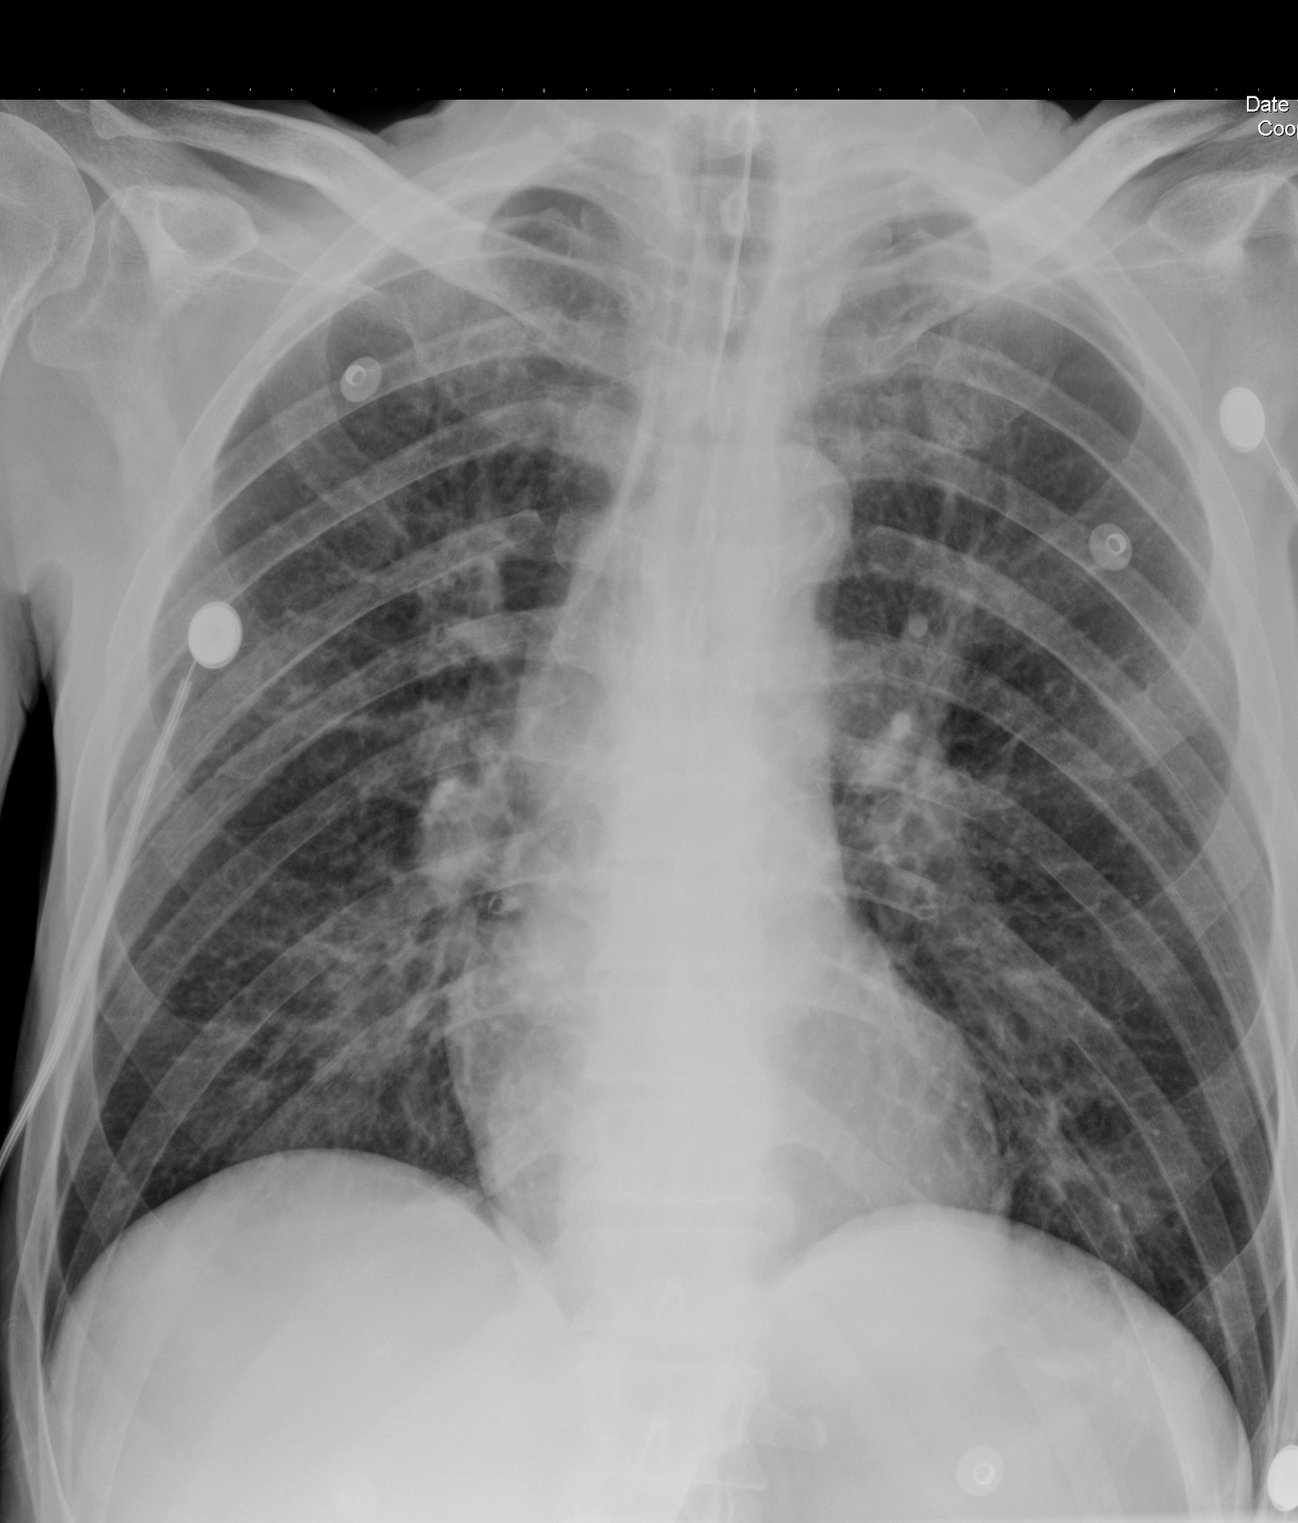
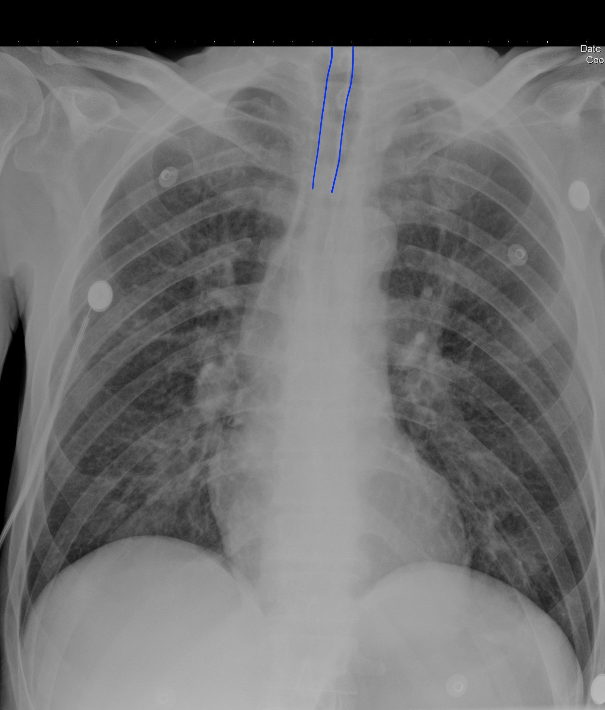
Endotracheal Tube: Proper Placement

Slide 6
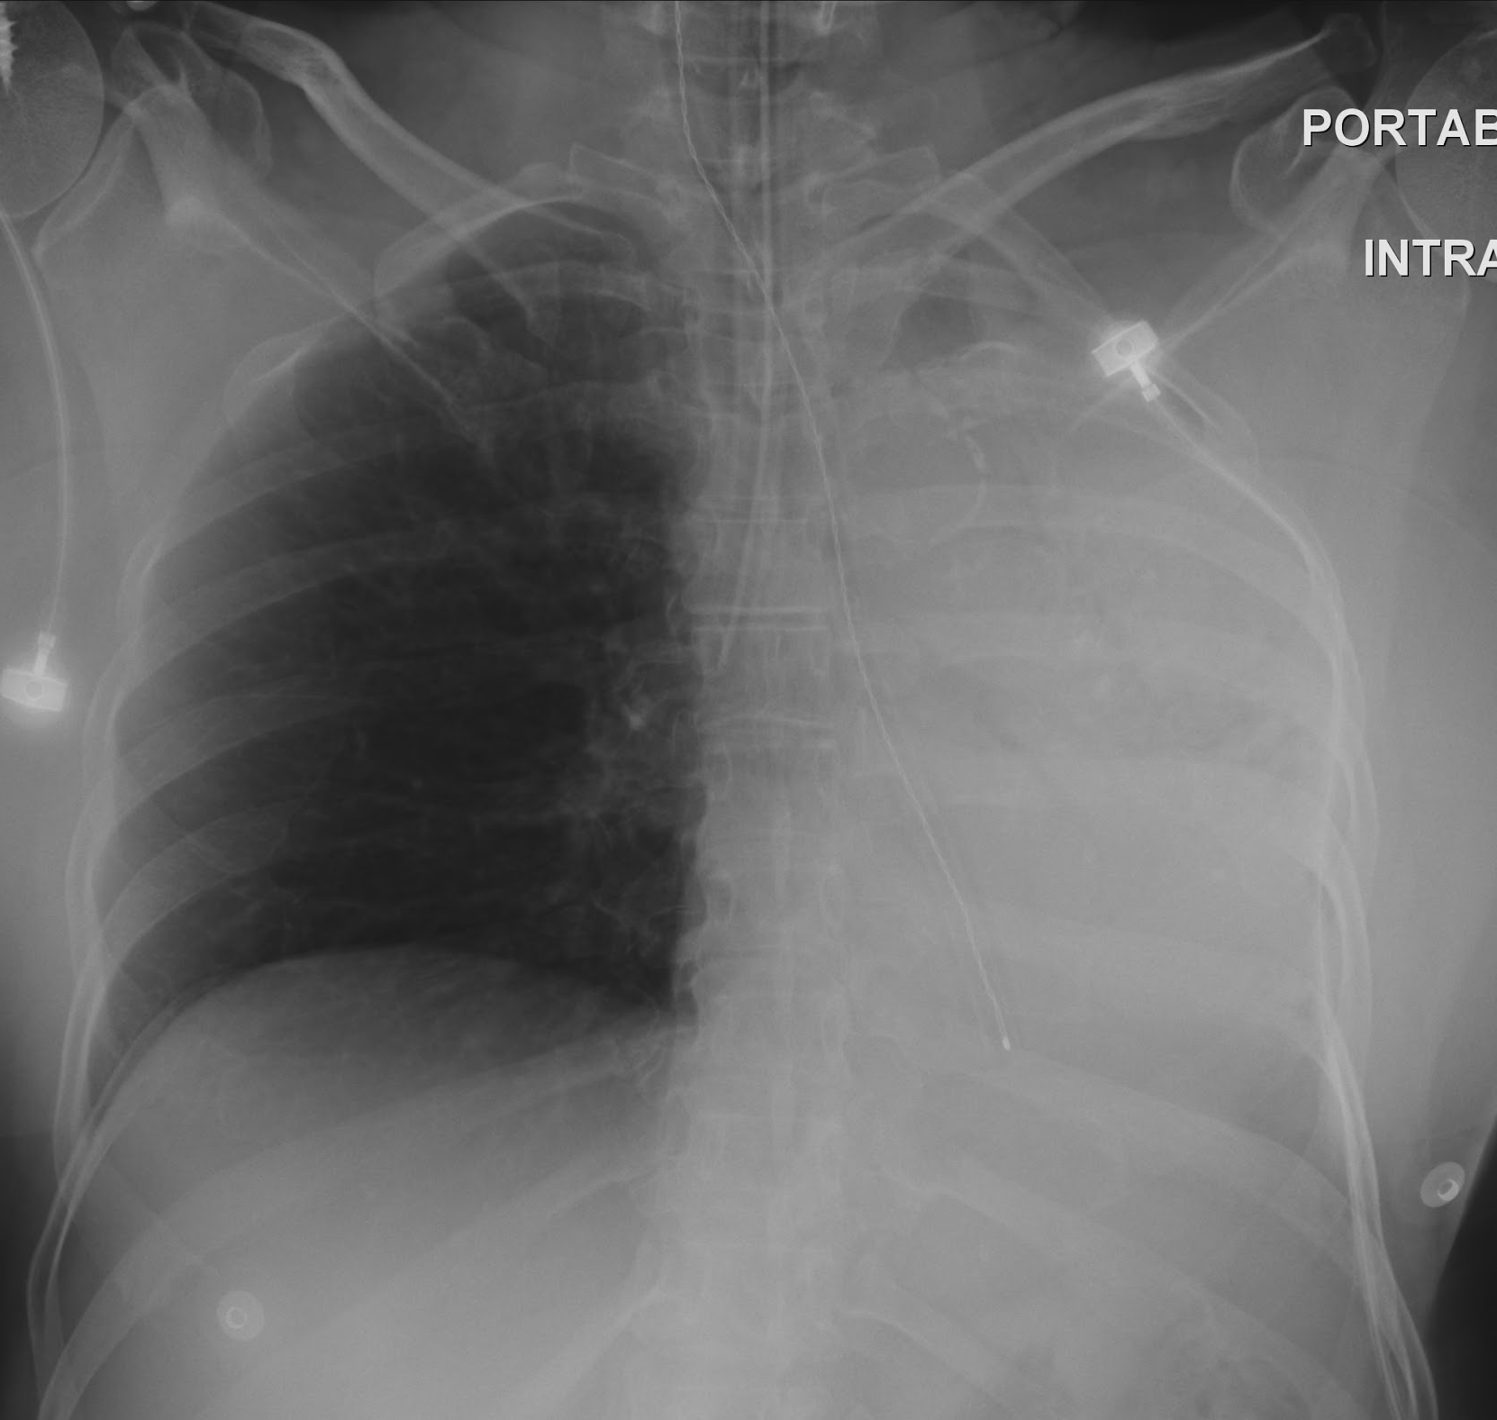
Endotracheal Tube: Misplaced
ET tip in the Right Mainstem Bronchus with complete Left lung atelectasis

Slide 7
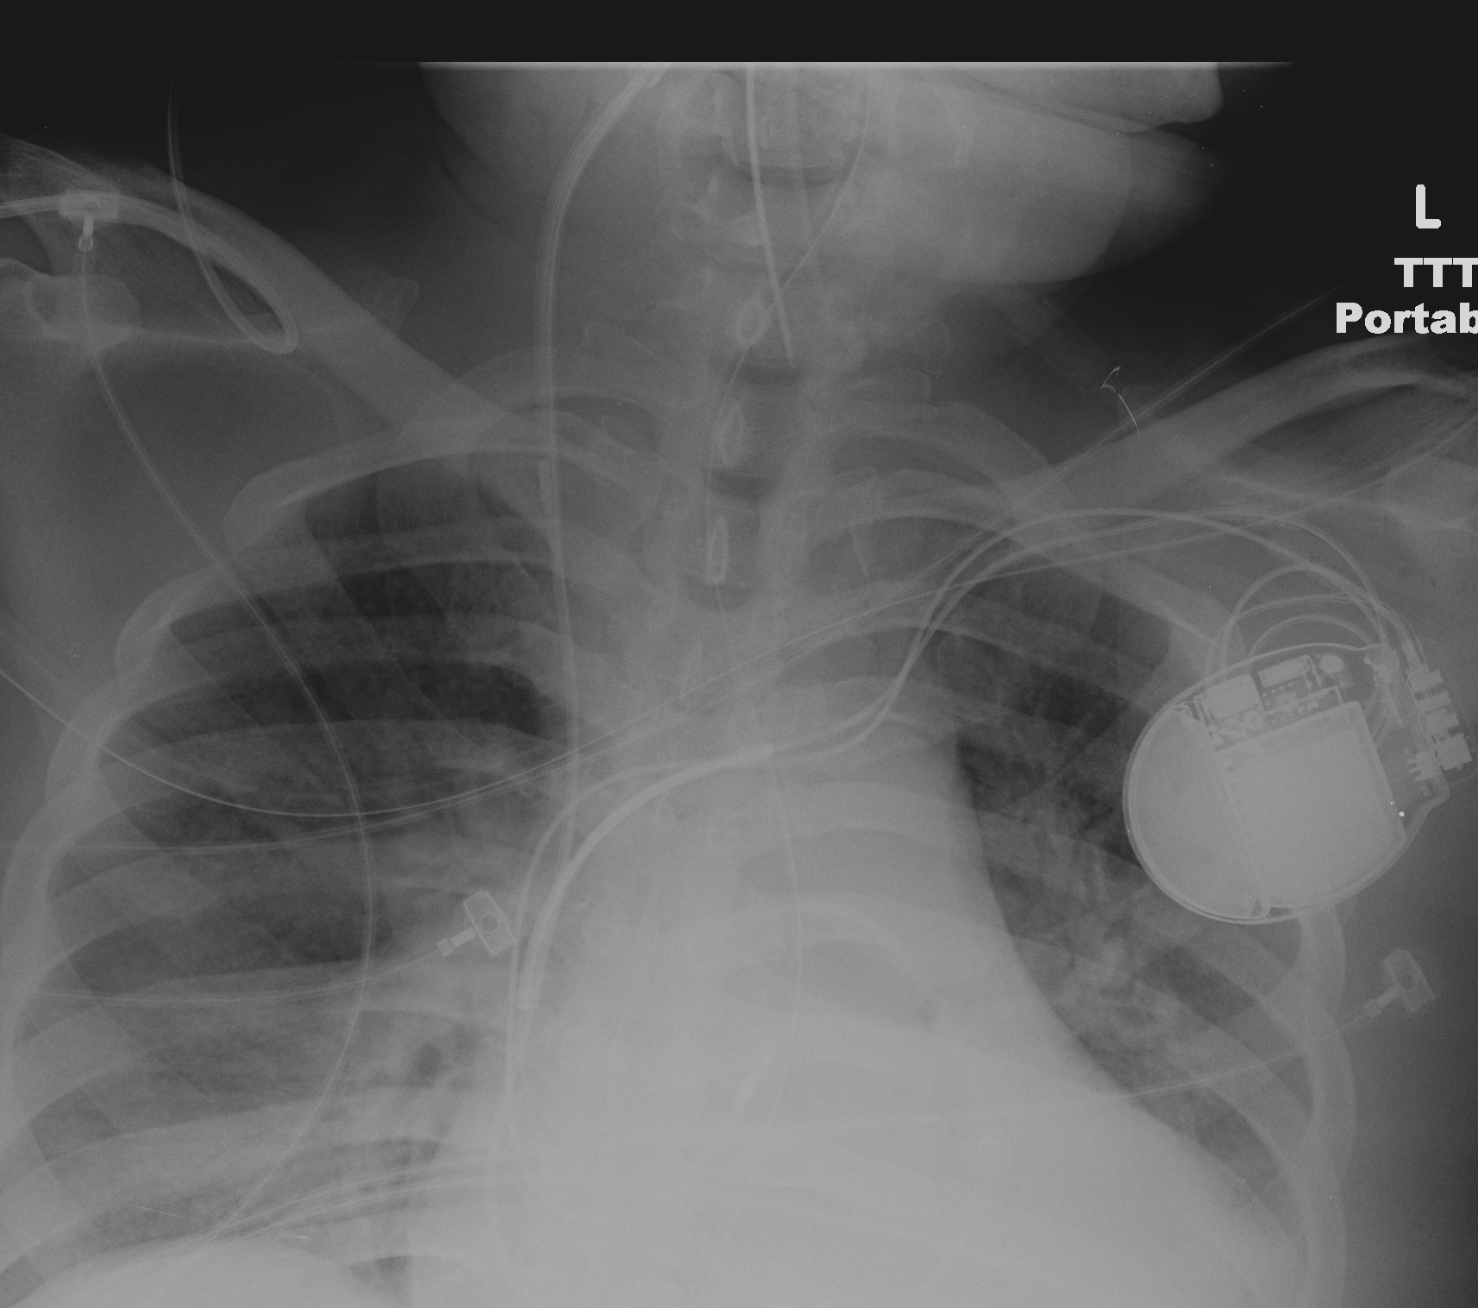
Endotracheal Tube: Misplaced
Balloon
ET Tip and balloon in the neck
Tip

Slide 8
Tracheostomy Tube
Purpose:
  Long term airway access in patients with obstruction at or above larynx
Proper placement:
  Should terminate ½ way between the stoma and carina (~T3 level)
Complications:
  Misplacement in lungs, mediastinum or subcutaneous tissues
  Perforation of trachea
  Aspiration
  Pneumomediastinum or pneumothorax
  Tracheal wall injury/stenosis

Slide 9
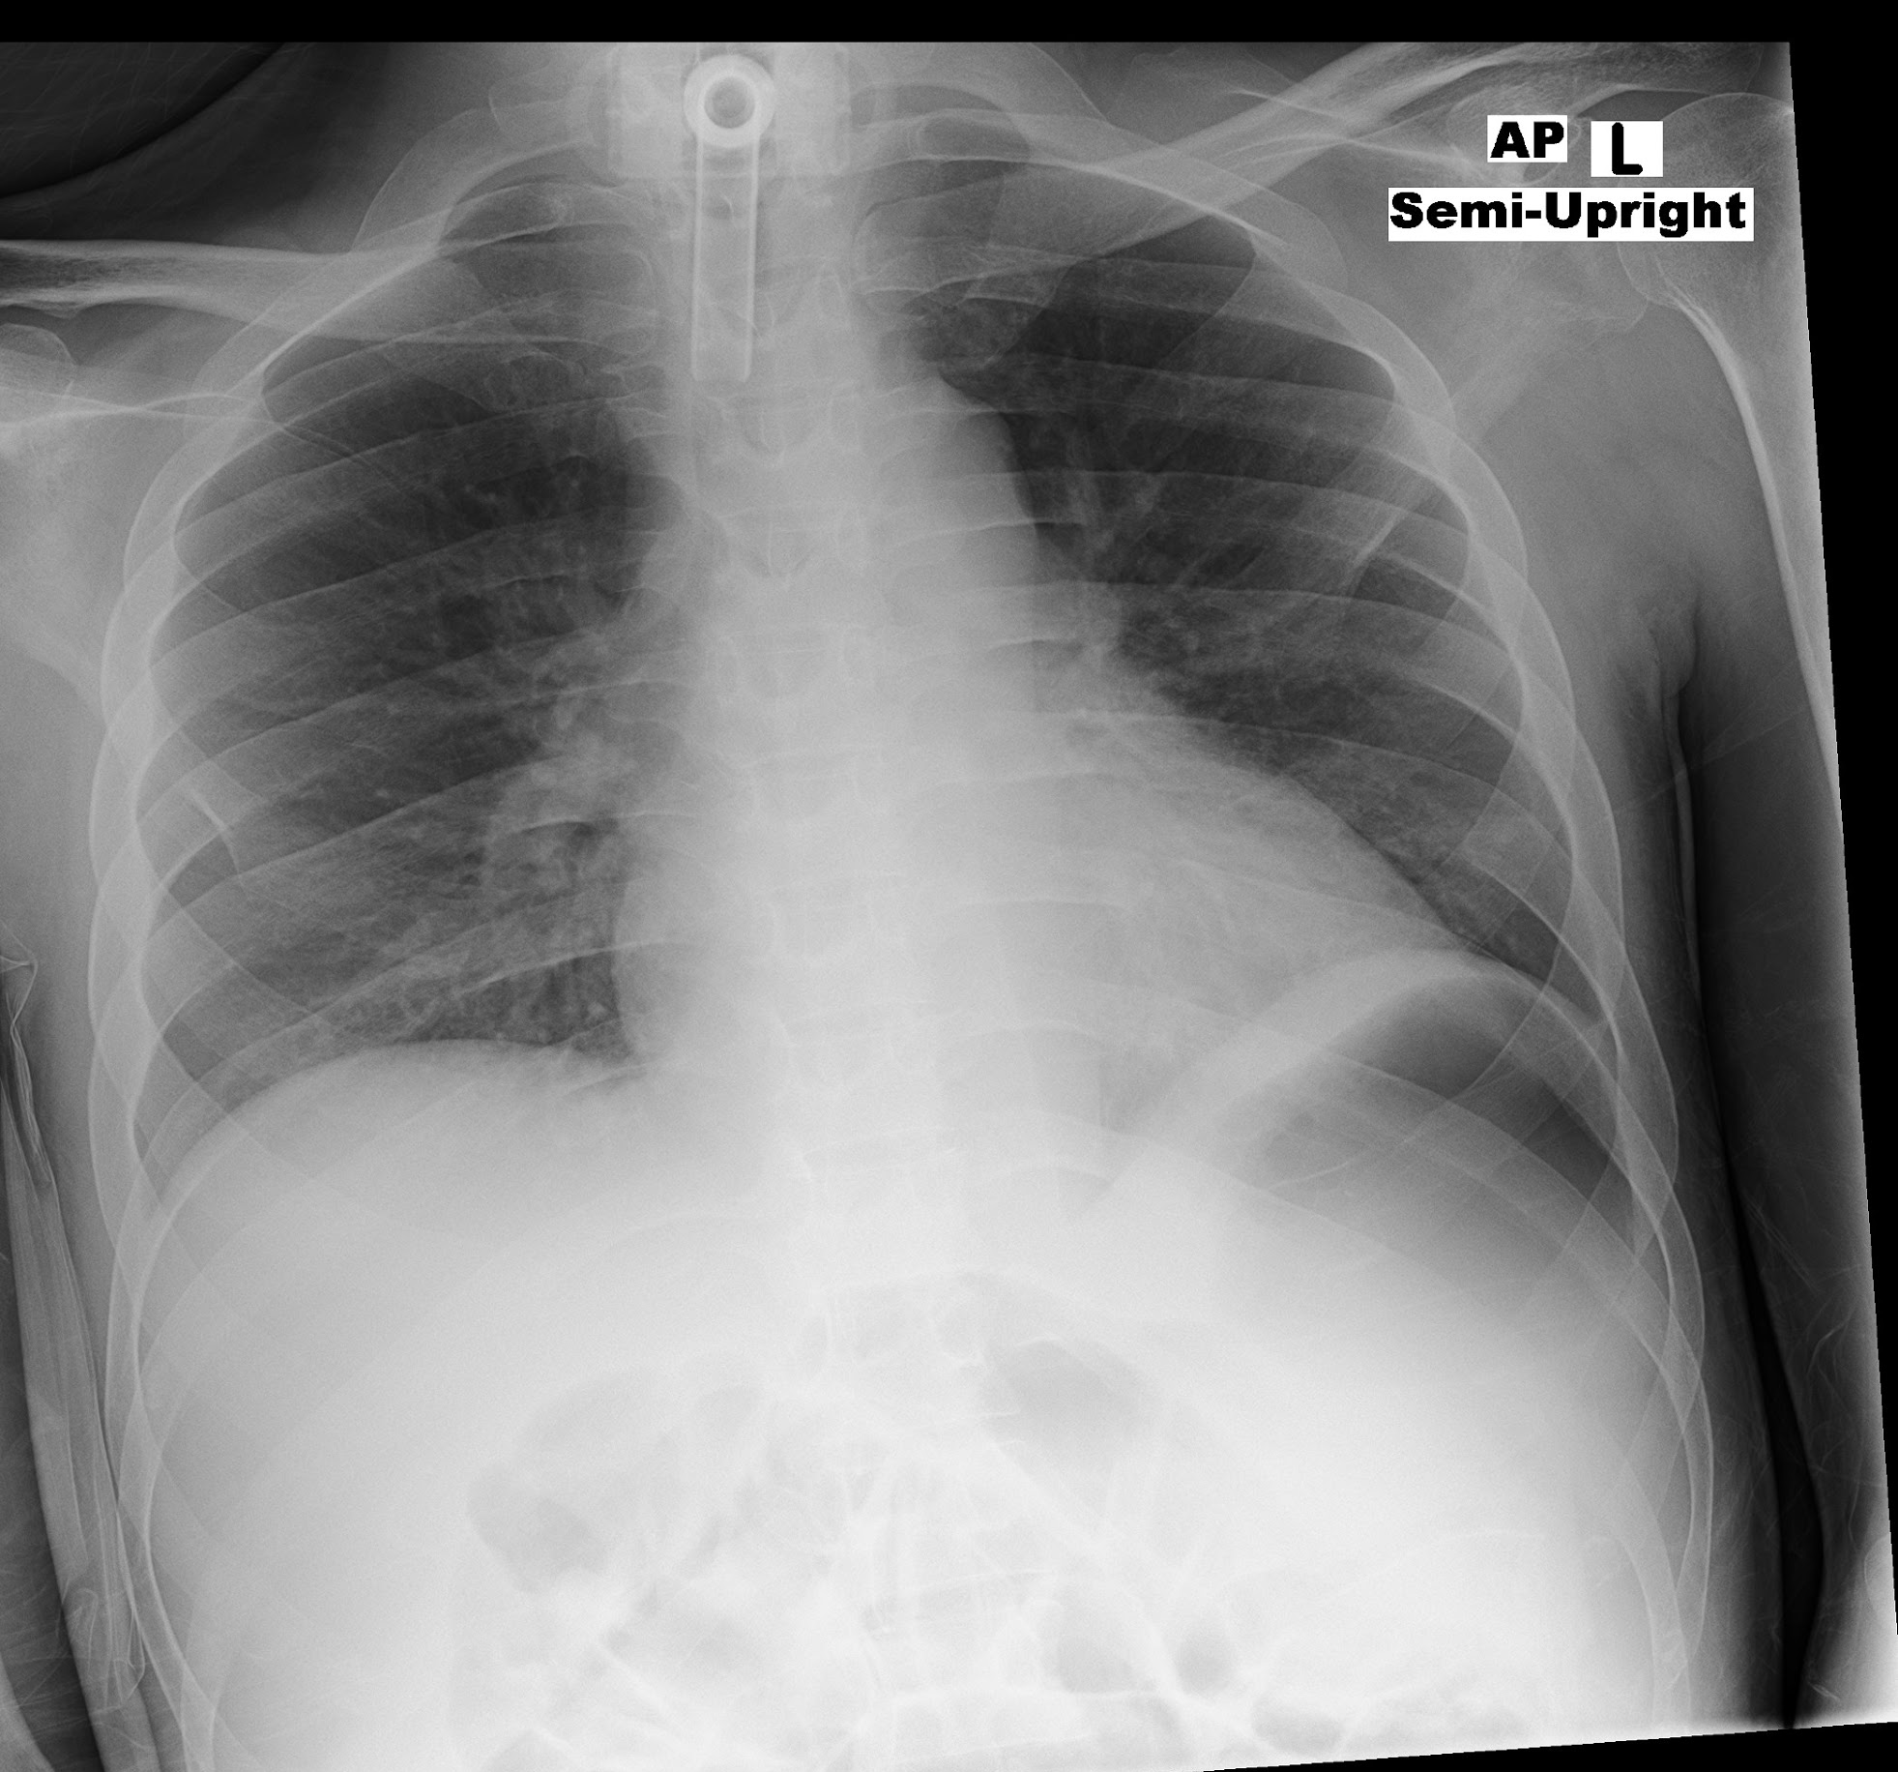
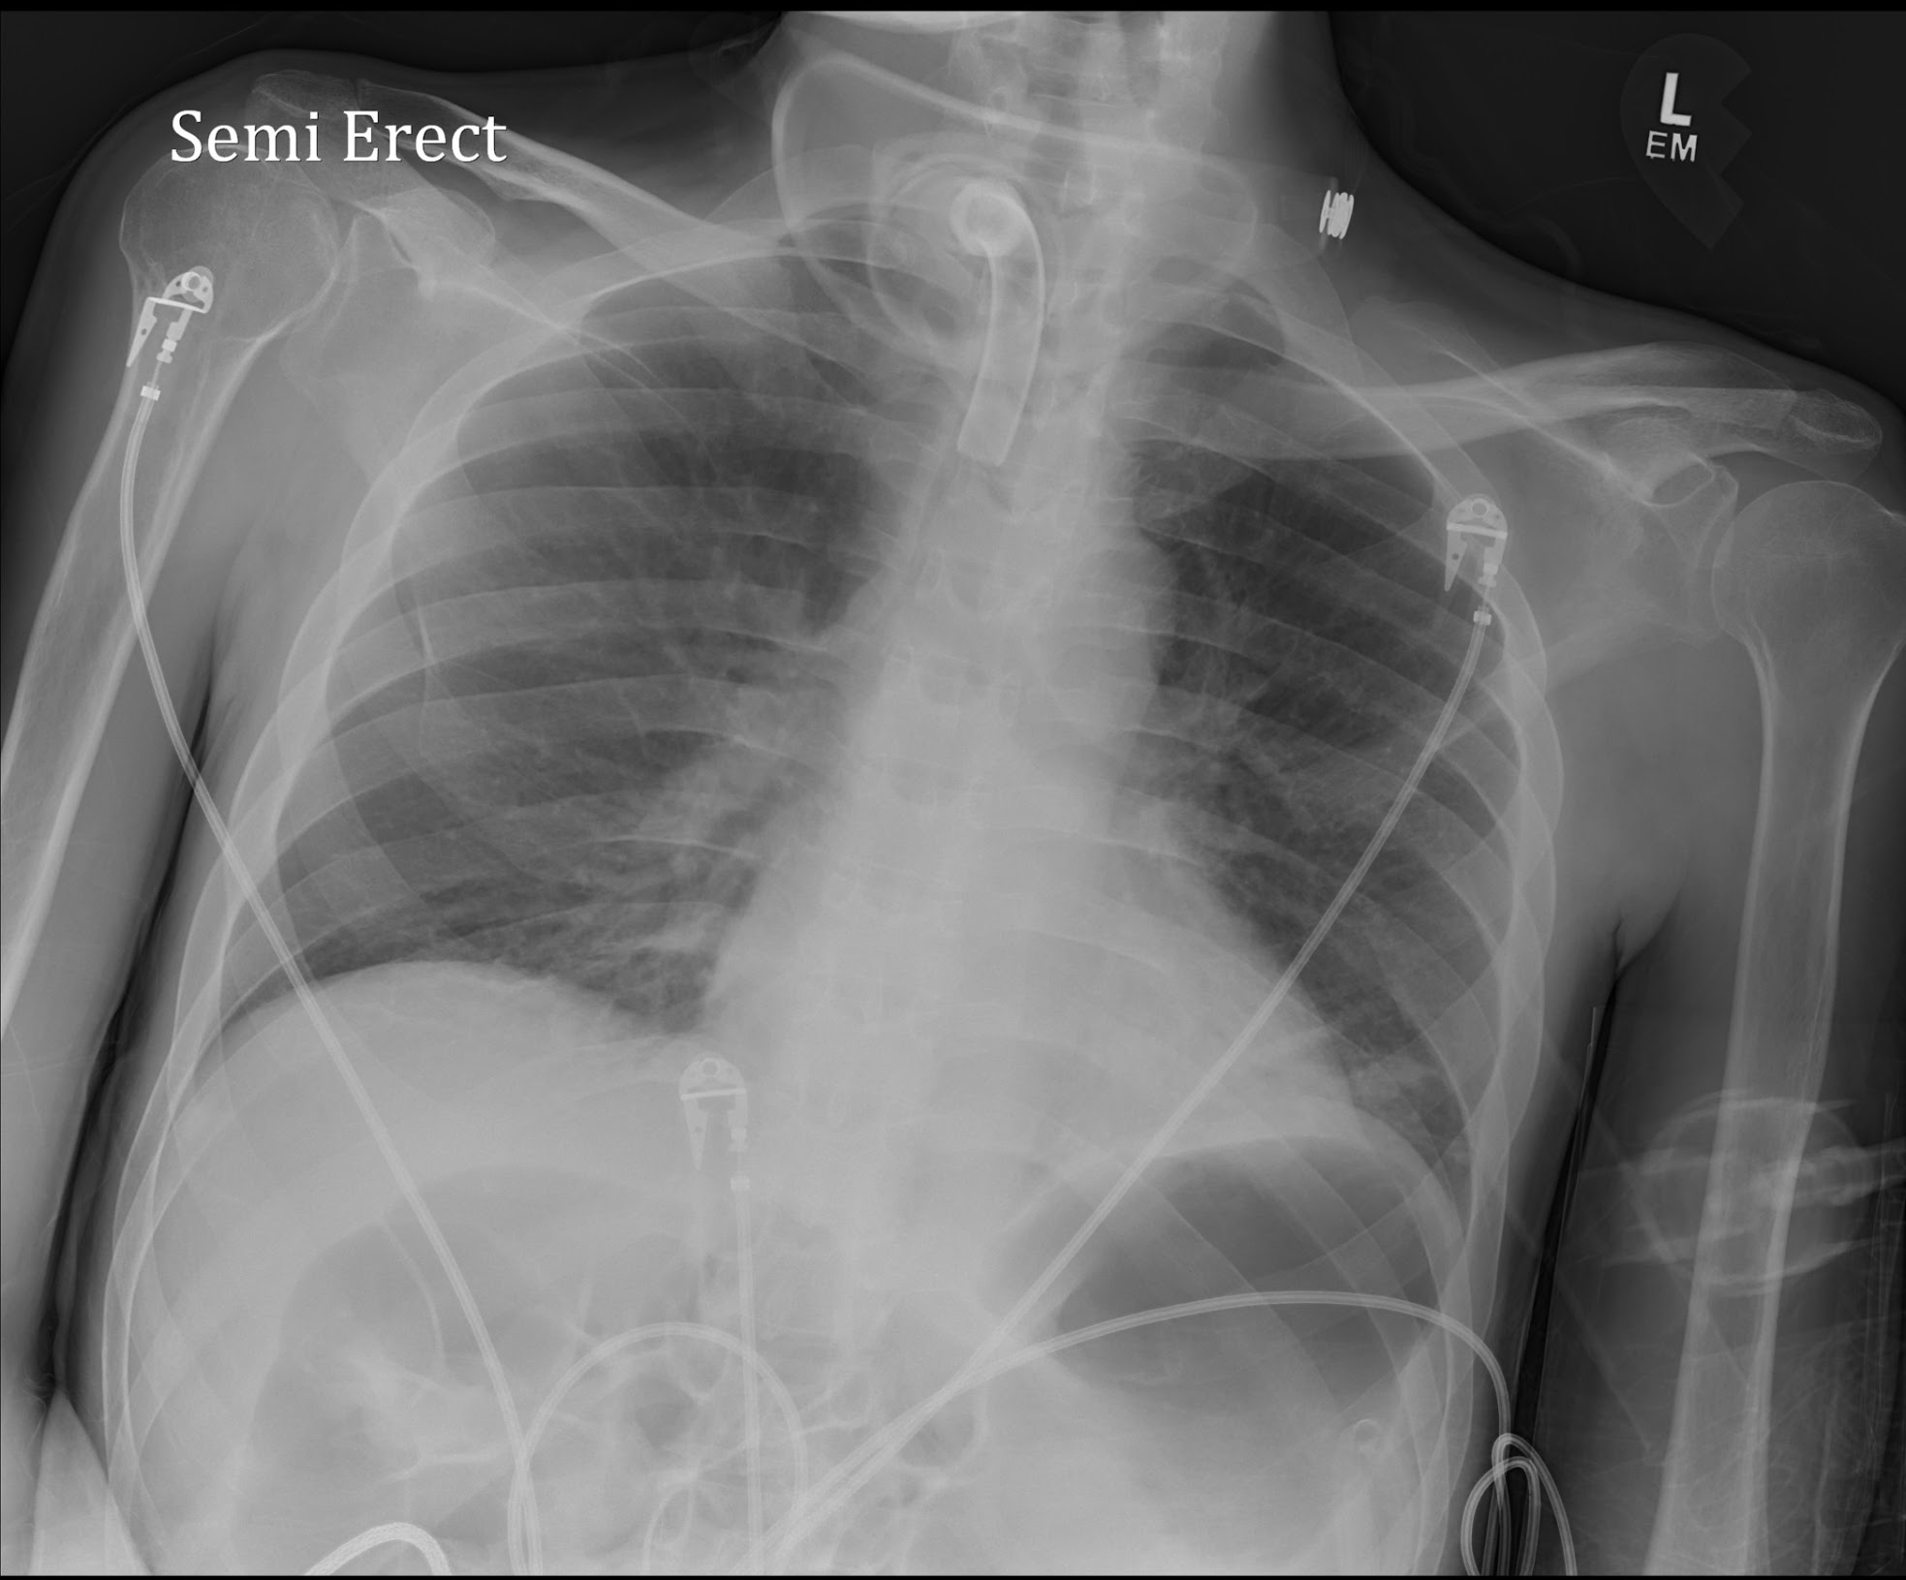
Tracheostomy Tube: Proper Placement

Slide 10
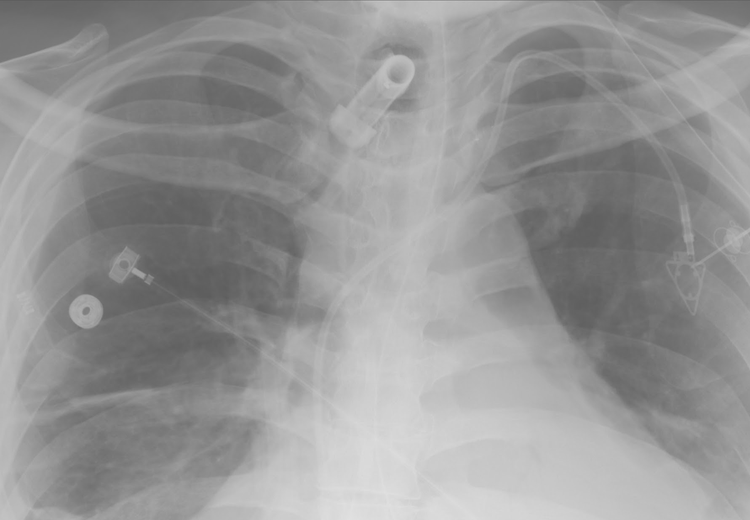
Tracheostomy Tube: Misplaced
The flange (light blue arrows) marks the outside tip and the blue arrow points to the internal tip which is not curving into the trachea. The tracheostomy tube is almost out.

Slide 11
Nasogastric tube
Purpose
  Short term feeding
  Gastric suction & decompression
  Medication administration
Proper placement
  Inserted via the nose, through esophagus into the stomach
  Tip and side hole should extend into the stomach
Complications
  Misplacement in the oropharynx, esophagus or airway
  Esophagitis, reflux, stricture, esophageal perforation
  Aspiration
  Lung injury, pneumothorax or hydropneumothorax
Notes:
The tip and sidehole needs to be distal to the EG junction but not 10 cm. AJR:198 p. 564
Airway misplacement can result in lung injury, PTX and hydropneumothorax.
Esophageal misplacement can lead to aspiration.

Slide 12
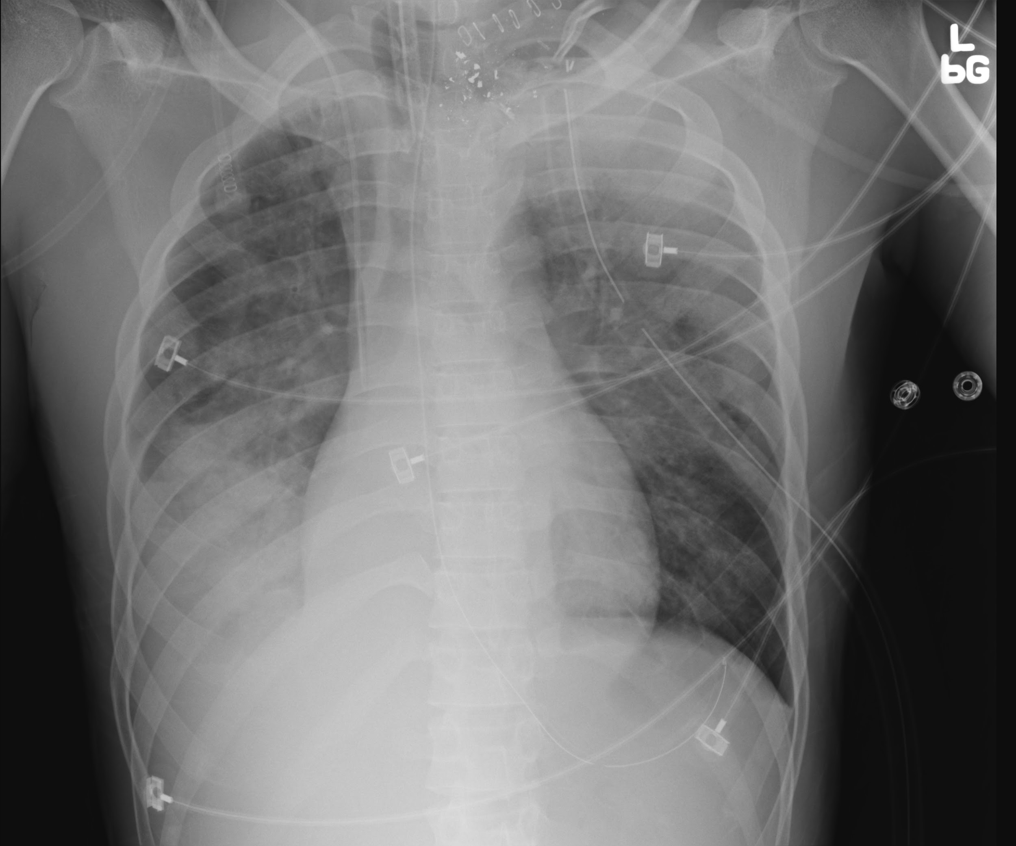
Nasogastric Tube: Proper Placement

Slide 13
Nasogastric Tube: Proper Placement
Both the tip and the sidehole are below the left diaphragm.
TIP
Sidehole

Slide 14
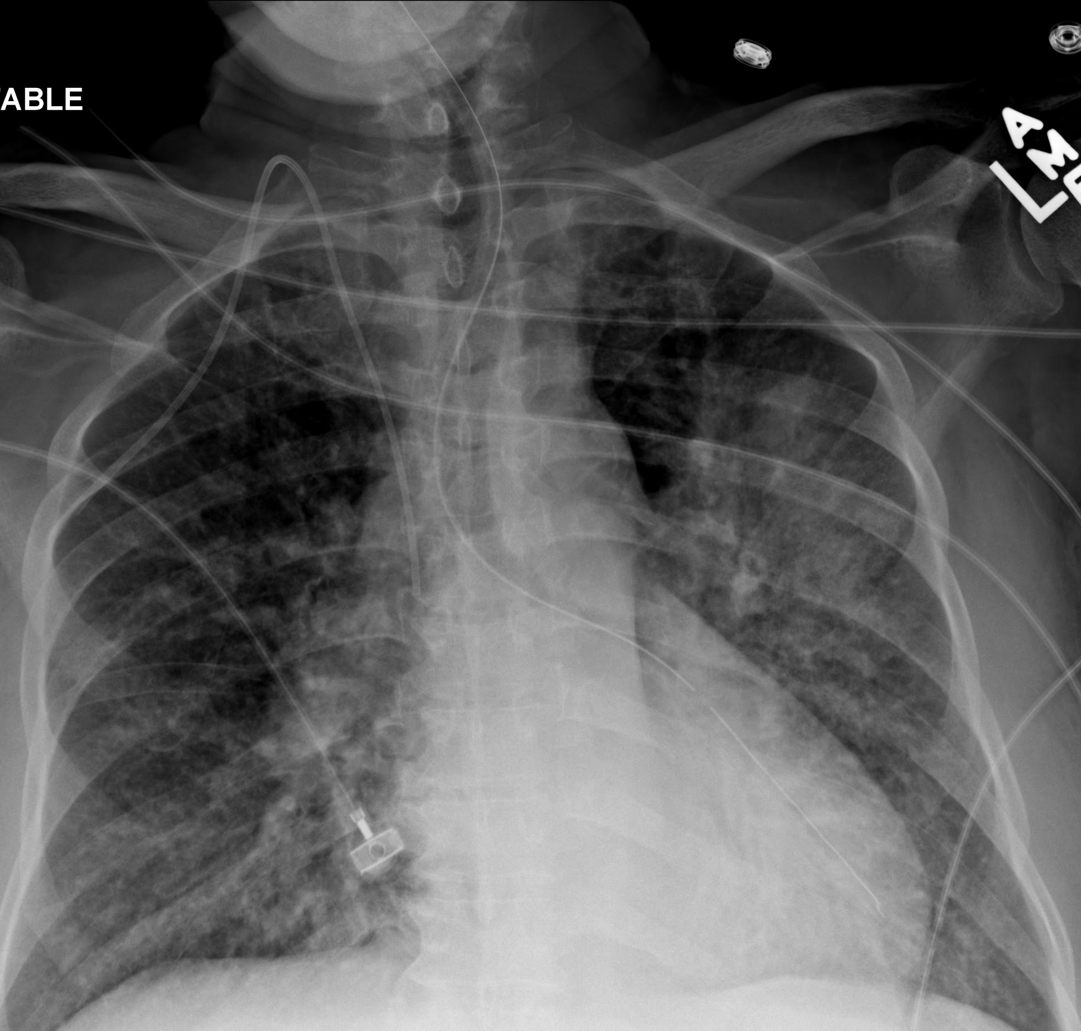
Nasogastric Tube: Misplaced
NG tube terminates in the Left Lower Lobe bronchus

Slide 15
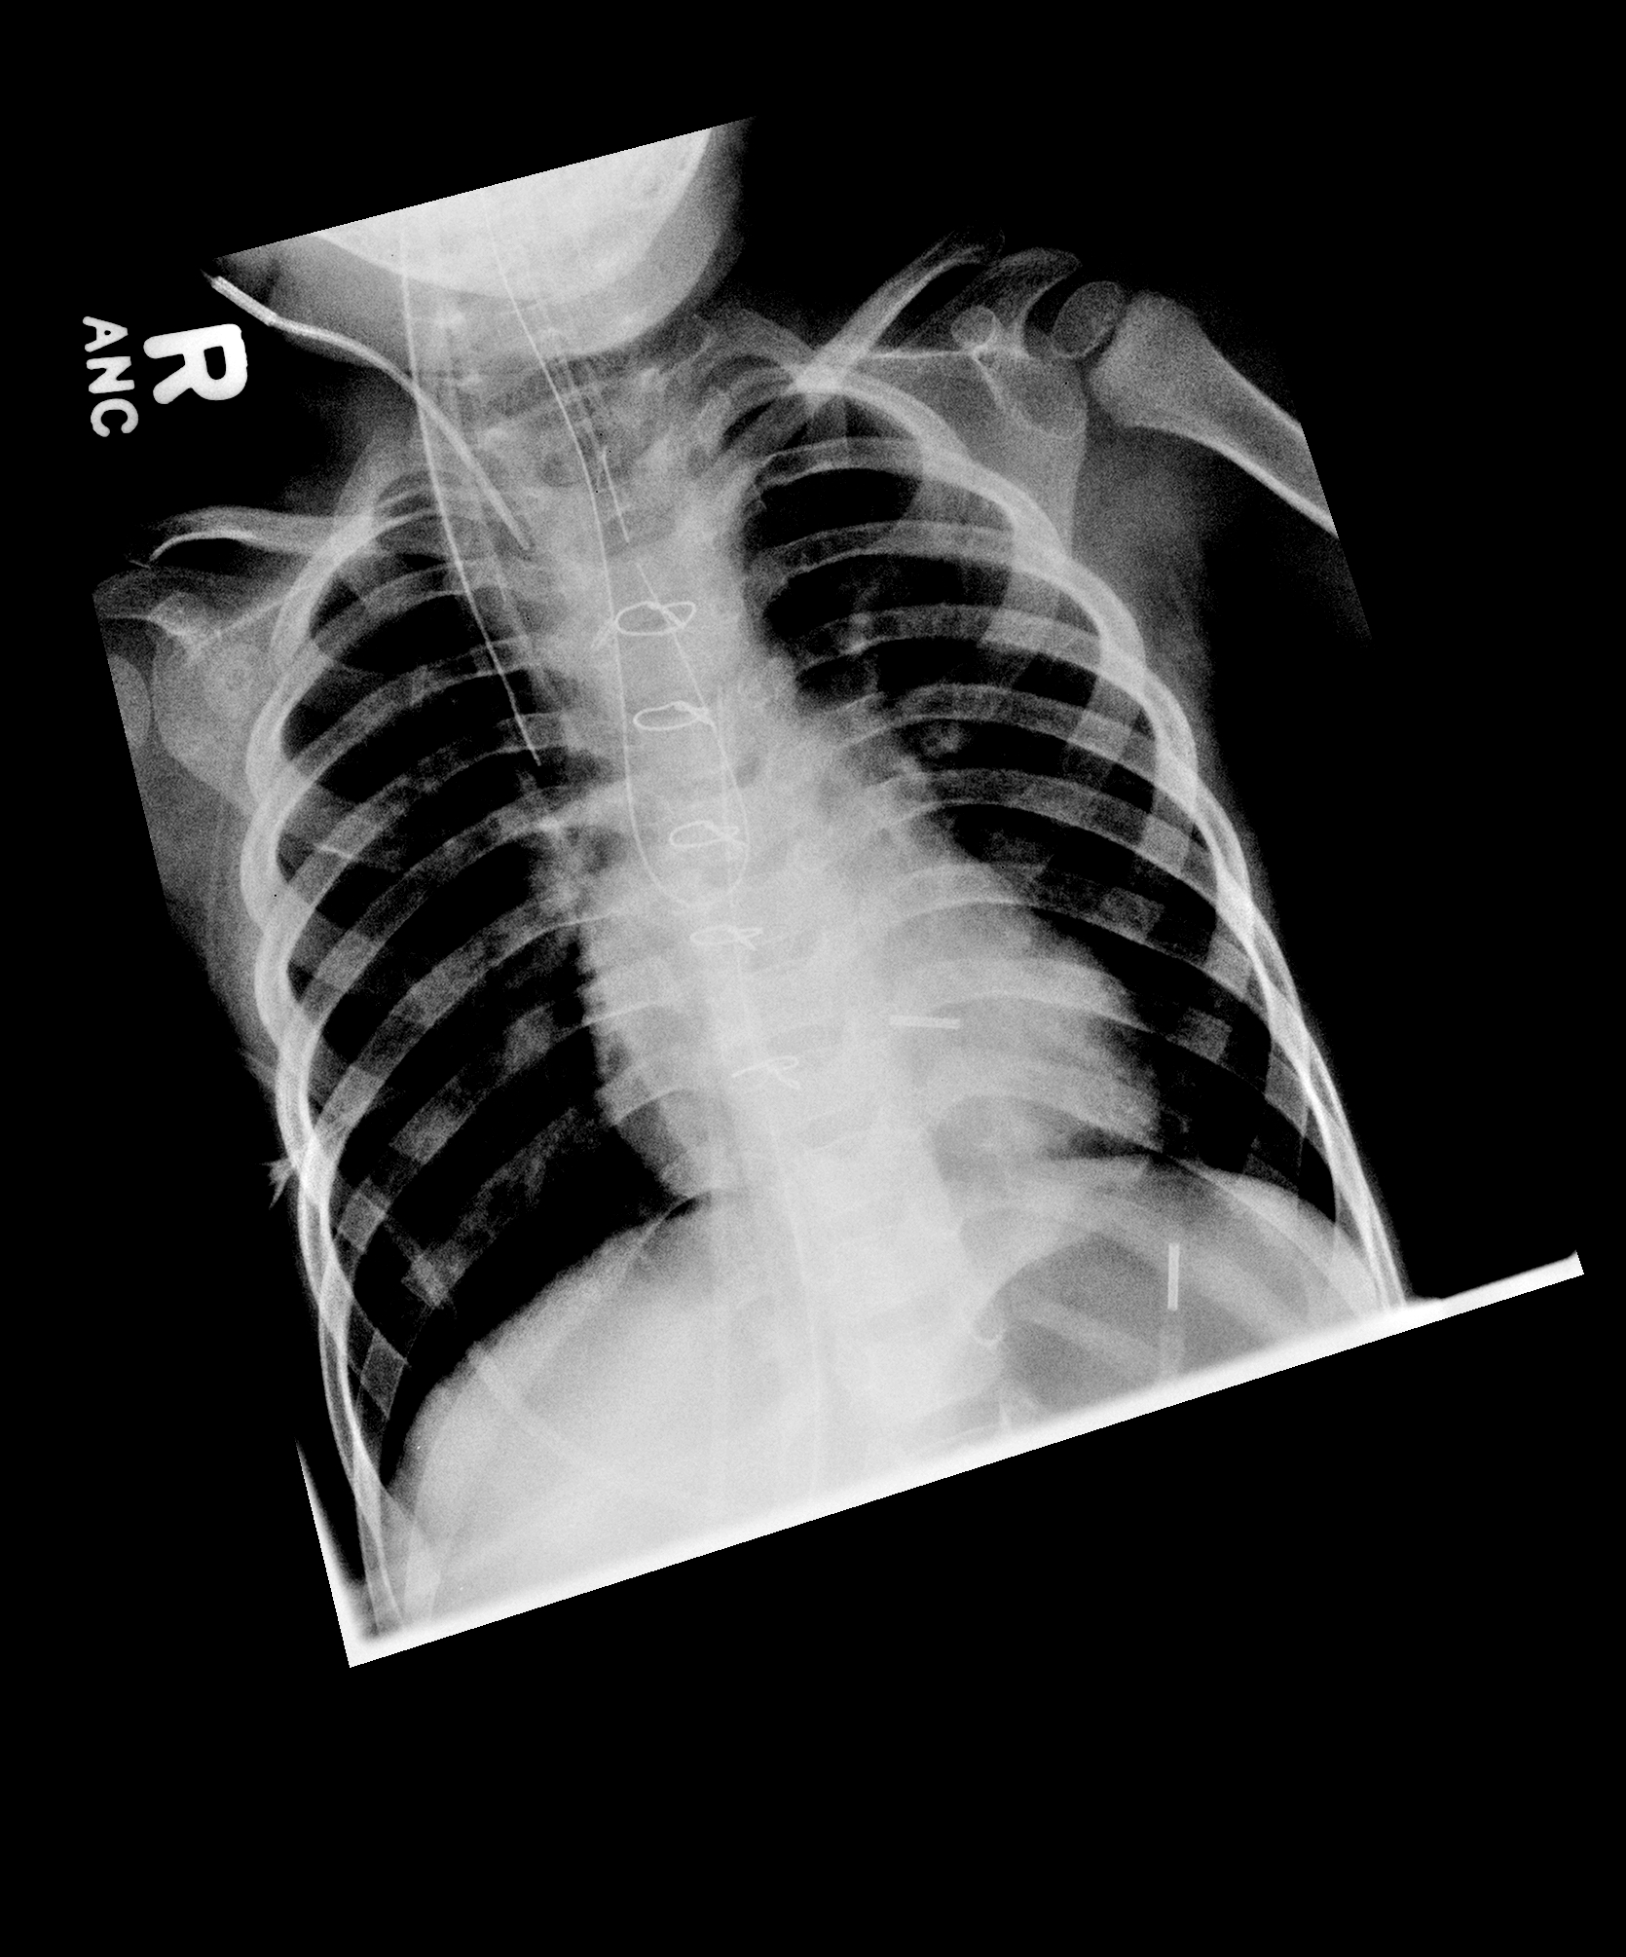
Nasogastric Tube: Misplaced
NG tube is coiled in Esophagus with tip in throat

Slide 16
Dobbhoff Tube
Purpose
  Short term feeding
  Prevent aspiration
Proper Placement
  Inserted via the pharynx, through esophagus and stomach into the duodenum
  Weighted tip should terminate in the proximal duodenum, past the level of the duodenal bulb [ Ideally tip should be at the Ligament of Treitz.]
Complications
  Misplacement in the oropharynx, esophagus, stomach or airway
  Esophagitis, reflux, stricture, esophageal perforation

Slide 17
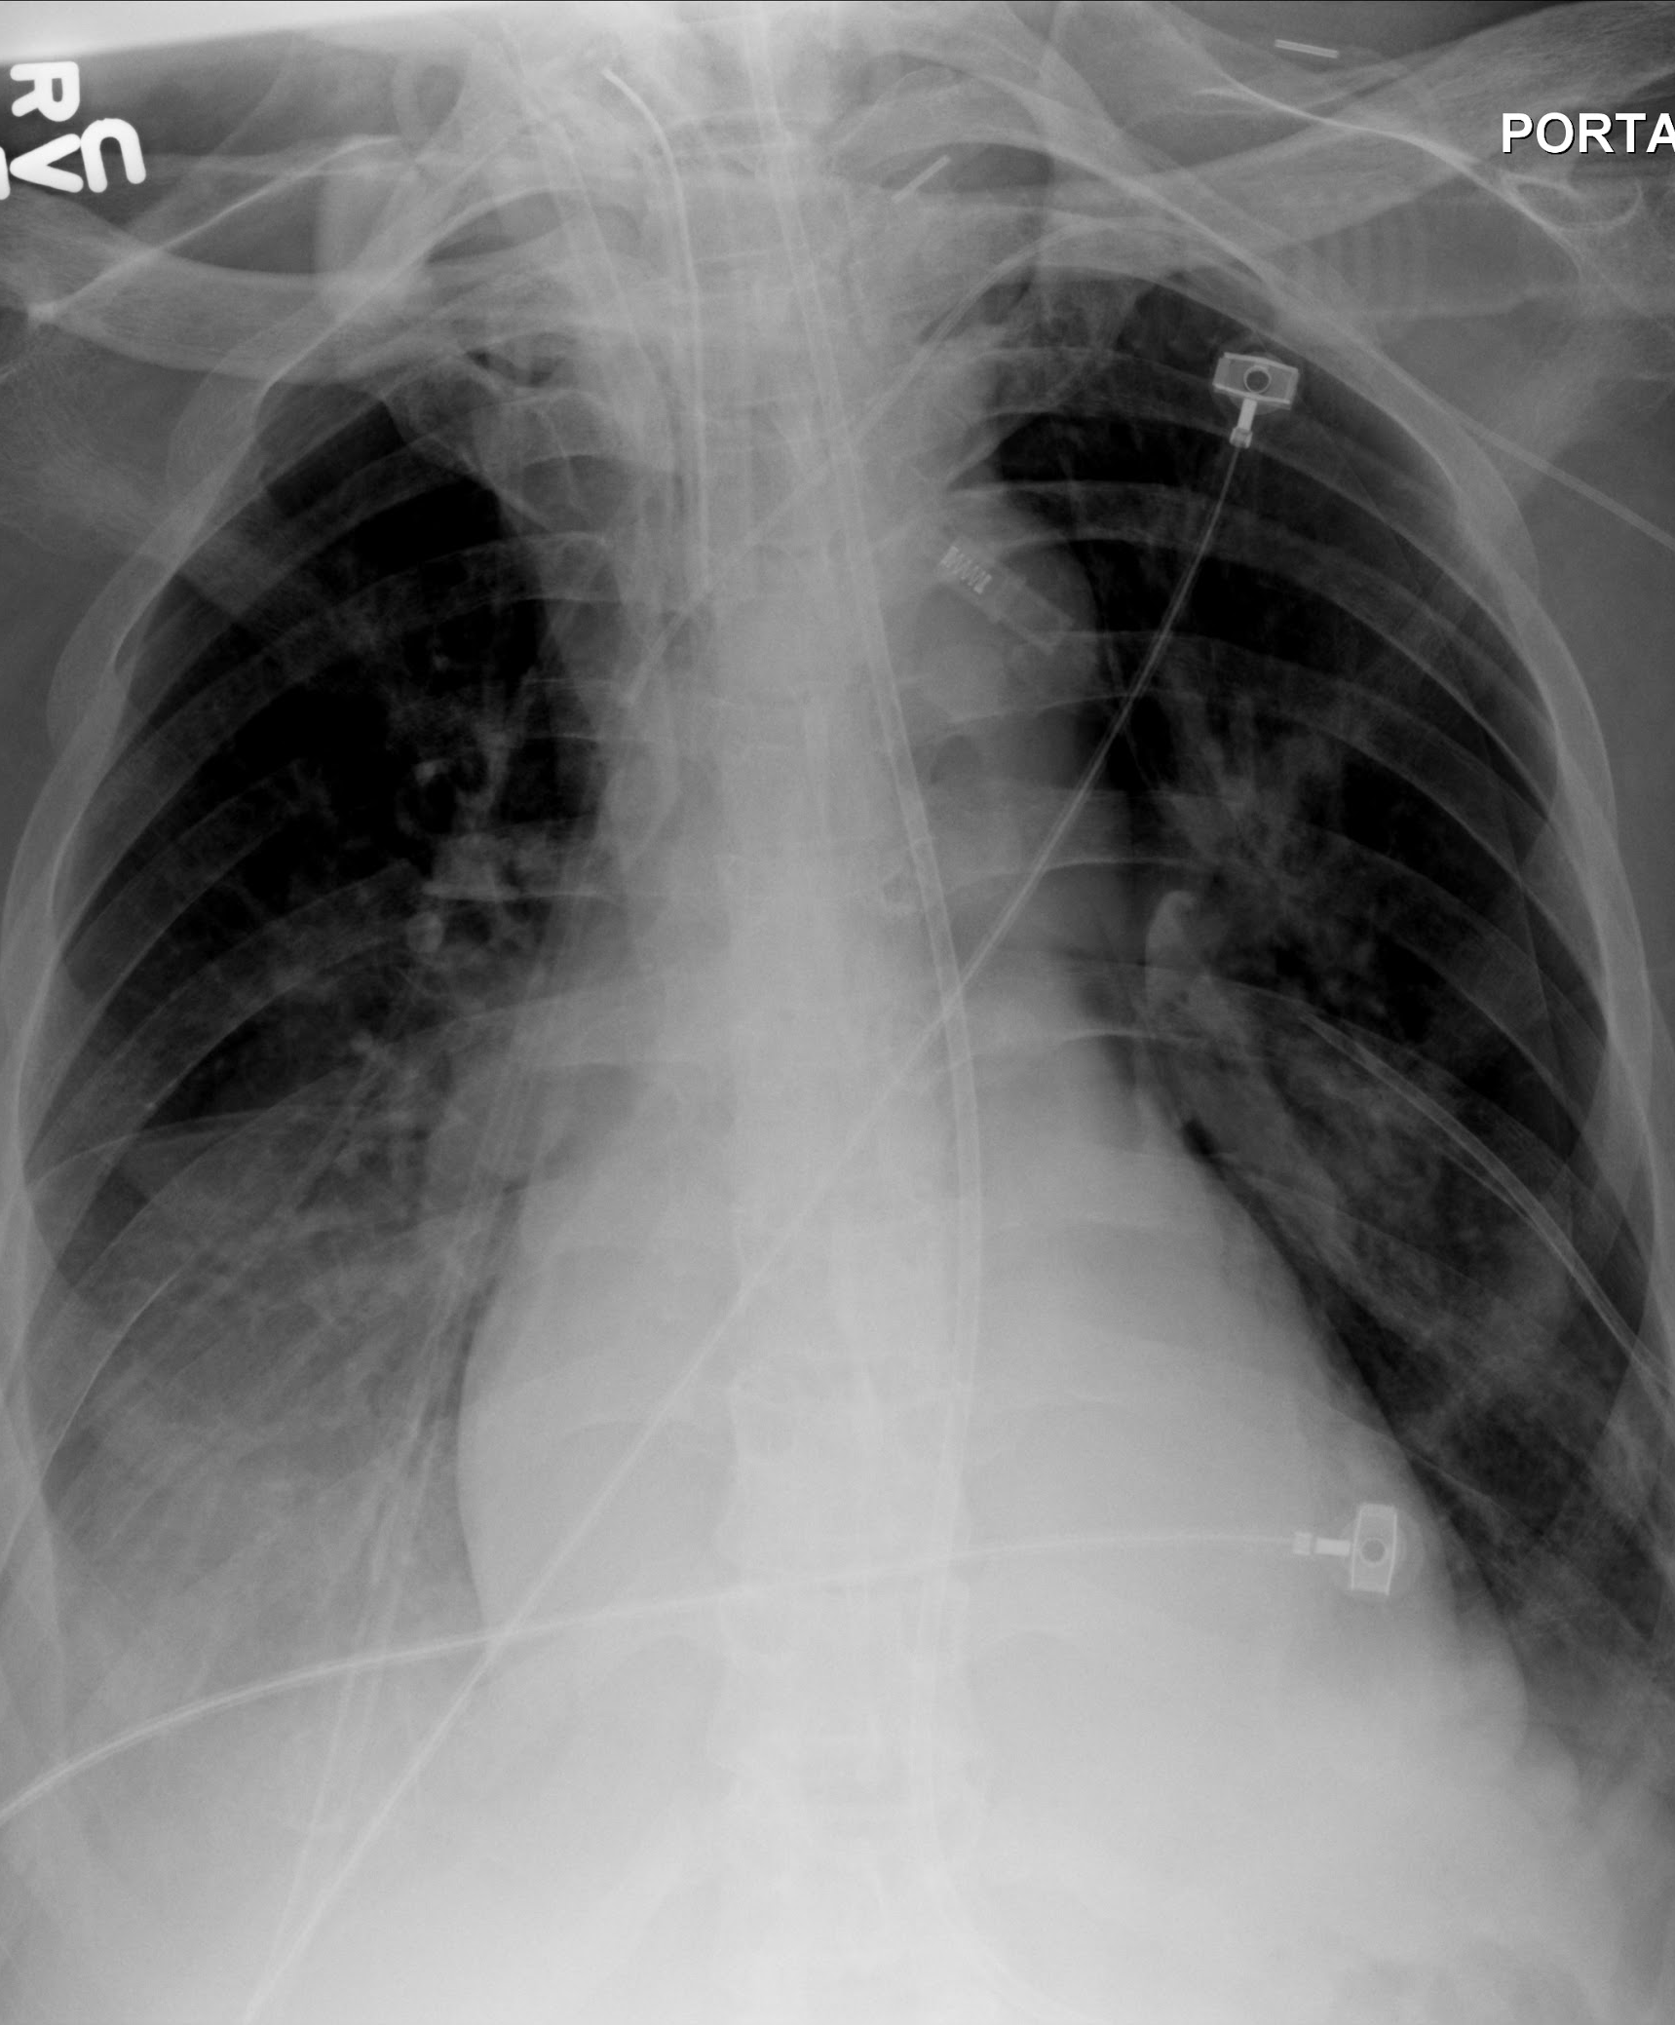
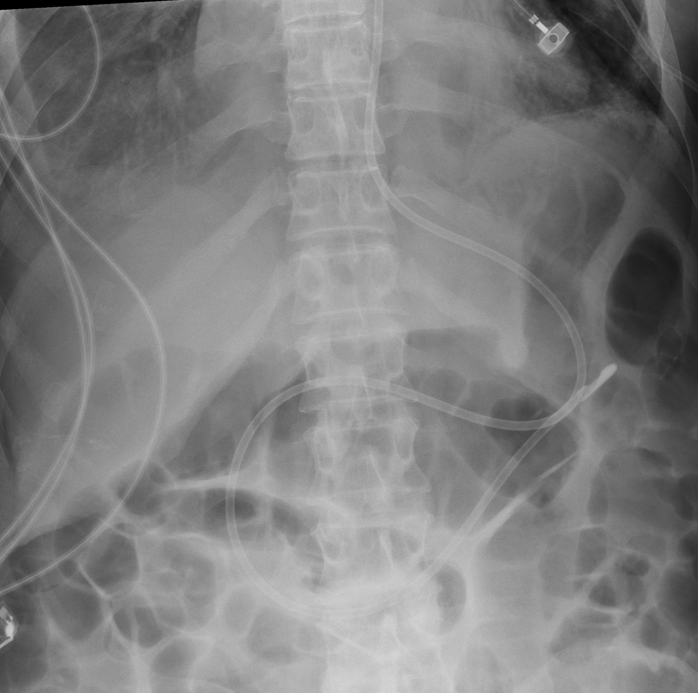
Dobbhoff Tube: Proper Placement
Chest and abdomen exam show DT following the course of esophagus and stomach to the Ligament of Treitz

Slide 18
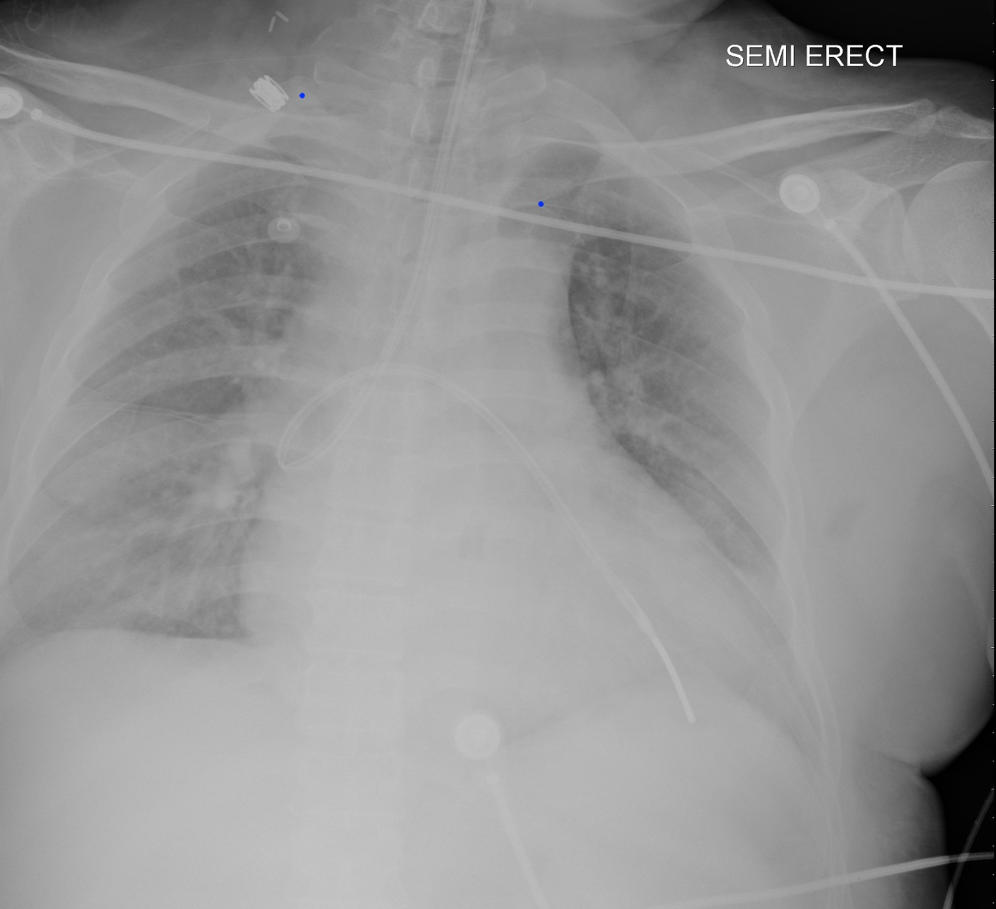
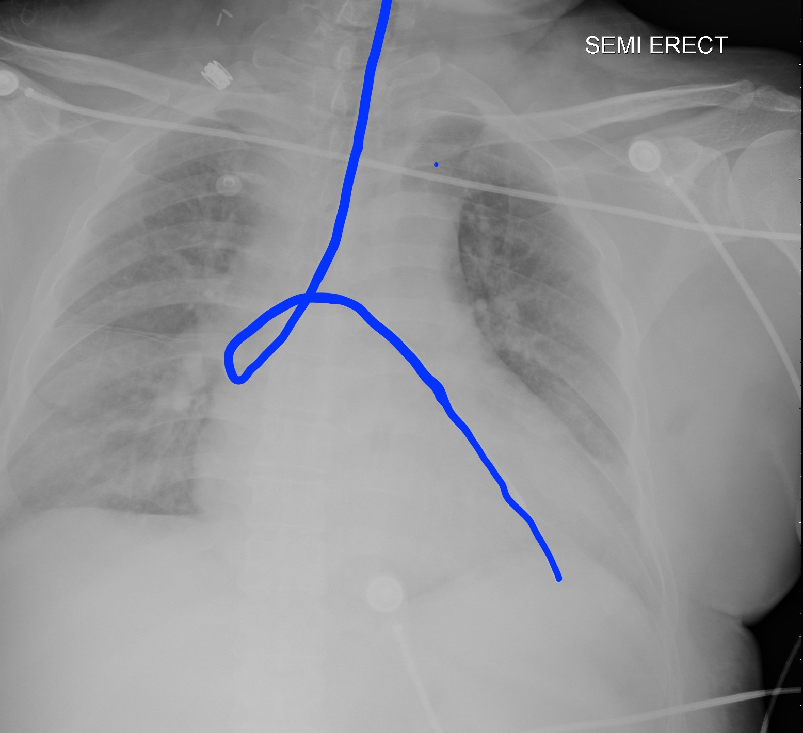
Dobbhoff Tube: Misplaced

Slide 19
Chest Tube
Purpose
  Remove air or fluid from the pleural space
Proper Placement
  For air evacuation, tip should point anterosuperior
  For fluid evacuation, tip should point posteroinferior
  Side holes should be inside the thorax
Complications
  Misplacement in the fissures, parenchyma, mediastinum, or diaphragm
  Pneumothorax
  Inadequate drainage
  Air leak
  Infection
  Bleeding from intercostal arteries
  Injury to diaphragm or upper abdominal organs

Slide 20
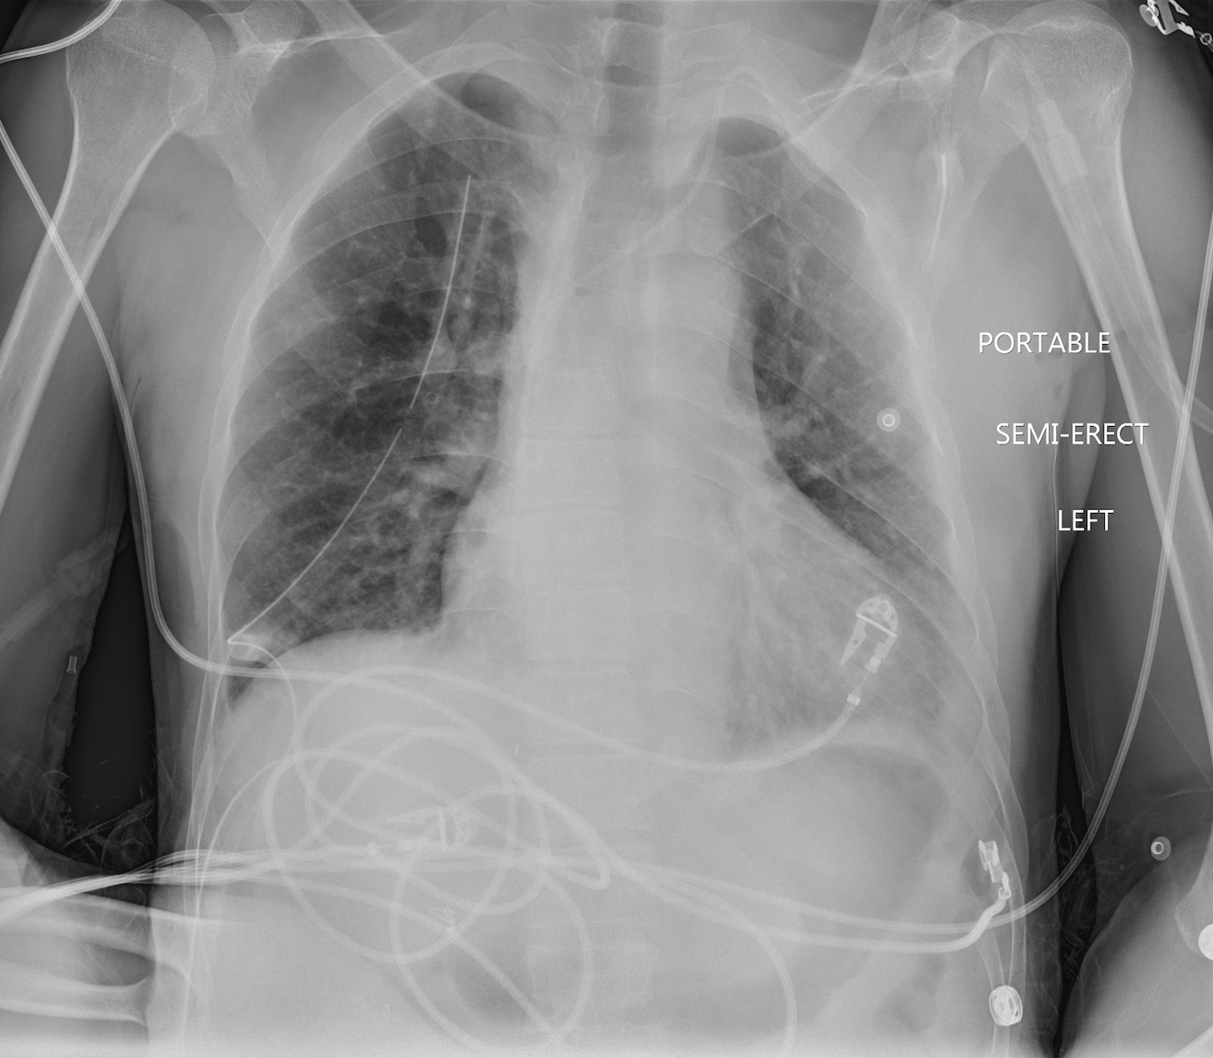
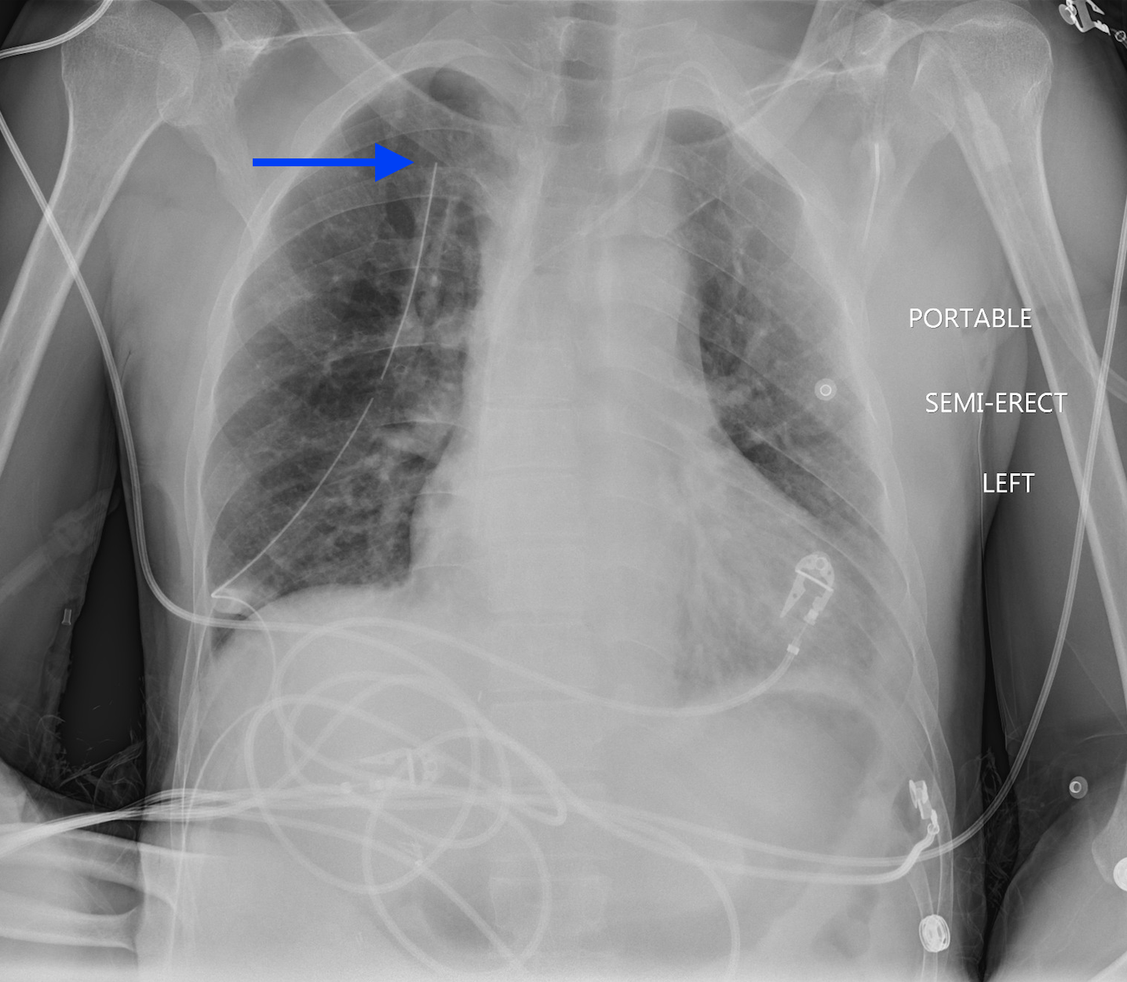
Chest Tube: Proper Placement
Notes:
Chest tube extends towards the apex, the side hole of the tube is in the pleural space

Slide 21
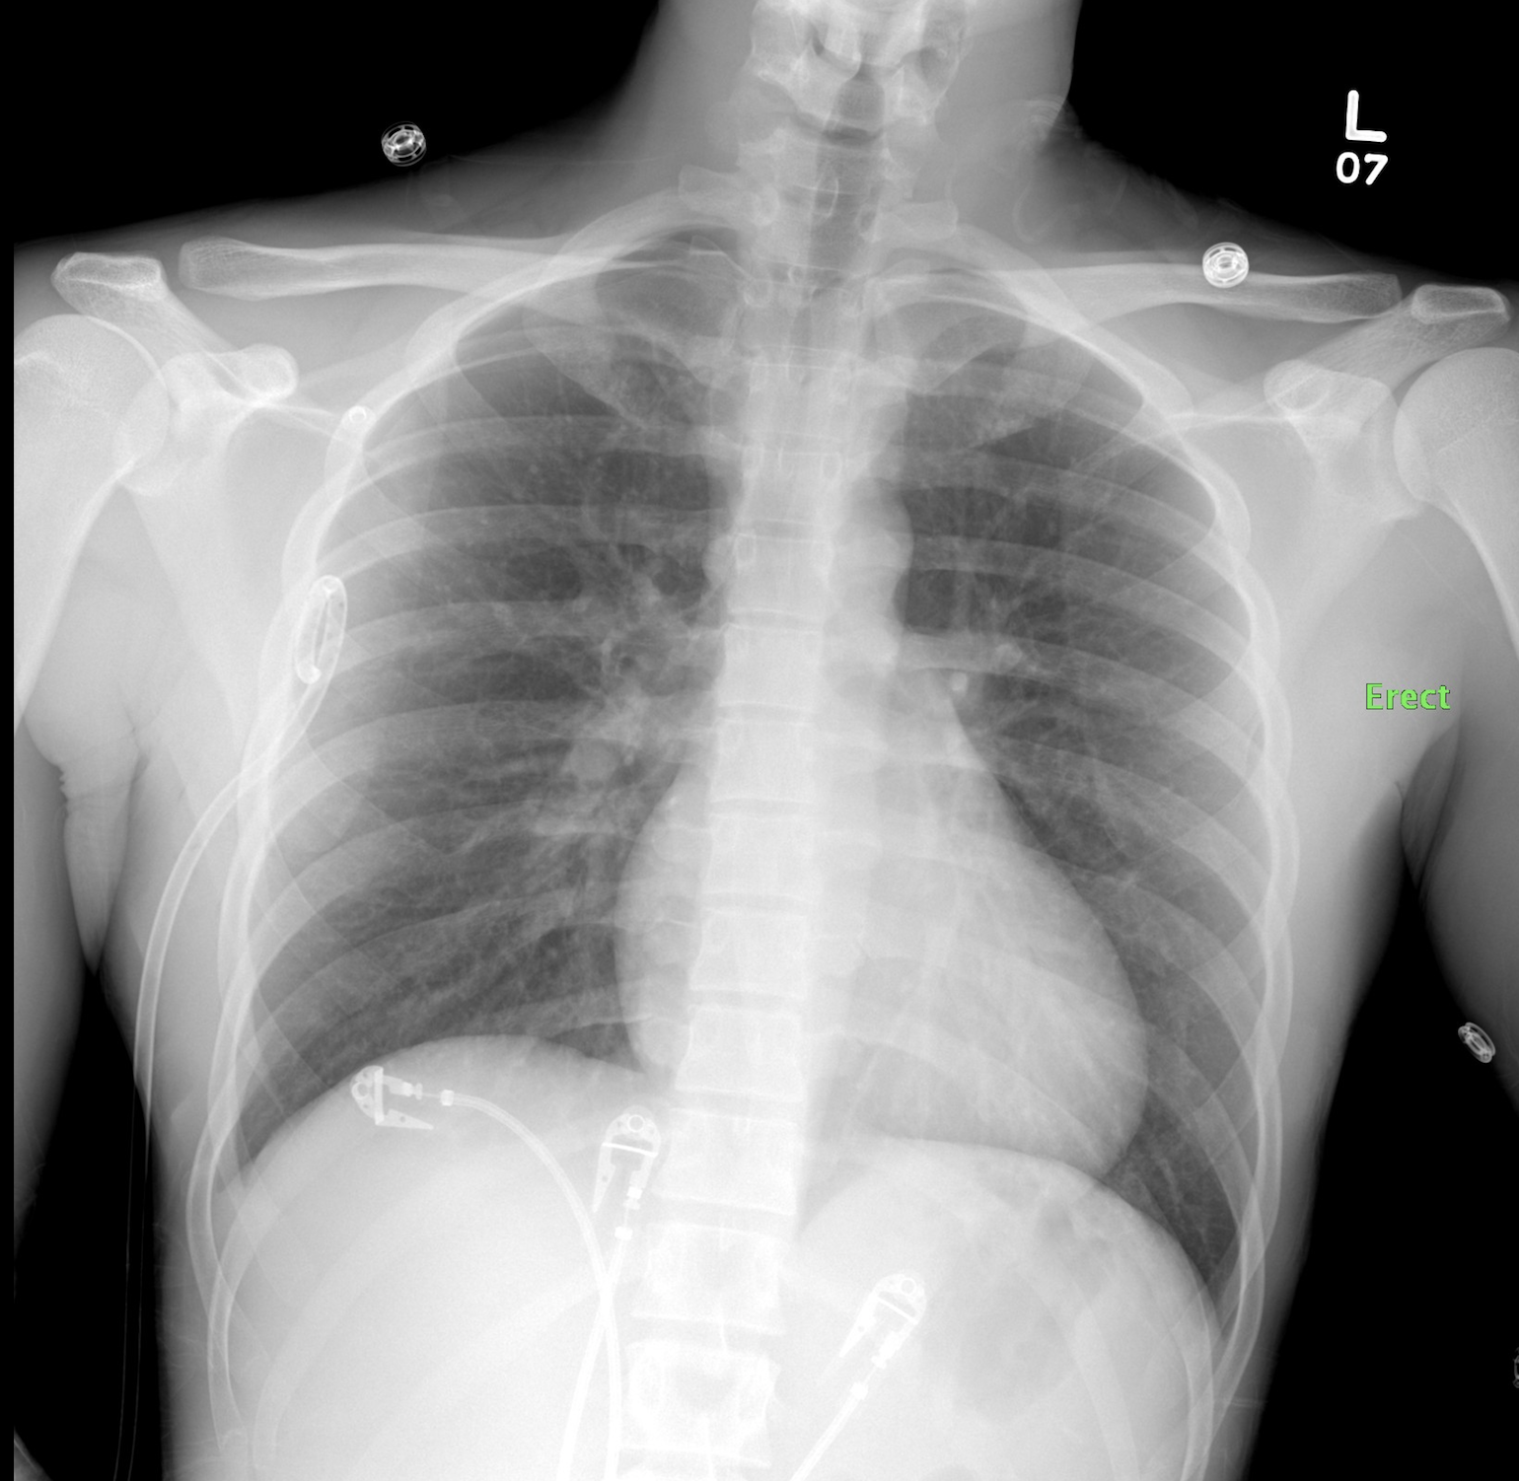
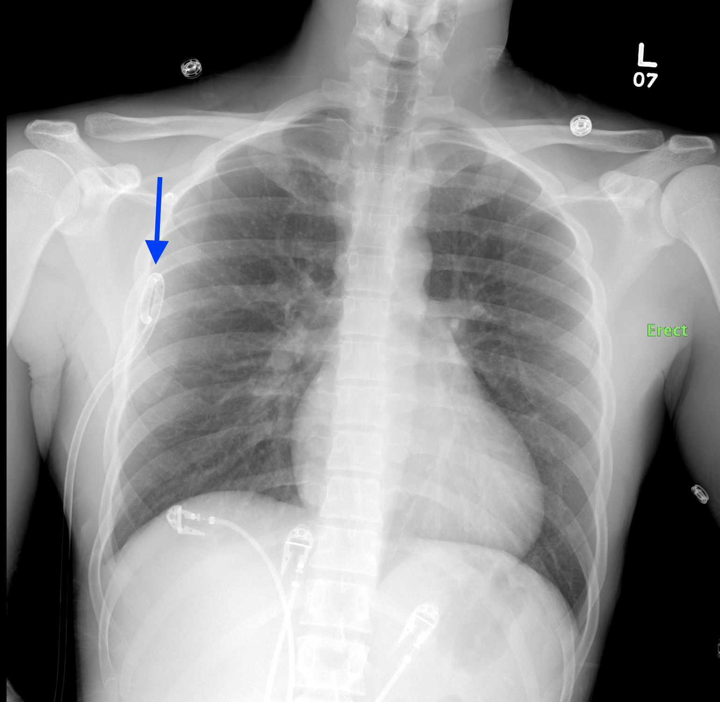
Chest Tube: Proper Placement
Notes:
Pigtail catheter is coiled inside the chest, all of the side holes project in the pleural space

Slide 22
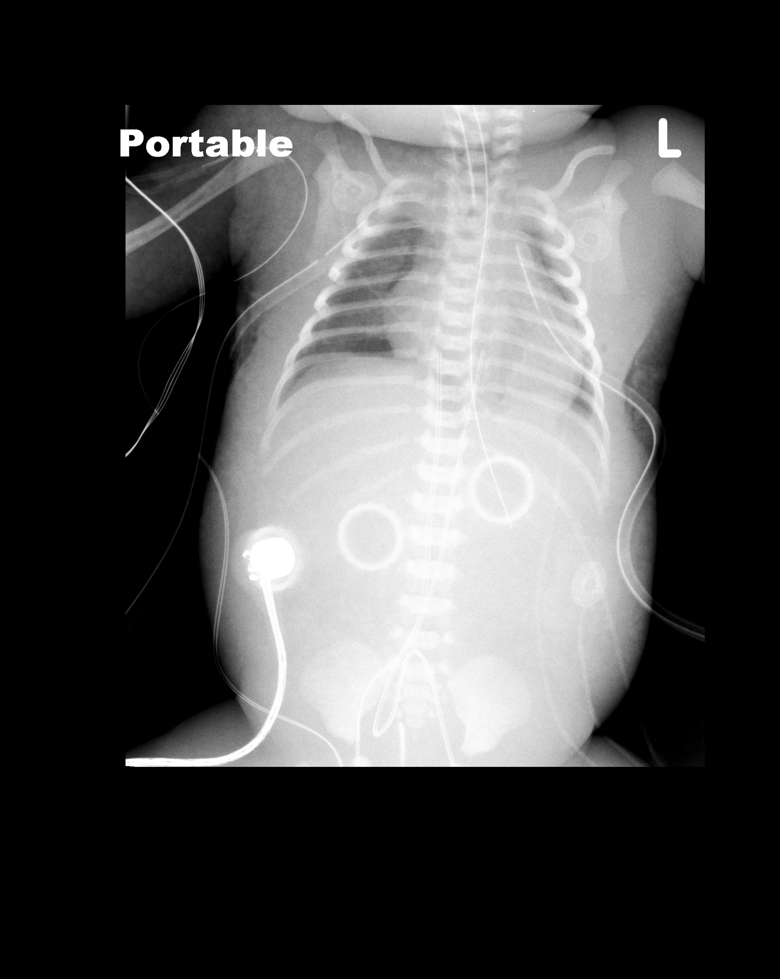
Chest Tube: Misplaced
Right chest tube in chest wall

Slide 23
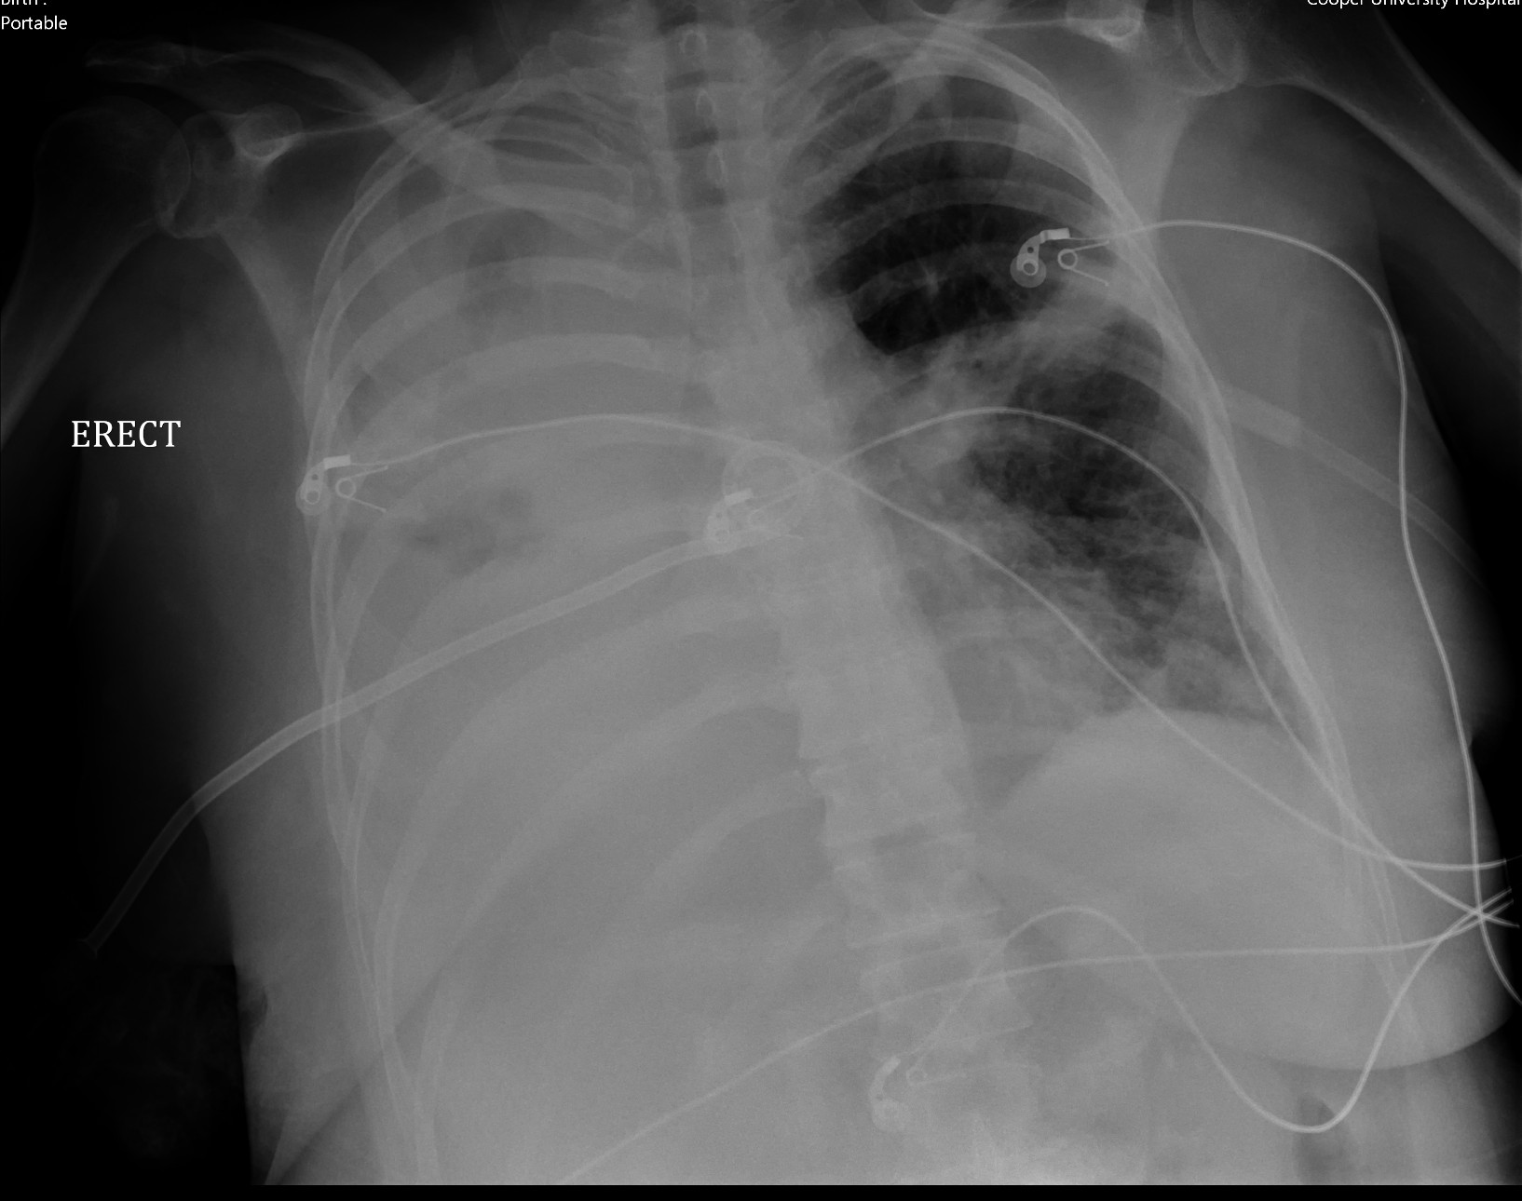
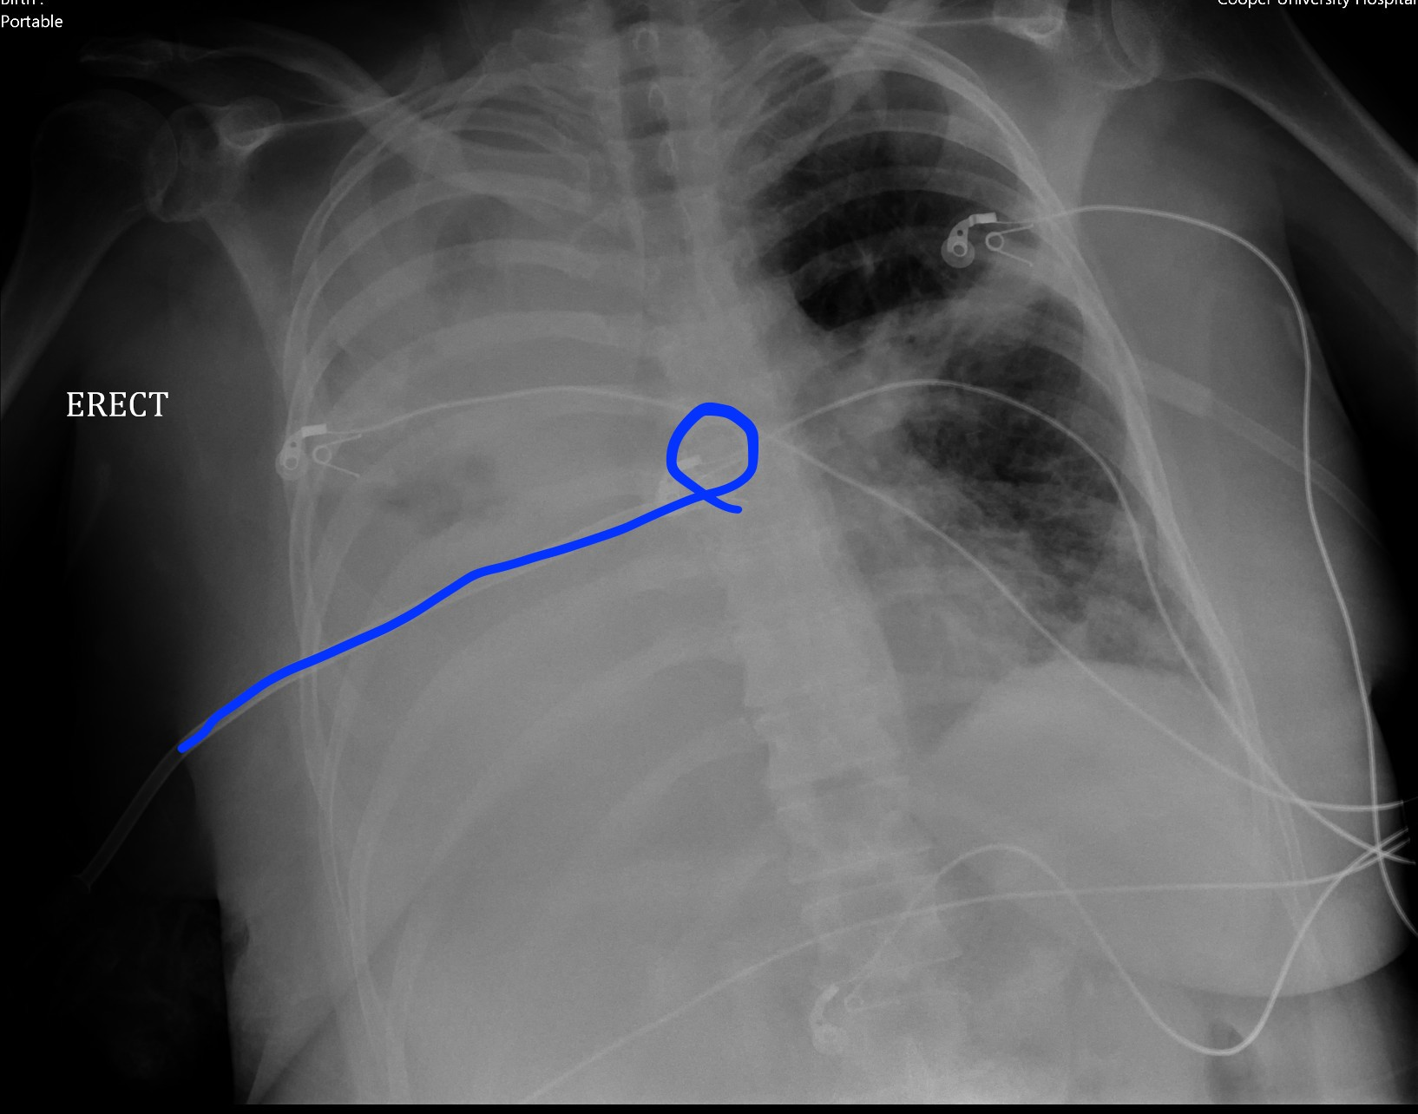
Chest Tube: Misplaced
Right chest tube tube projects over the mediastinum and was coiled in right main pulmonary artery on subsequent CT

Slide 24
Peripherally Inserted Central Catheter
Purpose
  Establish long-term venous access
Proper Placement
  Inserted via peripheral veins (i.e. basilic vein, brachial vein, cephalic vein or axillary vein) to terminate in the superior vena cava
Complications
  Misplacement in right heart chambers
  Phlebitis, bleeding, thrombosis
  Venous perforation
  Pain
  Sepsis

Slide 25
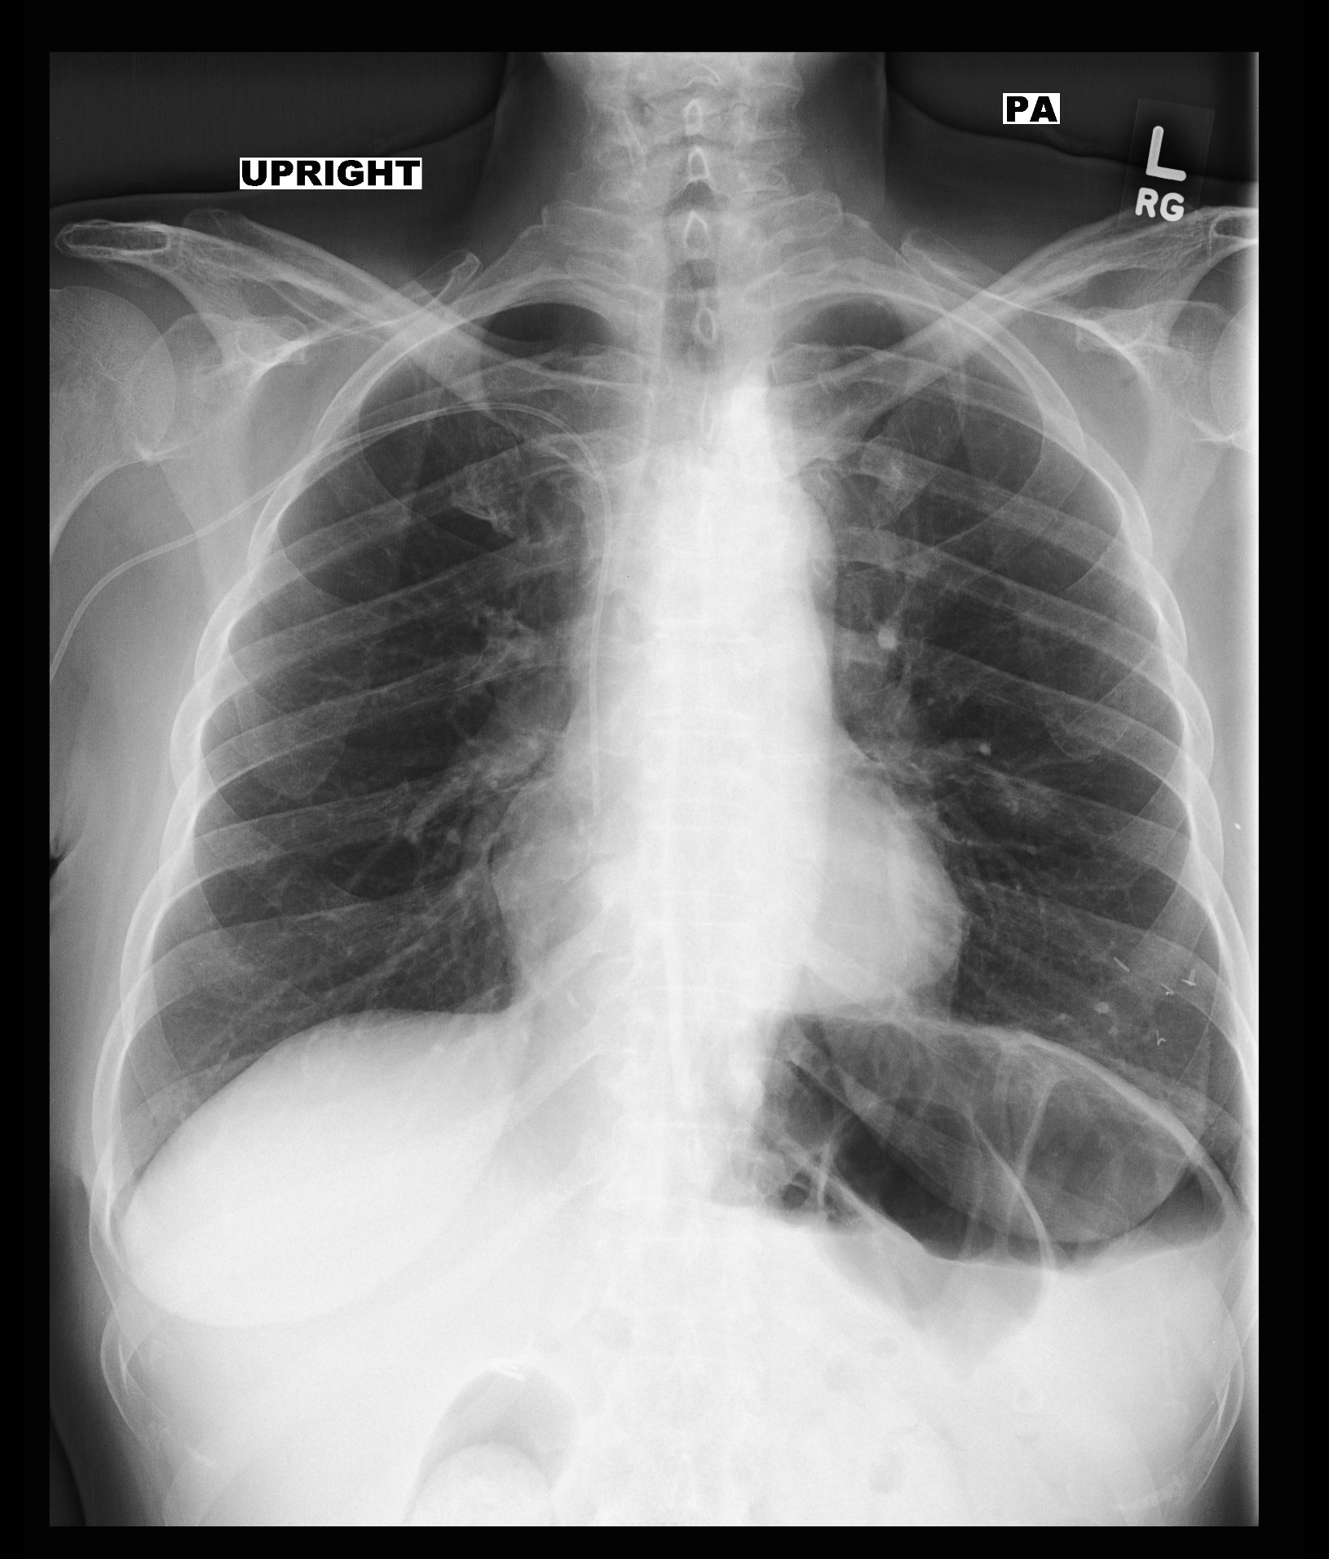
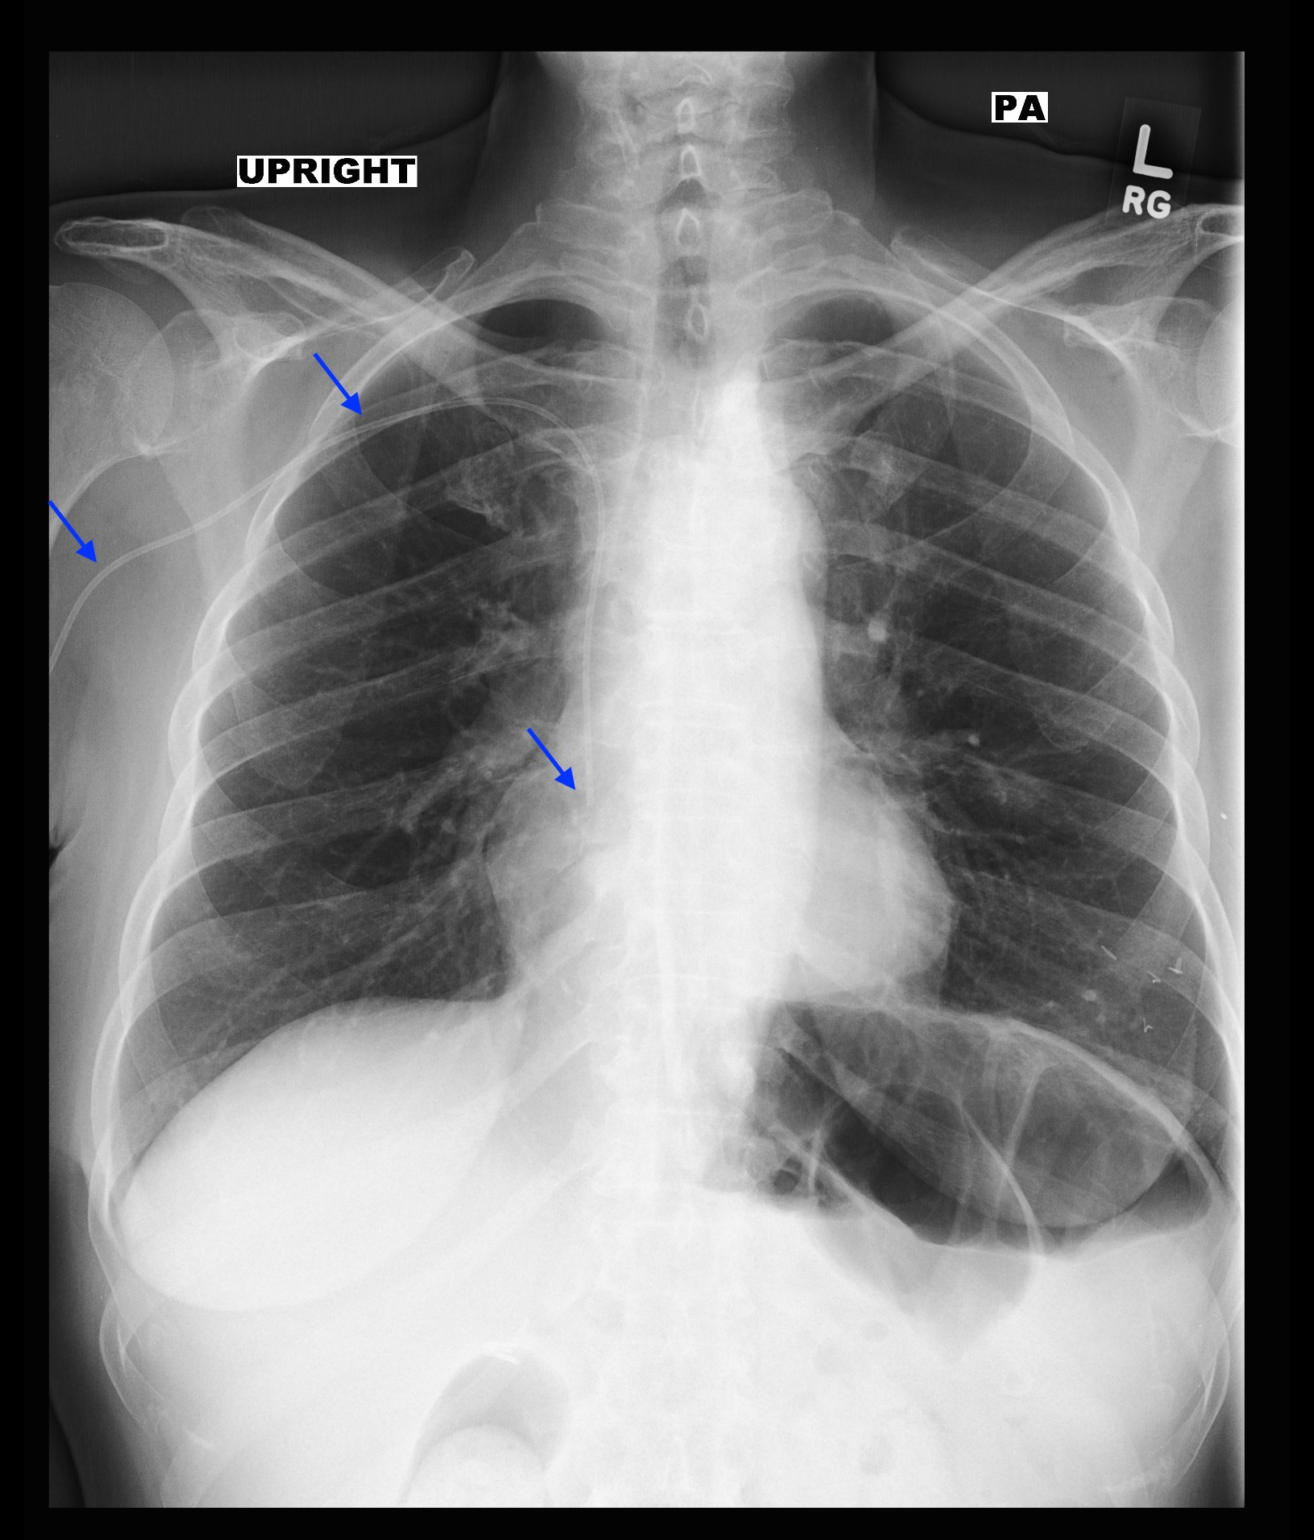
Peripherally Inserted Central Catheter: Proper Placement

Slide 26
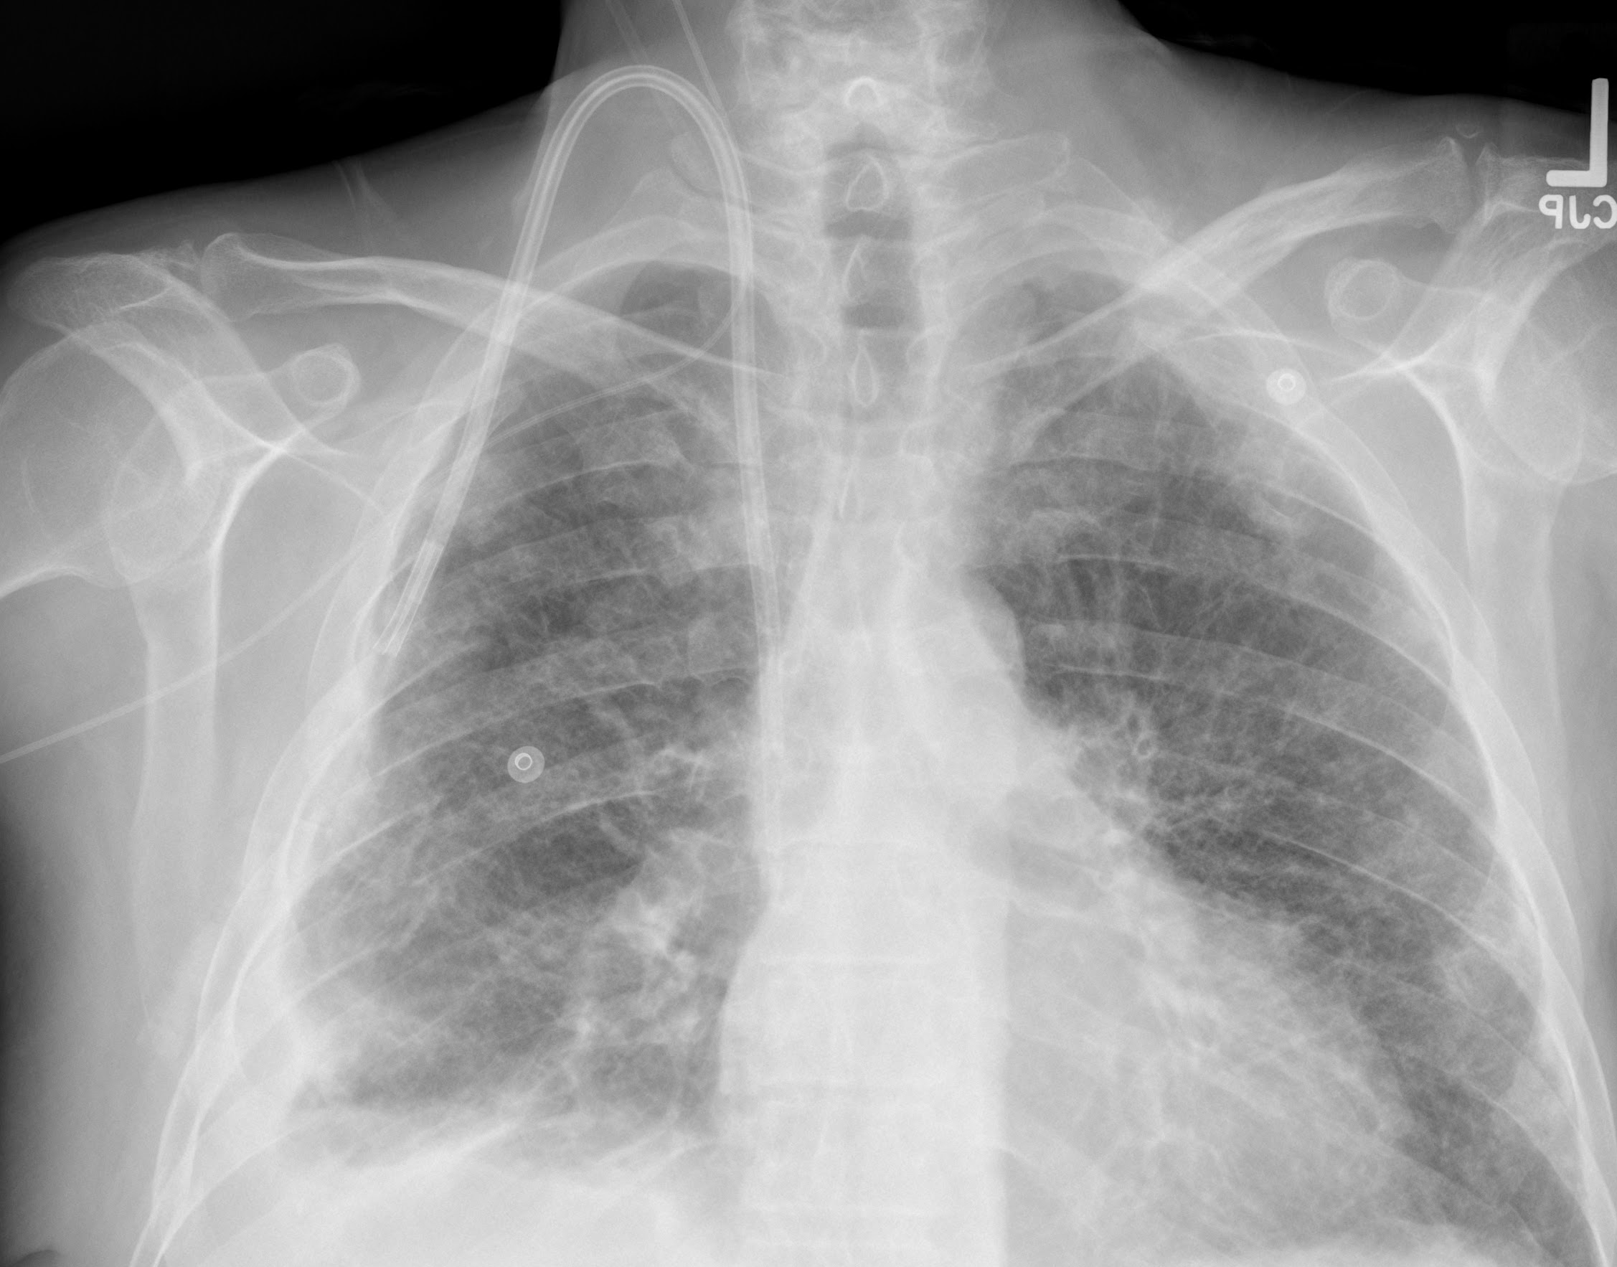
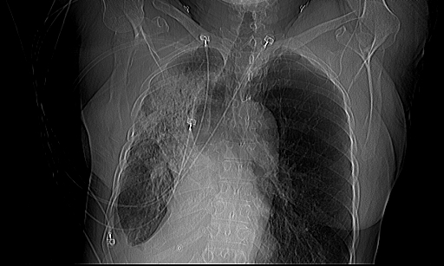
Peripherally Inserted Central Catheter: Misplaced
Right PICC line going up the right jugular vein

Slide 27
Central Venous Lines (CVL)
Purpose
  Central venous access for fluids, medications, IV contrast
Proper Placement
  Tip in the SVC-distal to subclavian/jugular junction and proximal to the right atrium
  Small sleeve of SVC extends into right atrium
Complications
  Malposition
  Pneumothorax
  Hemothorax
  Mediastinal hematoma
  Fracture of the line

Slide 28
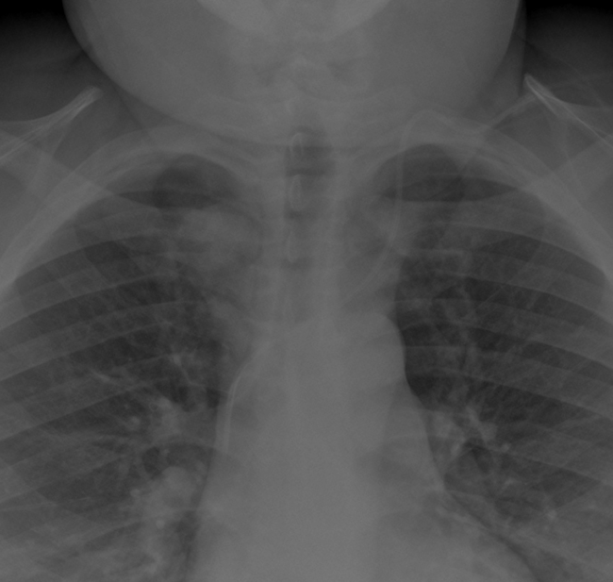
Central Venous Line: Proper Placement
Left Internal Jugular (IJ) line with tip in mid-SVC

Slide 29
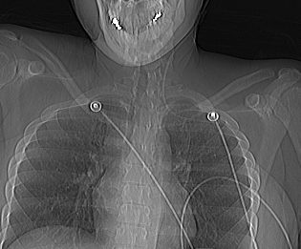
Central Venous Line: Misplaced
Left IJ (light blue arrow) with tip in Left Subclavian vein (Blue arrow)

Slide 30
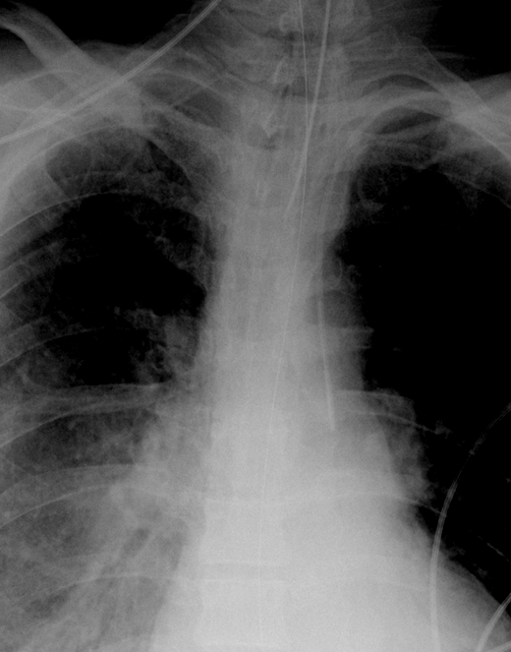
Central Venous Line: Misplaced
Left Subclavian line never crosses spine/midline. Tip projects over left mediastinum and aorta.
(Possible intra arterial placement)

Slide 31
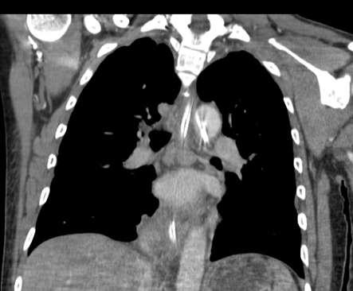
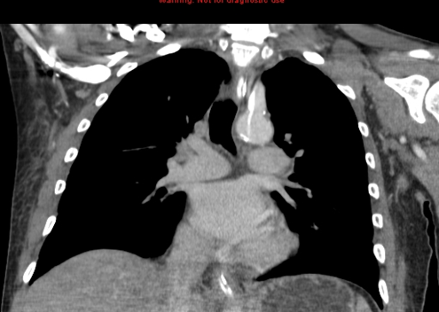
Central Venous Line: Misplaced
Intra arterial placement with line tip (Blue Arrow) in descending aorta.

Slide 32
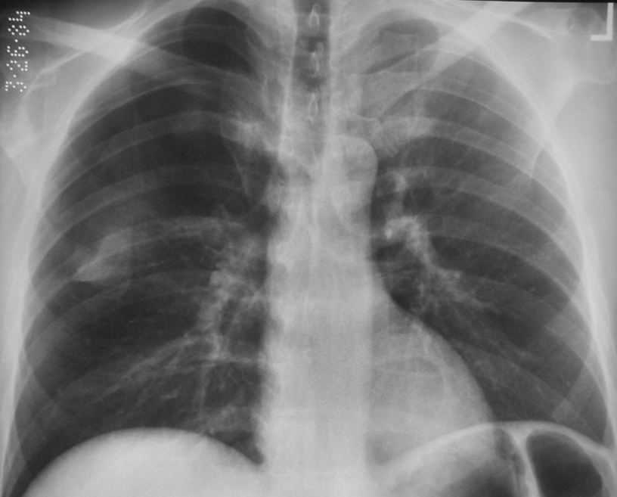
Central Venous Line, Complication: Pneumothorax
Right Subclavian line (Blue arrow) with pneumothorax (Light blue arrow).

Slide 33
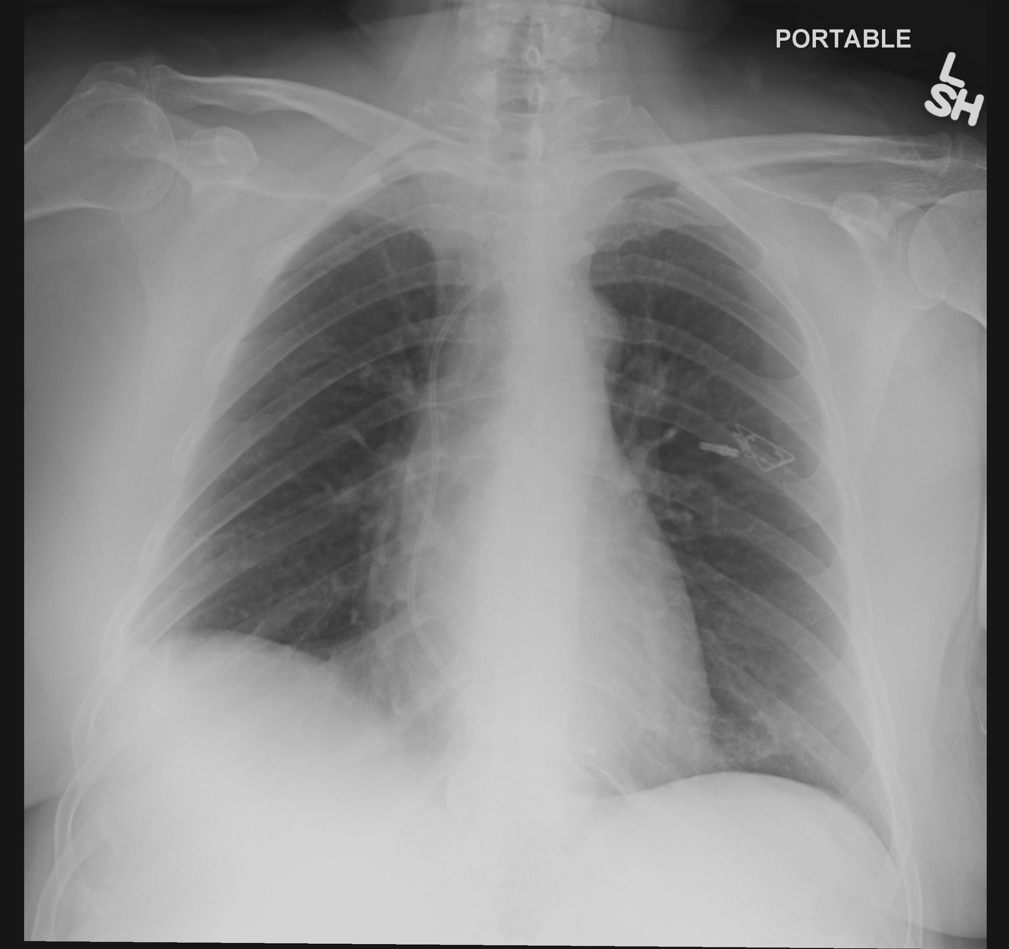
Central Venous Line, Complication: Fracture
Port catheter that has fractured and migrated into heart

Slide 34
Swan Ganz Catheter
Purpose
  Observe hemodynamic status of patient
  Distinguish cardiac from noncardiac pulmonary edema
Proper Placement
  Inserted via a large vein (i.e. internal jugular or subclavian vein or common femoral vein) to terminate in proximal right or left pulmonary artery ~ 2cm from the hilum
Complications
  Misplacement in large veins, right heart chambers, pulmonary trunk or peripheral pulmonary arteries
  Venous perforation
  Phlebitis, bleeding, thrombosis
  Right atrial or ventricular wall perforation
  Pulmonary infarction
  Pneumothorax
Notes:
Also rupture of the pulmonary artery branch if too far out and balloon expanded.

Slide 35
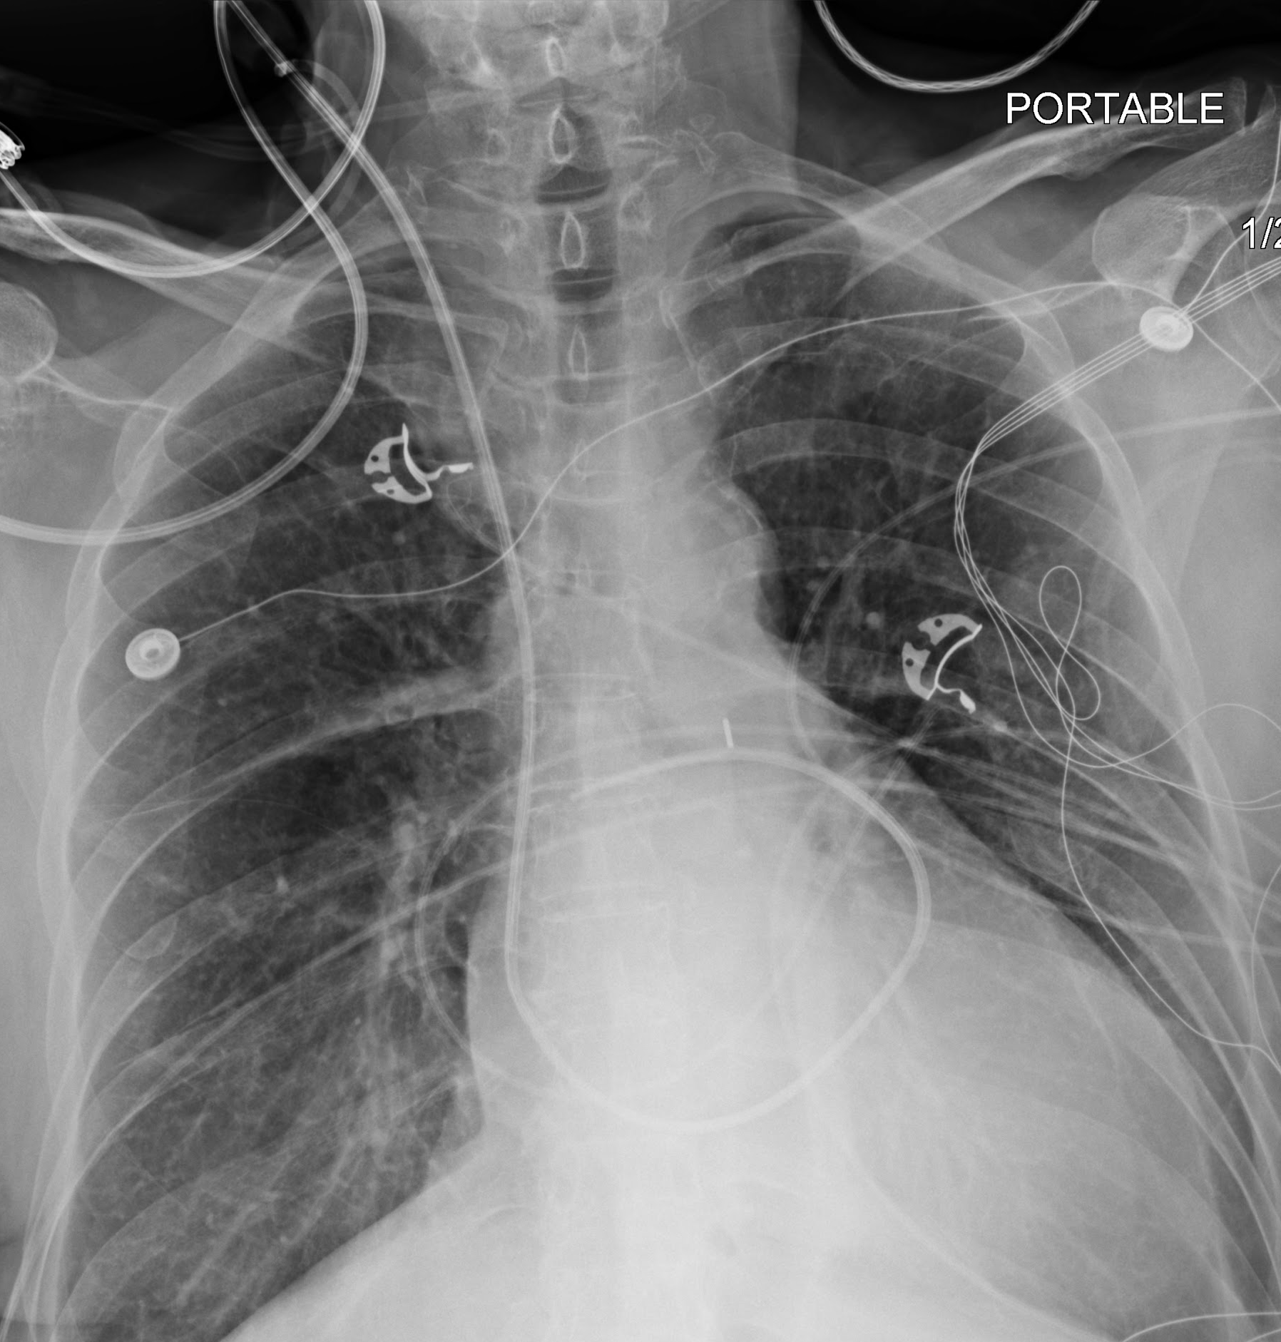
Swan Ganz Catheter: Proper Placement

Slide 36
Swan Ganz Catheter: Proper Placement
Right IJ approach with tip projecting in the mid right pulmonary artery

Slide 37
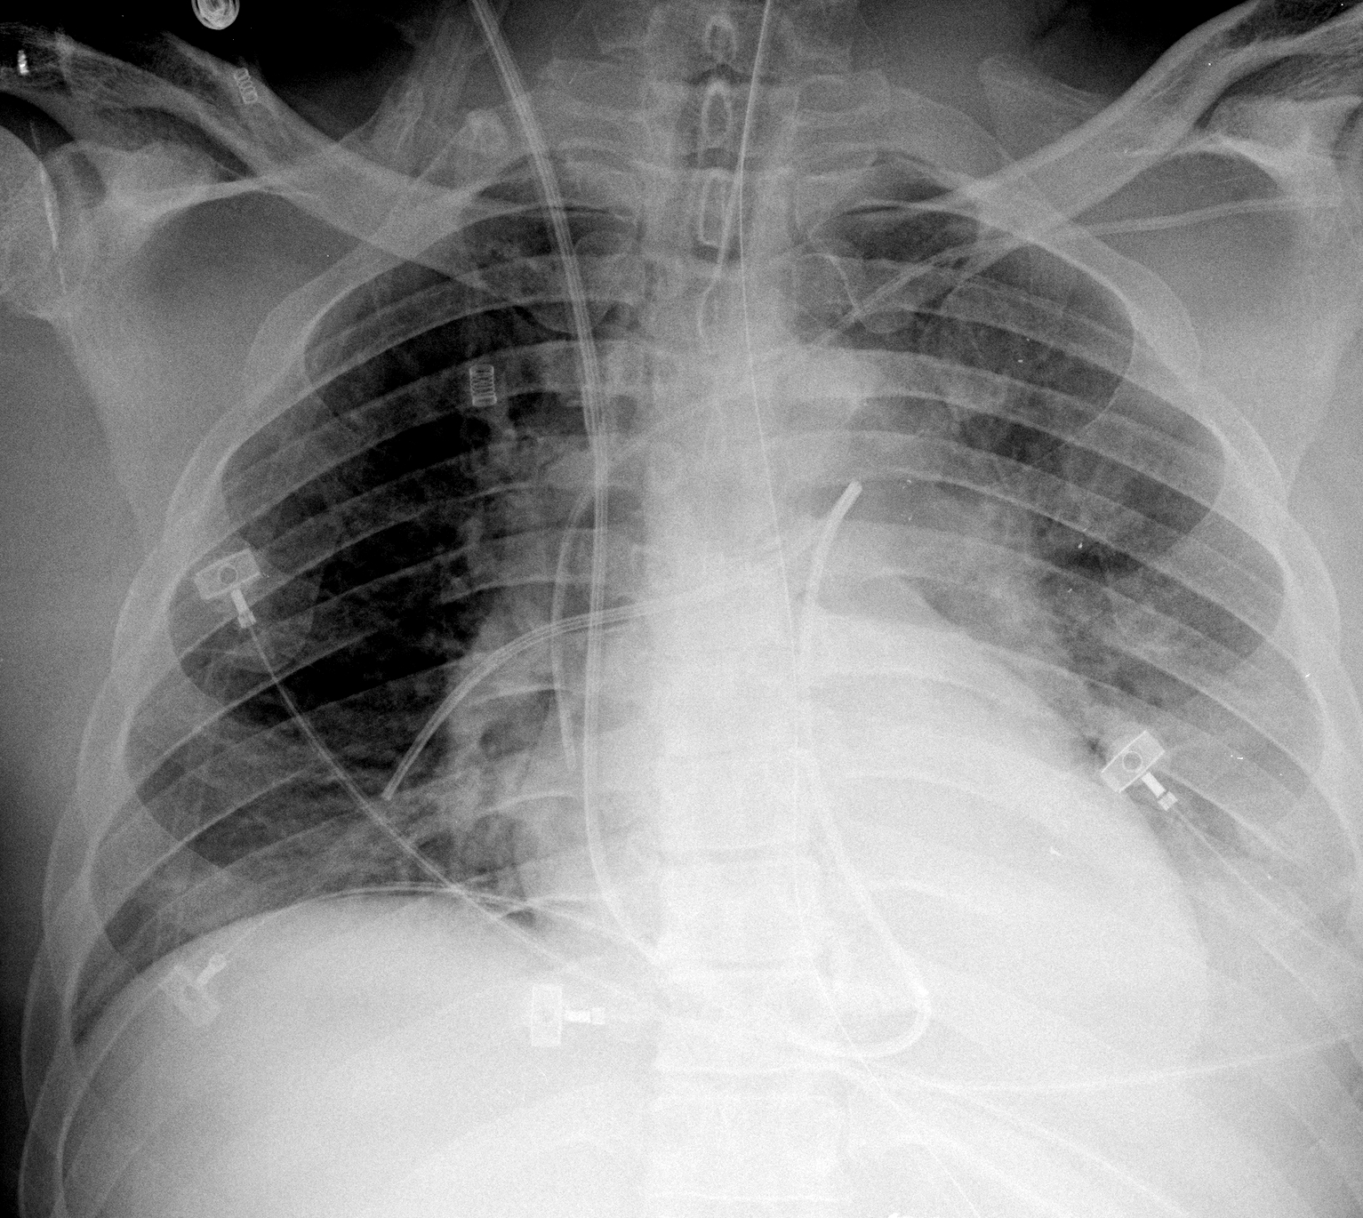
Swan Ganz Catheter: Misplaced
SG tip in distal right lower lobe artery.
At risk of arterial rupture if the balloon is expanded and at risk of pulmonary infarction if tip enters smaller side branch.

Slide 38
Cardiac Pacemaker/Implantable Cardiac Defibrillator
Purpose
  Assist in normal electrical conduction of the heart
  Break ventricular fibrillation
Proper Placement
  Pulse generator/defibrillator is positioned in subcutaneous tissues of the anterior chest wall
  Electrodes are guided via subclavian vein and SVC into right atrial appendage, right ventricle and coronary sinus
Complications
  Misplacement in the proximal veins or cardiac chambers
  Perforation of the heart
  Lead discontinuity
  Pneumothorax
  Pacemaker-mediated tachycardia
  Infection
Notes:
Infection also complication.

Slide 39
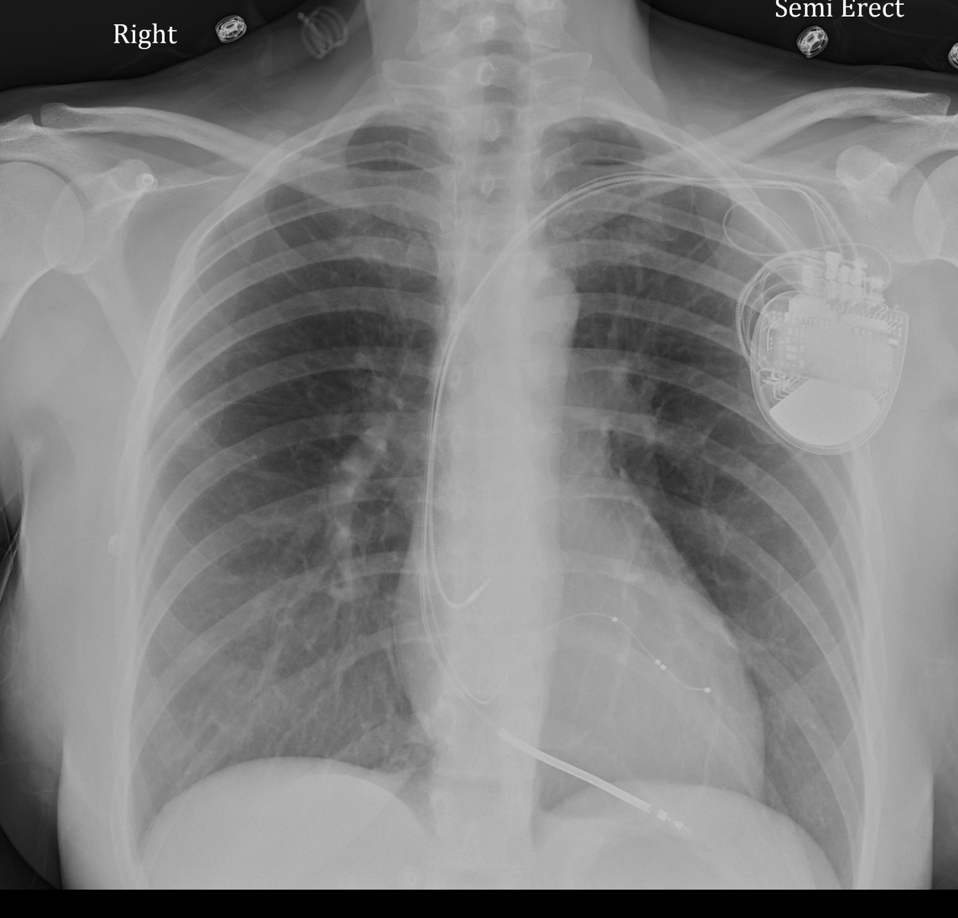
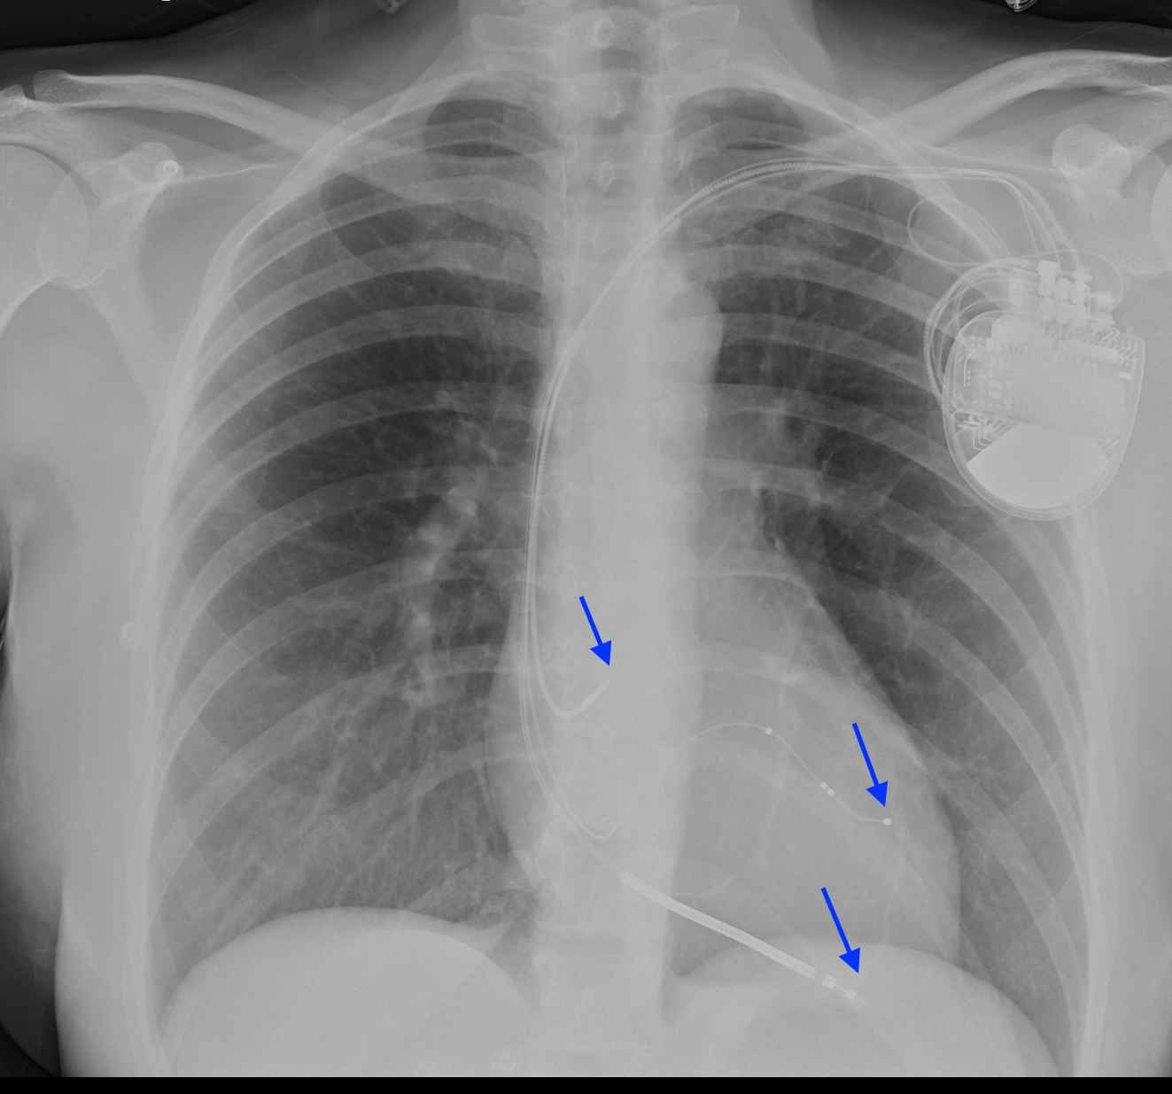
Cardiac Pacemaker/Implantable Cardiac Defibrillator: Proper Placement

Slide 40
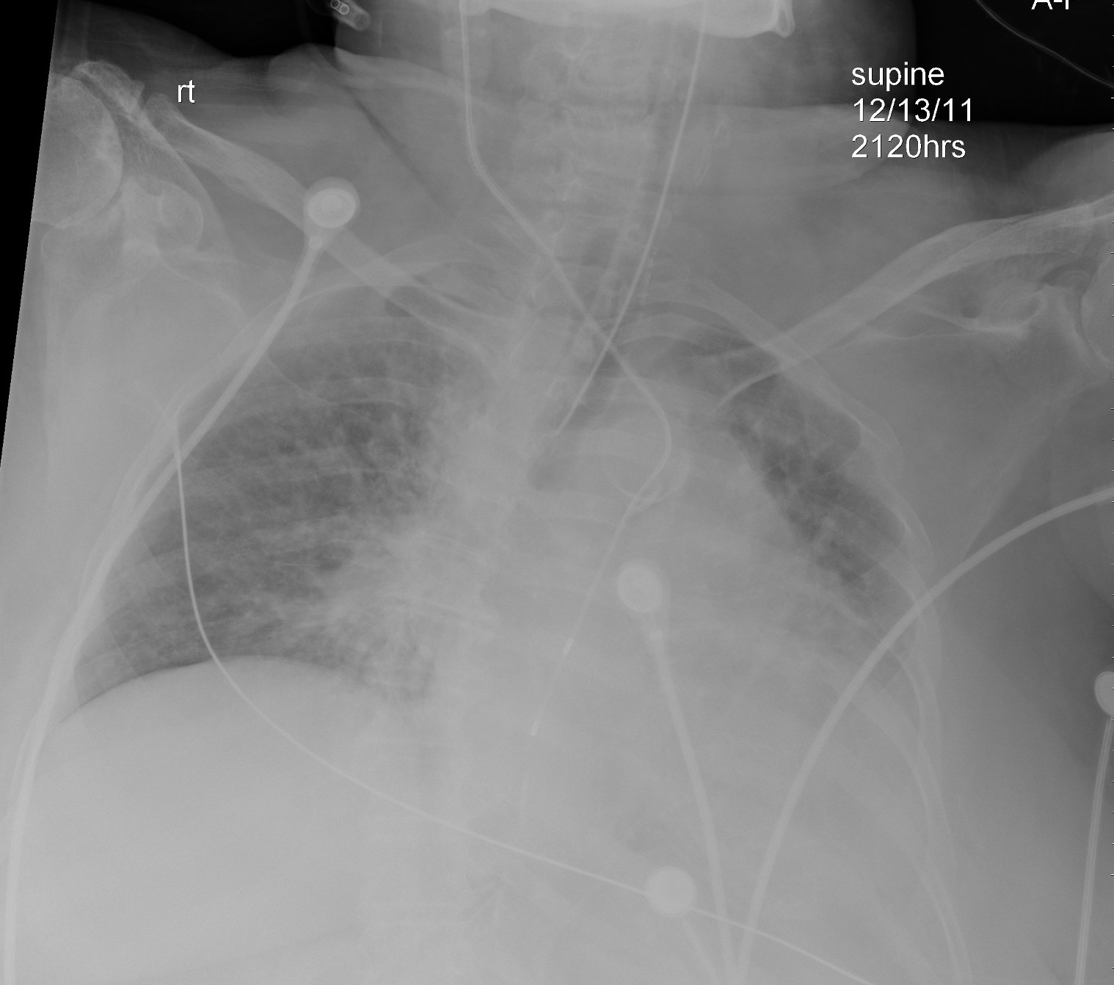
Cardiac Pacemaker/Implantable Cardiac Defibrillator: Misplaced
Right IJ cardiac lead extends into the aorta, terminating in the distal descending thoracic aorta

Slide 41
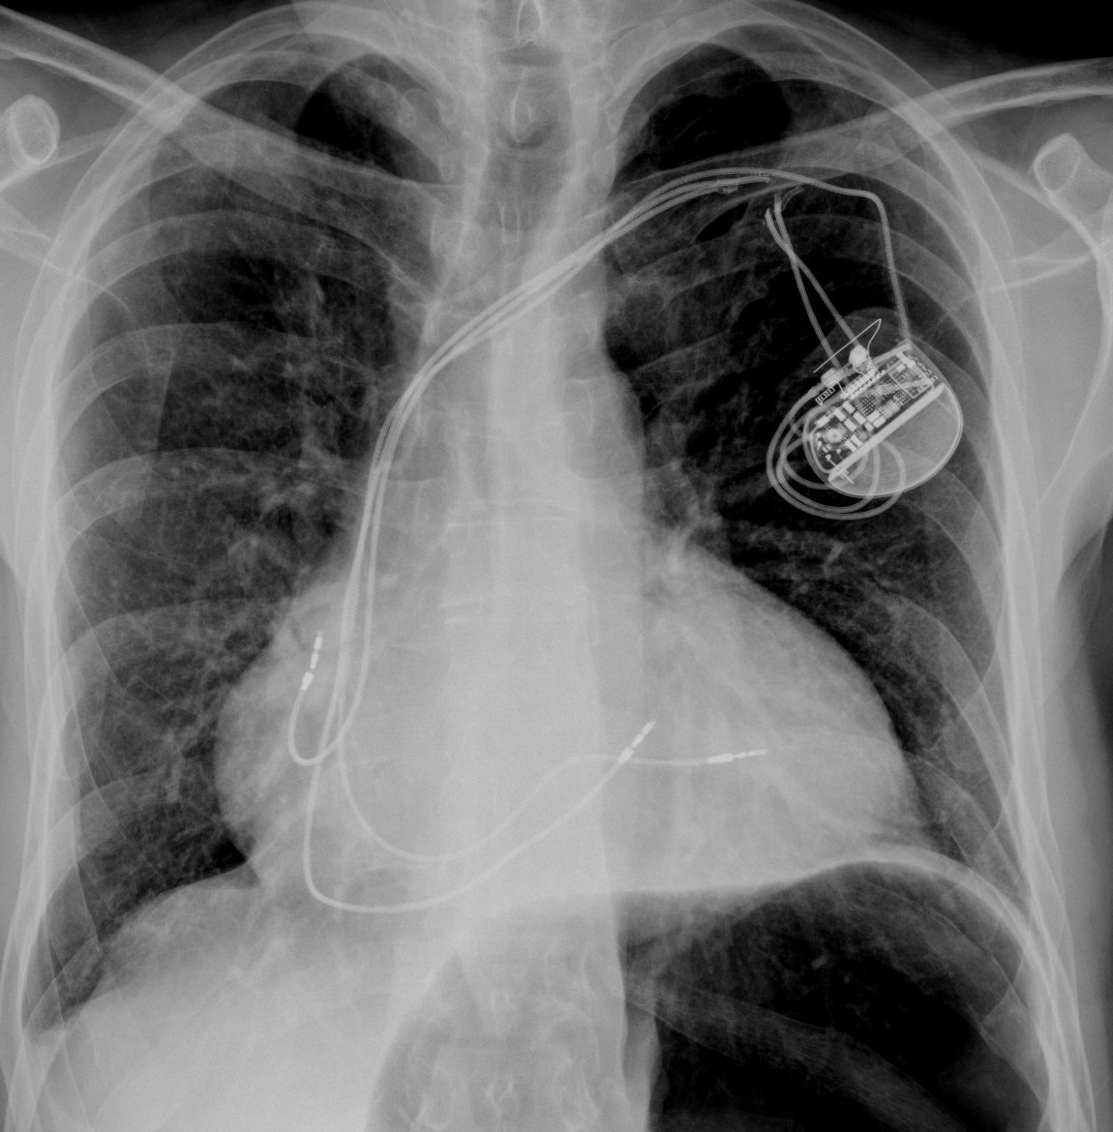
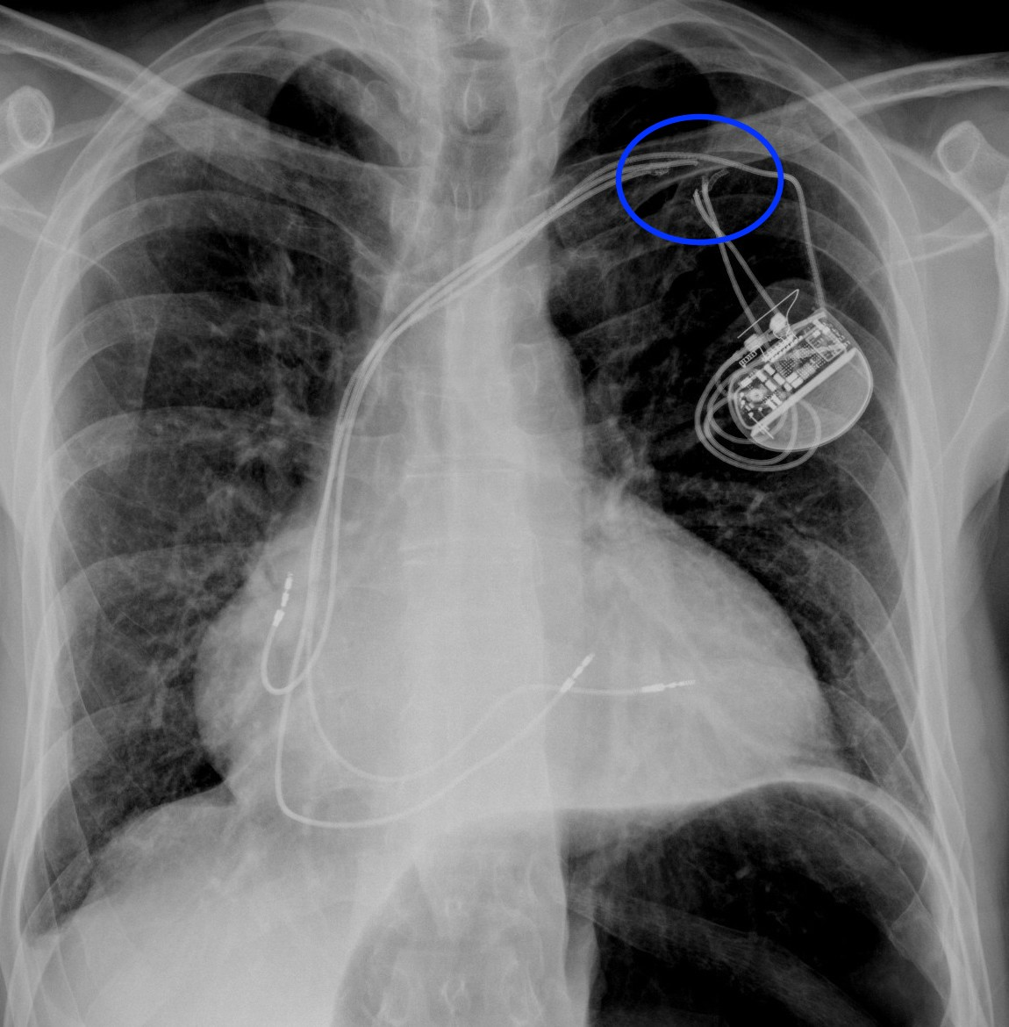
Cardiac Pacemaker/Implantable Cardiac Defibrillator: Fractured Leads

Slide 42
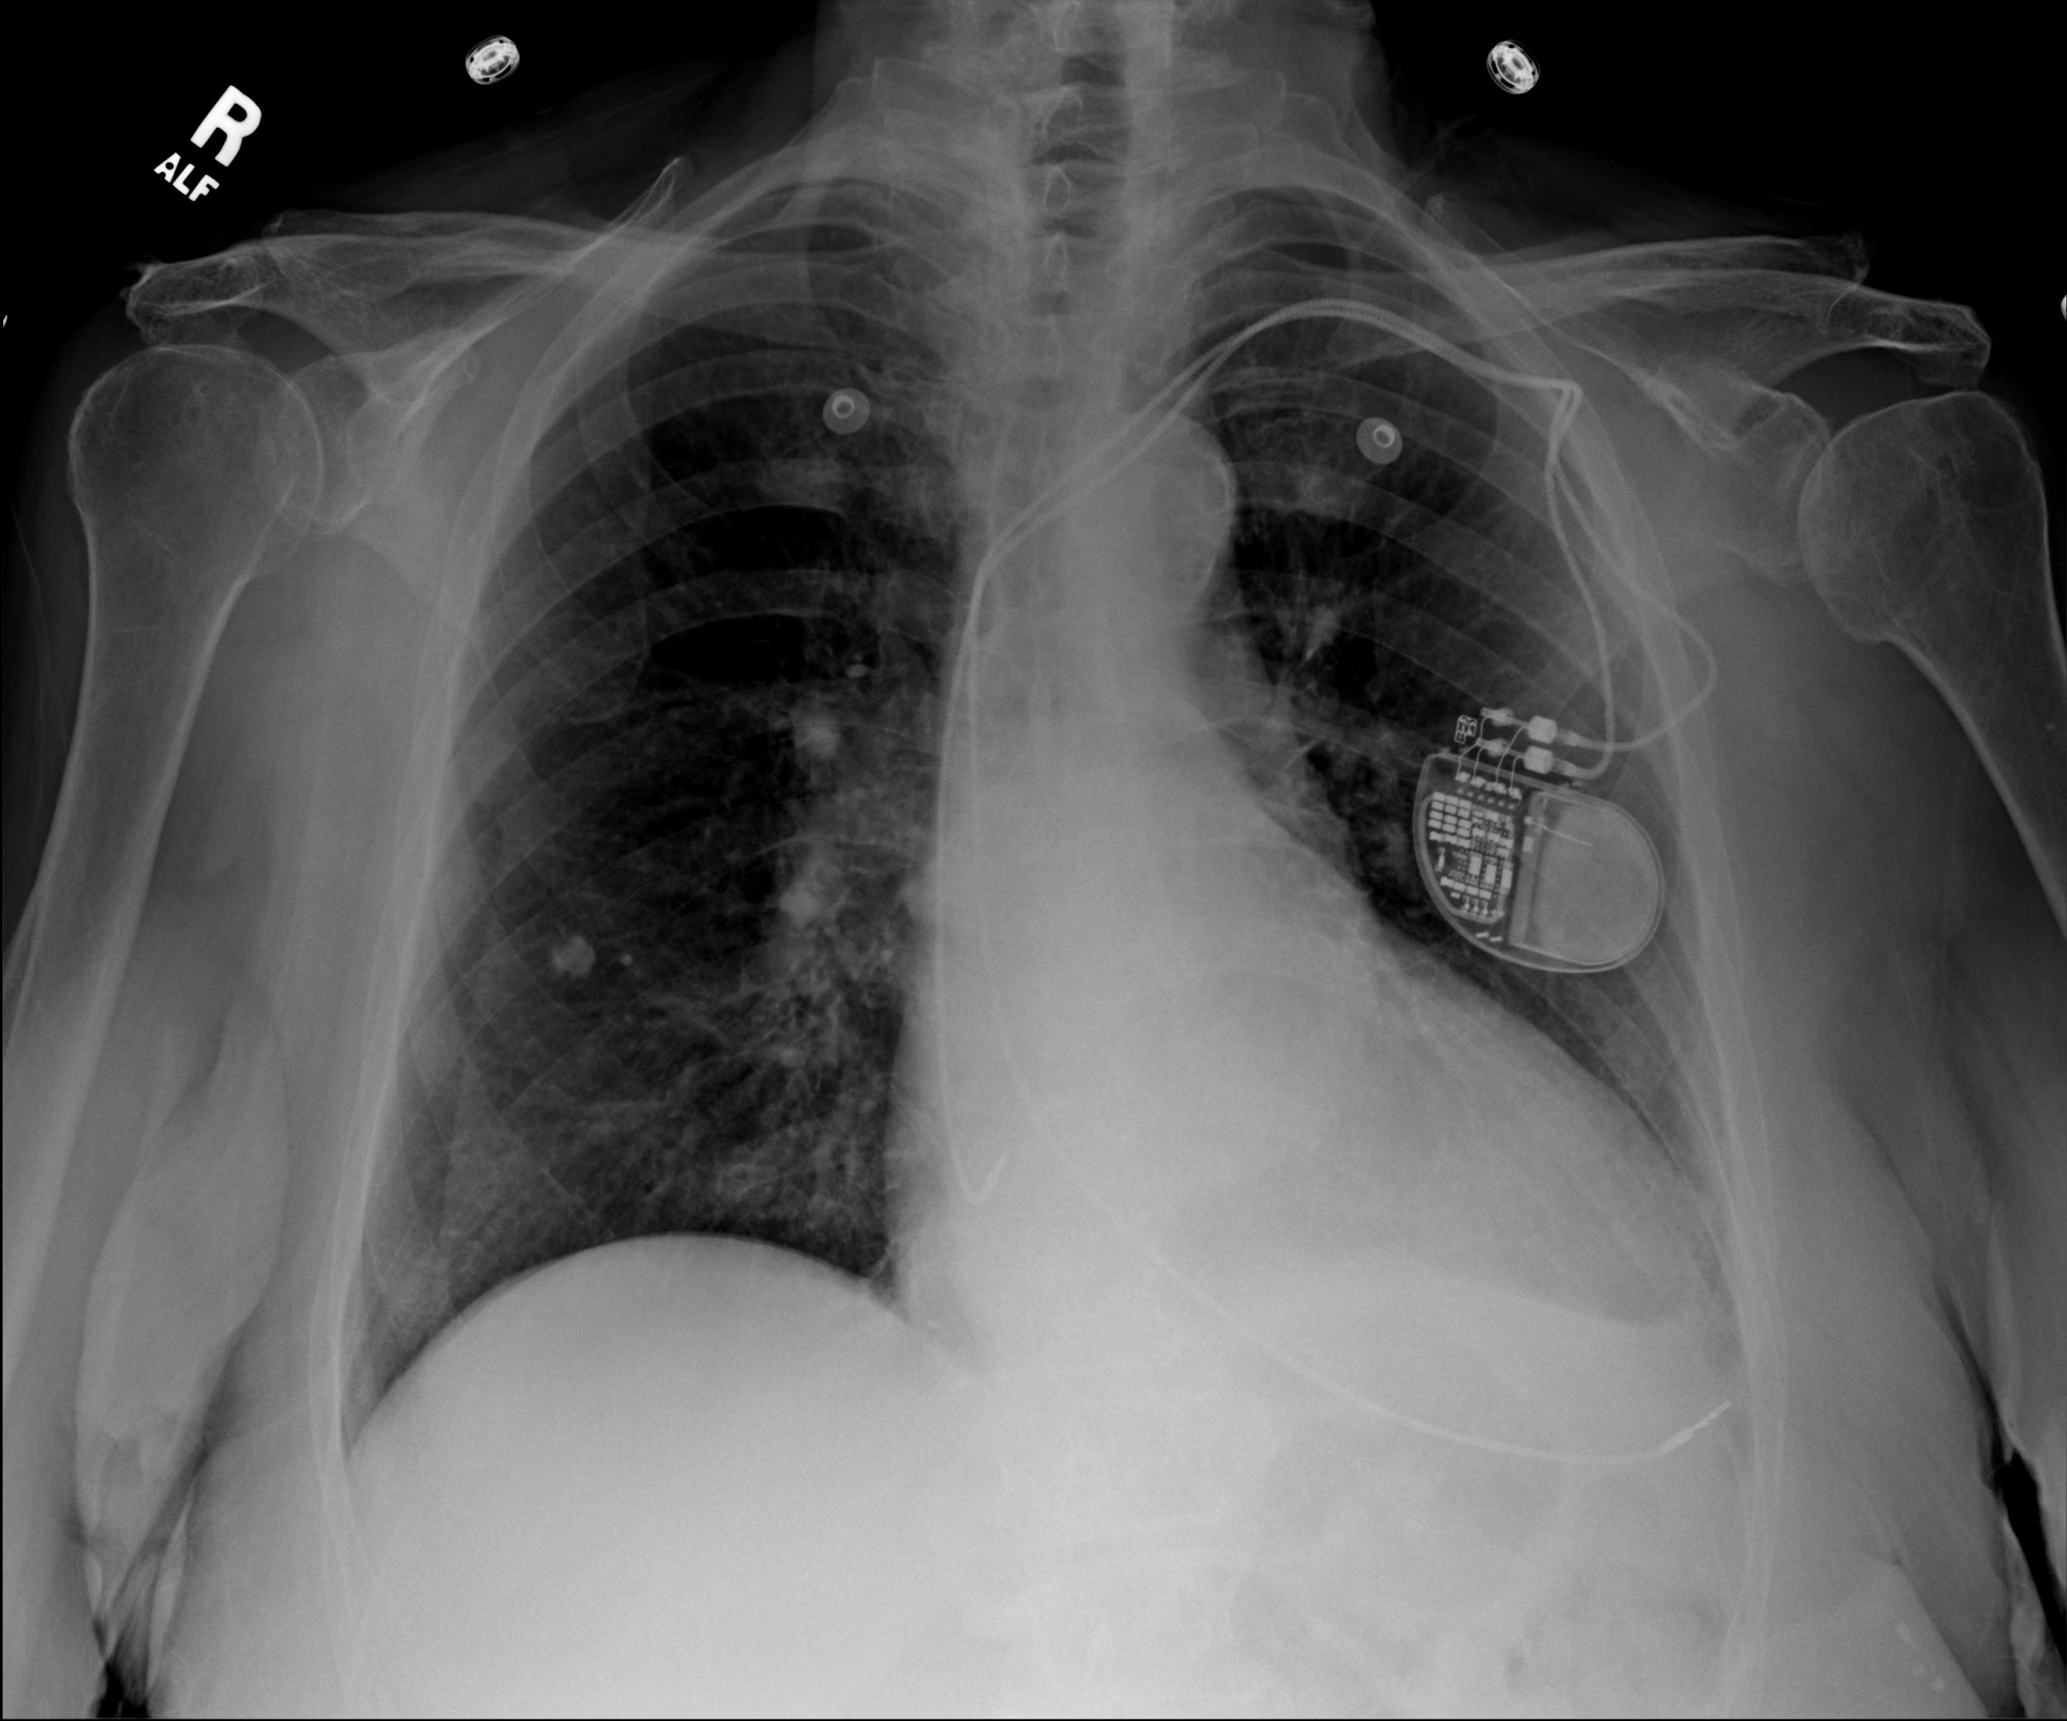
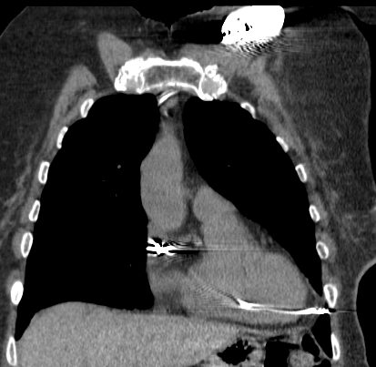
Cardiac Pacemaker/Implantable Cardiac Defibrillator:
Misplaced
RV lead though right ventricular wall with tip in pericardial fat.

Slide 43
The End

Slide 44
Approach
Evaluate Lines and Tubes first.
Identify and assess placement of each line/tube individually.
Look for expected complications.
Report all complications present.
Report absence of common complications. (Ex: Right subclavian line is in appropriate position. No pneumothorax.)
Report lines/tubes as being in correct or appropriate position,
NOT as stable.

Slide 45
Endotracheal Tube
Purpose:
  Airway control during assisted ventilation
  Access for airway suctioning
  Potential route for medication administration
Proper placement:
  Should terminate 2-5cm above the carina, or ½ way between carina and clavicles
  Balloon of the tube should not be hyperinflated
Complications:
  Misplacement in the pharynx or right/left mainstem bronchi
  Atelectasis
  Aspiration
  Pneumothorax
  Vocal cord injury
  Tracheal wall injury
  Esophageal dilatation
Notes:
I usually use 2-6 cm for adults but the AJR article on ICU Radiography lists 2-5 cm (AJR:198, March 2012 p563) so we should probably keep that.
Under complication I would add Dislodging teeth and fillings. I have a CT image of a tooth and crown in the right mainstem.

Slide 46
Endotracheal Tube: Proper Placement

Slide 47
Endotracheal Tube: Misplaced
ET tip in the Right Mainstem Bronchus with complete Left lung atelectasis

Slide 48
Endotracheal Tube: Misplaced
Balloon
ET Tip and balloon in the neck
Tip

Slide 49
Tracheostomy Tube
Purpose:
  Long term airway access in patients with obstruction at or above larynx
Proper placement:
  Should terminate ½ way between the stoma and carina (~T3 level)
Complications:
  Misplacement in lungs, mediastinum or subcutaneous tissues
  Perforation of trachea
  Aspiration
  Pneumomediastinum or pneumothorax
  Tracheal wall injury/stenosis

Slide 50
Tracheostomy Tube: Proper Placement

Slide 51
Tracheostomy Tube: Misplaced
The flange (light blue arrows) marks the outside tip and the blue arrow points to the internal tip which is not curving into the trachea. The tracheostomy tube is almost out.

Slide 52
Nasogastric tube
Purpose
  Short term feeding
  Gastric suction & decompression
  Medication administration
Proper placement
  Inserted via the nose, through esophagus into the stomach
  Tip and side hole should extend into the stomach
Complications
  Misplacement in the oropharynx, esophagus or airway
  Esophagitis, reflux, stricture, esophageal perforation
  Aspiration
  Lung injury, pneumothorax or hydropneumothorax
Notes:
The tip and sidehole needs to be distal to the EG junction but not 10 cm. AJR:198 p. 564
Airway misplacement can result in lung injury, PTX and hydropneumothorax.
Esophageal misplacement can lead to aspiration.

Slide 53
Nasogastric Tube: Proper Placement

Slide 54
Nasogastric Tube: Proper Placement
Both the tip and the sidehole are below the left diaphragm.
TIP
Sidehole

Slide 55
Nasogastric Tube: Misplaced
NG tube terminates in the Left Lower Lobe bronchus

Slide 56
Nasogastric Tube: Misplaced
NG tube is coiled in Esophagus with tip in throat

Slide 57
Dobbhoff Tube
Purpose
  Short term feeding
  Prevent aspiration
Proper Placement
  Inserted via the pharynx, through esophagus and stomach into the duodenum
  Weighted tip should terminate in the proximal duodenum, past the level of the duodenal bulb [ Ideally tip should be at the Ligament of Treitz.]
Complications
  Misplacement in the oropharynx, esophagus, stomach or airway
  Esophagitis, reflux, stricture, esophageal perforation

Slide 58
Dobbhoff Tube: Proper Placement
Chest and abdomen exam show DT following the course of esophagus and stomach to the Ligament of Treitz

Slide 59
Dobbhoff Tube: Misplaced

Slide 60
Chest Tube
Purpose
  Remove air or fluid from the pleural space
Proper Placement
  For air evacuation, tip should point anterosuperior
  For fluid evacuation, tip should point posteroinferior
  Side holes should be inside the thorax
Complications
  Misplacement in the fissures, parenchyma, mediastinum, or diaphragm
  Pneumothorax
  Inadequate drainage
  Air leak
  Infection
  Bleeding from intercostal arteries
  Injury to diaphragm or upper abdominal organs

Slide 61
Chest Tube: Proper Placement
Notes:
Chest tube extends towards the apex, the side hole of the tube is in the pleural space

Slide 62
Chest Tube: Proper Placement
Notes:
Pigtail catheter is coiled inside the chest, all of the side holes project in the pleural space

Slide 63
Chest Tube: Misplaced
Right chest tube in chest wall

Slide 64
Chest Tube: Misplaced
Right chest tube tube projects over the mediastinum and was coiled in right main pulmonary artery on subsequent CT

Slide 65
Peripherally Inserted Central Catheter
Purpose
  Establish long-term venous access
Proper Placement
  Inserted via peripheral veins (i.e. basilic vein, brachial vein, cephalic vein or axillary vein) to terminate in the superior vena cava
Complications
  Misplacement in right heart chambers
  Phlebitis, bleeding, thrombosis
  Venous perforation
  Pain
  Sepsis

Slide 66
Peripherally Inserted Central Catheter: Proper Placement

Slide 67
Peripherally Inserted Central Catheter: Misplaced
Right PICC line going up the right jugular vein

Slide 68
Central Venous Lines (CVL)
Purpose
  Central venous access for fluids, medications, IV contrast
Proper Placement
  Tip in the SVC-distal to subclavian/jugular junction and proximal to the right atrium
  Small sleeve of SVC extends into right atrium
Complications
  Malposition
  Pneumothorax
  Hemothorax
  Mediastinal hematoma
  Fracture of the line

Slide 69
Central Venous Line: Proper Placement
Left Internal Jugular (IJ) line with tip in mid-SVC

Slide 70
Central Venous Line: Misplaced
Left IJ (light blue arrow) with tip in Left Subclavian vein (Blue arrow)

Slide 71
Central Venous Line: Misplaced
Left Subclavian line never crosses spine/midline. Tip projects over left mediastinum and aorta.
(Possible intra arterial placement)

Slide 72
Central Venous Line: Misplaced
Intra arterial placement with line tip (Blue Arrow) in descending aorta.

Slide 73
Central Venous Line, Complication: Pneumothorax
Right Subclavian line (Blue arrow) with pneumothorax (Light blue arrow).

Slide 74
Central Venous Line, Complication: Fracture
Port catheter that has fractured and migrated into heart

Slide 75
Swan Ganz Catheter
Purpose
  Observe hemodynamic status of patient
  Distinguish cardiac from noncardiac pulmonary edema
Proper Placement
  Inserted via a large vein (i.e. internal jugular or subclavian vein or common femoral vein) to terminate in proximal right or left pulmonary artery ~ 2cm from the hilum
Complications
  Misplacement in large veins, right heart chambers, pulmonary trunk or peripheral pulmonary arteries
  Venous perforation
  Phlebitis, bleeding, thrombosis
  Right atrial or ventricular wall perforation
  Pulmonary infarction
  Pneumothorax
Notes:
Also rupture of the pulmonary artery branch if too far out and balloon expanded.

Slide 76
Swan Ganz Catheter: Proper Placement

Slide 77
Swan Ganz Catheter: Proper Placement
Right IJ approach with tip projecting in the mid right pulmonary artery

Slide 78
Swan Ganz Catheter: Misplaced
SG tip in distal right lower lobe artery.
At risk of arterial rupture if the balloon is expanded and at risk of pulmonary infarction if tip enters smaller side branch.

Slide 79
Cardiac Pacemaker/Implantable Cardiac Defibrillator
Purpose
  Assist in normal electrical conduction of the heart
  Break ventricular fibrillation
Proper Placement
  Pulse generator/defibrillator is positioned in subcutaneous tissues of the anterior chest wall
  Electrodes are guided via subclavian vein and SVC into right atrial appendage, right ventricle and coronary sinus
Complications
  Misplacement in the proximal veins or cardiac chambers
  Perforation of the heart
  Lead discontinuity
  Pneumothorax
  Pacemaker-mediated tachycardia
  Infection
Notes:
Infection also complication.

Slide 80
Cardiac Pacemaker/Implantable Cardiac Defibrillator: Proper Placement

Slide 81
Cardiac Pacemaker/Implantable Cardiac Defibrillator: Misplaced
Right IJ cardiac lead extends into the aorta, terminating in the distal descending thoracic aorta

Slide 82
Cardiac Pacemaker/Implantable Cardiac Defibrillator: Fractured Leads

Slide 83
Cardiac Pacemaker/Implantable Cardiac Defibrillator:
Misplaced
RV lead though right ventricular wall with tip in pericardial fat.

Slide 84
The End

