Slide 1


How to Approach Breast Ultrasound
Mai Elezaby¹, MD
Cecelia Marcado², MD
Monica Sheth³, MD
University of Wisconsin School of Medicine and Public Health
NYU Langone Health
NYU Langone Health

Slide 2
Indications
Patients present for breast ultrasound for either screening or diagnostic purposes
Screening:
Asymptomatic patients with high risk for breast cancer and contraindication to screening MRI
Asymptomatic patients with dense breast (ACR categories C or D) +/- ↑ risk of breast cancer
Diagnostic-Problem Solving for the evaluation of:
Breast symptoms: lump, pain, nipple discharge, skin retraction
  Patients < 30 years, US first, otherwise start with MG
Mammographic abnormality
MRI abnormality

Slide 3
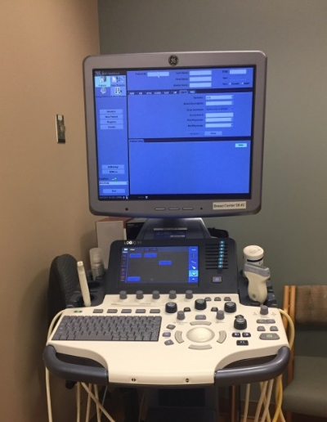
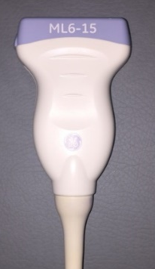
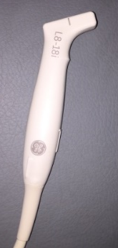
Equipment
Standard US Equipment:
Monitor - displays images
Keyboard - houses controls to optimize images - focal zone, depth, spatial compounding, gain, harmonics, etc. to clarify images
Measurement tools and doppler imaging to provide additional details.
Transducers - come in various frequencies
  lower frequency transducers having deeper penetration of tissue.
Monitor
Linear Transducer
Hockey stick transducer
Keyboard to control imaging settings and label images

Slide 4
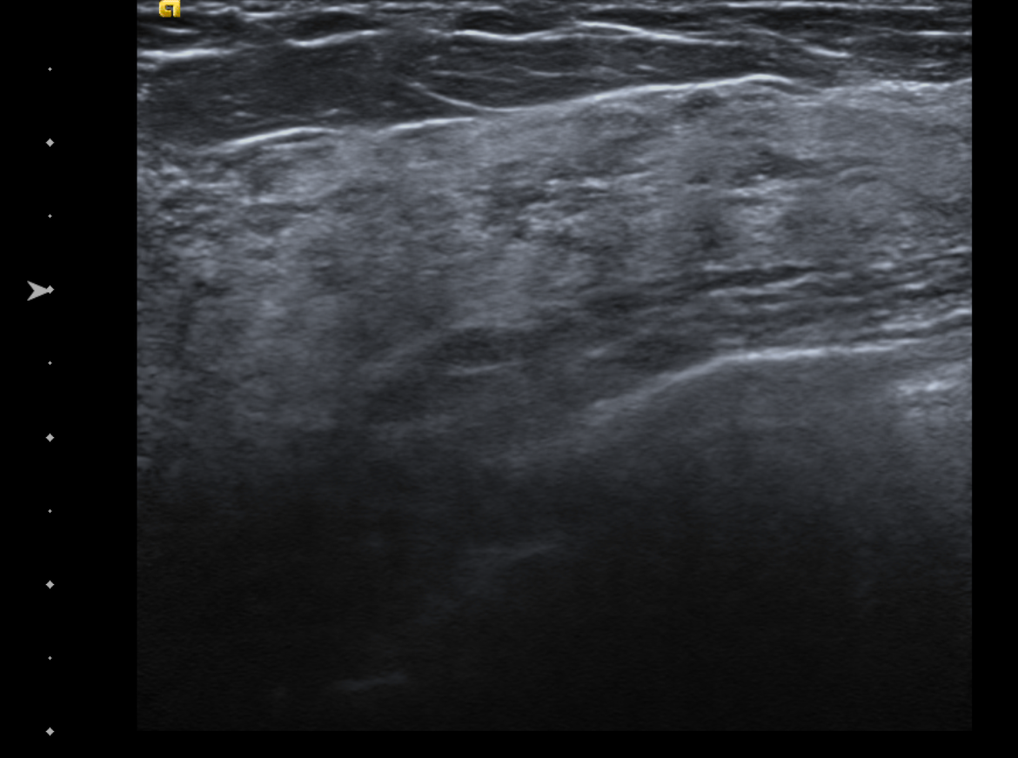
Technique: Optimize Imaging
High frequency, linear array transducer
  with center of frequency of at least 10MHz
  with maximum frequency 12-18 MHz
Field of view - reach chest wall but not beyond
Overall gain - set so that fat is gray
TGC - increase with increasing depth
Focal zone - set at lesion
  Most transducers allow for multiple focal zones
  Increase resolution of lesion with one focal zone
Focal Zone

Slide 5
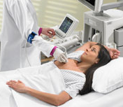
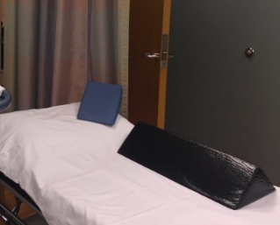
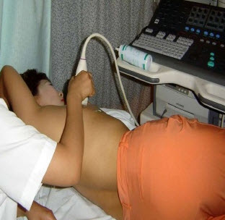
Technique: Patient Positioning
Positioning is key to immobilize breast tissue and aid with scanning
Good positioning includes:
  Arm above the head - helps thin and spread breast tissue for improved penetration
  Lying supine to evaluate medial tissue
  Lying supine oblique for lateral breast and axilla evaluation
  Wedges can be used to provide additional support

Slide 6
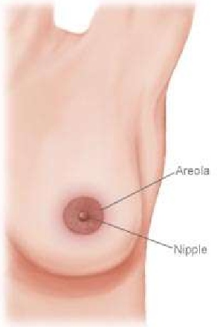
Approach: Scanning planes
Document findings in two planes (transverse/longitudinal or radial/antiradial). Images below demonstrate orientation of the transducer (blue rectangle) in relation to the breast
Transverse
Longitudinal
Radial- spokes on wheel
Anti-radial - perpendicular to radial spokes

Slide 7
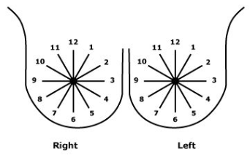

Lesion Location:
Findings in ultrasound are given two location identifiers:
1) Clock face position 2) Distance (cm) from the nipple ssssssssssssssssssssssssssssssssssssssssss(center of probe to nipple)

Slide 8

Lesion Location:
Now let’s practice. What is the clock face position of the following findings?
Right Breast:
Left Breast:
2:00
Right
Left
7:00

Slide 9
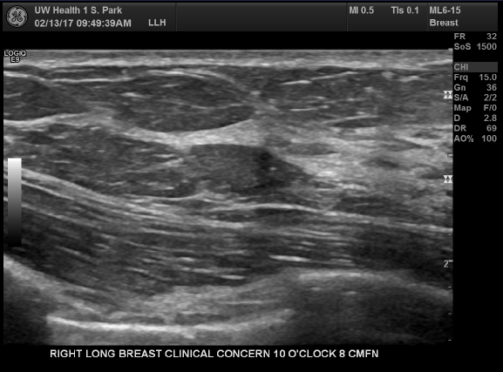
Normal Anatomy
Skin
*Fat - hypoechoic (gray)
Fibroglandular tissue - echogenic (light gray/white)
Skeletal muscle
(Pectoralis muscle/chest wall)
Ribs
Lung Pleura
Important to note that echogenicity of ultrasound findings are described relative to echogenicity of breast fat.

Slide 10
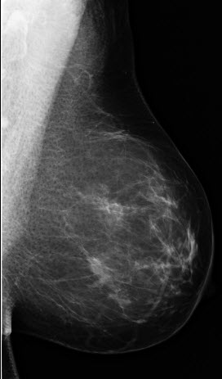
Relationship of tissue depth on MG and US
Closer to skin
Closer to pectoralis muscle
Within
Glandular tissue

Slide 11
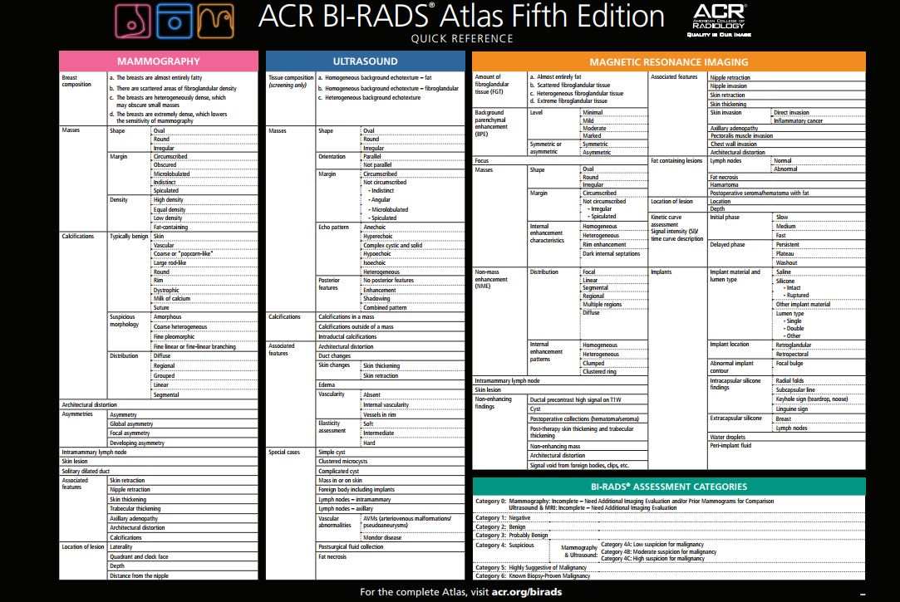
Ultrasound Reporting: BIRADS
https://www.acr.org/~/media/ACR/Documents/PDF/QualitySafety/Resources/BIRADS/Posters/BIRADS-Poster_36x24in_F.pdf?la=en

Slide 12
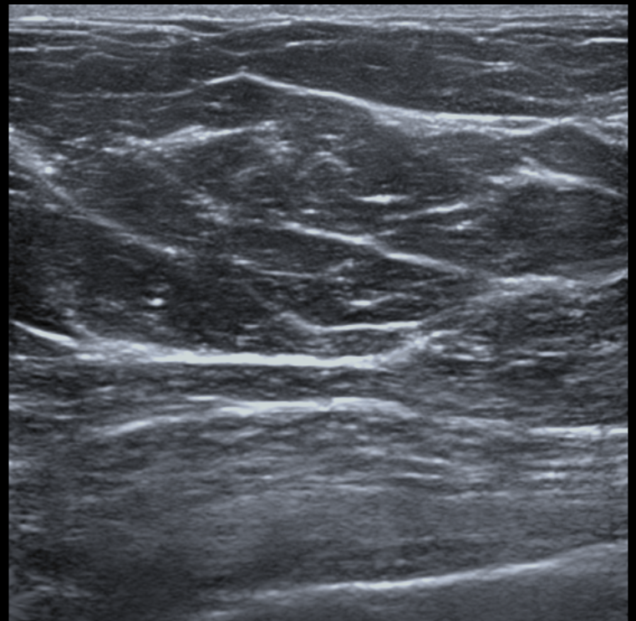
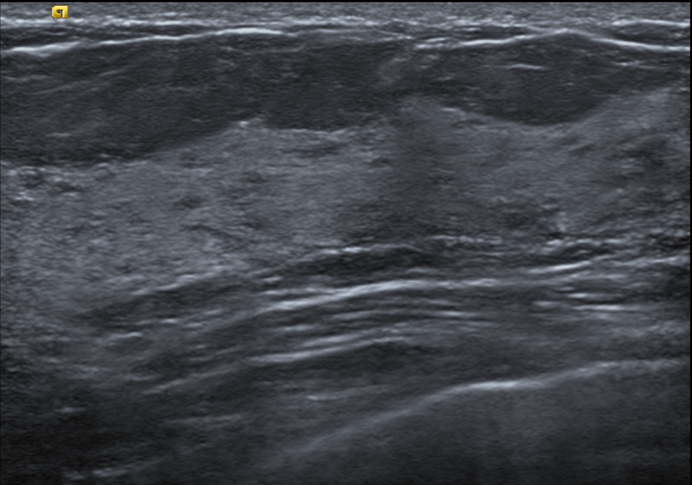
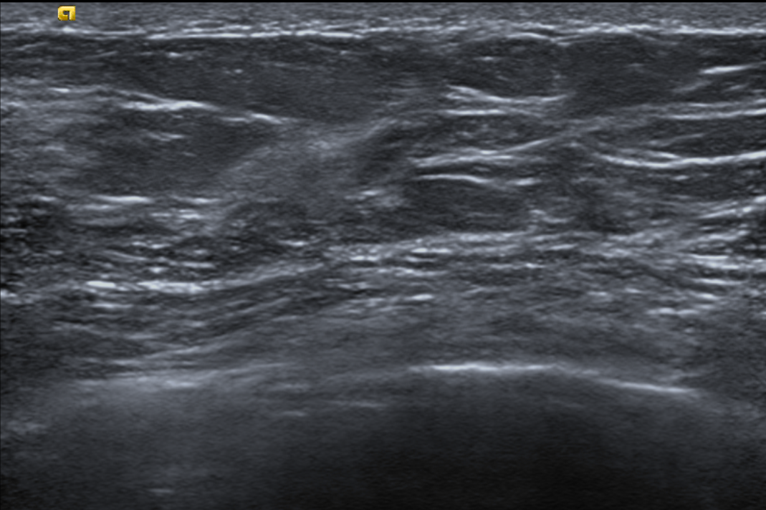
Tissue Composition
(Screening Ultrasound)
On screening ultrasound exams, documentation of the patient’s tissue background echotexture is a standard component of report.
Homogeneous background
echotexture - fat
Homogeneous background echotexture - fibroglandular
Heterogeneous background echotexture

Slide 13
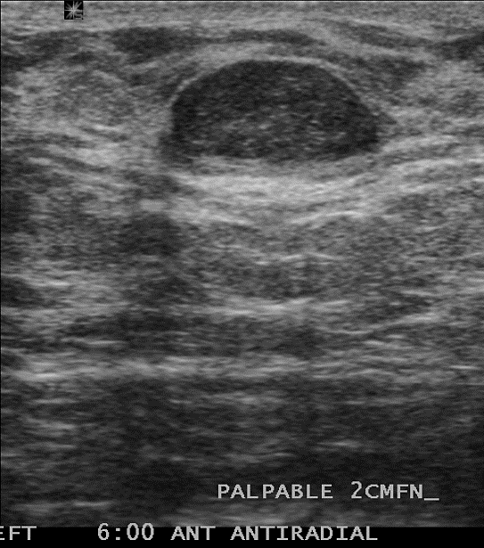
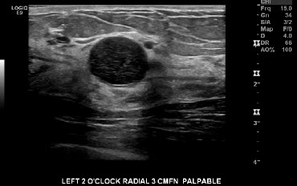
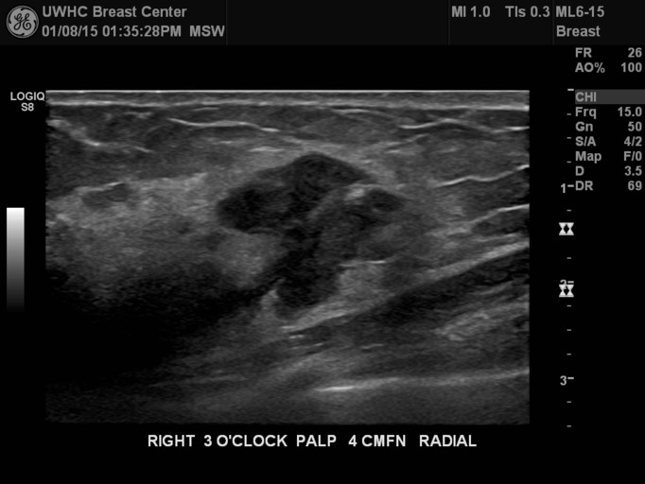
Ultrasound Findings
Mass - Shape
Oval
Round
Irregular
Lower likelihood of malignancy (LOM)
Higher LOM

Slide 14
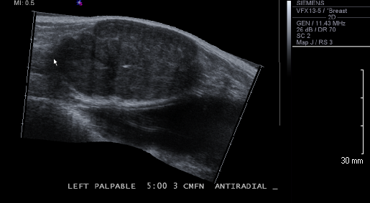
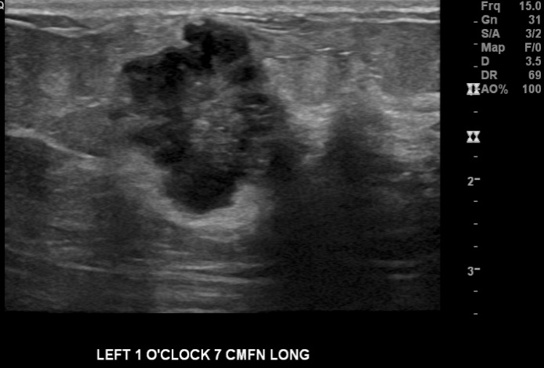
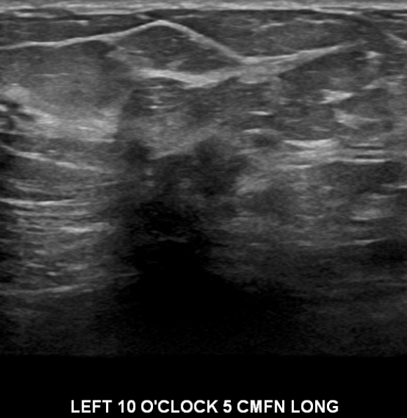
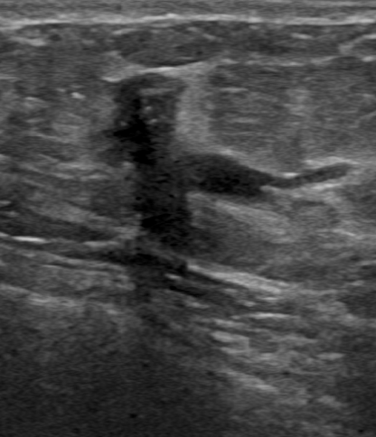
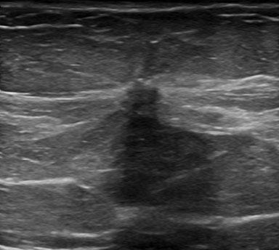
Ultrasound Findings
Mass - Margin
Circumscribed
Microlobulated
Indistinct
Angular
Spiculated
More suspicious

Slide 15
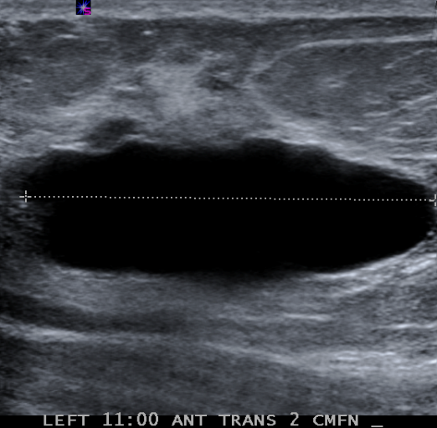
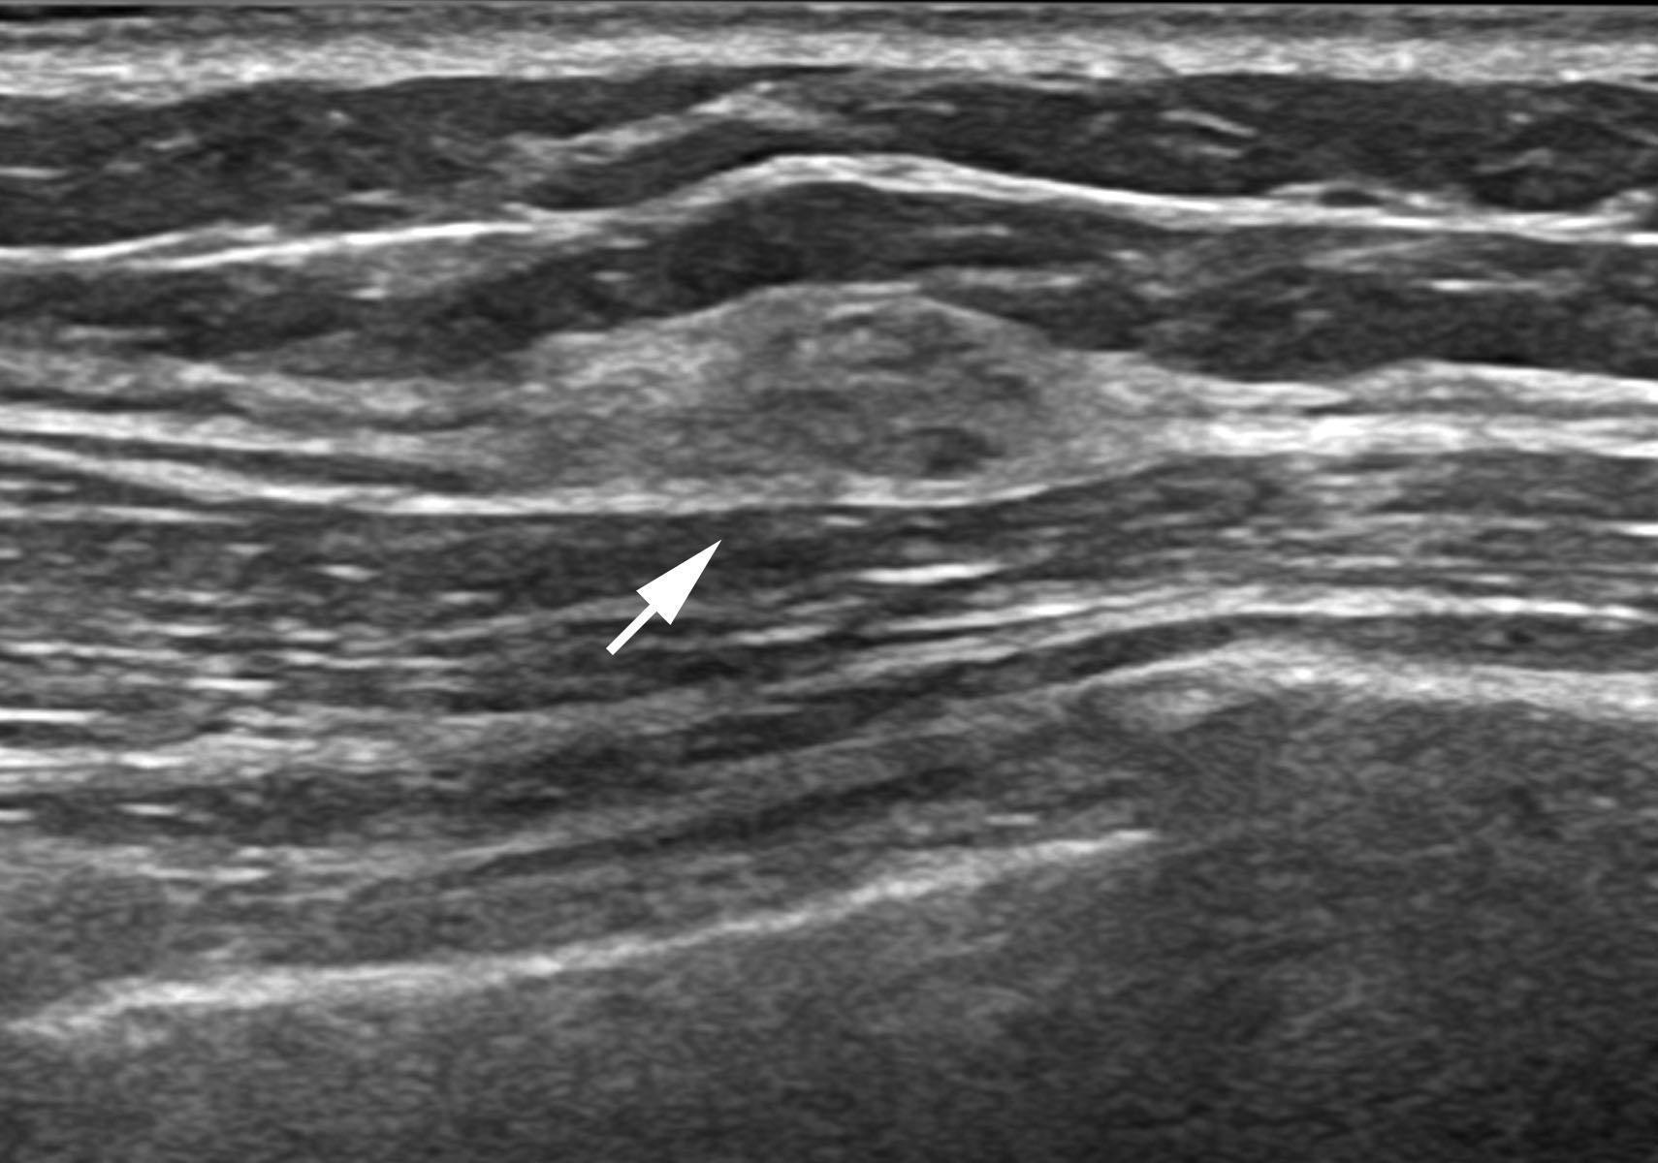
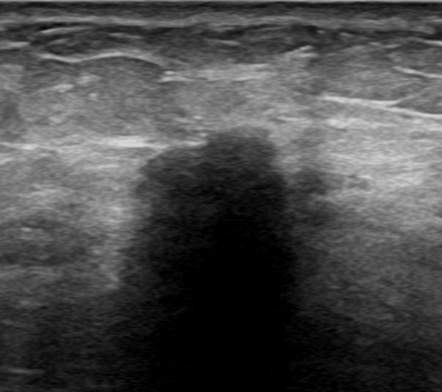
Ultrasound Findings
Mass - Echogenicity
Anechoic
Hyperechoic
Hypoechoic
No internal echoes (black)
Mostly indicates simple cyst
Brighter than FAT (light gray-white)
Usually benign
Darker than FAT
Most of masses

Slide 16

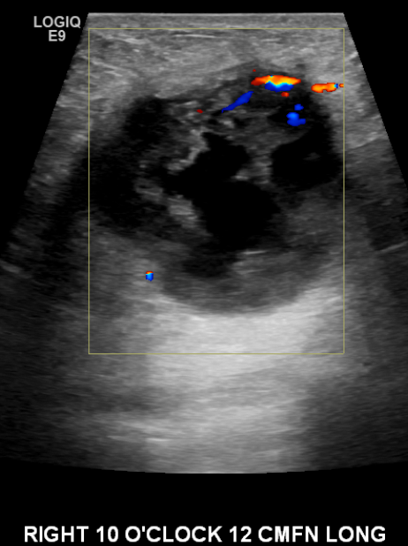
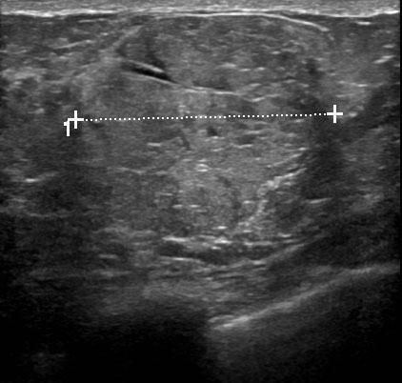
Ultrasound Findings
Mass - Echogenicity
Isoechoic
Heterogeneous
Complex Solid and cystic
Similar to FAT
Typically benign
Highly suspicious for malignancy

Slide 17
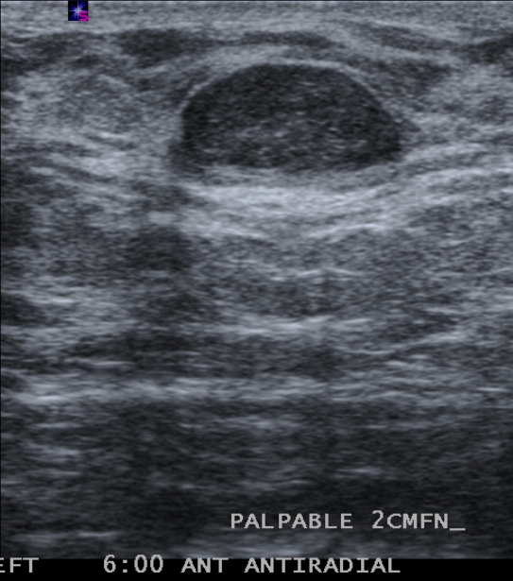
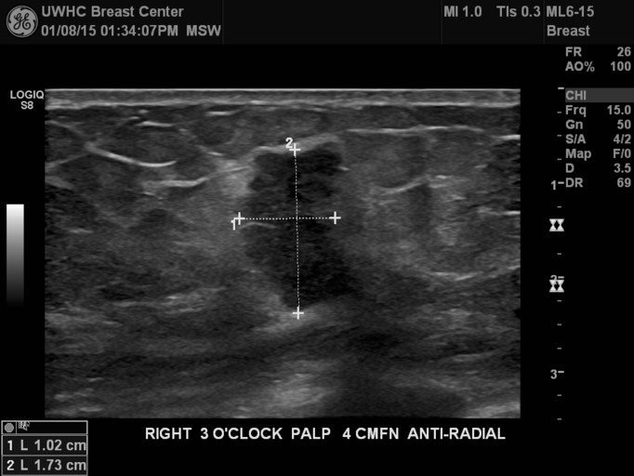
Ultrasound Findings
Mass - Orientation
wider than tall
Taller than wide
More common with benign masses
More common with malignant masses

Slide 18
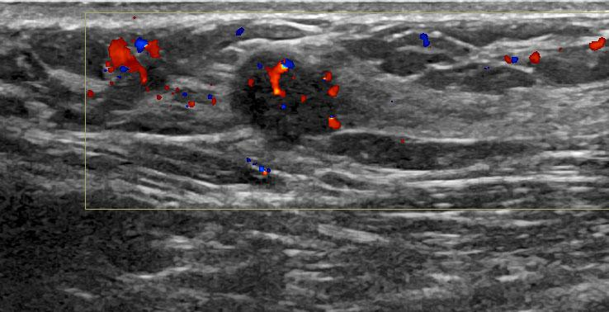
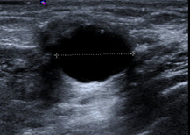
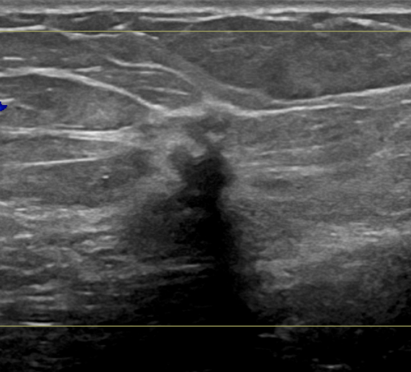
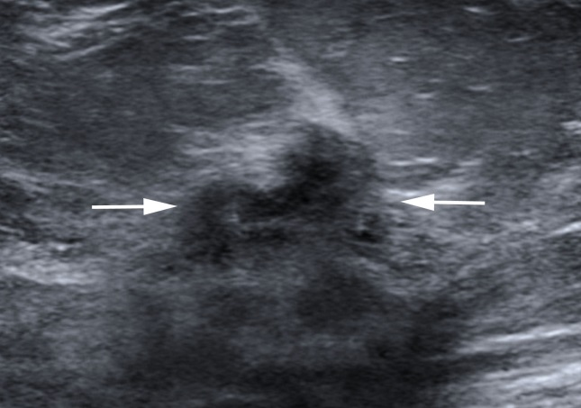
Ultrasound Findings
Mass - Posterior Features
None
Enhancement
Shadowing
Combined
Tissue posterior to mass is brighter
Tissue posterior to mass is darker

Slide 19
MASS SUMMARY
More common with Benign | More common with Malignant
Oval | Round/irregular
Circumscribed | Not circumscribed (indistinct, microlobulated, angular, spiculated)
Posterior enhancement | Posterior shadowing
Hyperechoic/isoechoic | Hypoechoic
Parallel | Not-parallel

Slide 20
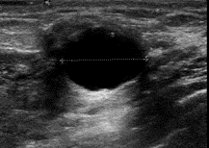
CYSTS
Simple Cyst
Anechoic
Smooth internal wall
Posterior enhancement
No internal vascularity
Benign-No follow up needed
CC
MLO

Slide 21
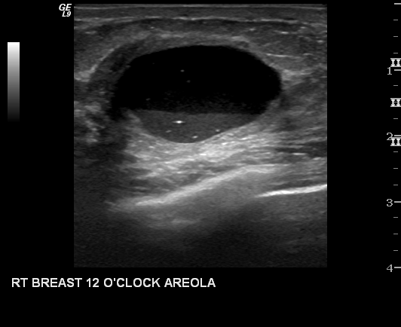
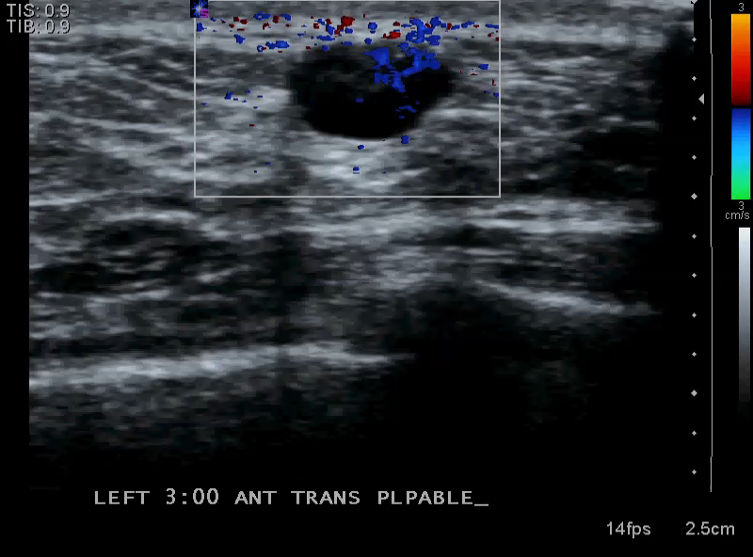
CYSTS
Complicated Cyst
Mixed echogenicity
Fluid/fluid level
Floating debris
Posterior enhancement
No internal vascularity
Benign-No follow up needed
CC
MLO

Slide 22
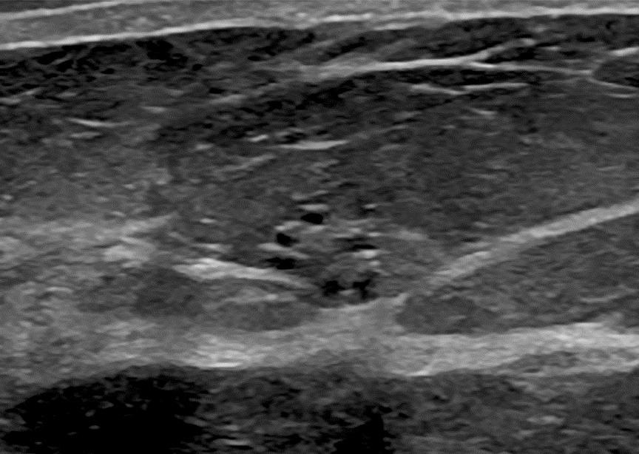
CYSTS
Clustered Microcysts
Multiple small cysts (< 2-3mm)
Imperceptible wall
No internal vascularity
Benign - No follow up needed
If solid component→ biopsy
CC
MLO

Slide 23
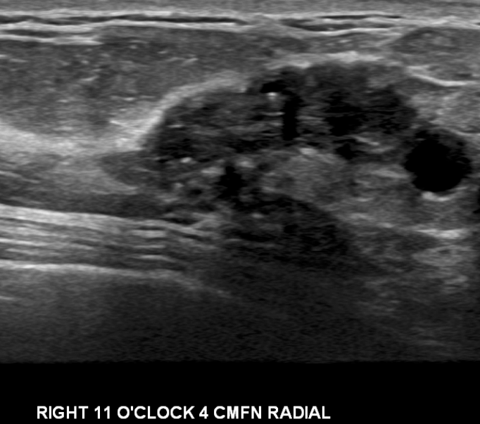
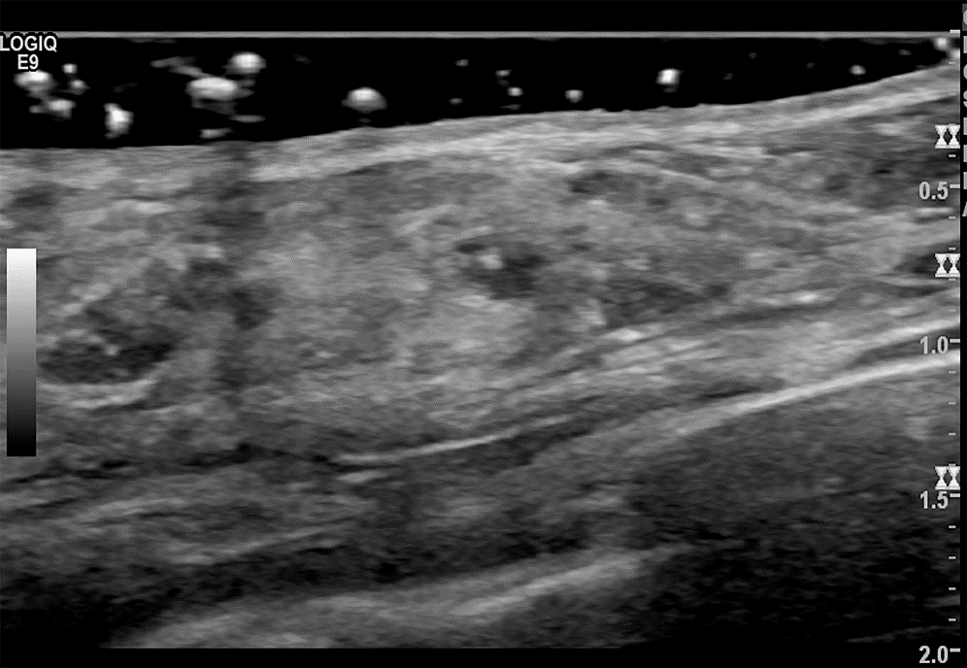
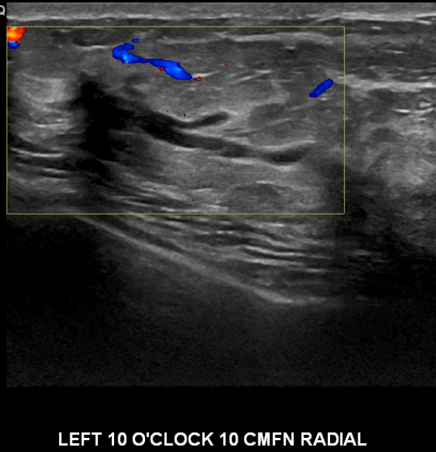
CALCIFICATIONS
Calcifications appear as small echogenic foci on ultrasound.
CC
MLO
In a mass
Outside a mass
Intraductal

Slide 24
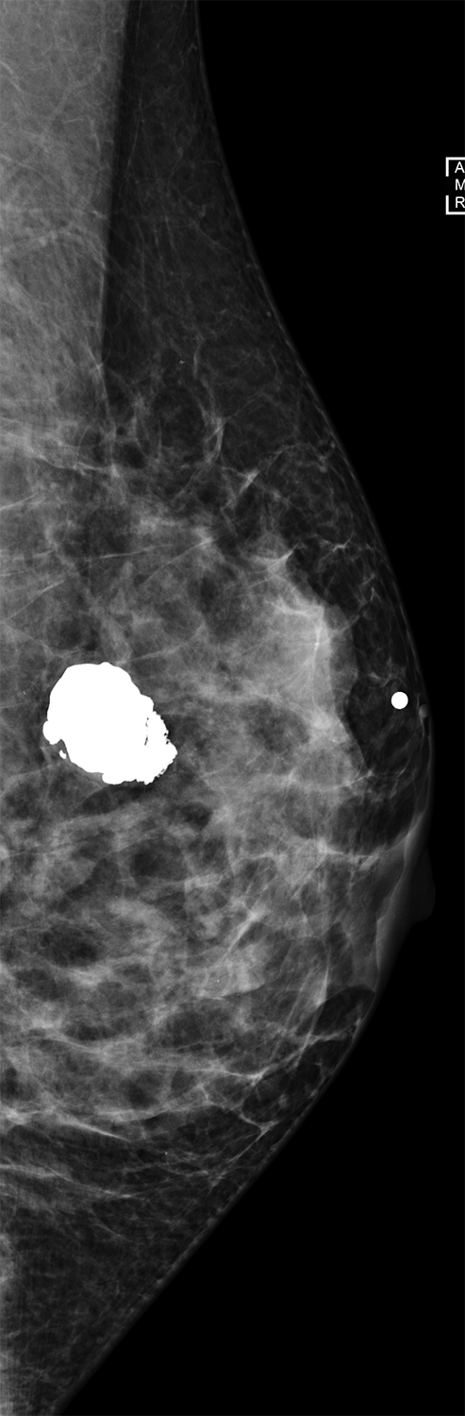
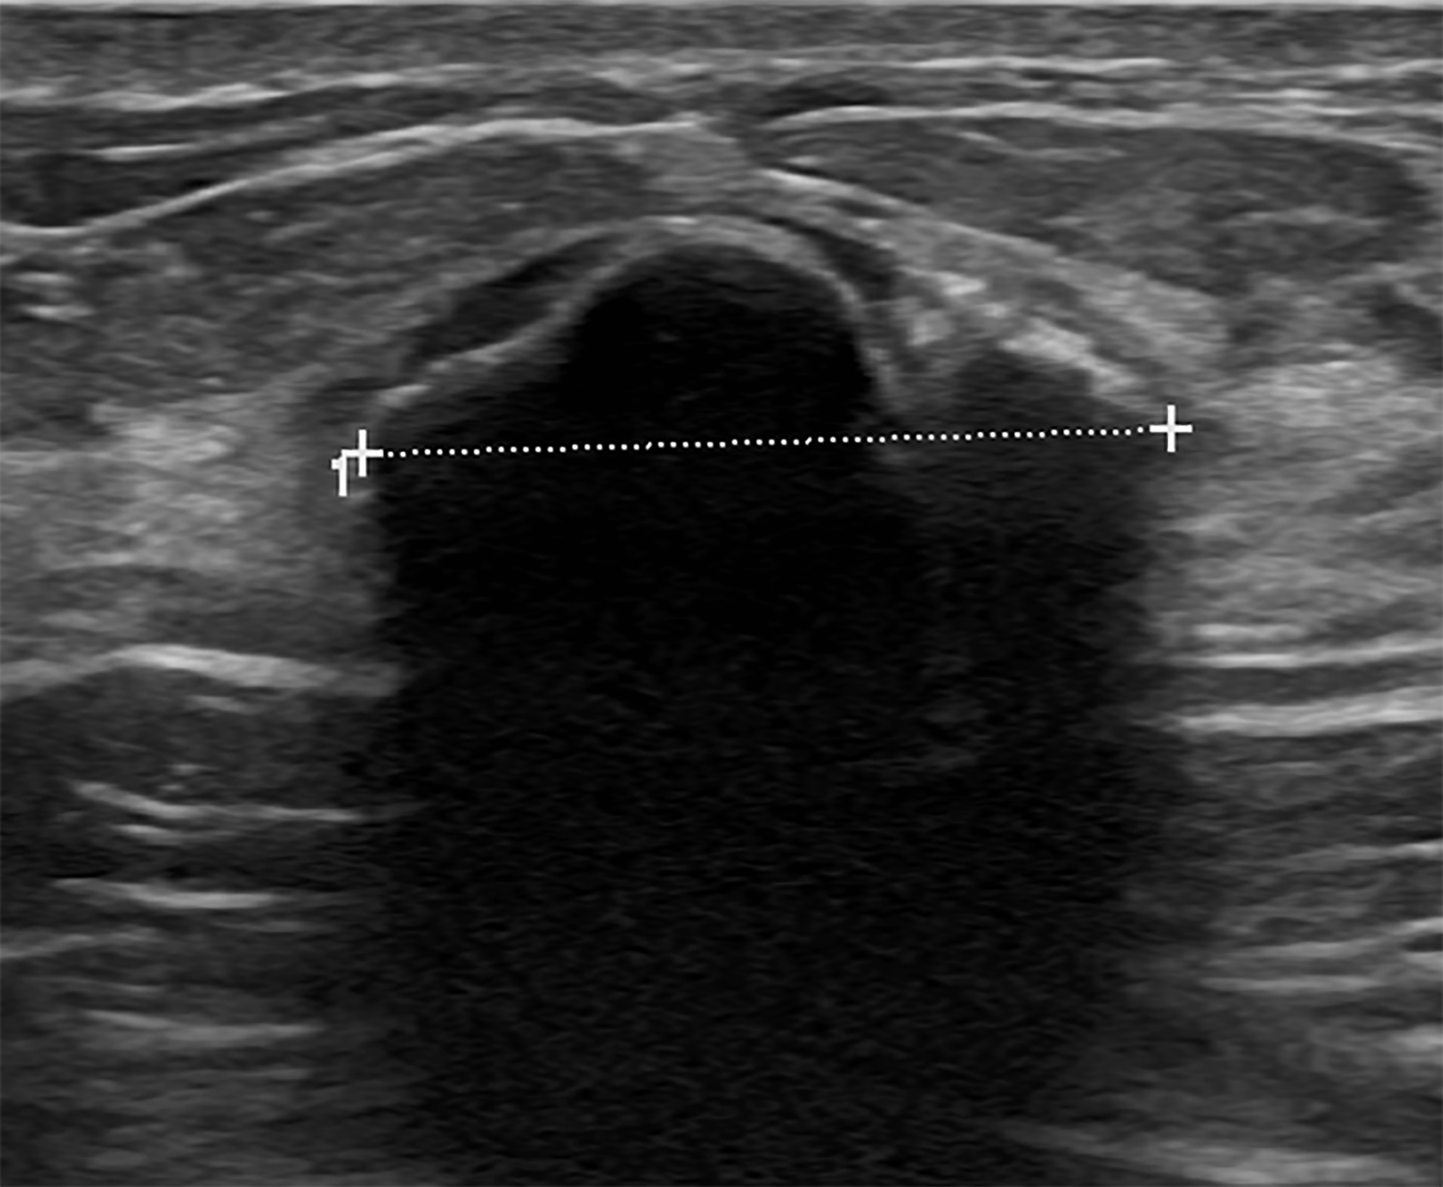
CALCIFICATIONS
Large dystrophic calcifications may appear echogenic superficially (arrow head), with marked posterior shadowing (long arrow).
CC
MLO
Dystrophic calcification on US
Dystrophic calcification on MG

Slide 25
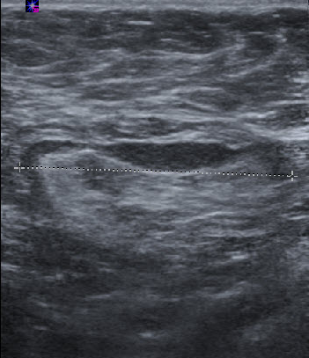
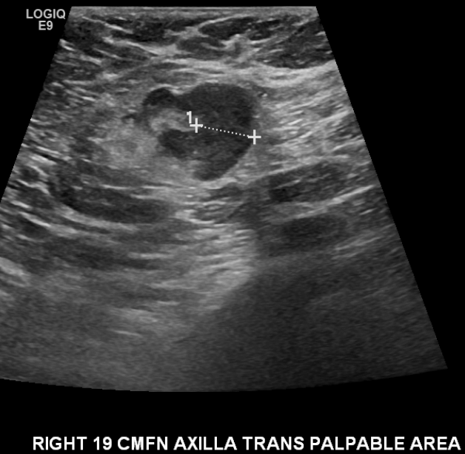
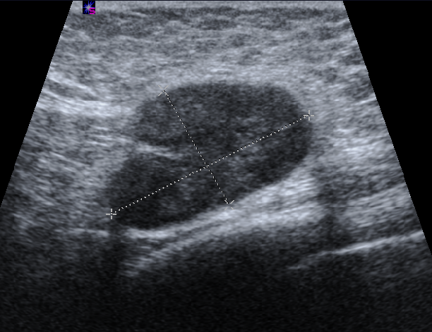
LYMPH NODES
Normal
Abnormal
Eccentric cortical thickening ≥ 3mm
Thin uniform cortex
CC
MLO
Maintain fatty hilum
Attenuated to
complete loss of
fatty hilum

