Slide 1
How to approach Bone Tumors
Kristen E. McClure, MD
Lukas M. Trunz, MD

Slide 2
Evaluation of bone tumors- Radiographs
Margin/Zone of Transition
Geographic (Type 1a vs 1b vs 1c)
Focal discrete lesion
Narrow vs. broad zone of transition
Sclerotic vs. nonsclerotic margin
Moth Eaten (Type 2)- Multiple lytic areas with broad zone of transition
Permeative (Type 3)- Ill defined margins with broad zone of transition
Distinction between Type 2 and 3 is not significant, both indicate aggressive lesions
Applies to lytic
lesions

Slide 3
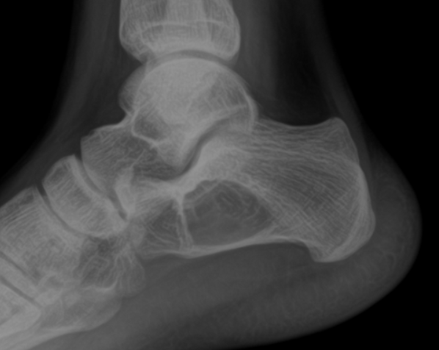
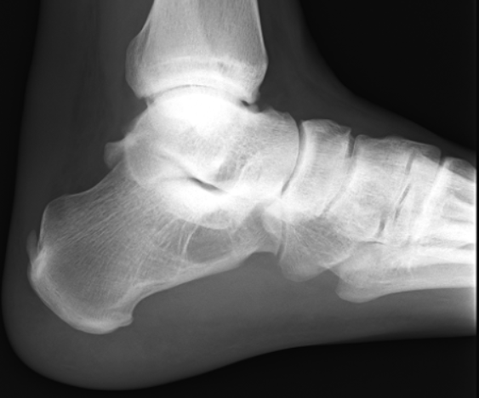
Type IA lesion- Focal, sclerotic margins, narrow transition zone → nonaggressive

Slide 4
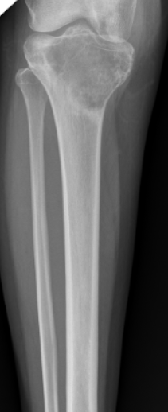
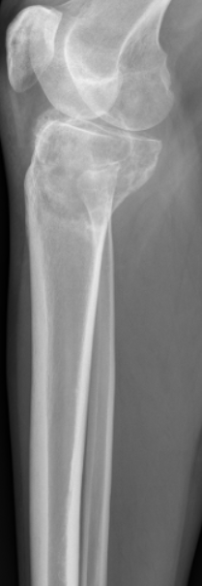
Type IB lesion- Focal, nonsclerotic margins, narrow transition zone

Slide 5
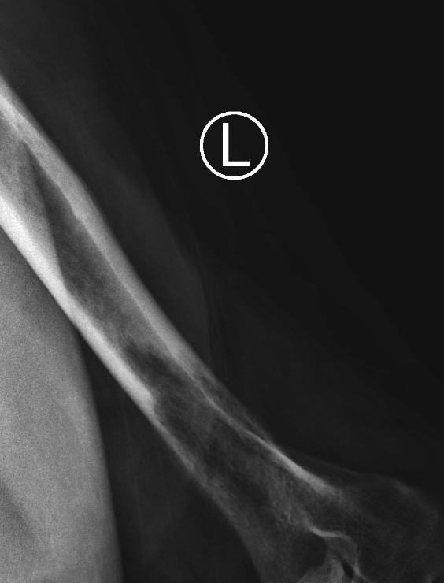
Type 1c lesion- Focal, non sclerotic margins, broad transition zone → aggressive

Slide 6
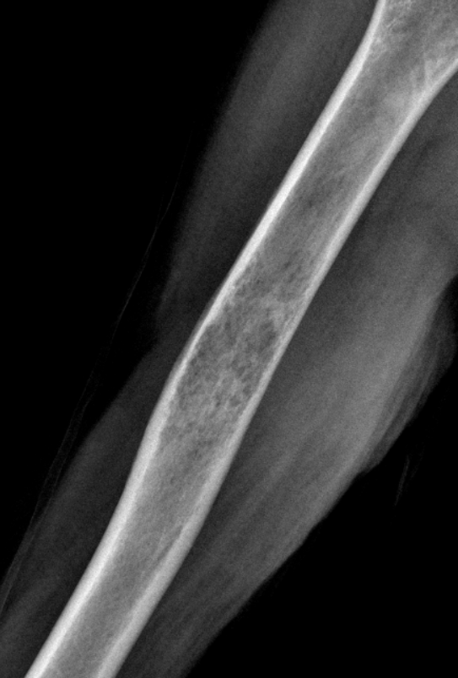
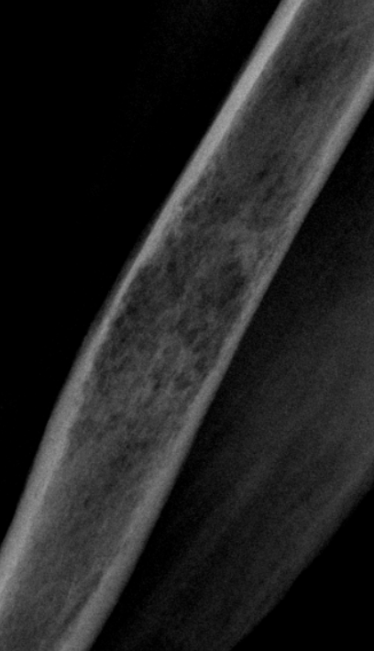
Moth-eaten (Type 2)- Multiple lytic areas with broad zone of transition → aggressive

Slide 7
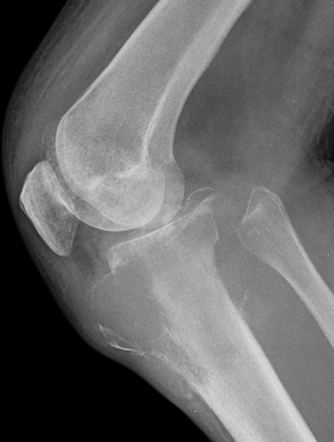
Permeative (Type 3)- Ill defined margins with broad zone of transition
→ aggressive

Slide 8
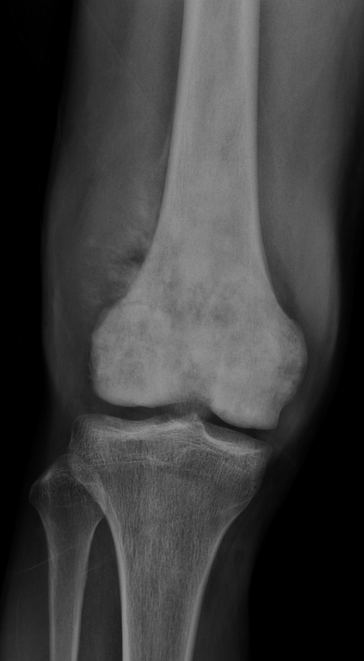
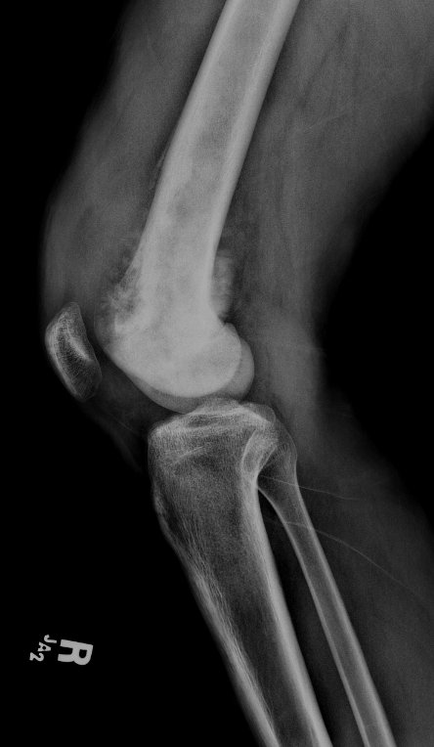
Evaluation of bone tumors- Radiographs
Periosteal reaction
Unilamellated- Single layer of reactive periosteum
Multilamellated- Multiple layers (onion skin) periosteal reaction
Codman Triangle- Elevated periosteum creating an angle with the cortex
Sunburst- Spiculated, hair-on-end periosteal reaction

Slide 9
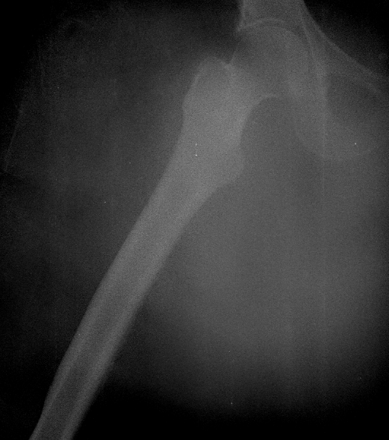
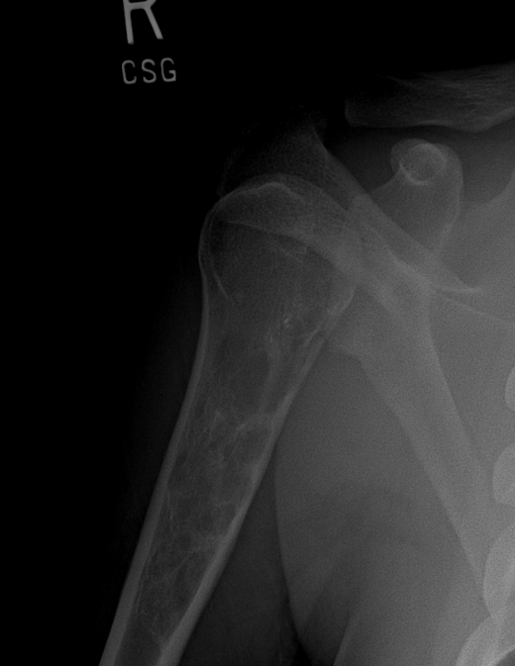
Cortical Involvement
Endosteal scalloping
Saucerization

Slide 10
Evaluation of bone tumors- Radiographs
Lesion density/ tumor matrix
Chondroid
Osseous
Fibrous
Fat
Cystic
Location
Epiphysis / Apophysis
Diaphysis
Metaphysis

Slide 11
Evaluation of bone tumors- Radiographs
Patient Age
Size and Number of lesions

Slide 12
Evaluation of bone tumors- MRI Protocol & Approach
General recommendations:
Similar to ‘Soft Tissue Mass’ protocol
FOV determined by mass size/ location
Always image in three planes
T2 fat saturated sequences typically in two planes (better SNR than STIR)
However, inhomogeneous fat saturation is a possibility
Third plane usually STIR sequence
Evaluate T1 and T2 characteristics. If the the T1 signal is darker than that of the adjacent muscle, this is concerning for a marrow replacing process.
This can be confirmed on in and out of phase imaging. If the abnormal signal does not decrease by $≥$ 20% on out of phase imaging, this is again concerning for a marrow replacing process

Slide 13
Evaluate for aggressive features including cortical destruction, soft tissue mass,
adjacent marrow edema, and periosteal reaction
Evaluate the matrix by MRI if possible (i.e. chondroid, cystic)
If gadolinium contrast is administered, evaluate for the presence or absence of
enhancement and define enhancement patterns
Contrast is especially useful to evaluate a possible soft tissue component (‘dirty
edema’ versus possible soft tissue component)
Evaluate for additional lesions

Slide 14
Routine Shoulder MRI Protocol
Seq. | FOV | Matrix/ Nex | Slice | TR | TE | TI | Flip | ETL | BW
Axial T1 SE Non FatSat |  | 256 x 192 | 5/1 | 400-800 | minimum |  |  |  | 16
Axial T2 FSE FatSat |  | 256 x 192 | 5/1 | > 2000 | 40-60 |  |  | 8 | 16
Sag or Cor T1 SE NonFatSat |  | 256 x 192 | 5/1 | 400-800 | minimum | 150 |  |  | 16
Sag or Cor STIR |  | 256 x 192 | 5/1 | > 2000 | 30-40 |  |  | 8 | 16
Axial T1 GRE or SE FatSat Pre/Post Gd |  | 256 x 192 | 5/1 | 60 400-800 | 5 minimum | 30-40 - |  | 8 | 16
Sag or Cor T1 GRE or SE FatSat PRE/Post Gd |  | 256 x 192 | 5/1 | 60 400-800 | 5 minimum | 30-40 - |  | 8 | 16

Slide 15
Common Cases

Slide 16
Osteosarcoma
Multiple different types of Osteosarcomas (conventional, parosteal, periosteal etc.)
Conventional by far the most common and discussed in the following
Malignant, highly aggressive bone tumor
Most common malignant bone tumor in children/adolescents ( most common age range 10-25 years)
Older patient often secondary Osteosarcoma ( e.g. Paget’s, history of radiation)
Long bones most commonly affected (50% around the knee), typically arising from the metaphysis
Density ranges from lytic to densely sclerotic
Demonstrates typical aggressive features (Cortical destruction, wide zone of transition, associated soft
tissue mass)
On MRI: Heterogenous mass on fluid sensitive sequences with intense enhancement of marrow and
associated soft tissue mass

Slide 17
Large osteoblastic lesion
in the distal femur
Aggressive features include
sunburst periosteal reaction
wide transition zone and
associated soft tissue mass
Note also the large joint
effusion
$$∗$$
19 year old male presenting with knee pain

Slide 18
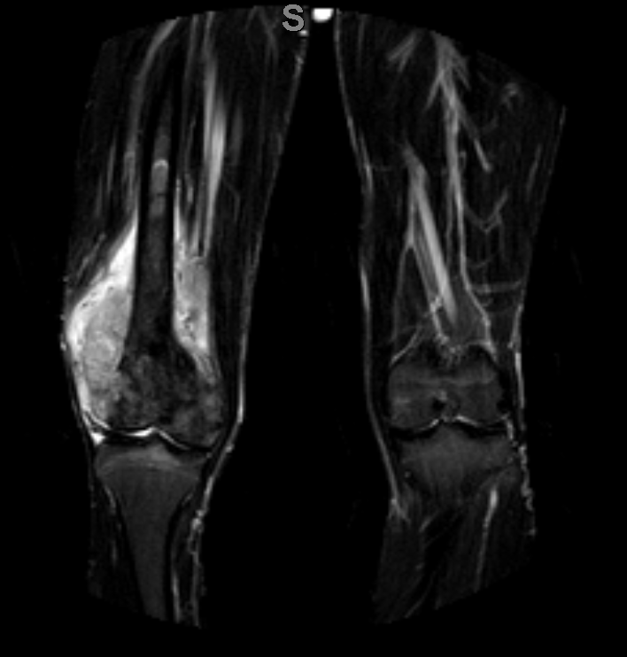
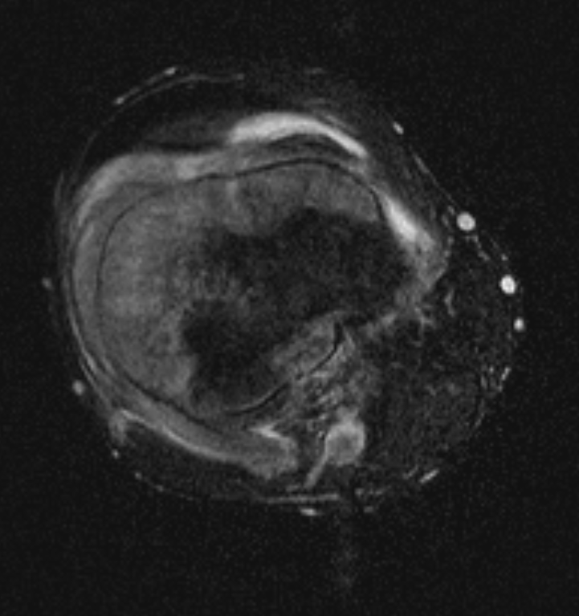
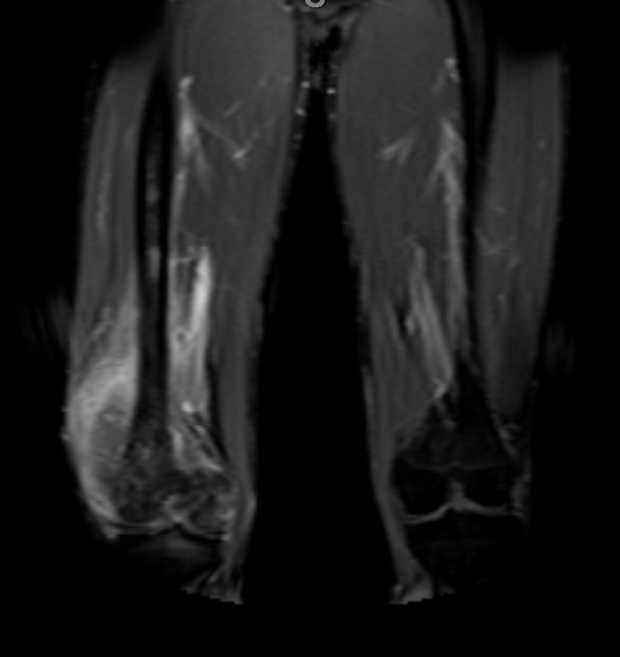
MRI in the same patient demonstrates abnormal signal and enhancement, most pronounced in the metadiaphysis
with cortical breakthrough and extension into the surrounding soft tissues/musculature
STIR
T2
Post contrast

Slide 19
Ewing's Sarcoma
2nd most common sarcoma in children and adolescents
Location: Diaphysis or metadiaphysis of long bones with up to 25 % of Ewing’s sarcomas located in flat bones (e.g. ilium, scapula)
Demonstrates typical aggressive imaging features (often associated with a large soft tissue mass)
Periosteal reaction often lamellated (Osteosarcoma shows sunburst pattern more often, however imaging features overlap )
Bone and lung metastasis are common

Slide 20
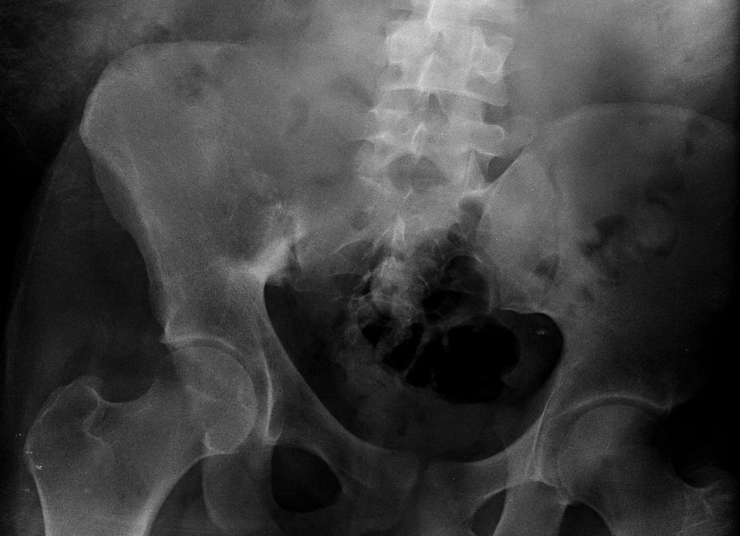
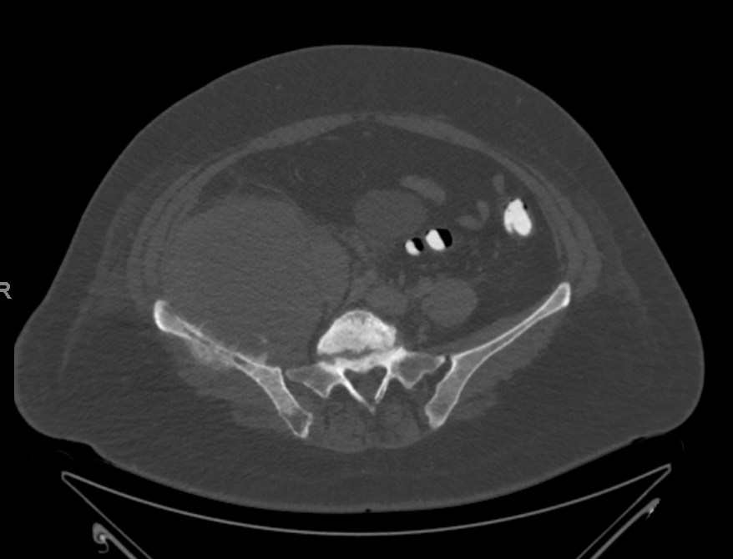
Large lytic lesion centered in the right hemipelvis seen on radiograph in a 16 yo patient who was worked up for RLQ pain to rule out appendicitis
CT of the same patient demonstrates typical appearance
of Ewing’s Sarcoma: Large soft tissue mass centered in the
right iliac bone with associated bony destruction and
extension into the surrounding musculature

Slide 21
Chondrosarcoma
3rd most common primary malignant bone tumor
Chondroid tumor matrix (variable expression, lesion might be almost entirely cystic)
Central, metaphyseal, endosteal cortical thickening as well as scalloping can be seen
Peak incidence 50-70 years of age (but wide age range, can be also seen in younger patients)
Can have a nonaggressive appearance
Large lesions, lesion growth or increasing pain should raise suspicion for Chondrosarcoma

Slide 22
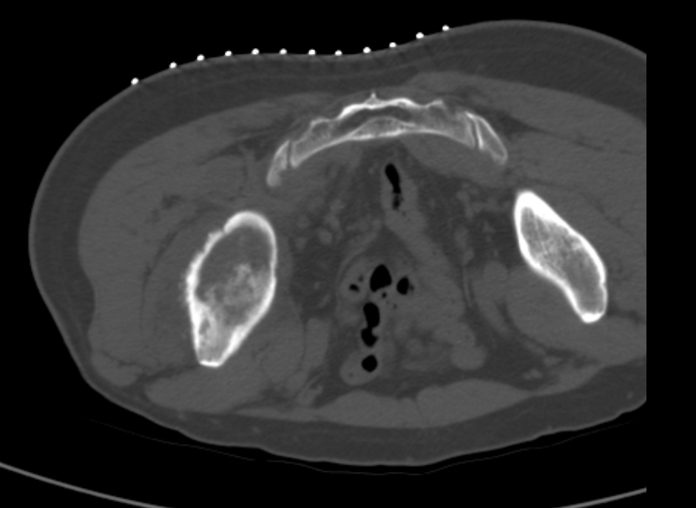
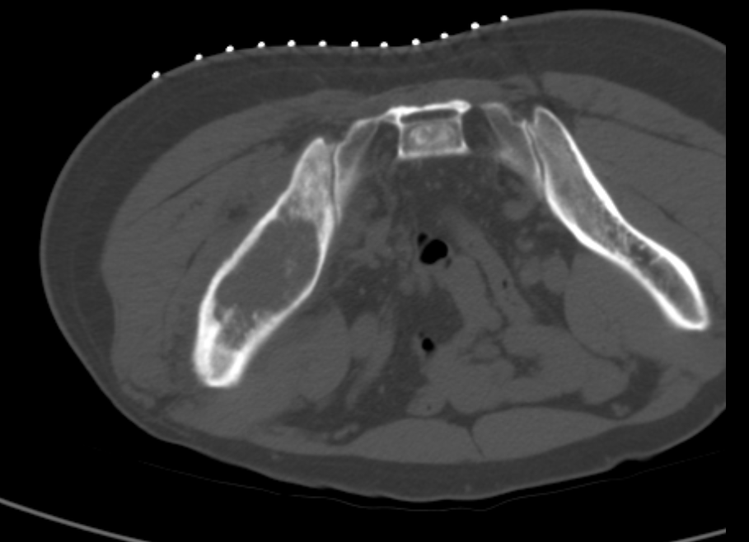
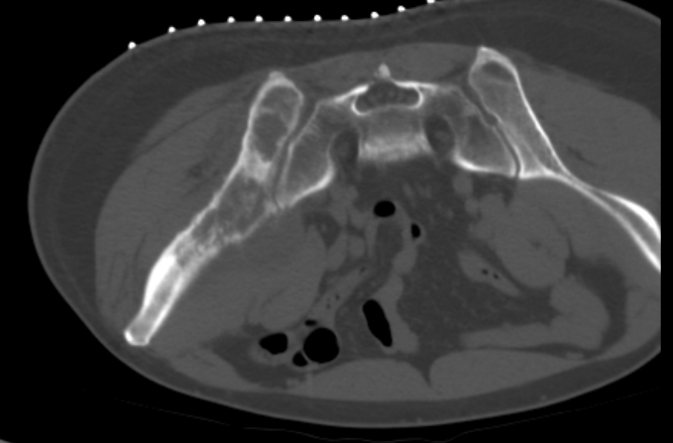
Note the chondroid matrix of the large mass on CT obtained during biopsy
MRI (next slide) shows a large mass involving almost the entirety of the right iliac bone with cortical destruction,
areas of necrosis, and a enhancing soft tissue component

Slide 23
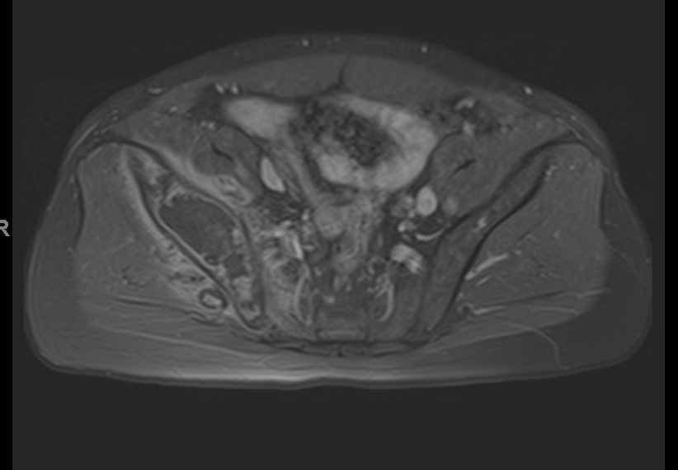
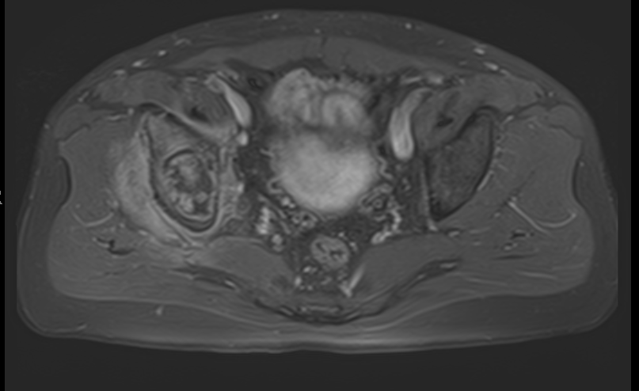
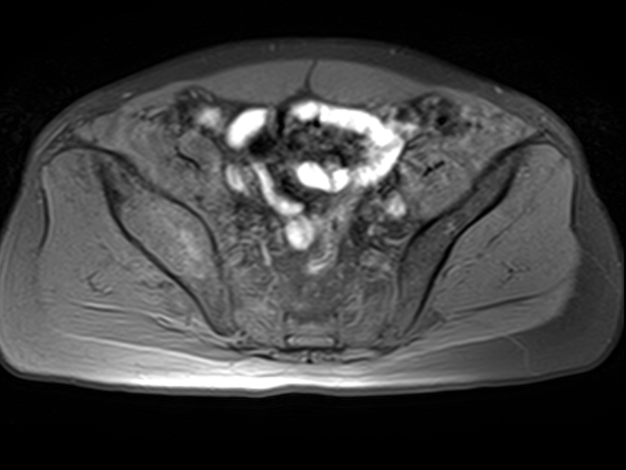
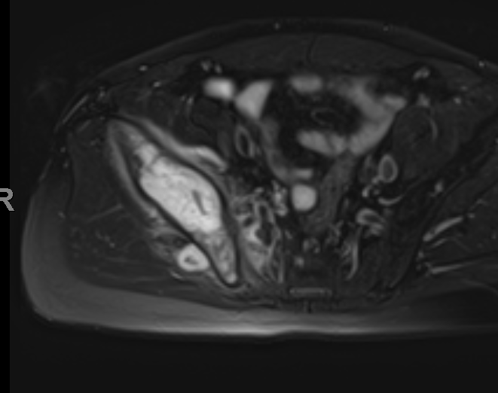
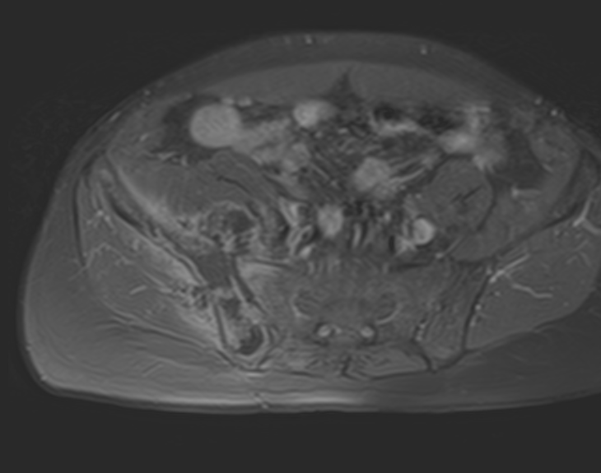
Peripheral and septal enhancement is noted
around lobulated cartilage
Post contrast axial
Post contrast axial
Lobulated high signal intensity
Mass fairly isointense to skeletal muscle
Pre contrast axial T1
Axial T2
Post contrast axial

Slide 24
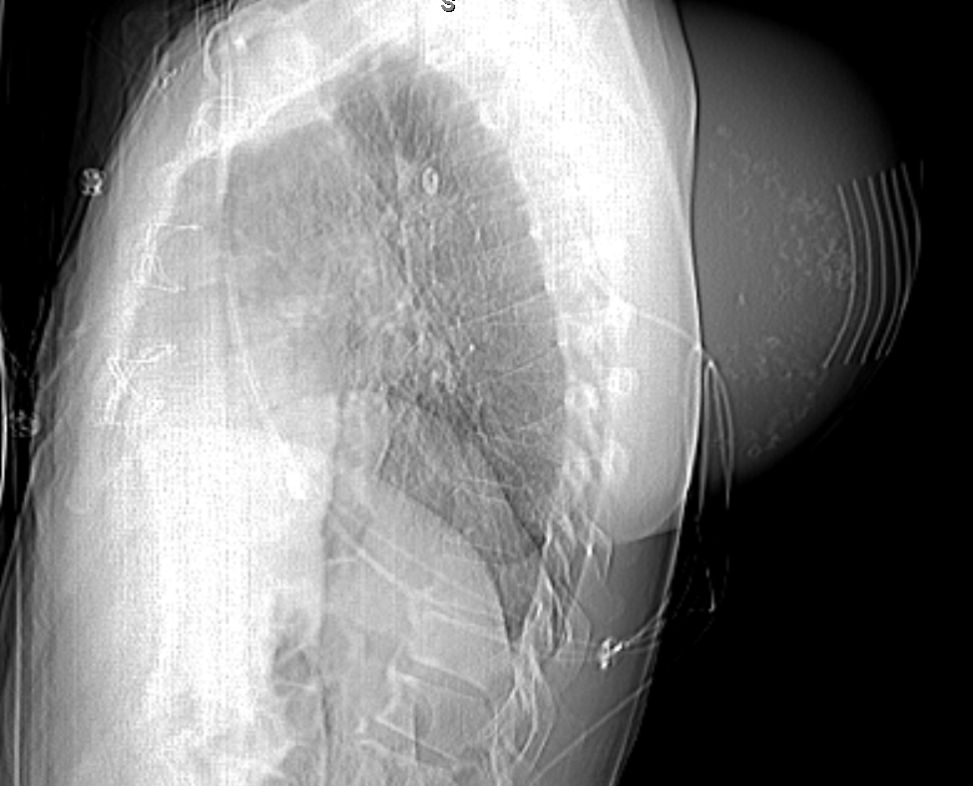
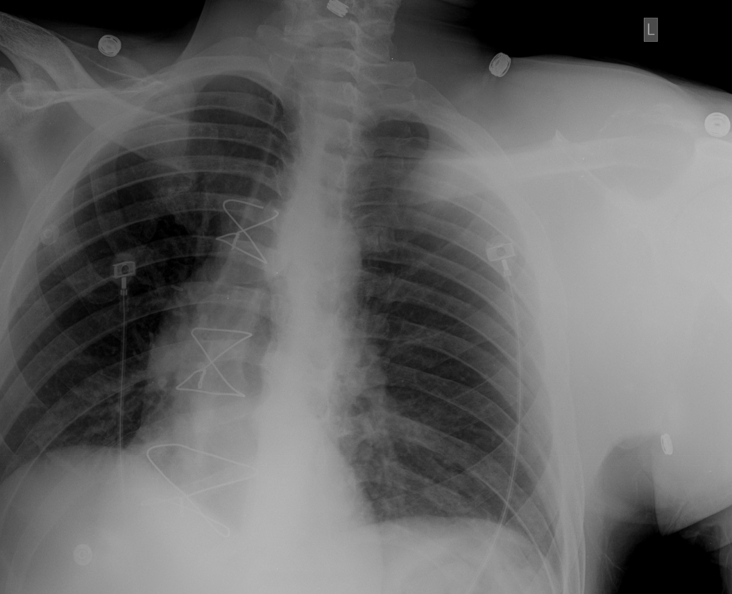
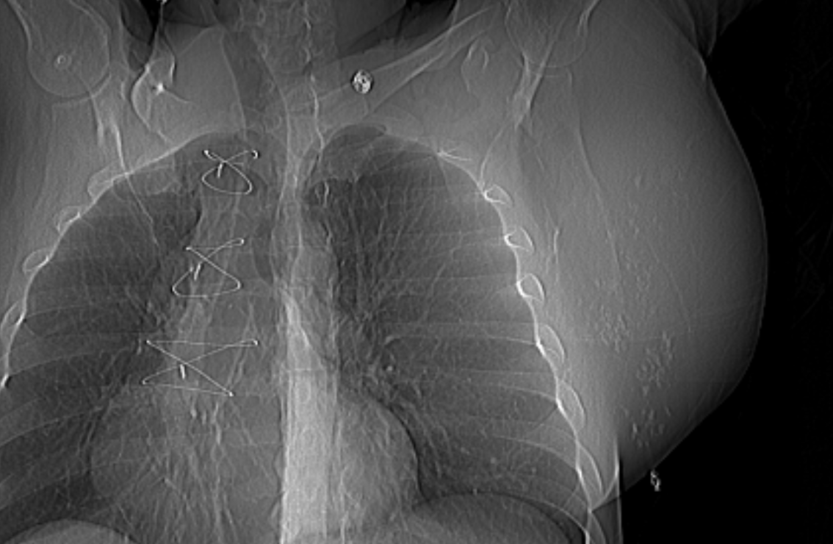
Chest radiograph and scout images of a CT shoulder in a different patient demonstrate a large mass in the region of the left scapula
containing multiple areas of calcifications

Slide 25
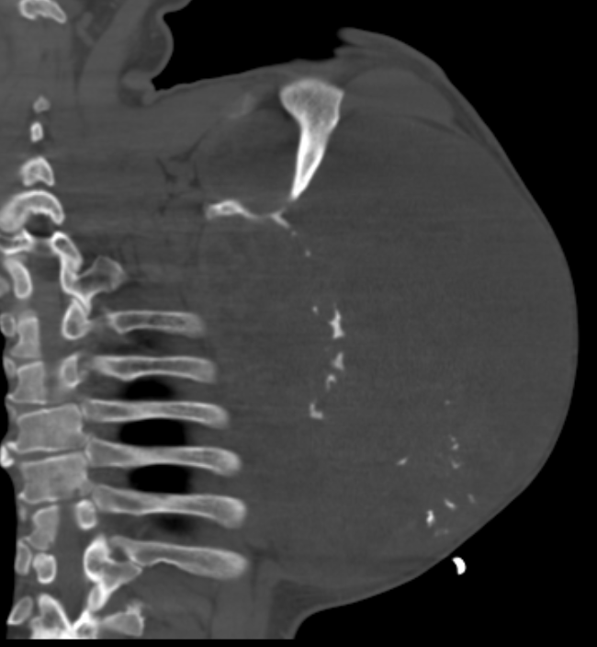
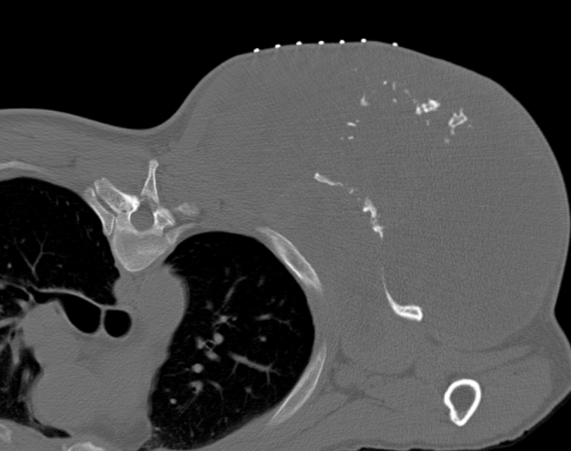
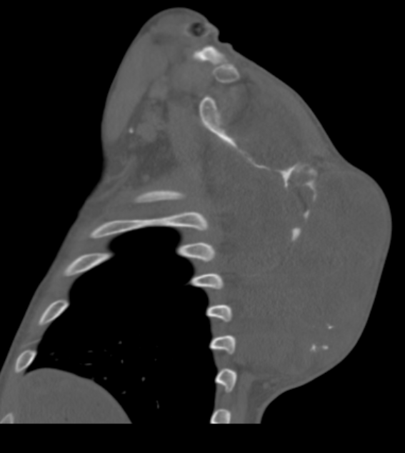
CT shows a large mass arising from the body of the left
scapula, with extensive soft tissue component, eroding and
destroying the majority of the scapular body, and containing
multiple coarse/lobular calcifications suggestive of chondroid
matrix. Biopsy result revealed chondrosarcoma.

Slide 26
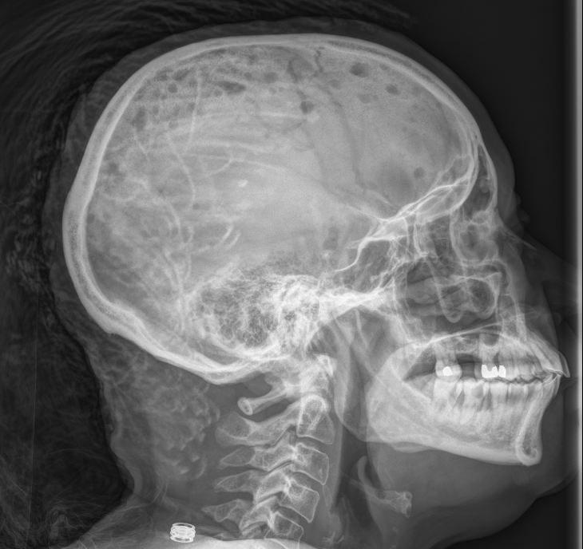
Metastasis / Multiple Myeloma (MM)
Lytic metastasis , and multiple myeloma are very
similar in appearance
Should be in the differential in any patient with
new lytic lesion(s) above the age of 40
Tumors with purely lytic metastasis: Lung, Renal cell cancer
Thyroid, Breast, GI, neuroblastoma (variable)
Multiple ’punched-out’ lytic lesions in patient with MM, a typical appearance

Slide 27
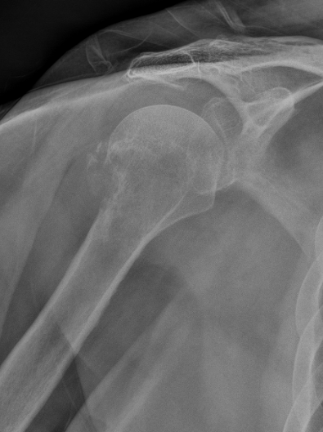
Lytic Metastasis
Expansile lytic lesion with
wide zone of transition in the
proximal anterior tibia
Expansile metastasis are
associated with renal or
thyroid cancer (variable)
Pathologic destruction
of the greater tuberosity

Slide 28
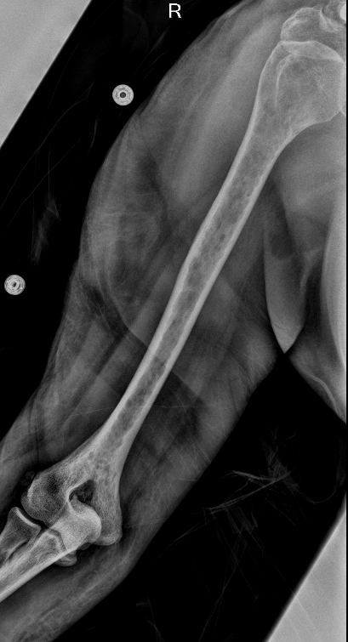
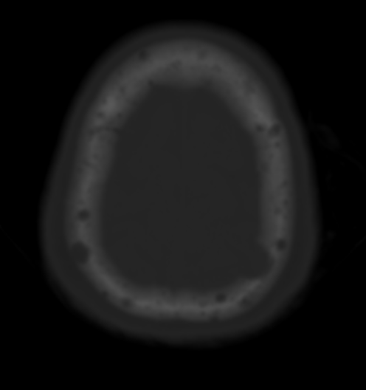
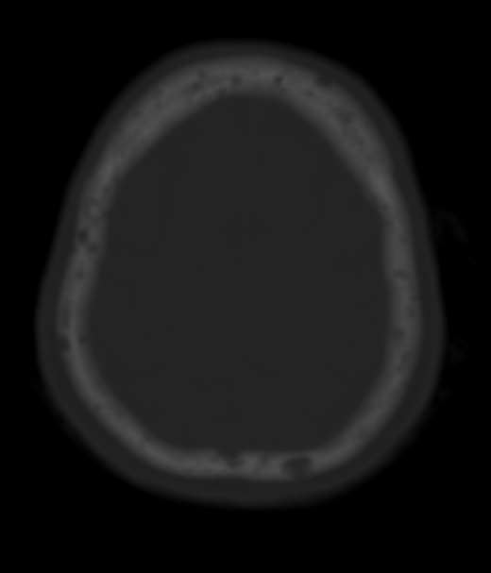
Multiple Myeloma (MM)
Most common primary bone tumor
Solitary lesion: plasmacytoma
Monoclonal gammopathy of undetermined significance (MGUS):
Precursor to MM (1% per year)
Sclerotic form of MM rare ( 5%)
’Punched-out’ lytic lesions in patient with MM on head CT

Slide 29
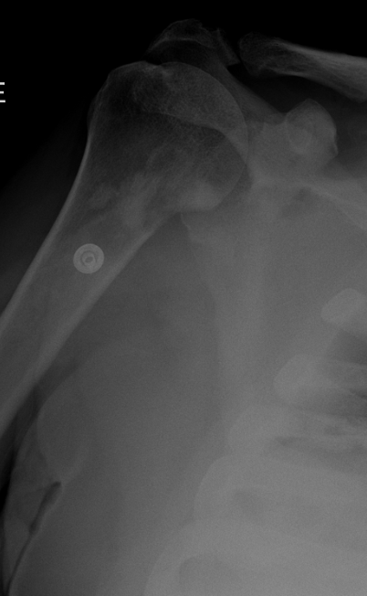
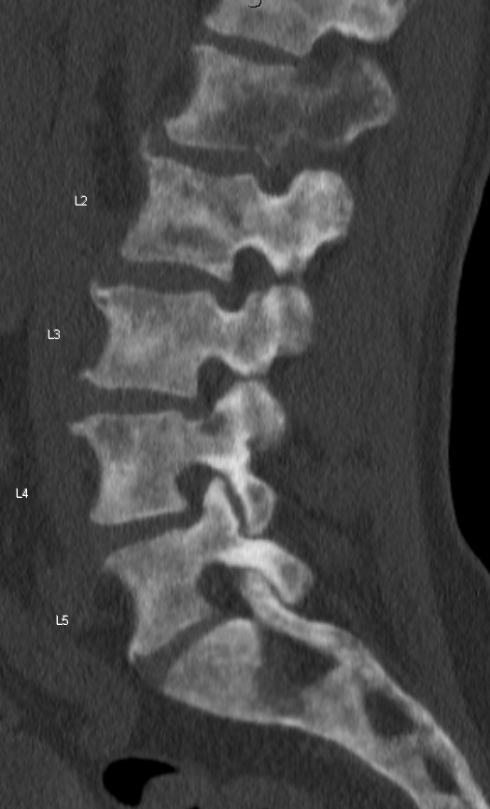
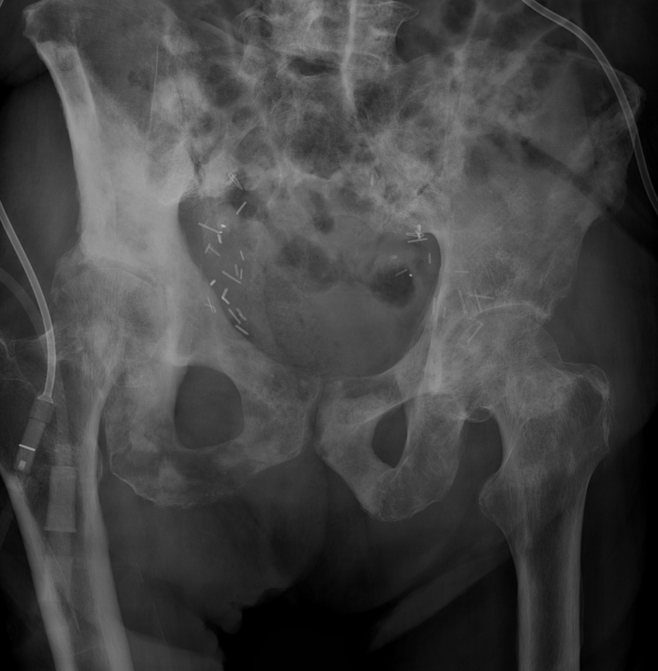
Sclerotic Metastasis
Tumors with purely sclerotic metastasis: Prostate, breast, bladder, GI (carcinoid), Lung (Small cell lung cancer),
medulloblastoma

Slide 30
Fibrous Dysplasia
Benign condition
Can be seen in any bone, however certain locations are more common
Tubular bones, pelvis, ribs, skull and facial bones preferred
Density varies from lytic to densely sclerotic
Lesions can causing some degree of expansion/bowing of the bone
No aggressive features seen (e.g. periosteal reaction, cortical breakthrough etc.)

Slide 31
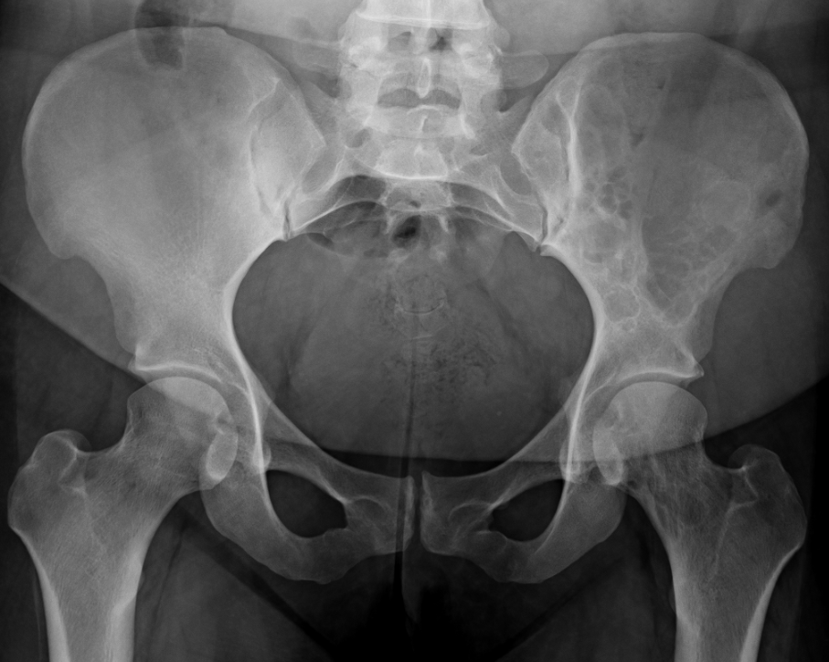
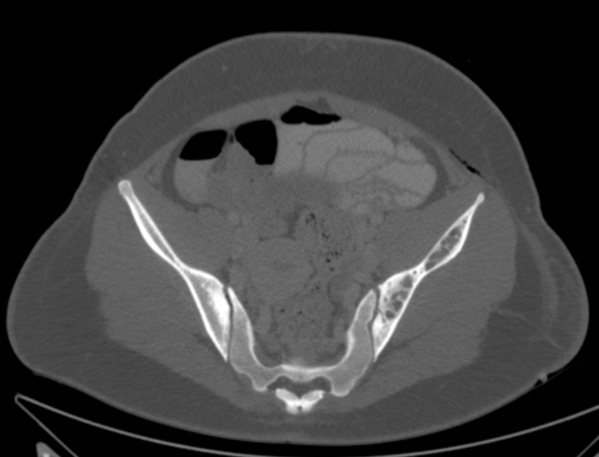
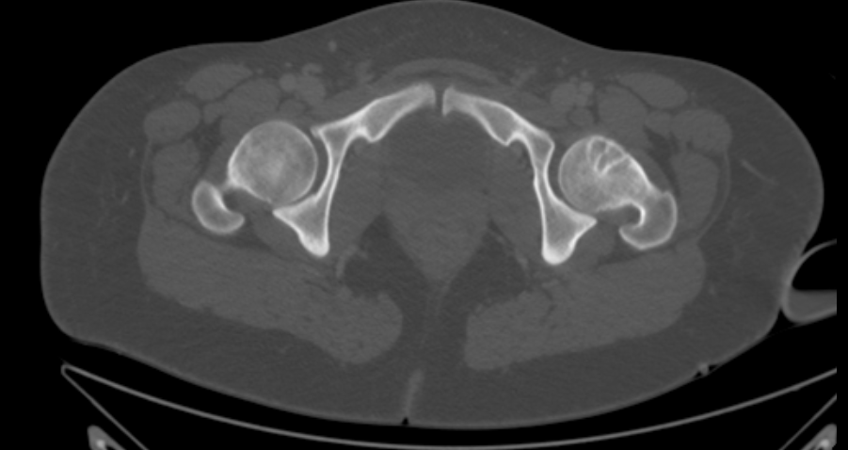
Fibrous Dysplasia
Mixed density lesion involving the
left hemipelvis and proximal left femur

Slide 32
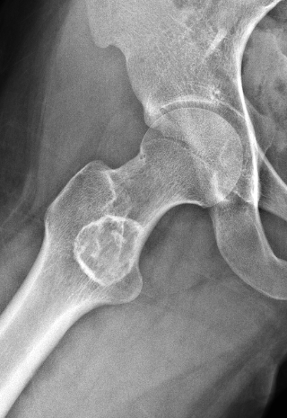
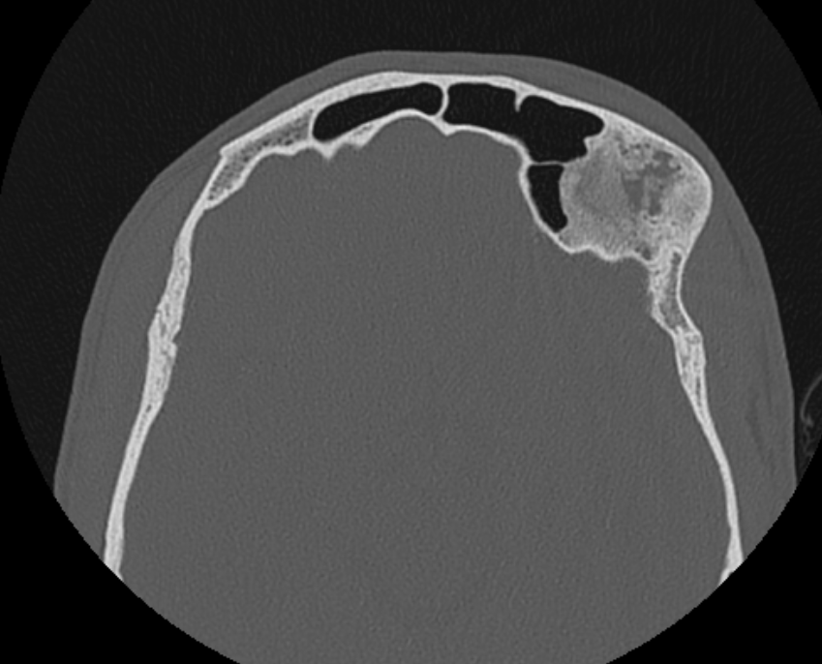
Fibrous Dysplasia
Expansion of the left frontal sinus
with ‘ground-glass’ appearance
Mixed density lesion with
thick sclerotic borders

Slide 33
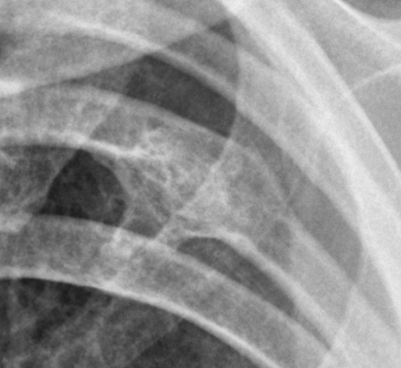
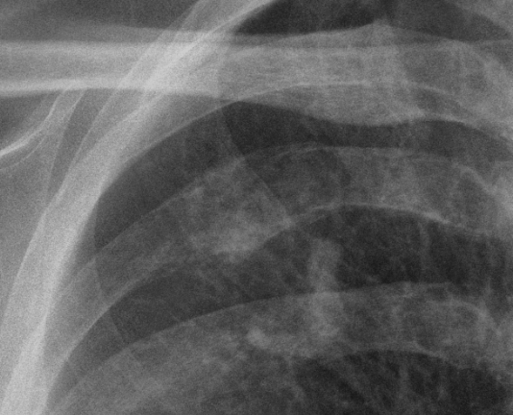
Note the similarity of these rib lesions
Further imaging and biopsy may be necessary to distinguish between lesions at times
Fibrous dysplasia
Lytic metastasis

Slide 34
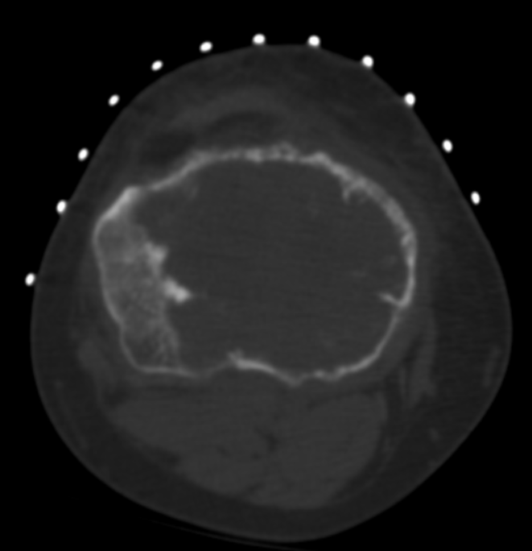
Giant cell tumor (GCT)
Usually benign lesion ( 5% are malignant)
Originates in metaphysis and extends into epiphysis
Often extends to end of bone
Narrow transition zone with non-sclerotic margins
Unique appearance
Can have fluid levels on MRI
High recurrence rate
Corresponding CT of the
same patient (obtained during biopsy) shows large lytic lesion with areas of cortical thinning/destruction
Biopsy result revealed GCT with atypical features

Slide 35
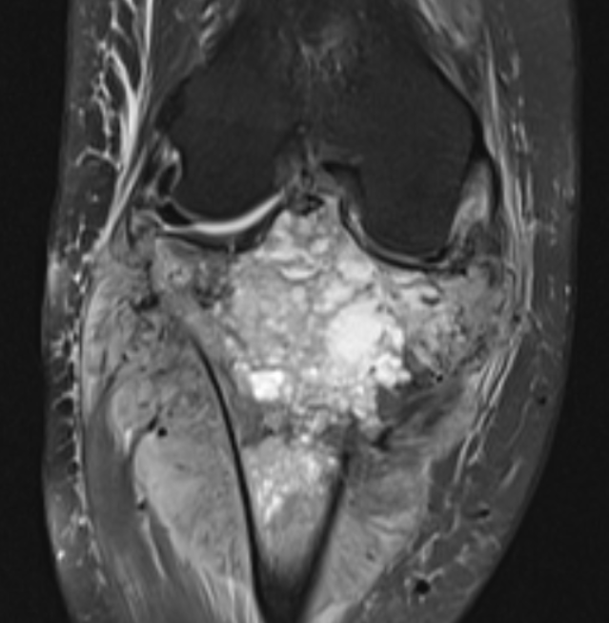
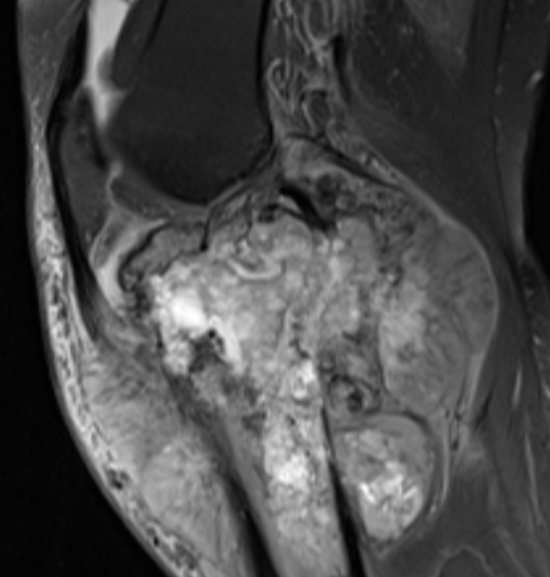
MIR in the same patient 6 month later status post neoadjuvant chemotherapy to assess for treatment response shows
marked interval increase in size of the lesion
T2 images demonstrate large heterogenous mass with nodular/whorled features
Coronal T2
Sagittal T2

Slide 36
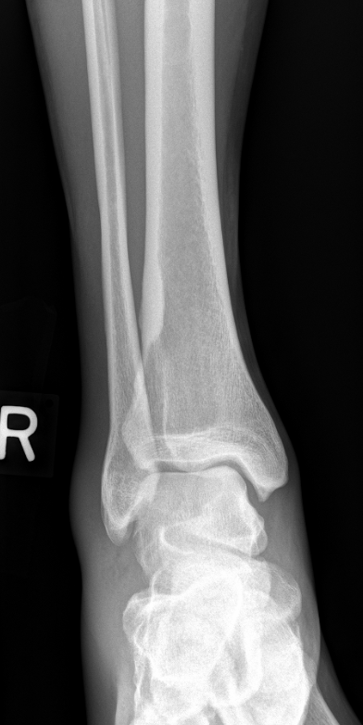
Nonossifying Fibroma (NOF)
Benign lesion
Cortical based, lytic lesion with sclerotic margin
Often ‘heals’ with age
Ossified
’healed’
NOF
Axial T1

Slide 37
Aneurysmal Bone Cyst (ABC)
Benign cystic lesion
Primary vs. secondary ABCs (secondary ABCs can arise in various other tumors)
Usually seen in long bones
Also found in the posterior elements in the spine
Patients are usually < 30 years old
Lytic, expansile lesion, thin sclerotic margin, may contain septations
CT and MRI demonstrate fluid levels in most cases
May demonstrate rapid growth → can simulate a more aggressive lesion

Slide 38
Axial T2
Expansile, lytic lesion with internal septations,
without bony destruction
Cor T2
MRI of the same patient demonstrates a
multiloculated, cystic lesion containing
multiple layering fluid-fluid levels

Slide 39
Simple (Unicameral) bone cyst
Benign cystic lesion
First and second decades of life
Expansile, arising centrally in the medullary cavity, may contain septations and loculations
ABC usually more eccentric
‘Fallen fragment’ sign → represents fractured fragment of bone
May spontaneously resolve
No consensus on best treatment option (Steroid injection, curettage etc.)

Slide 40
Cor T2
Cyst occupying the medullary cavity with slight extension into the
Intertrochanteric region, no cortical destruction, fracture
or soft tissue component
Relatively well circumscribed medullary
lytic lesion in the proximal femoral
metadiaphysis

Slide 41
‘Fallen Fragment’ sign indicating a
pathologic fracture
Representing a fracture fragment resting
dependently in the cystic bone lesion
Pathognomonic for simple bone cyst
Stable simple
bone cyst in
the proximal fibula
2016
Differential Dx: Intraosseous Lipoma
2009

Slide 42
Enchondroma
Benign, cartilage forming
tumor
Chondroid matrix, usually
central location
In small tubular bones
may be expanded and
bubbly appearing
Differential Dx:
Medullary bone infarct
DDx: Bone infarct

Slide 43
Chondroblastoma
Benign tumor in skeletally immature individuals
Epiphyseal origin, proximal humerus most common location
Geographic lytic lesion, up to 50% contain chondroid matrix
Main differentials include infection, Langerhans cell histiocytosis, Clear Cell Chondrosarcoma
On MRI lesion can contain fluid levels (secondary aneurysmal bone cyst)
Treatment usually consists of curettage and bone graft

Slide 44
16 year old male presenting with shoulder pain for 5 months.
MR arthrogram demonstrates a mildly T2 hyperintense lesion
in the proximal humeral epiphysis with extensive surrounding
bone marrow edema . Biopsy confirmed a chondroblastoma.
Axial T1
Lytic lesion eccentrically located
in the humeral epiphysis. There
is a sclerotic margin and small
calcifications within the lesion
Cor T2

